Slide 1


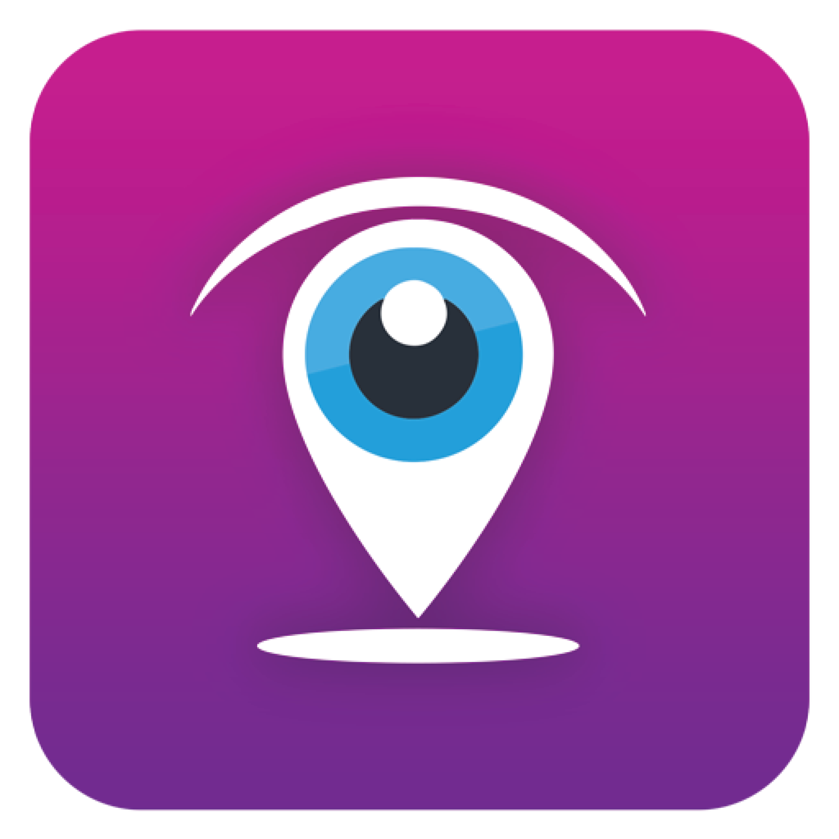


cVigil
cVigil - Monitor
cVigil - Investigator
cVigil - Decider
Observer
Enable citizens to report MCC/ Expenditure violation
Presented by
Santosh Pathariya (Head Solution Delivery)

Slide 2
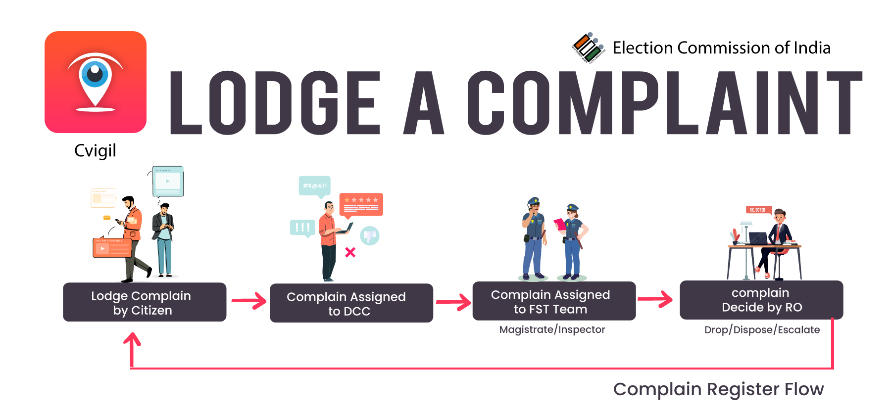

Slide 3
Prerequisites
Setup District control center (24X7) for complaint assignment
Setup DEO accounts for each Districts
Setup RO account for each AC
Setup FSTs Teams (Magistrate & Inspector) for each AC
Setup additional CEO office account if required
Setup additional DEO office account if required
Share updated GIS Shape files if there is change in any District/AC

Slide 4
What is cVIGIL?
cVIGIL provide time-stamped evidentiary proof of Model code of conduct / Expenditure Violation by empowering every citizen to click a photo, audio or video using his or her smartphone. Application has below unique features
Pictorial, audio and video evidence
GIS based auto tracking
Robust and prompt response system
Get response about the action taken
Rapid and accurate reporting
Report live MCC violation
Doesn’t allow pre-recorded images and videos
Notes:
Robust and prompt response system
GIS based auto tracking
Pictorial and video evidence
Get response about the action taken
Rapid and accurate reporting
Report live MCC violation
Doesn’t allow pre-recorded images and videos

Slide 5
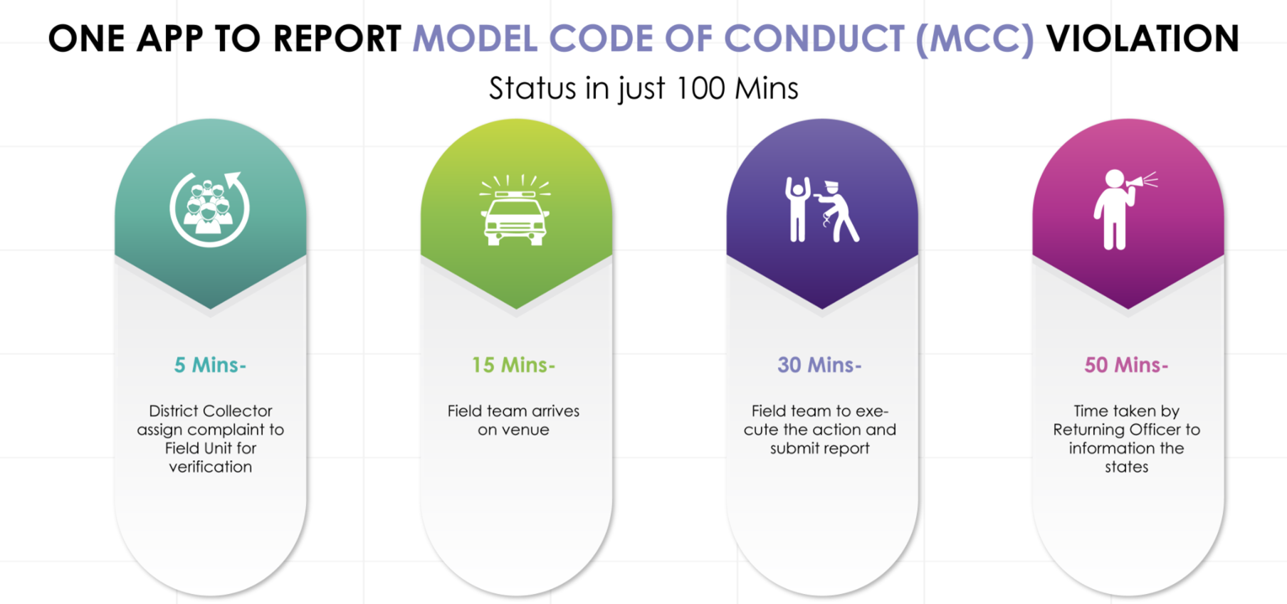
How it works?

Slide 6


cVIGIL offering
Web based Application | Mobile App | Android | iOS
ECI | Citizen
CEO | Investigator
DEO | Monitor
RO/ARO | Decider
 | Observer

Slide 7
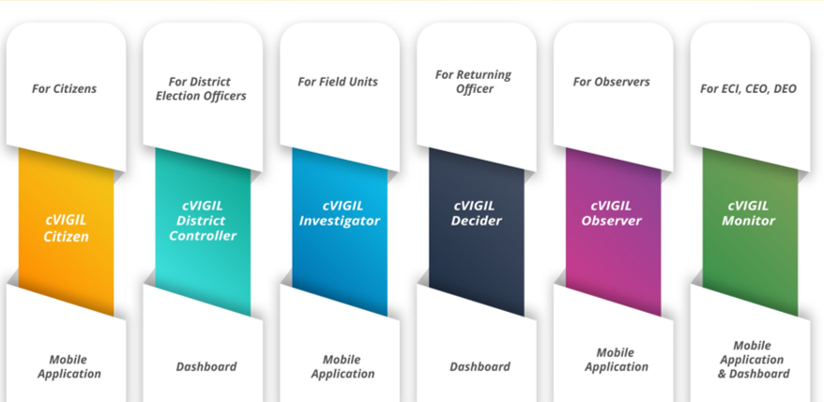
cVIGIL Modules

Slide 8
cVIGIL Users?
Citizen
  Log a complaint
  View status of complaint
Monitor
  ECI/CEO/DEO can view complaint
  Highlight the case
DCC
  Assign complaint to FST
  User management
FST
  Accept the case
  Submit report
Decider(RO/ARO)
  View the cases
  Decide on the case
Observer
  View the complaint
  Comment on submitted report

Slide 9
cVIGIL citizen App
Lightweight user-friendly App
Android & iOS based mobile App available on Google Play Store (compatible with 4.1 Jelly Bean and above) and App Store
App is available at web site https://cvigil.eci.gov.in under user manuals

Slide 10
Citizen App: prerequisite
The User must have a smartphone with Android (4.1.X or Jellybean version) or iOS operating system
The mobile phone must have camera.
The connection should be preferably with 4G/ 3G connection.
The transmission of cVIGIL complaints requires internet bandwidth.
The User must make sure the GPS is turned on.
The app must be given permission of camera to take pictures and record videos.
The app must be given permission to access photos/ media and files on the device.

Slide 11
Citizen App: steps to install
Step 1: A User can go to Google Play Store/ App Store to download cVIGIL App.
Step 2: Download and install the App

Slide 12
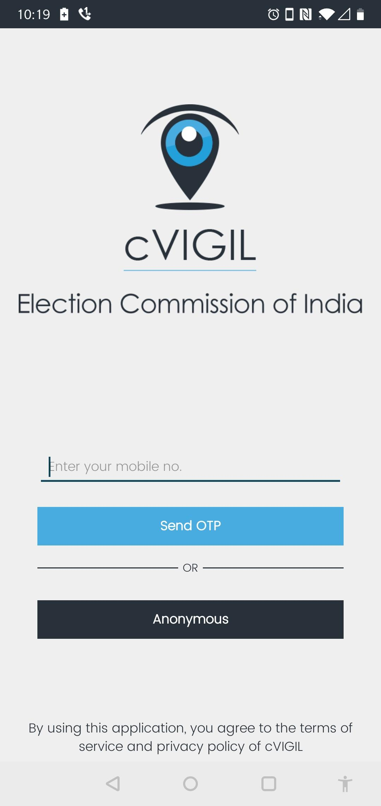
Citizen App: How to use?
After installation of App, Login screen gives user two options:
  Non registered User
    Anonymous user can also lodge complaint
  Registered User
    By registering personal details, including name, address and mobile number.

Slide 13
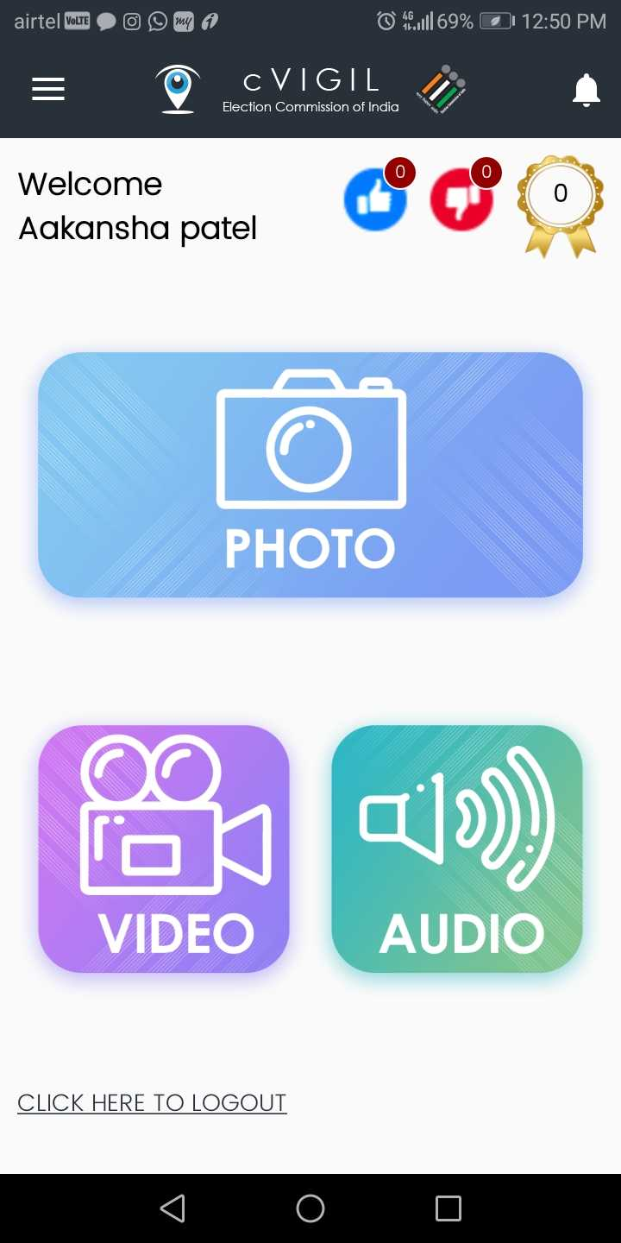
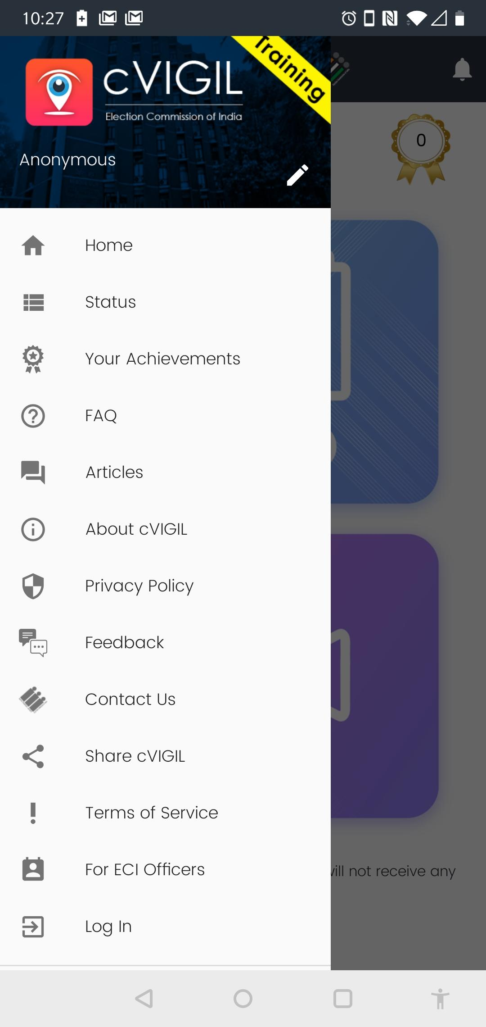
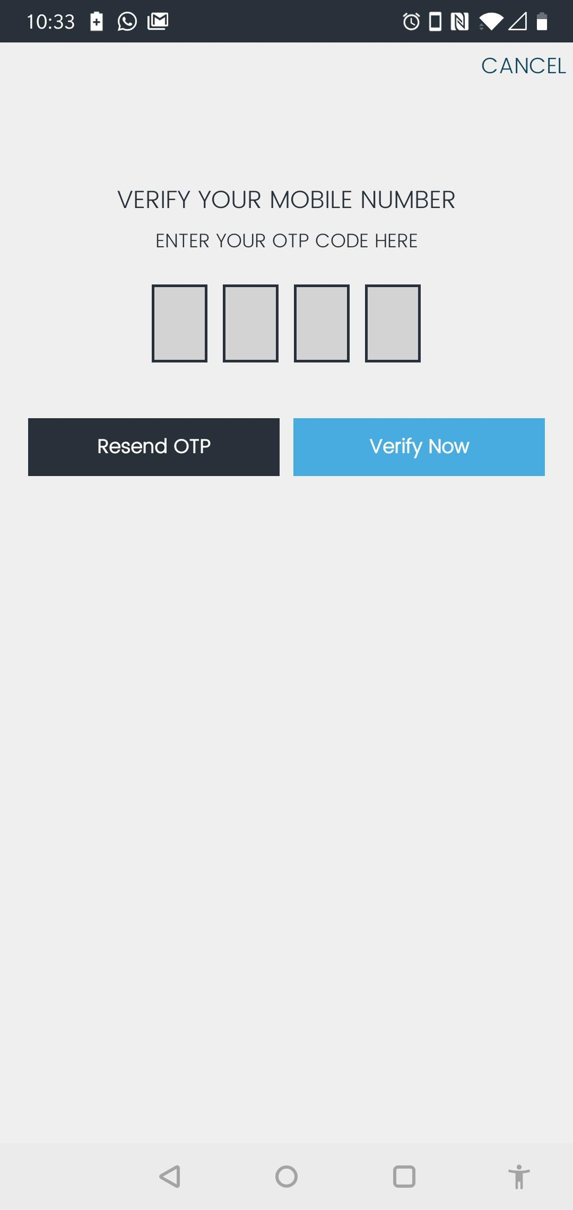
Citizen App: How to use?

Slide 14
Citizen App: How to use?
Sign in using mobile number and OTP
Enter your mobile number
Tap on send OTP(one time password)
Enter OTP and verify mobile number
On user profile screen enter your Name, Address, State, District, Assembly and Pin Code
Select checkbox and click on Verify Now icon

Slide 15
Citizen App: File a complaint?
Step 1: Capture photo or video of the MCC/ expenditure violation incident.
Step 2: Preview of captured picture/video
Step 3: Enter the Additional Location info to help in identification of the exact location by a Flying Squad.
Step 4: Select the nature of the complaint
Step 5: Enter precise description of the incident in the provided space.
Step 6: Click on submit after entering mandatory fields
Notes:
Money Distribution
Gifts/Coupons Distribution
Liquor Distribution
Posters/Banners without permission
Display of Firearms, Intimidation
Vehicles or Convoys without permission
Paid News
Property Defacement
Transportation of Voters on polling day
Campaigning within 200 meters of the polling booth.
Campaigning during ban period
Religious or Communal speeches/messages
Use of speakers beyond permitted time.
Posters without mandatory declaration declaration
Transportation of public for rallies
Others

Slide 16
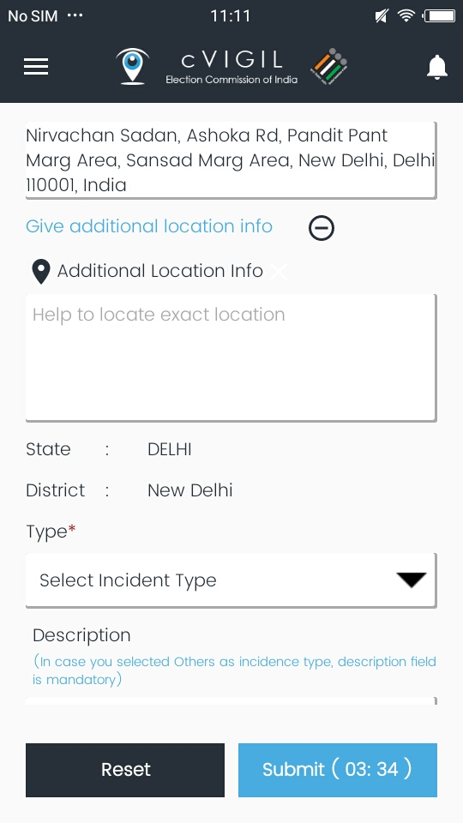
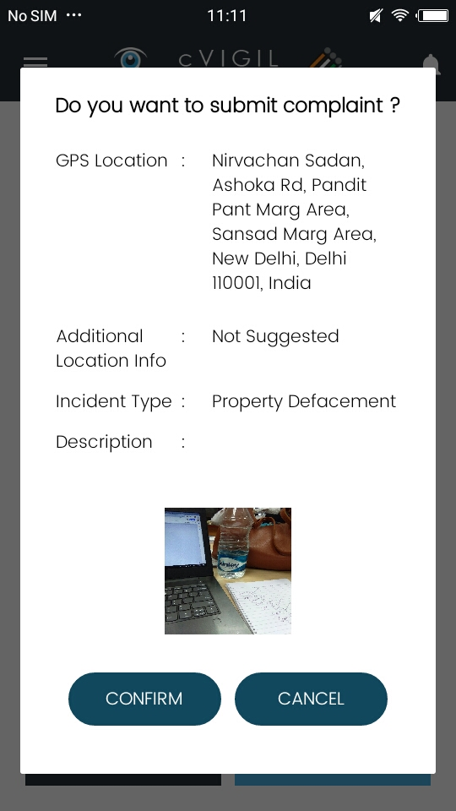
Citizen App: File a complaint?

Slide 17
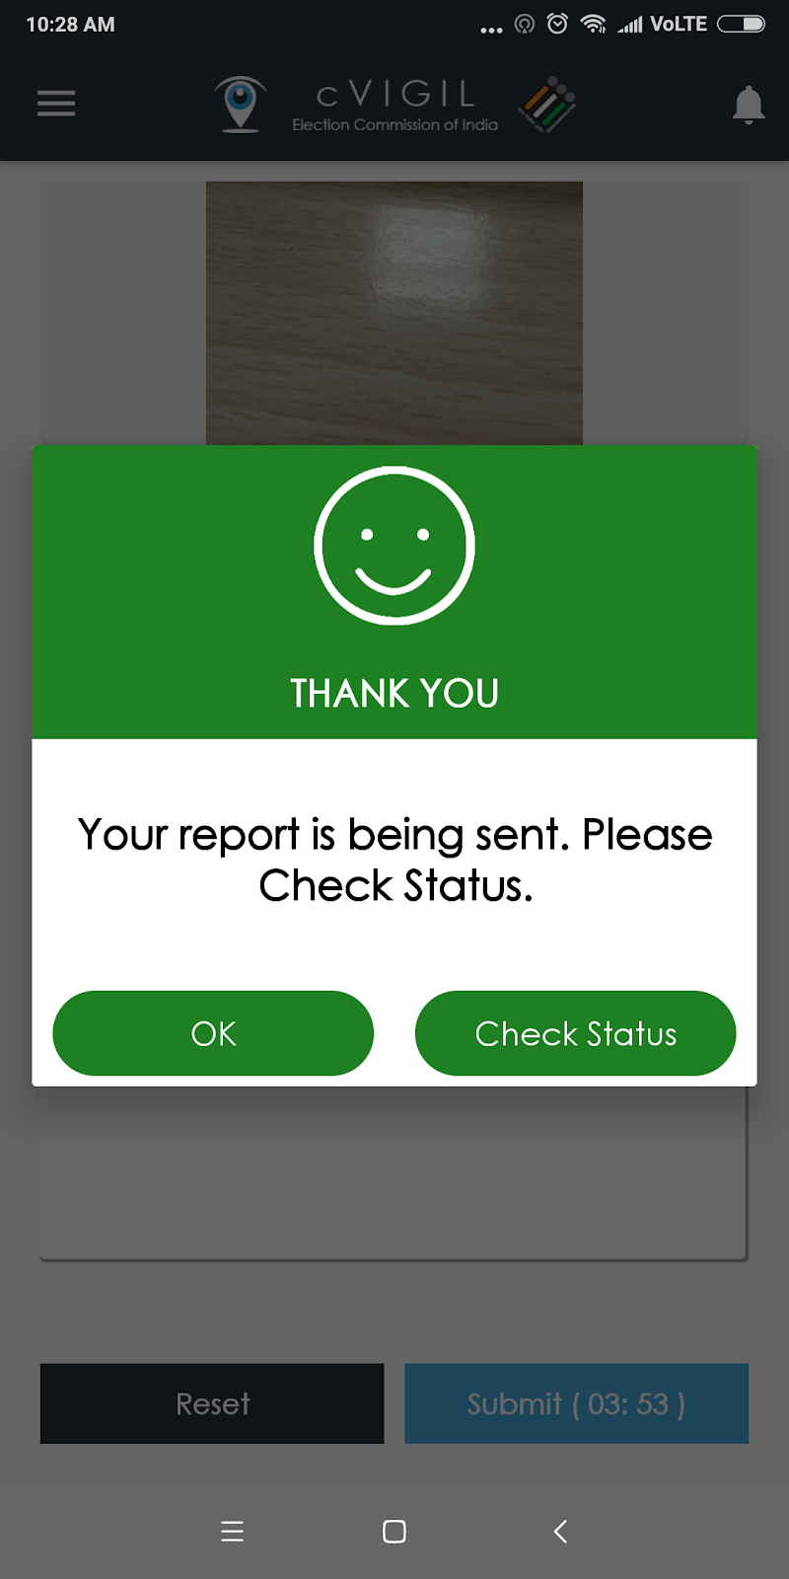
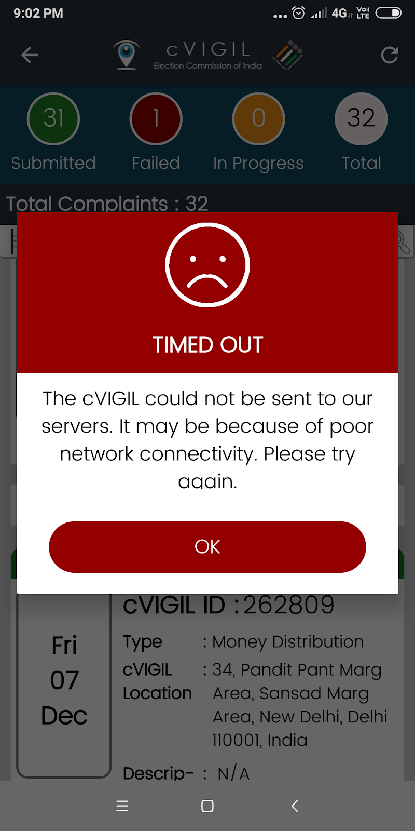
Citizen App: File a complaint?

Slide 18
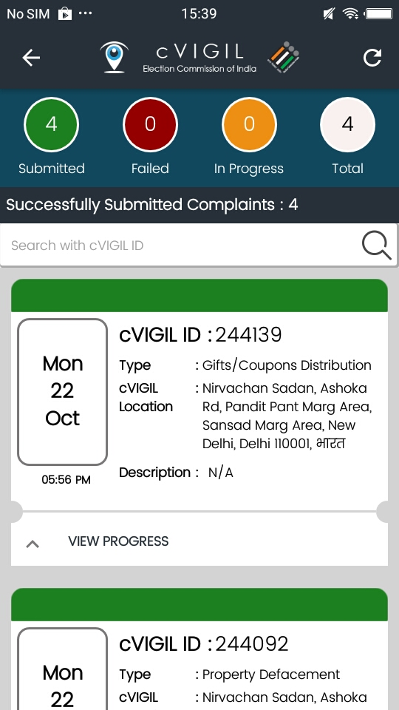
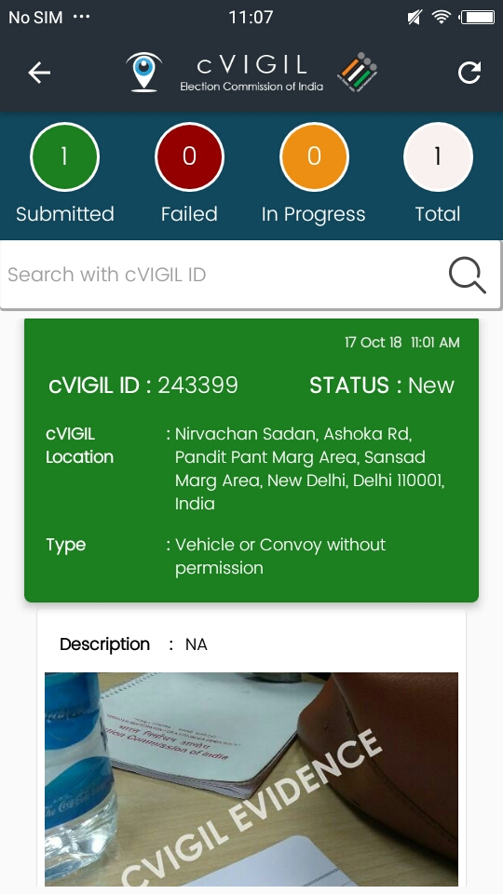
Citizen App: complaint status

Slide 19
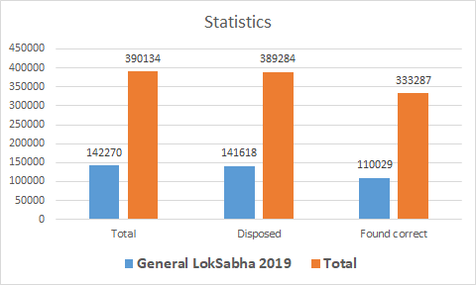
Citizen App: success stories
App has been a huge success in the General elections 2019 and subsequent Assembly & Bye elections, statistics are as follows
Notes:
Total cases reported : 1,42,270
Disposed of (acted upon): 141,618 (99%)
Found correct : 110,029 (80%)

Slide 20
Citizen App
Quick Live Demo

Slide 21
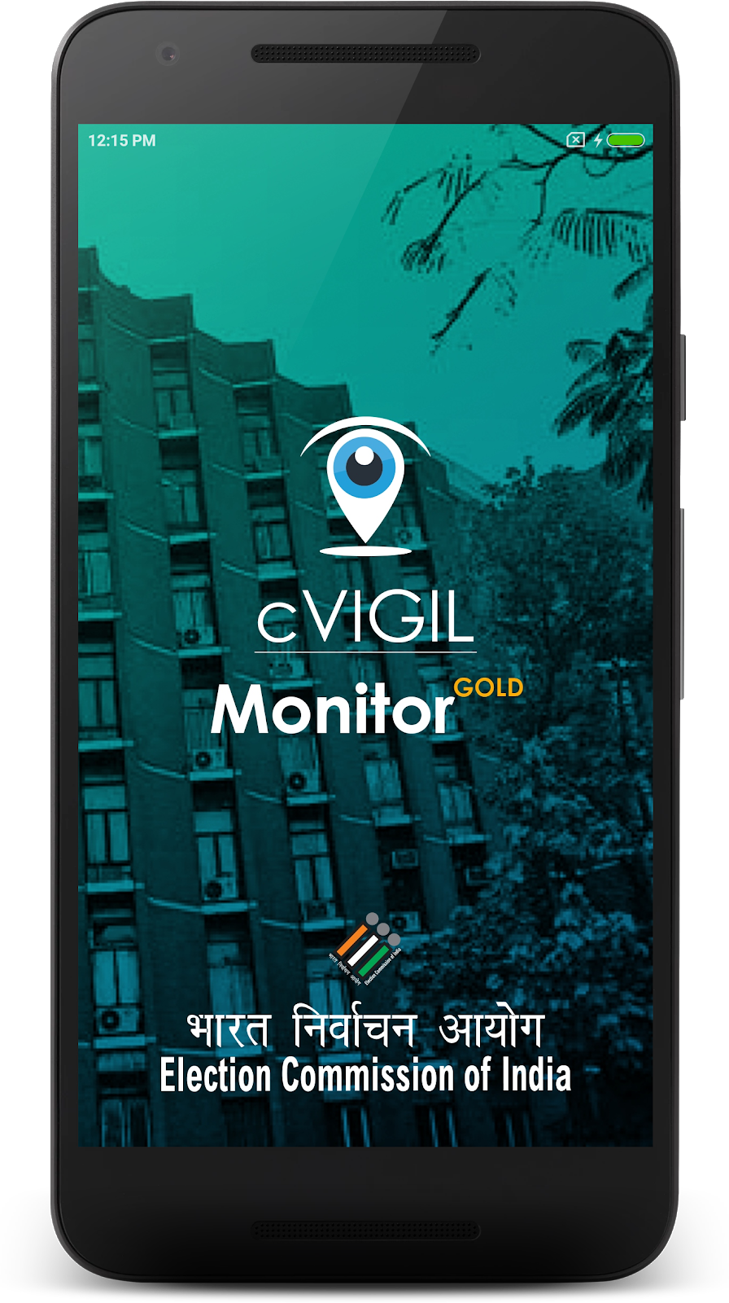
cVIGIL Monitor App

Slide 22
cVIGIL Monitor App
Allows CEO, DEO and ECI officials to see MCC / Expenditure violation complaints directly on their mobile devices
ECI officials can view all the complaints
CEO can view complaints for their state
DEO can view complaints for their District
ECI/CEO/DEO can highlight the complaint for early resolution/urgent case/VIP/ Extensive enquiry

Slide 23
Monitor App: steps to install
Download from https://cvigil.eci.gov.in
Installation
  Go to the Downloads folder on your device.
  Double click on the downloaded file and then tap on Install apk.
  Click on “I Agree” to accept the terms & conditions.
  Click on Allow button to give permissions to the app for using the Phone State, SMS and Location.

Slide 24
Monitor App: How to use?
Step 1: Enter your mobile number
Step 2: Tap on Send OTP(One time password)
Step 3: To verify your account, enter the 4-digit OTP number sent on your mobile number.

Slide 25
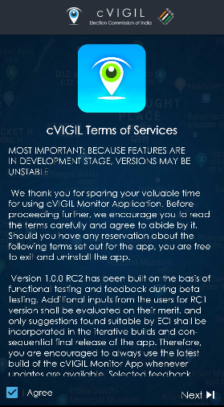
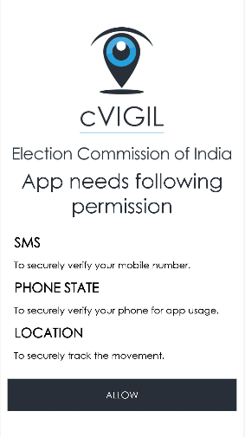
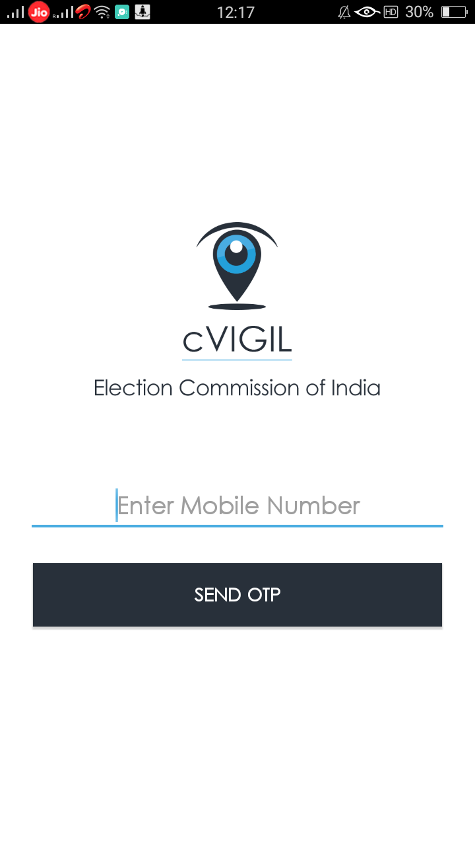
Monitor App: How to use?

Slide 26
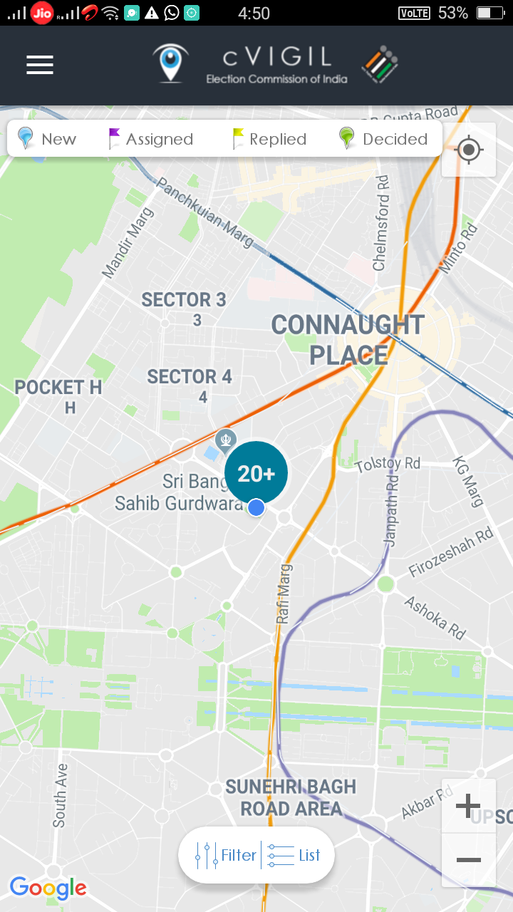
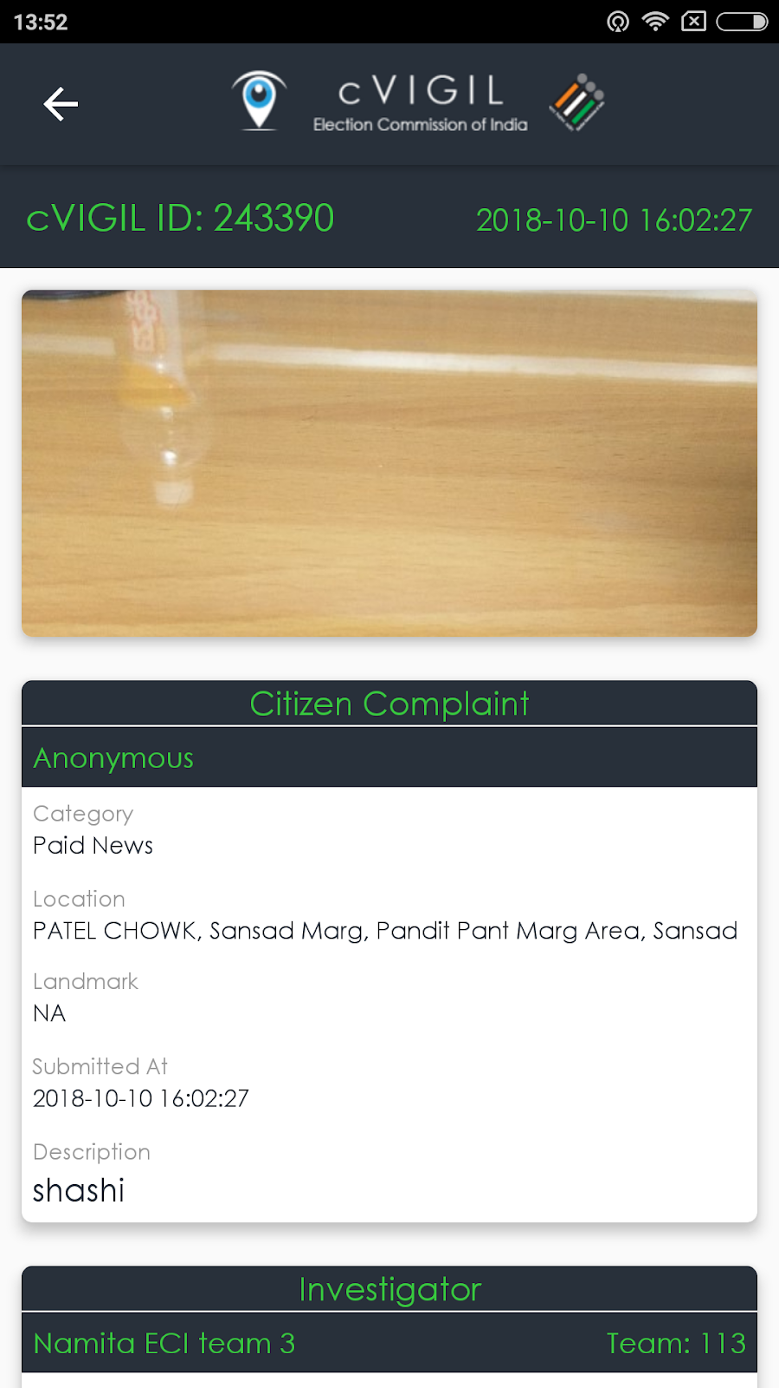
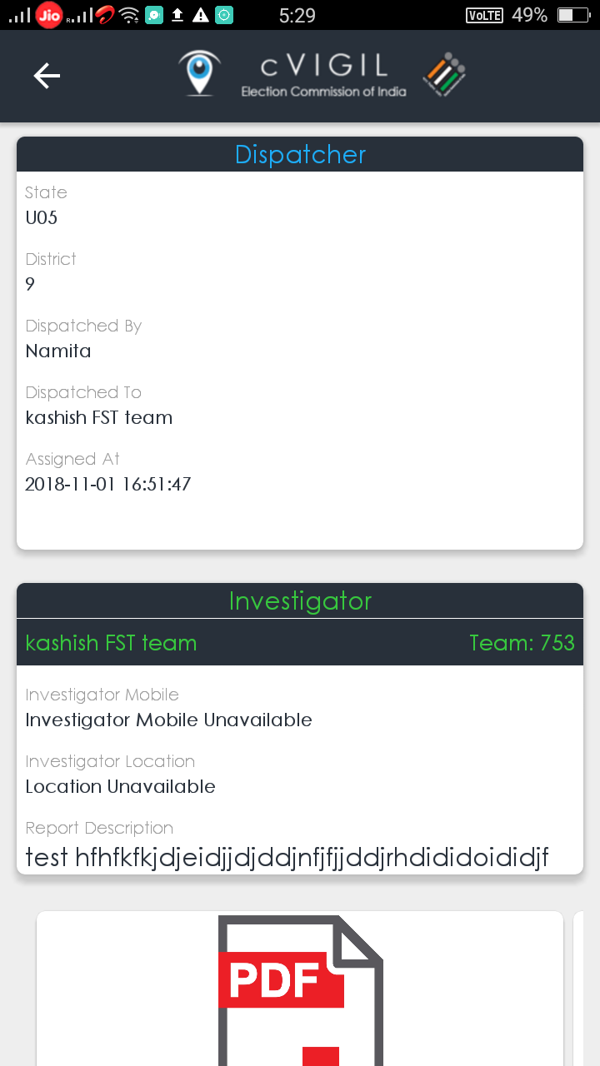
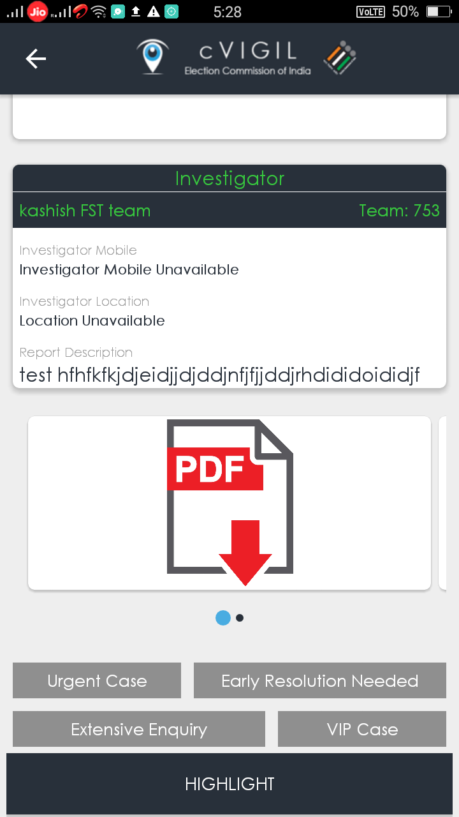
Monitor App: How to use?

Slide 27
Monitor App
Quick Live Demo

Slide 28
cVIGIL Monitor Dashboard
Monitor(ECI/CEO/DEO) can also login on web based interface and view cases of their state/District
ECI | CEO | DEO
Can view All cases | Can view cases from their state | Can view cases from their District
Can view Reports State wise report Category wise report Escalated report Vigilant Citizen report User Reports Activity Reports Performance reports | Can view Reports Category wise report District wise report Escalated report Vigilant Citizen report Performance report | Can view Reports AC wise report Escalated report User Report Activity Report Field Unit Info Performance report
Feedback | Feedback | Manage Investigators Manage DCC supervisors
Survey | User Management Manage District categories | User Management Feedback Survey

Slide 29
cVIGIL Monitor Dashbaord
Quick Live Demo

Slide 30
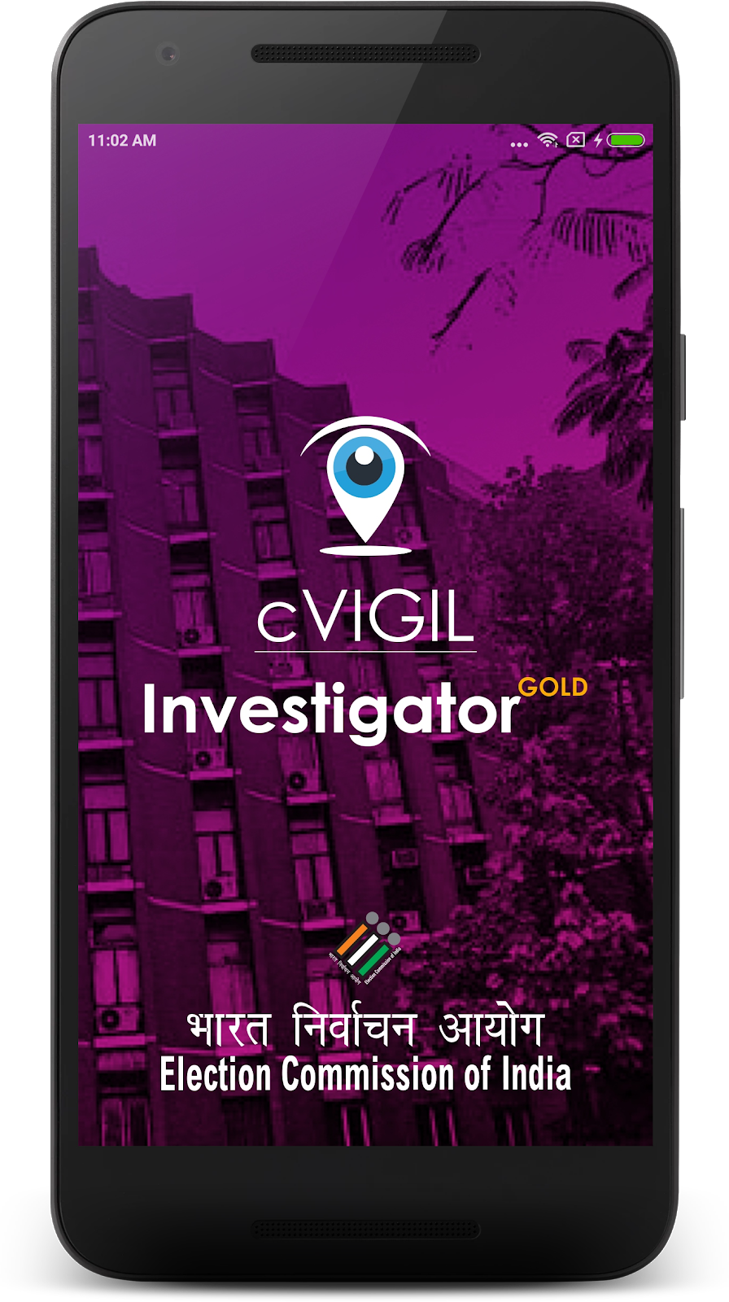
cVIGIL Investigator App
Allows Field Teams to promptly investigate MCC/ Expenditure violation incidents.

Slide 31
cVIGIL Investigator App
Role of Investigator
  To receive the cases assigned from DCC
  To accept or reject the assignment
  To reach to the place of incidence
  To investigate the incidence with photos and documents through the mobile app
  To submit the report to the ARO/ RO as the case may be through the mobile app
  To use the app to conduct suo-moto inquiry and submit the cvigil cases for decision of the RO.

Slide 32
Investigator App: How to use?
Download the App from cVIGIL website
Install the App on mobile with good internet speed and GPS enabled
Installation steps
  Go to the Downloads folder on your mobile device
  Double click on the downloaded file and then tap on Install apk
  Now, click on “I Agree” to accept the terms & conditions

Slide 33
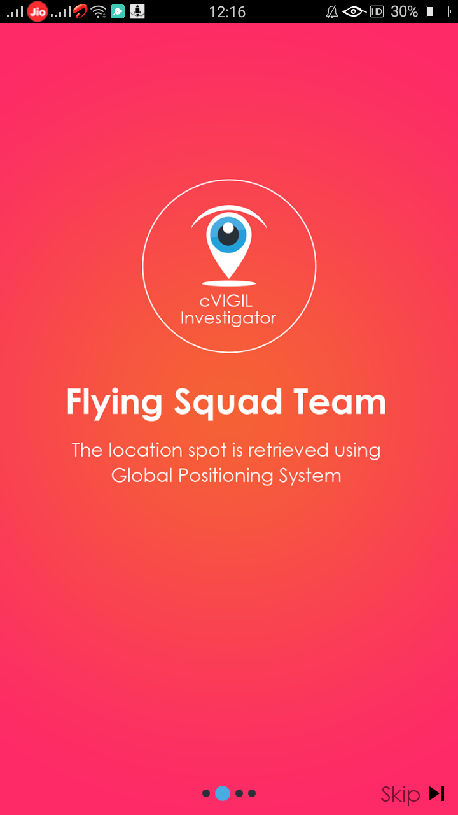
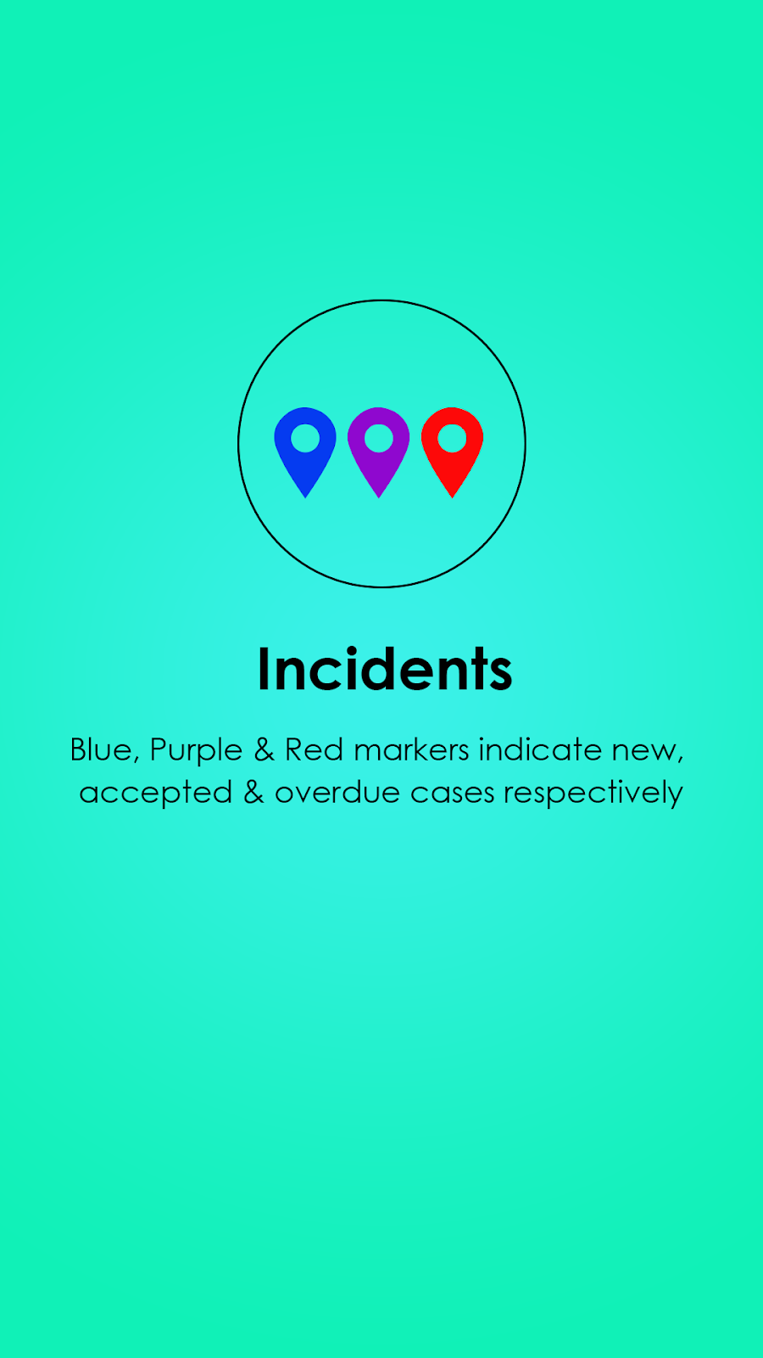
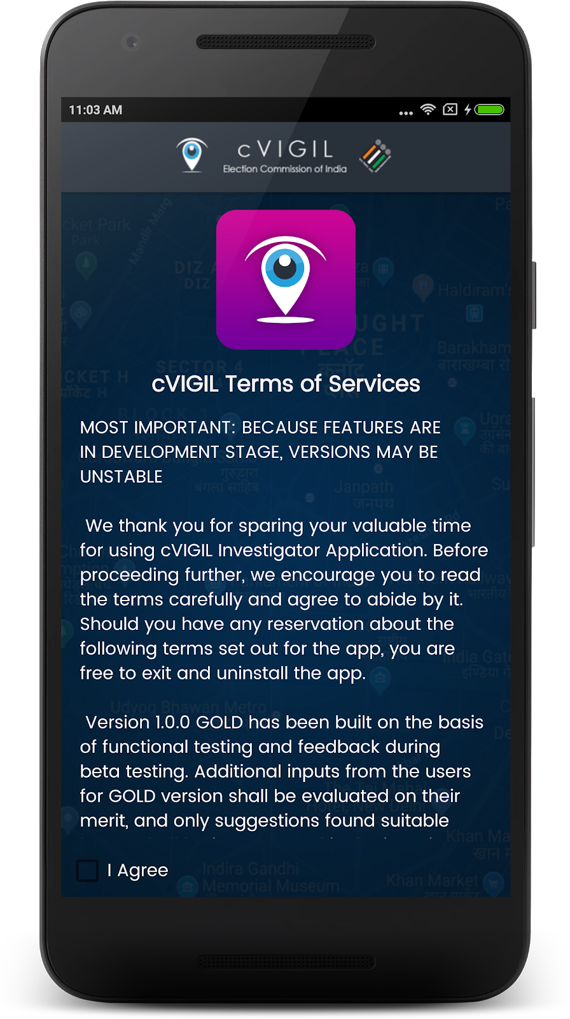
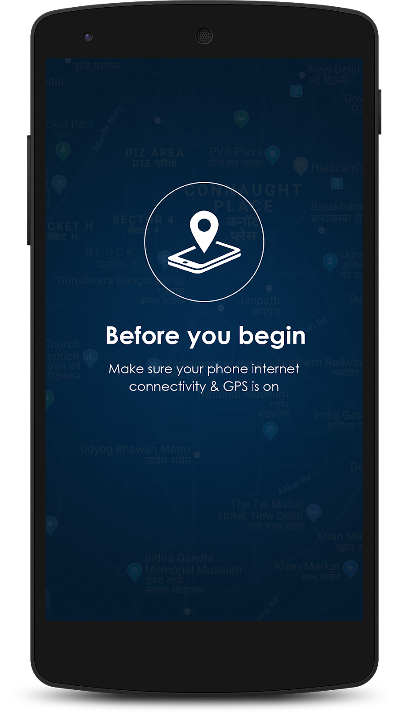
Investigator App: How to use?

Slide 34
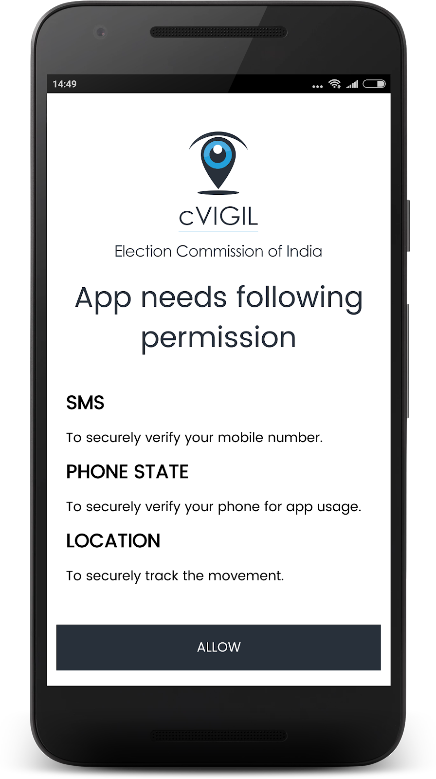
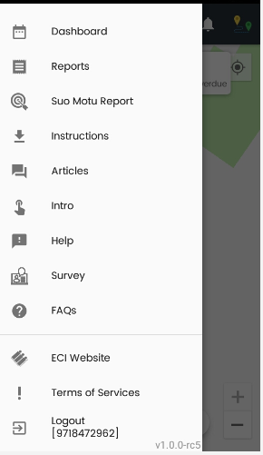
Investigator App: How to use?

Slide 35
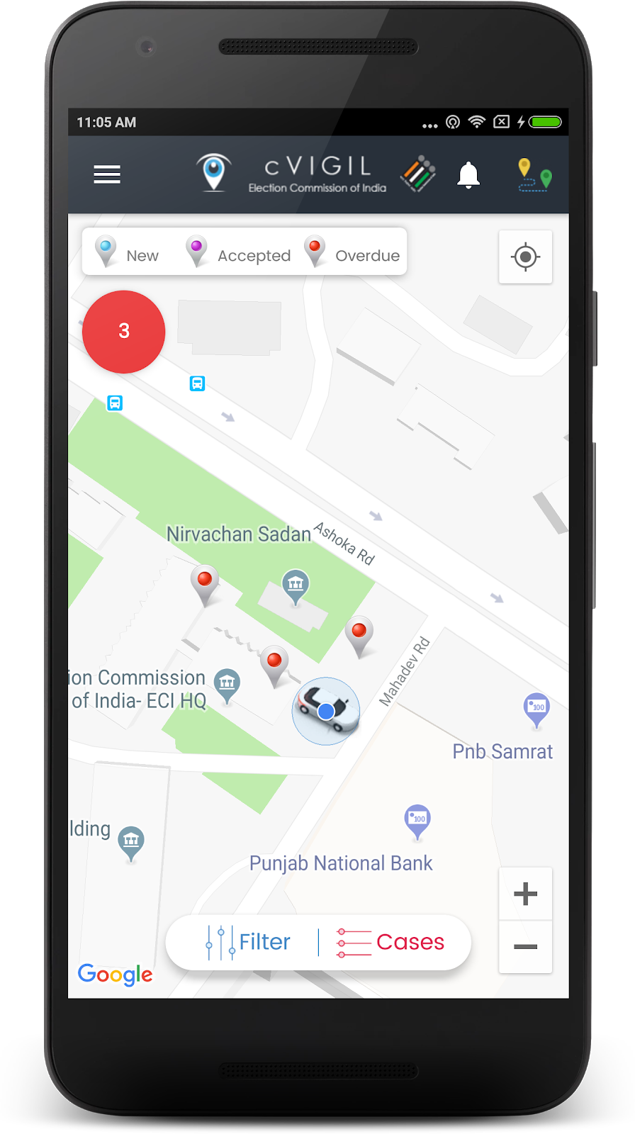
Investigator App: Live view
Field unit will see three color icons
  Blue: New cases
  Purple: Accepted cases
  Red: Overdue cases

Slide 36
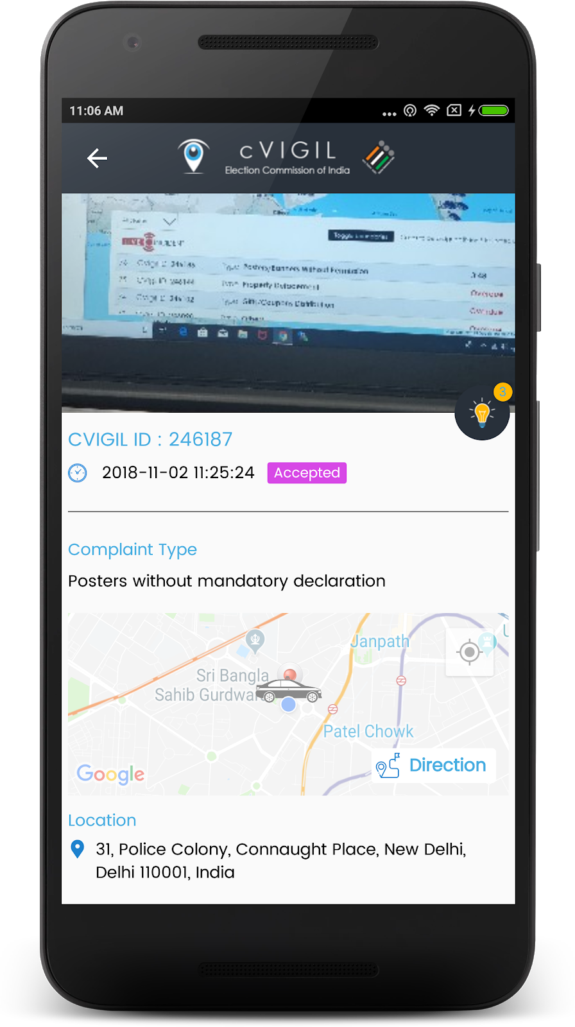
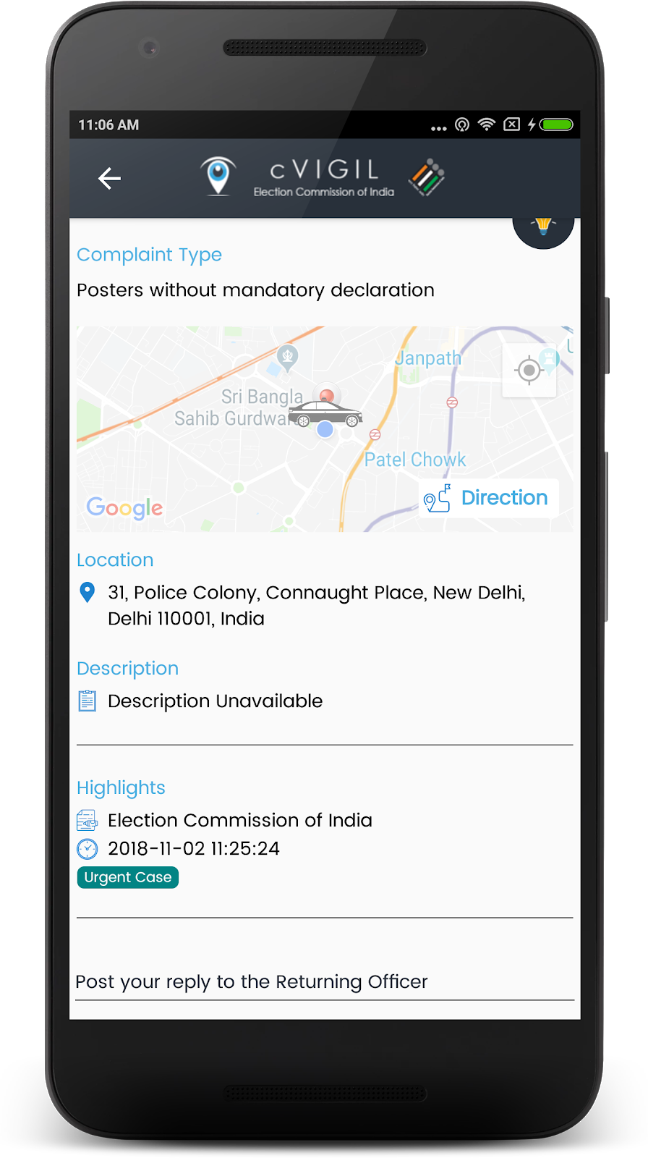
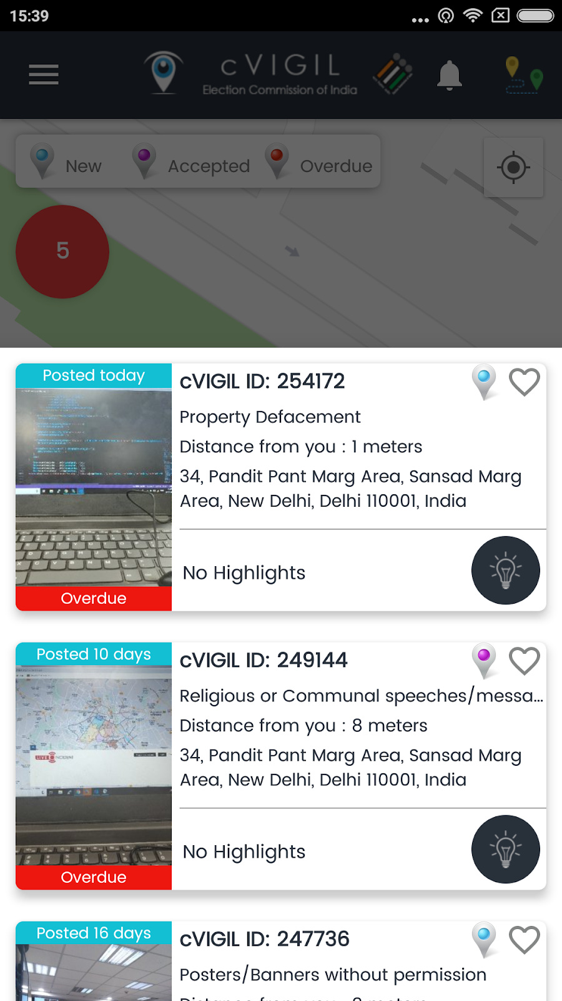
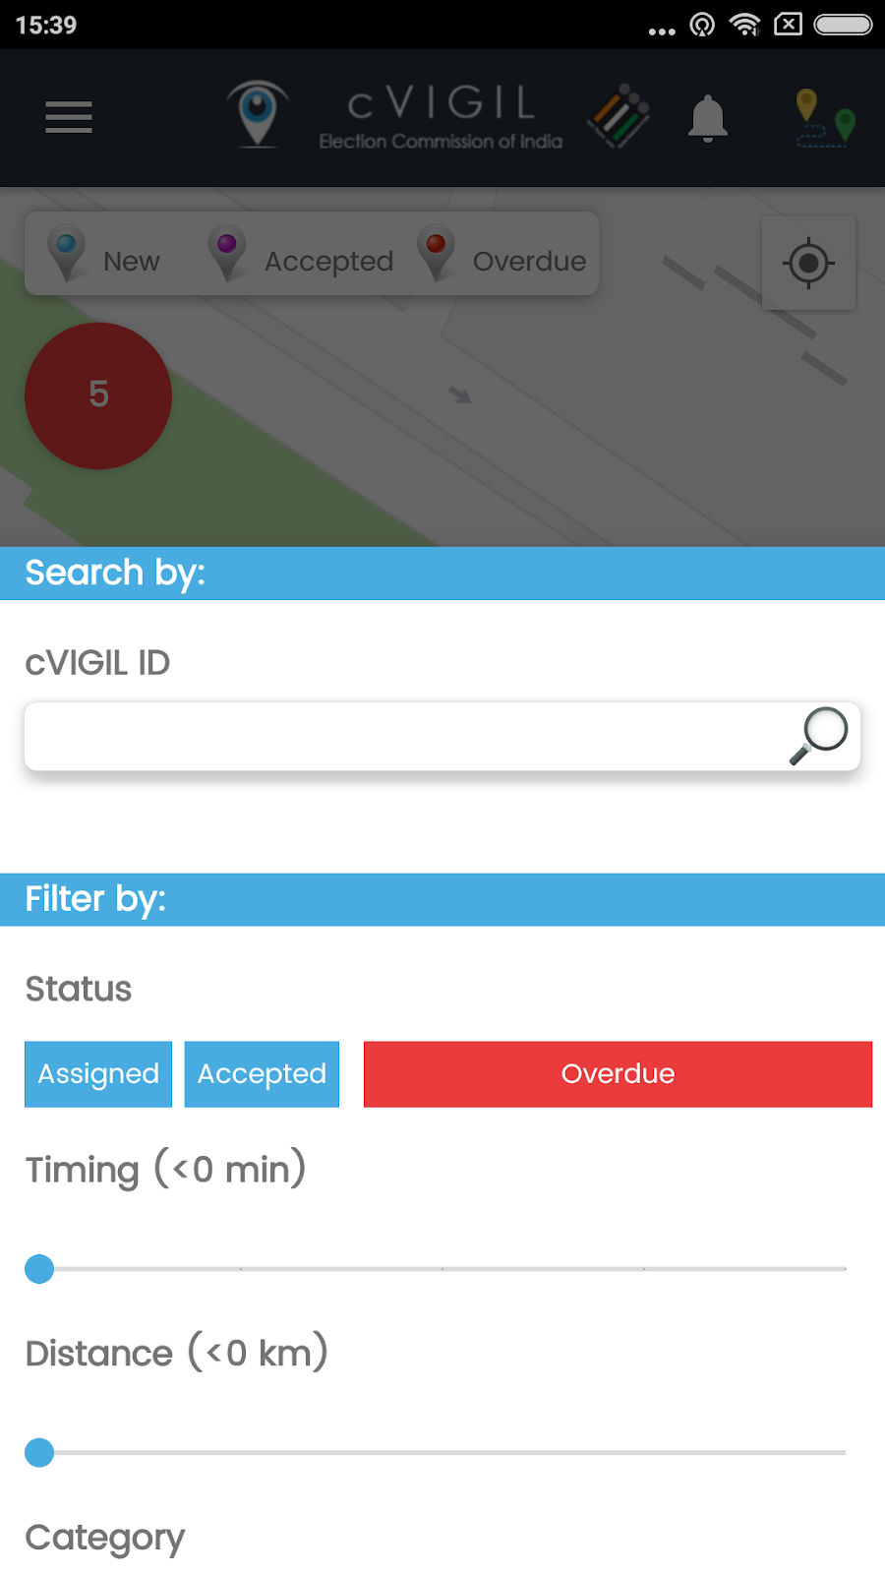
Investigator App: case details

Slide 37
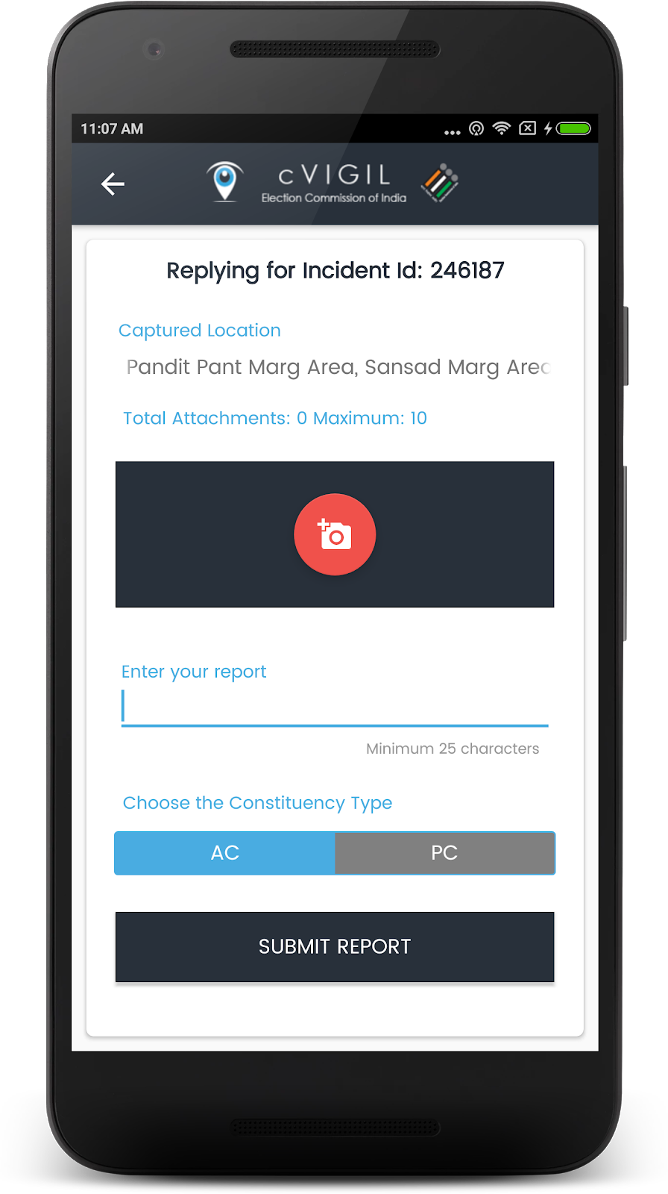
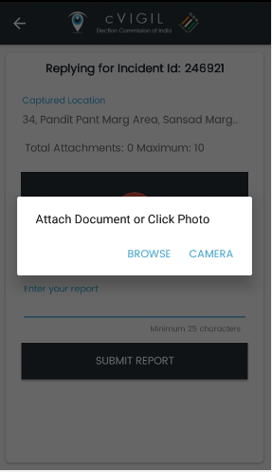
Investigator App: reply

Slide 38
Investigator App: suo moto
A Field Unit can click on Suo Moto Report from the menu, if he/ she notices a MCC/Expenditure violation incident and wants to immediately send their reply to the RO/ ARO
  Step 1: Select Type of Incident.
  Step 2: Location will be automatically captured.
  Step 3: Enter your Report.
  Step 4: Capture and attach the pictures of incident.
  Step 5: Click on Submit Report.

Slide 39
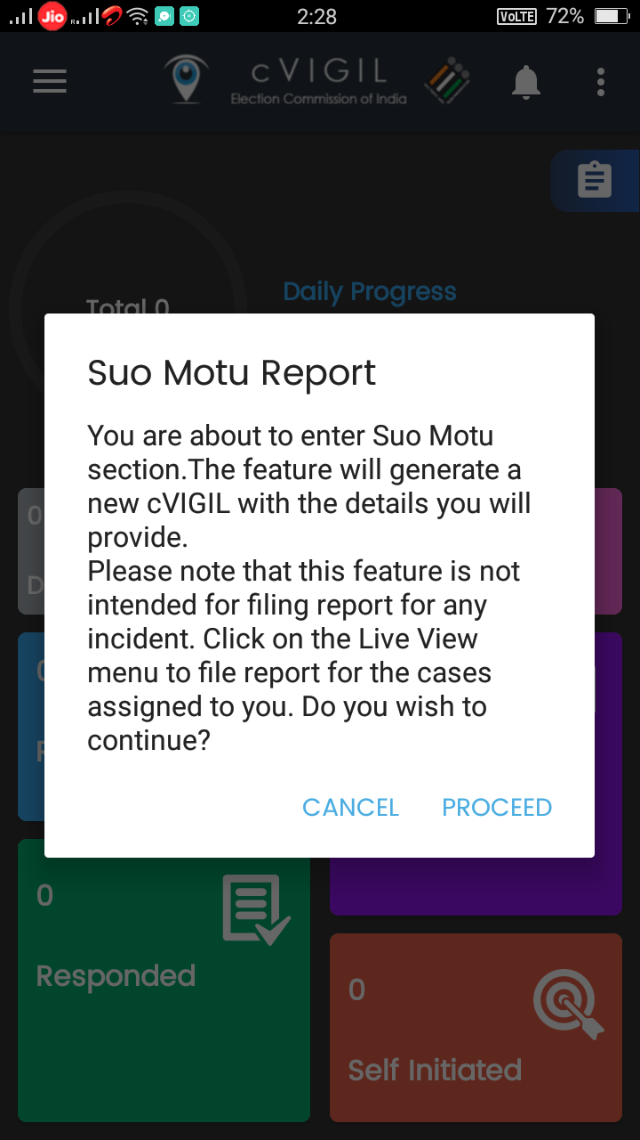
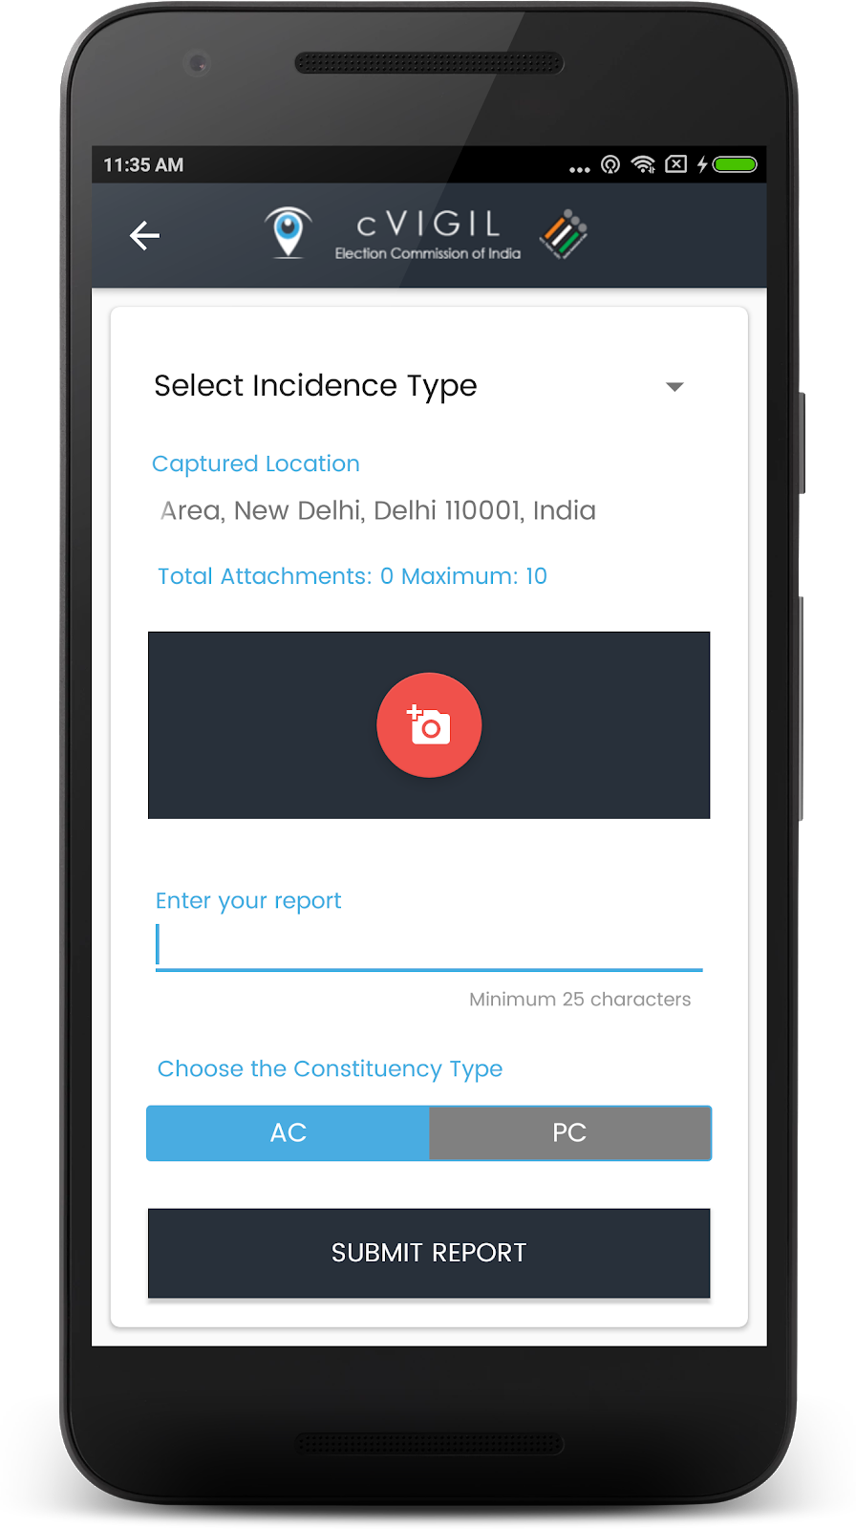
Investigator App: suo moto

Slide 40
Investigator App
Quick Live Demo

Slide 41
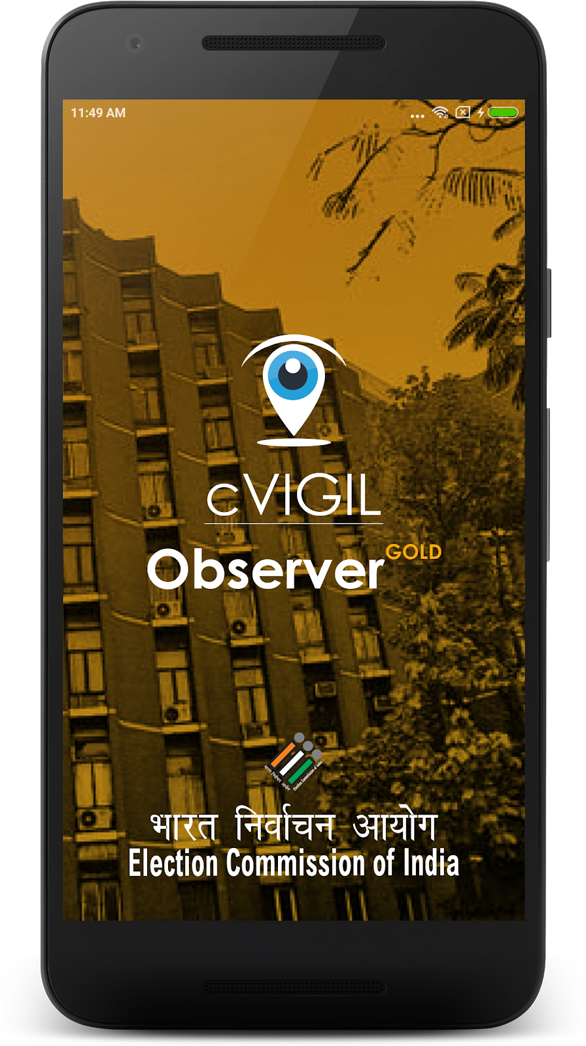
cVIGIL Observer App

Slide 42
cVIGIL Observer App
cVIGIL Observer App allows Observers and other staff authorized by ECI, to see MCC/ expenditure violation
Can view the complaints lodged by citizen
Can comments on the reports submitted by FST
Can upload max 10 pictures from incident spot

Slide 43
cVIGIL Observer App
Role of cVIGIL Observer
  It is meant for general observers, expenditure observers, police observers
  Observers can observe the cases falling under their jurisdictions
  Give observation after the investigation is complete by FST.
  Observer can comment only, after a Field Unit have submitted ‘action taken’ reports on them.

Slide 44
Observer App: how to use?
Download from website
Install the App
Accept terms and conditions
Allow permissions for GPS
Login with username/password provided by ECI
Ready to use

Slide 45
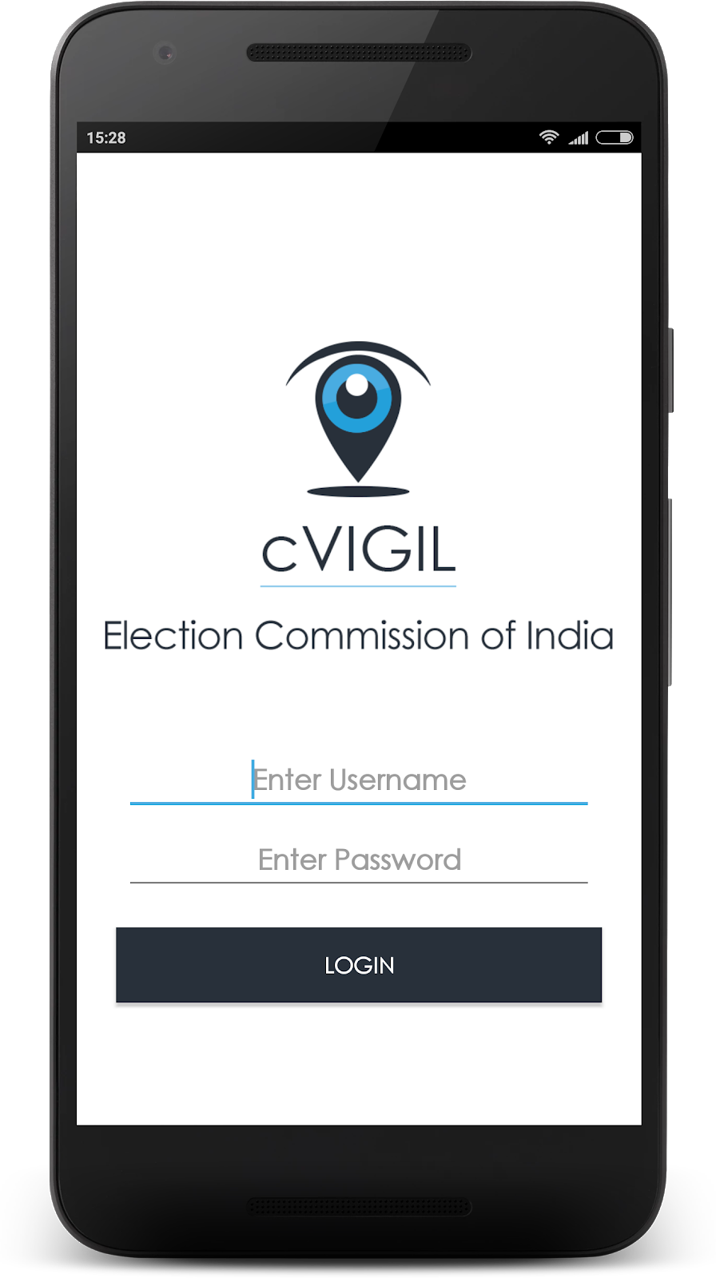
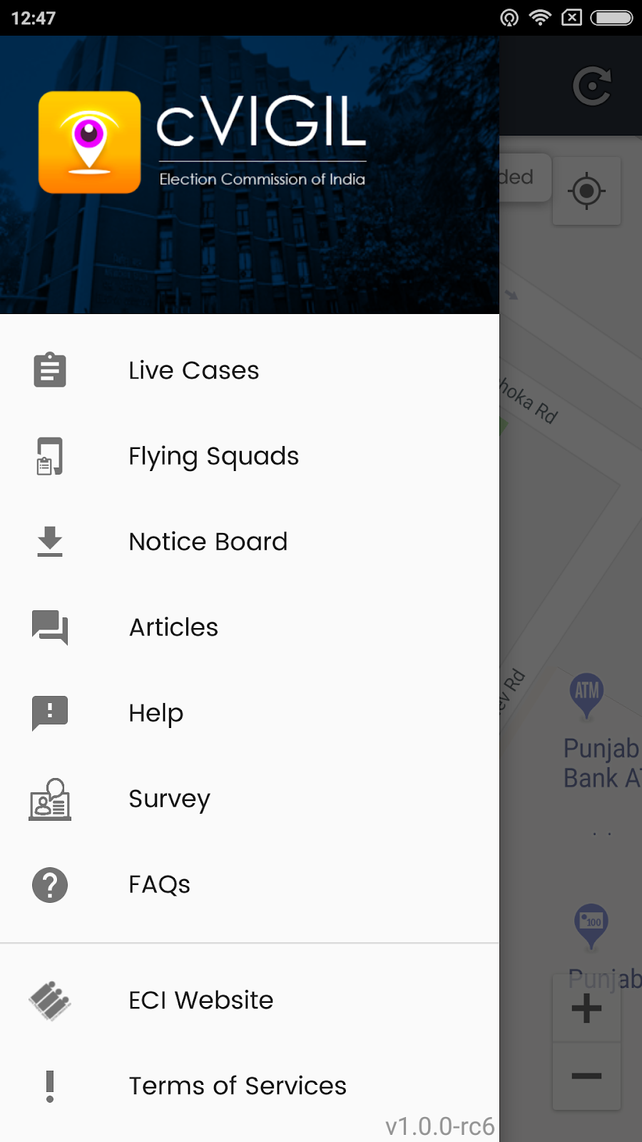
Observer App: how to use?

Slide 46
Observer App: Live cases
Live Cases screen displays the list of live cases and location of FST.
Observer will see three icons to identify complaints in different stages of action.
  New: is denoted by Blue marker, which represents the count of new cases.
  Assigned: is denoted by purple flag, which displays the count of assigned cases to the FST.
  Replied: is denoted by yellow flag, displays the count of cases replied the by the FST/ RO.
  Decided: is denoted by Green marker, which represents the count of total decided cases.

Slide 47
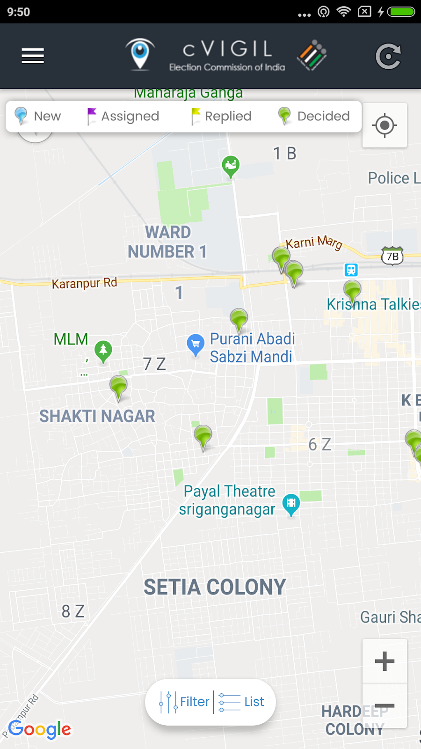
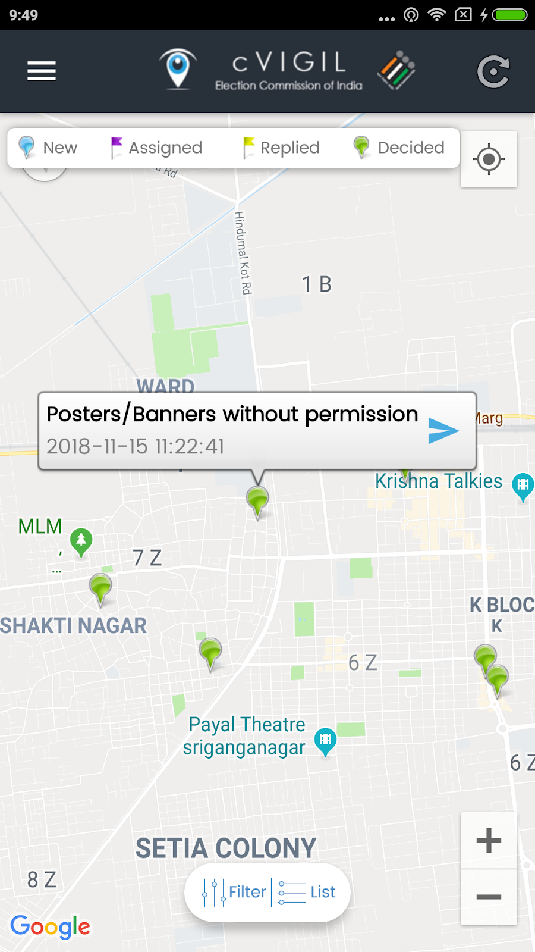
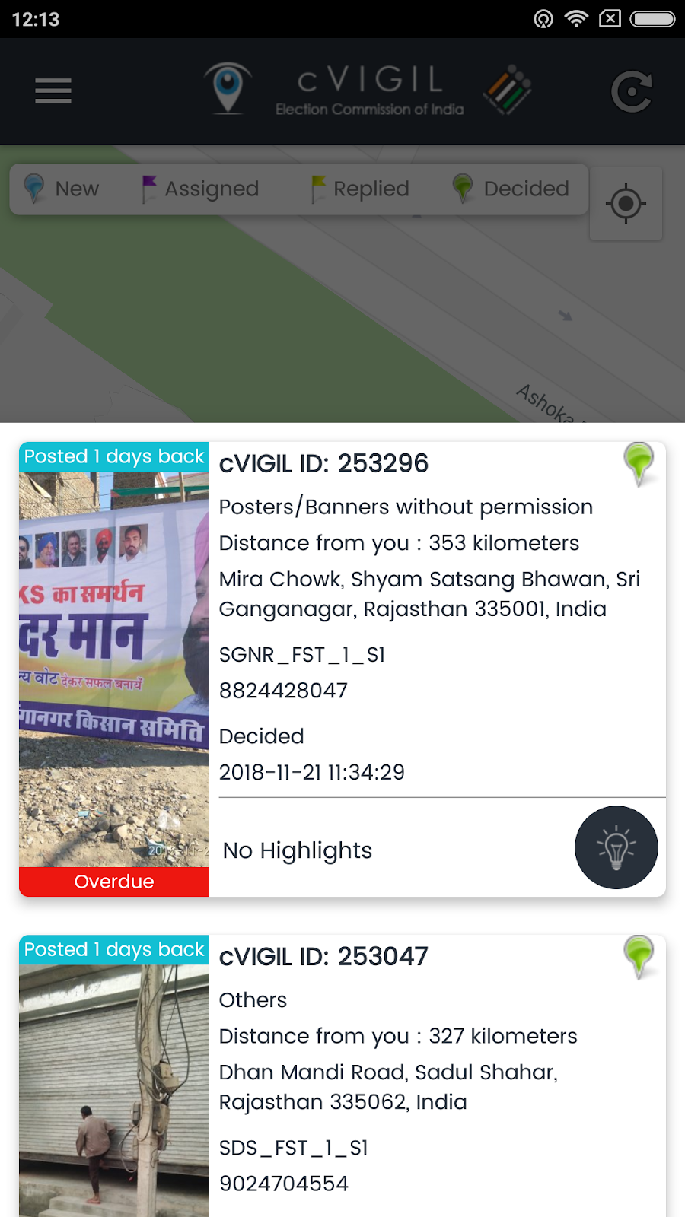
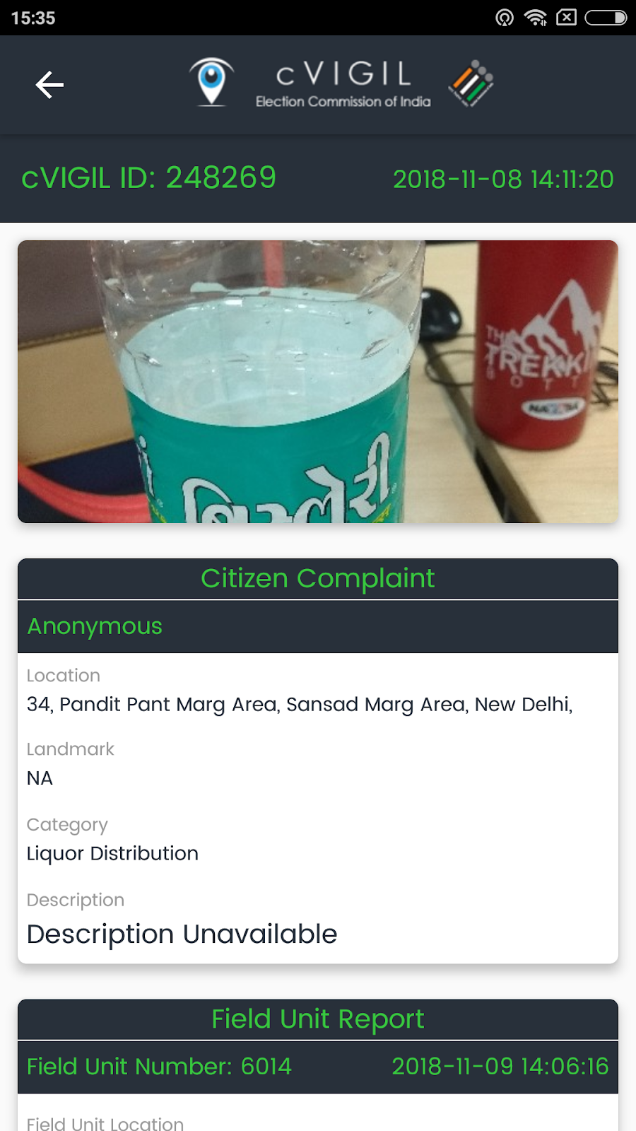
Observer App: Live cases

Slide 48
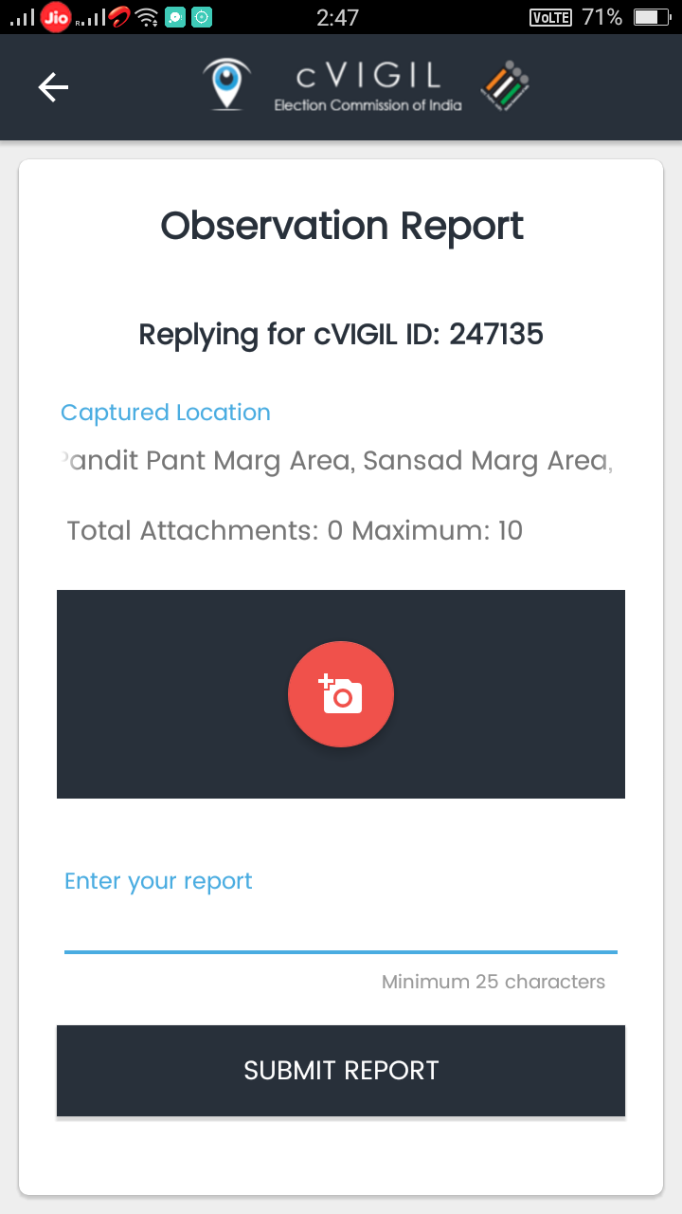
Observer App: submit report
After going through the
description and content
of report given by the
Field Unit, the Observer
clicks on Make Observation
icon to give his inputs.

Slide 49
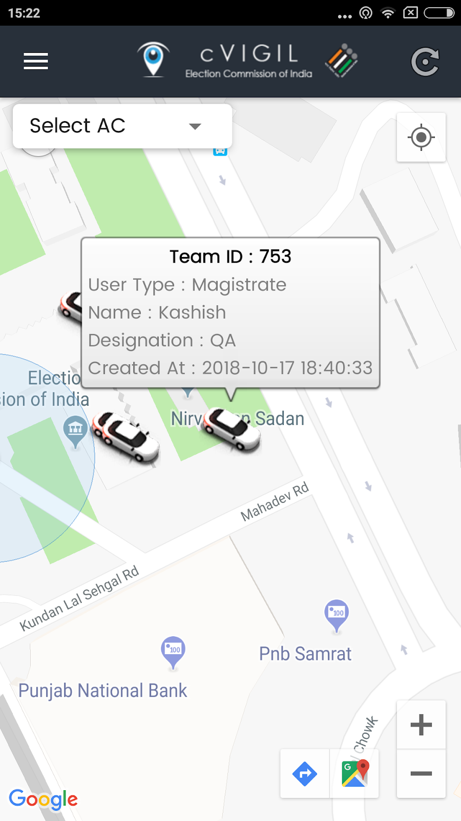
Observer App: Flying Squad
List of Field Unit can be shown
On the screen. Also observer
Can view the details of the
FST Team like Name and
Designation.

Slide 50
Observer App
Quick Live Demo

Slide 51
cVIGIL Decider(RO/ARO)
Play important role for complaint resolution
Decide on the cases investigated by field units
Drop, dispose or escalate within the time limit prescribed
Bypass Investigator in case of delay
Dispose of the escalated cases to NGSP in the stipulated timelines.

Slide 52
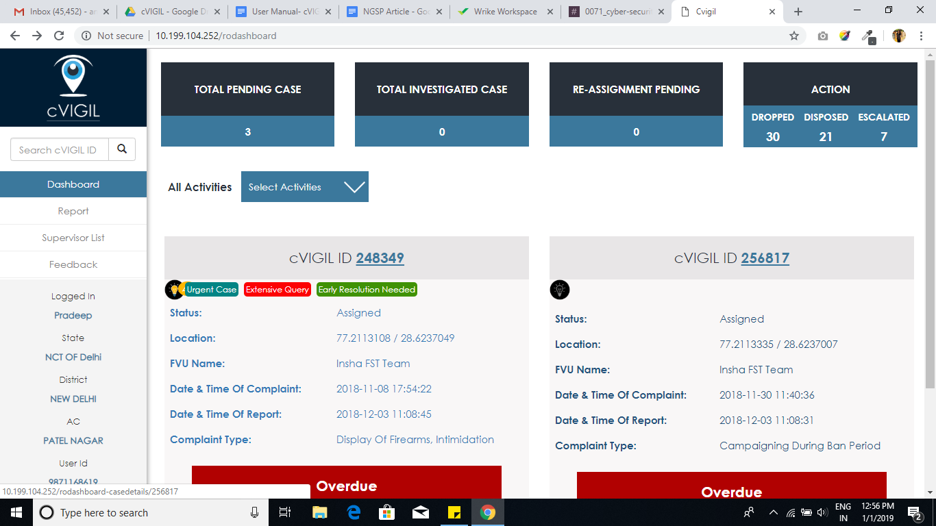
Decider Dashboard

Slide 53
Decider Dashboard
RO/ARO Action items:
Drop(Found Incorrect): The RO/ ARO will only drop the case if after the investigation or otherwise, the case is found to be incorrect
Dispose(Found Correct): RO/ ARO finds that the case has already been addressed by the field unit or the same can be addressed at his level then and their itself.
Escalate: If case found correct but beyond his/her power jurisdiction or which require more investigation. In that case, that Returning Officer can escalate the case by giving full case information to National Grievance Service Portal for further action
Notes:
For example, a poster complaint which has been removed by field unit and reported from investigator app should be marked as disposed. It is very important to remember that drop cases (cases not found correct by investigation) are not marked as Disposed. This will create incorrect MIS reporting. The outcome is calculated by number of disposed and escalated cases. Therefore, if a "Not found Correct" case is mistakenly marked as "Disposed" it will display wrong figures.

Slide 54
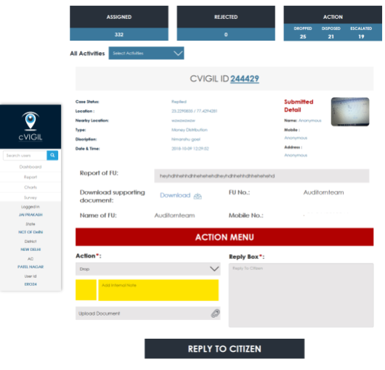
Decider Dashboard

Slide 55
Decider Dashboard
Quick Live Demo

Slide 56
cVIGIL User Manuals & FAQ
https://cvigil.eci.gov.in/theme/user-manual.html
https://support.ecitech.in

Slide 57
Thanks!

