Slide 1
District election management plan (DEMP)
MUNIR VHORA
NLMT - ECI

Slide 2
: Disclaimer :
Pl note, this PPT is made as Training aid and shall in no manner be taken as substitute of Statutory Provisions and ECI Directions.
In case of any doubts, please refer to ECI Directions/Provisions.

Slide 3
Why to prepare district election management plan ?
Proper and timely preparation of District Election Management Plan helps the administration to manage the elections effectively in a planned manner.
It enables us to know about election-related processes in proper order.
It is a complete district election profile from the beginning of the election process till declaration of results.
It is a useful handbook for the Observers to know about district as well as election related preparedness of the district.
It is a convenient handbook for DEO/RO and other officials of the district.

Slide 4
Process of preparation
SO collects field data
ARO compiles the data
ARO submits preliminary report to RO
RO checks and makes modifications as required
RO submits to DEO
DEO finalizes the plan
DEMP sent to CEO who suggests changes, if any

Slide 5
components of DEMP
Basic information related to the district.
Electors’ & P.S.’ details, Material mgmt. Plan.
Manpower Mgmt.
Movement Plan, Communication Plan.
Trainings of diff. officials / Staff welfare
SVEEP.
MCC/Expenditure Monitoring.
Media-related issues: MCMC; Certification and monitoring for paid- news, Standing Committee meetings, complaint –monitoring.
Force - deployment plan.
Plan for arrangements of Poll-day & Counting day.

Slide 6
District Profile
Poll/Counting day mgmt.
Electors & PS Details+ Logistics
Force Deployment plan
Manpower planning
DEMP
Media+Compl. Monitoring
Communication+Movement plan
MCC+Exp. moni. plan
Trainnings+Staff welfare
SVEEP

Slide 7
1. DISTRICT PROFILE

Slide 8
DISTRICT BRIEF PROFILE DISTRICT BRIEF PROFILE
DEMP shall contain basic information related to the district :-
Maps:-
Map of the district
Maps of all ACs
Telephone Directory:-
Telephone numbers of important officers
Geography:-
General information
Geographical structure

Slide 9
DISTRICT BRIEF PROFILE
Demography :-
Administrative Structure
Population
Male – Female Ratio
Literacy
Forest
Industry
Electricity
Financial Institution
Public Health
History of District – Constituencies
Past Electoral Offences

Slide 10
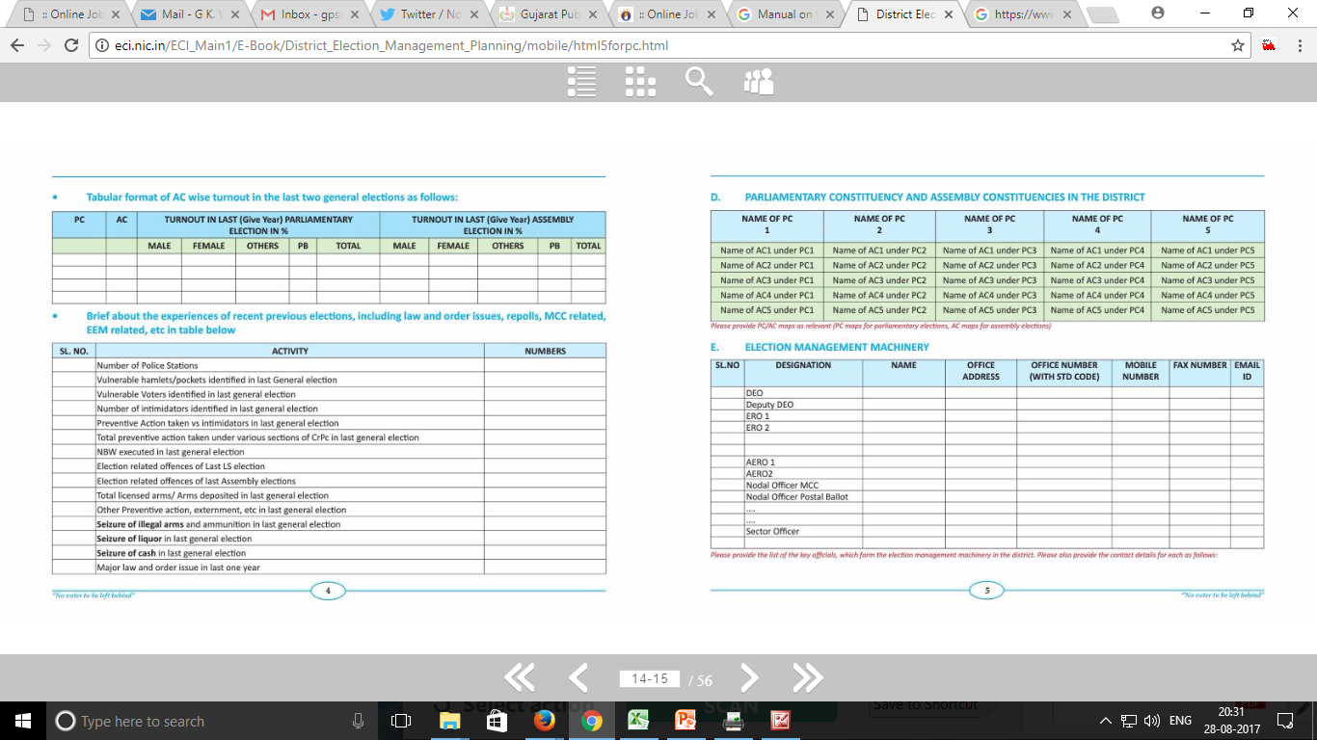
DISTRICT BRIEF PROFILE

Slide 11
DISTRICT BRIEF PROFILE

Slide 12
2. ELECTORS’
&
POLLING
STATIONS’ DETAILS

Slide 13
Electors’ details
The DEMP to contain electors’ details like
Gender- Ratio,
Elector - Population Ratio,
Age Cohort Chart,
Inclusion and deletion in current electoral-roll and information containing Photo
Coverage and EPIC-coverage in prescribed formats of Commission. (Formats – 1A, 1B, 2A, 2B, 3A, 4A, 4B, 5A, 5B, 5C & 5D)
Special focus on PwDs, senior citizens, marginalized communities

Slide 14
Information related to polling stations
DEMP to contain Constituency-wise abstract information of polling- stations.
Indicating identified Vulnerable and Critical polling-stations

Slide 15
Vulnerability mapping and critical booths
DEO to do vulnerability-mapping and classify Polling-Stations as Critical, Highly Critical and Non-Critical, following points are relevant:-
Read ECI’s circular (No.464/INST/2007-PLN-1, dated 12.10.2007)
Identify vulnerable hamlets / wards etc and identity persons who make it vulnerable
Worry-list of candidates is very important before finalizing criticality

Slide 16
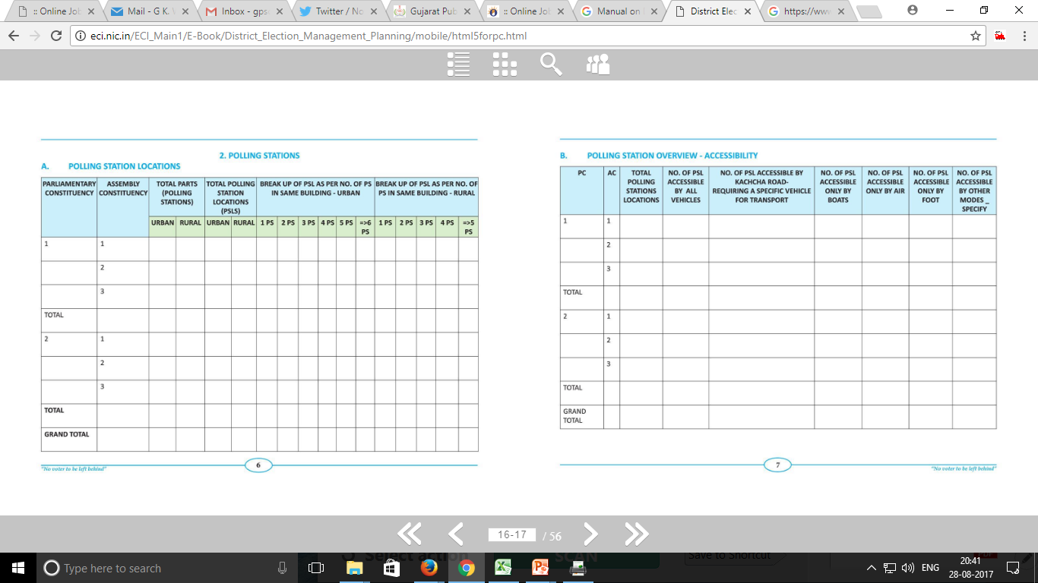
Polling stations : location wise

Slide 17
Polling stations : accessibility

Slide 18
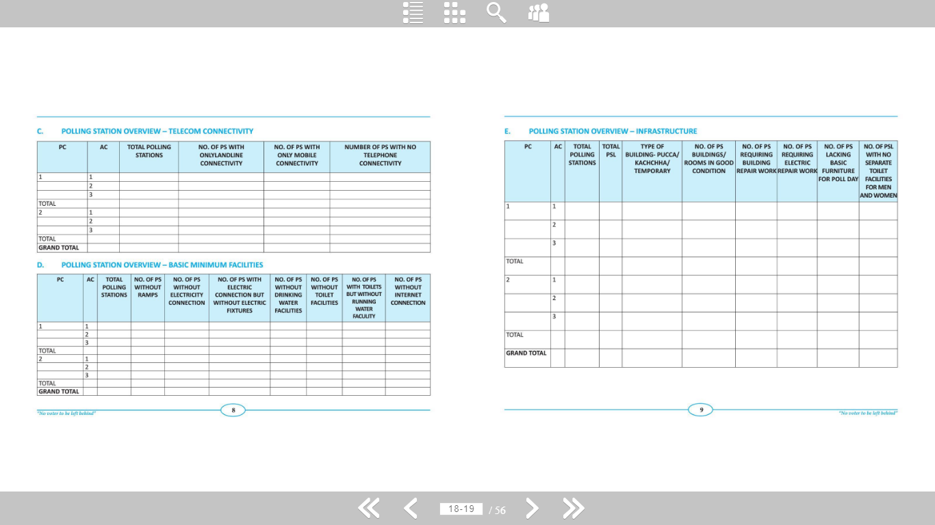
Polling stations : connectivity & bmf

Slide 19
Polling stations : infrastructure

Slide 20
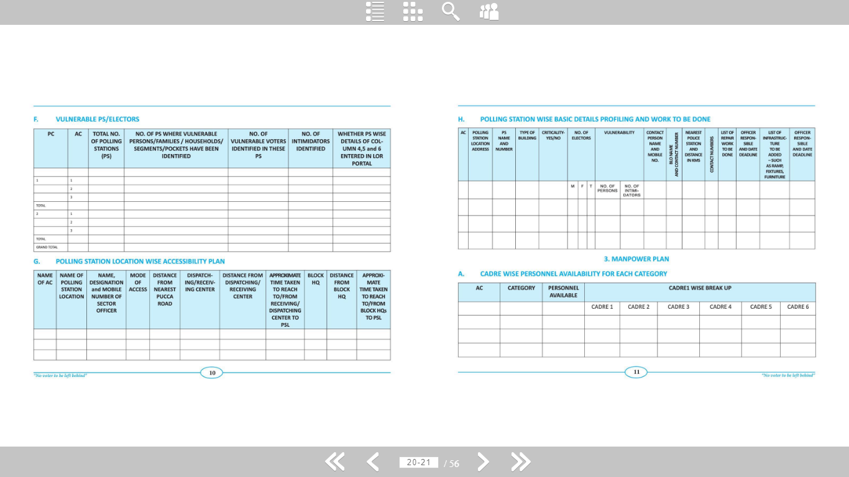
: Polling stations :

Slide 21
Polling stations : overview

Slide 22
Evm and vvpat
DEO shall ensure the following with respect to the EVMs/VVPATs:
Proper Storage, First Level Checking by Engineers, Randomization of machines,
Preparation, sealing and keeping the machines after preparation under supervision and tight security.

Slide 23
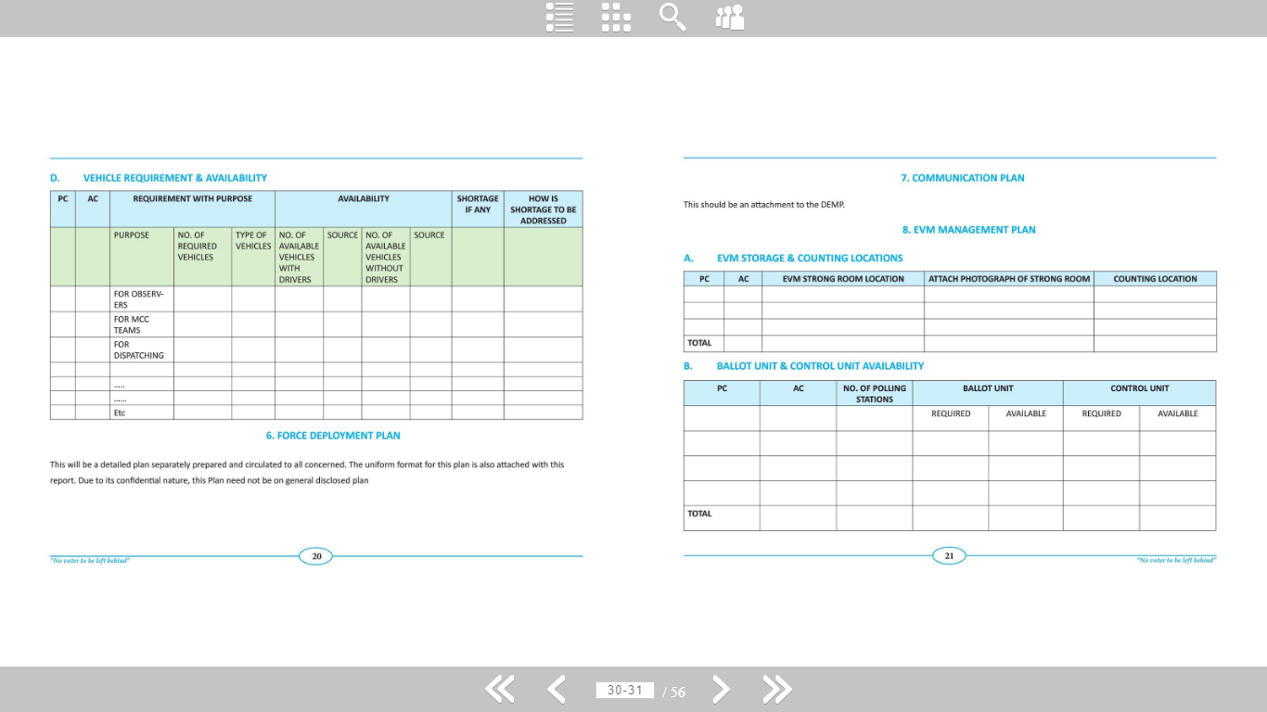
Evm management plan

Slide 24
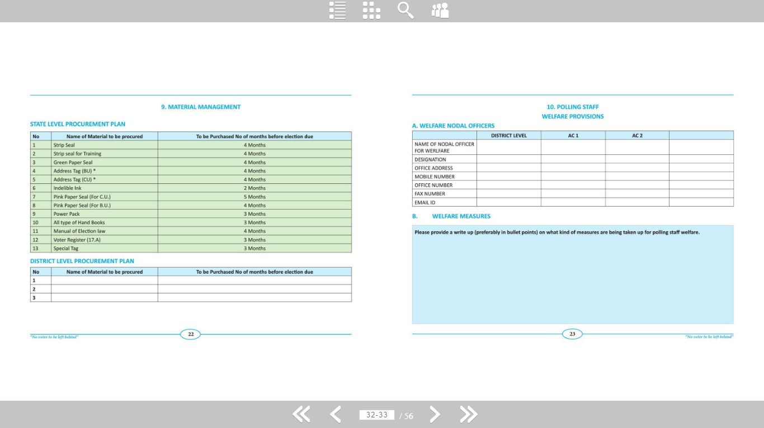
Material management plan

Slide 25
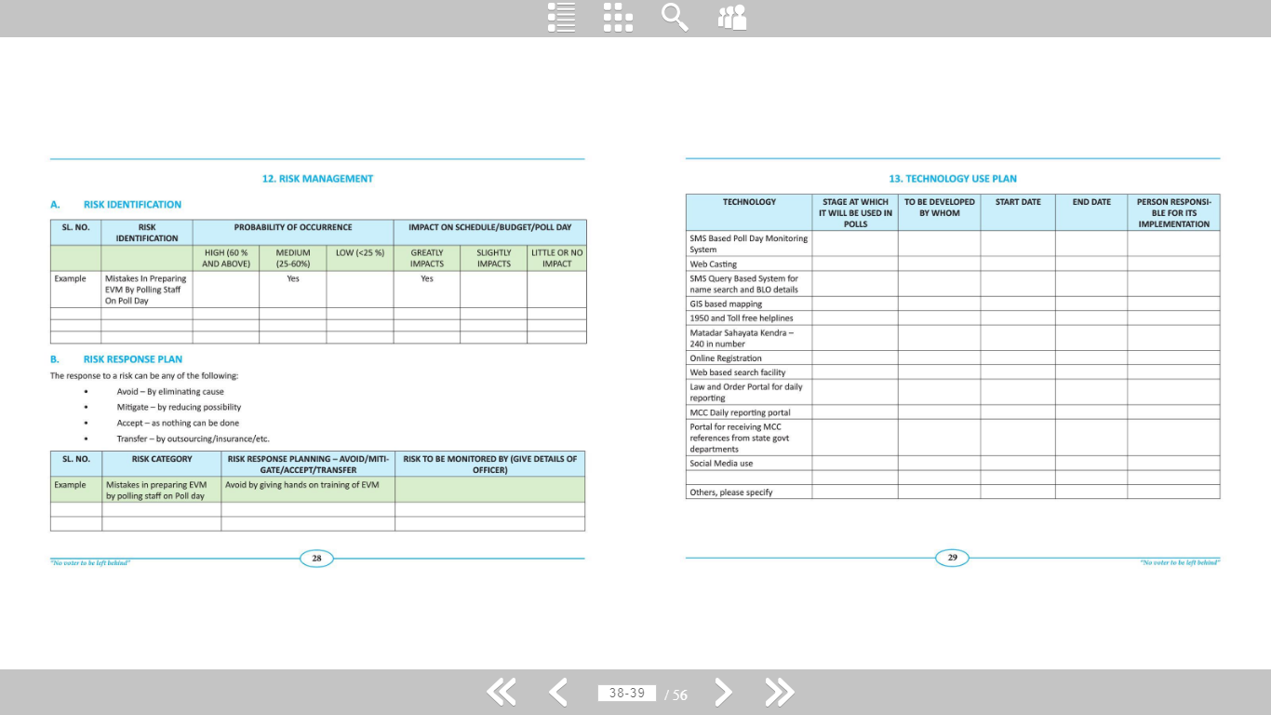
Risk management

Slide 26
TECHNOLOGY USE PLAN

Slide 27
3. MANPOWER
PLAN

Slide 28
Manpower planning
Data-base creation and classification of…
Polling-Personnel as PO, P1, P2 and P3 through randomization process
Different duty allotment
Sector Officers
Micro Observers

Slide 29
Manpower planning

Slide 30
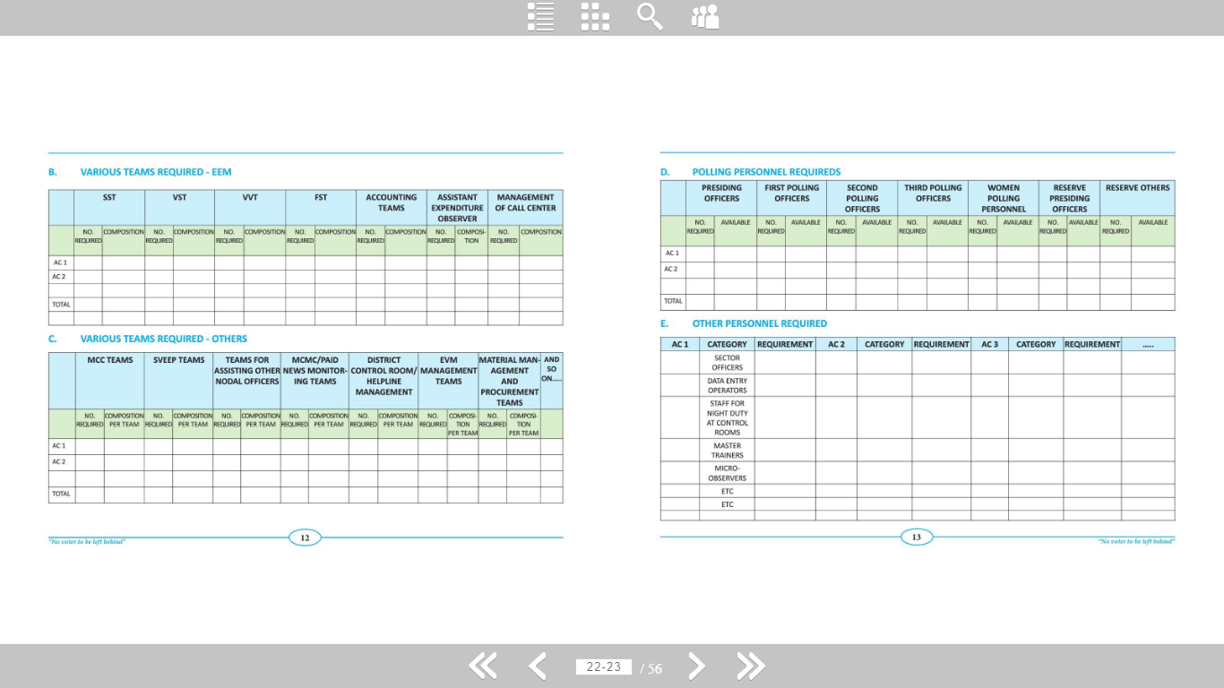
Manpower planning

Slide 31
Manpower planning

Slide 32
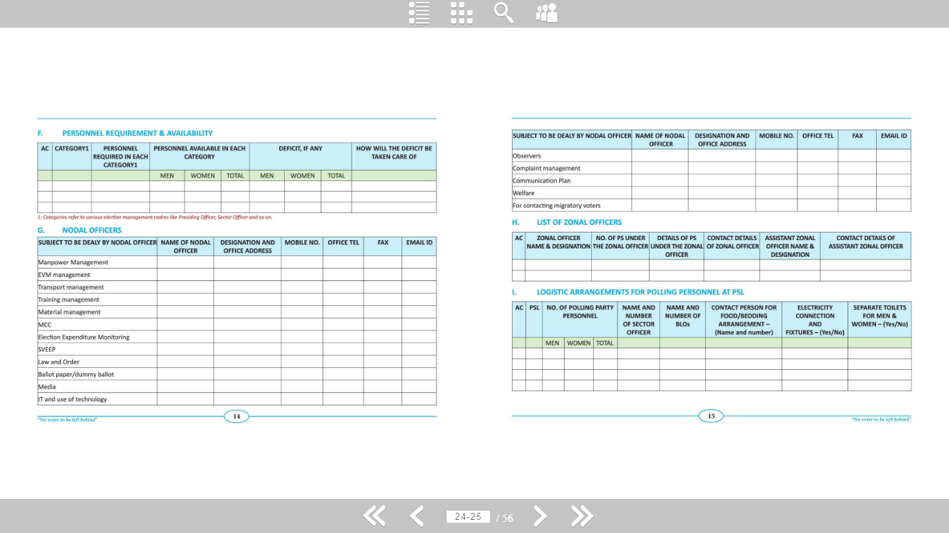
Manpower planning

Slide 33
Manpower planning

Slide 34
Assignment of duties to different officers
DEO shall plan the Election process and appoint the officer in-charge for various election- related activities such as :-
Polling personnel
Electoral roll
Postal Ballots/EDC/Ballot Papers
Law and Order
Polling Personnel Welfare
Vulnerability Mapping
Standing Committee meeting
Facilitation Centre
Complaint Monitoring
Daily Monitoring
Election Expenses
Distribution Centre
Counting Centre
Police Personnel

Slide 35
Contd.
Polling Stations
Transportation arrangements
Route Chart preparation (Sector Movement Plan)
Training
Communication Plan
Model code of conduct
Sector officers
EVMs
Media Centre/Cell
Videography
Procurement of Election materials
Identity Card
Computerization / Randomization
Reception Centre
Counting Staff

Slide 36
Sector officers
DEO to ensure the following with respect to Sector Officers:-
Data- base Creation of Sector Officers.
Appointment of Sector- Officers.
Training of Sector Officers.
1st and 2nd Visit of Sector Officers, feed back.
1st and 2nd rehearsal of COMMUNICATION PLAN.

Slide 37
movement plan
DEMP should contain Sector Movement Plan for Polling Parties, Sector Officers, other Personnel , Micro- observers etc.
Assessment of vehicle- requirement as per the Route Chart.
Separate Route Chart for Micro-observers.

Slide 38
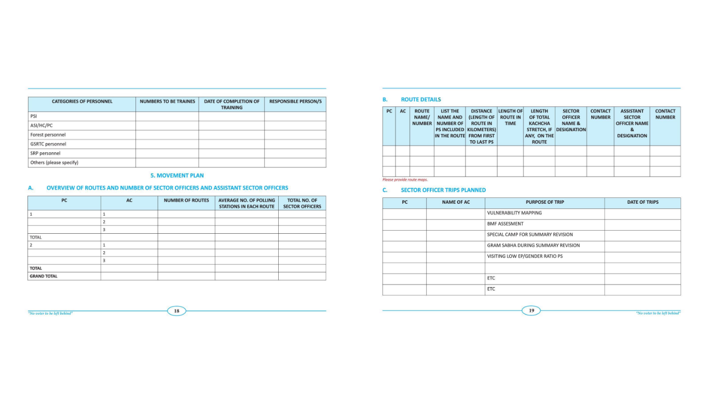
Movement plan

Slide 39
Movement plan

Slide 40
Movement plan

Slide 41
4.
COMMUNICATION PLAN

Slide 42
Communication plan
DEMP to contain detailed account of III tier Communication Plan, at DEO office, RO Officer & Polling Stations.
DEO to hold meeting with mobile-service providers.
Separate Communication plan for police personnel.(confidential, not to be shared in DEMP)

Slide 43
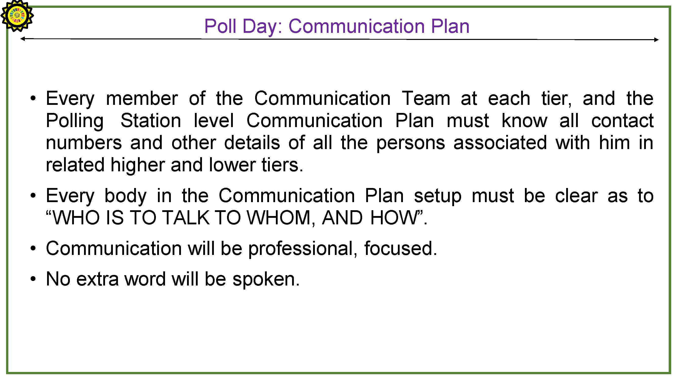

Slide 44
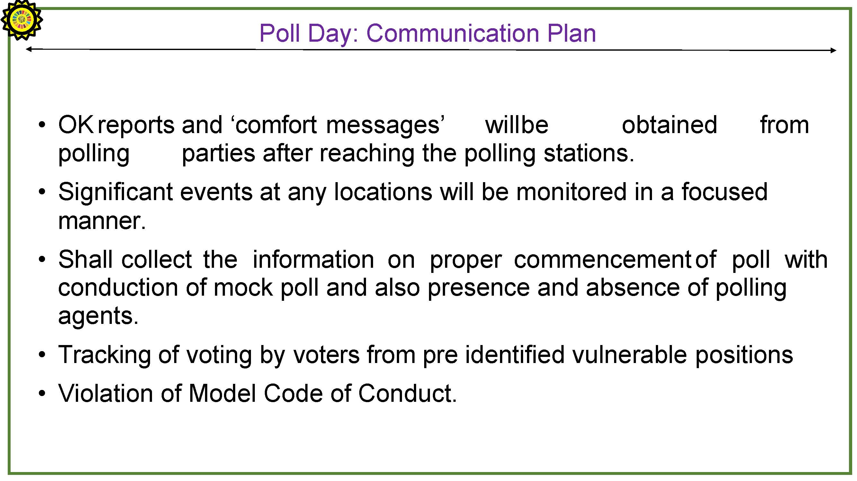

Slide 45
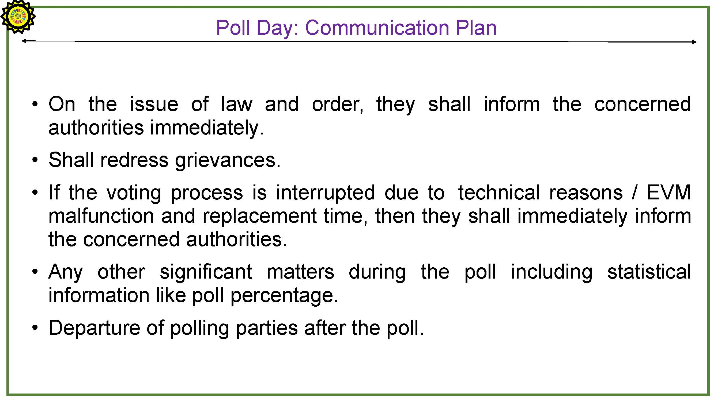

Slide 46
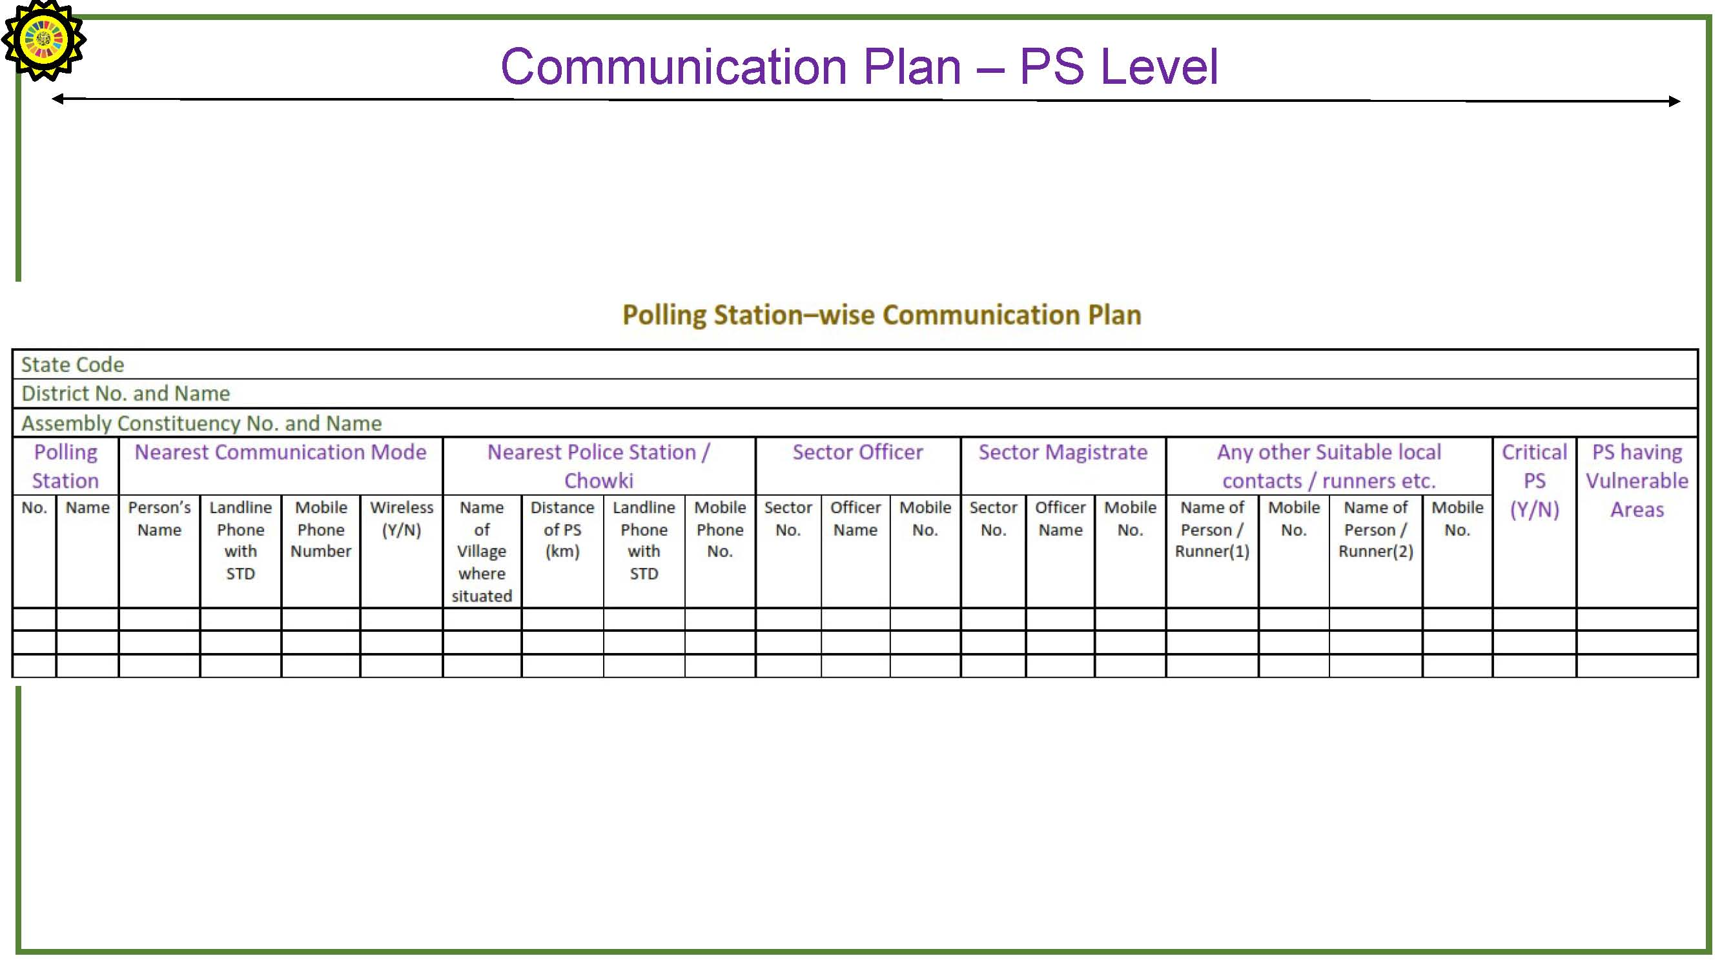

Slide 47
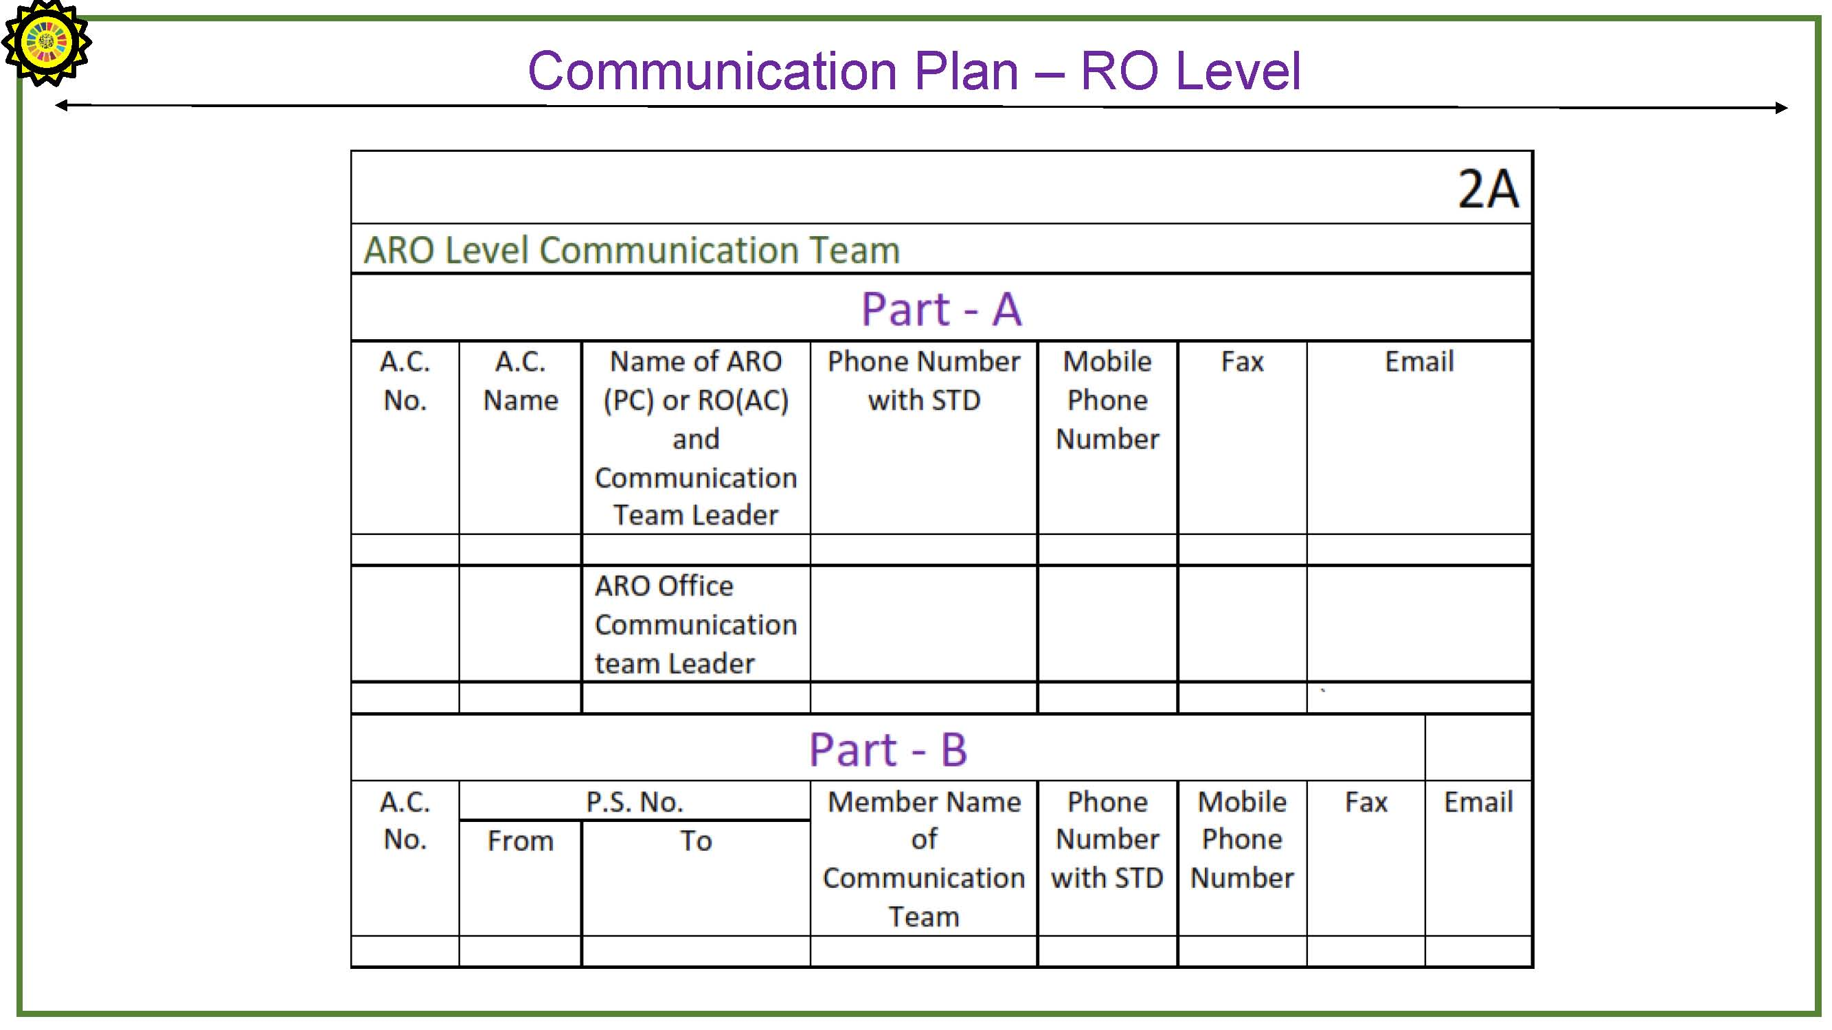

Slide 48
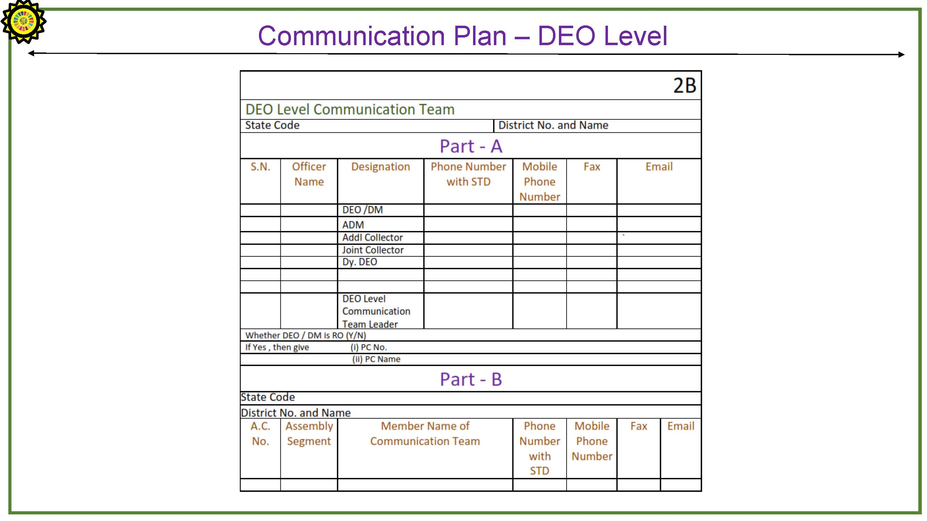

Slide 49
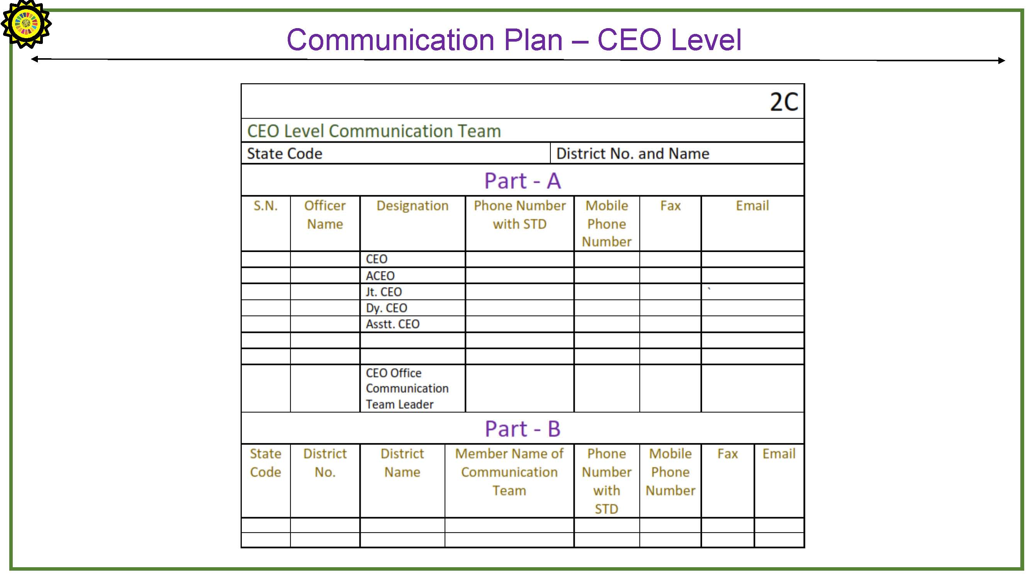

Slide 50
5. TRAININGS
&
WELFARE

Slide 51
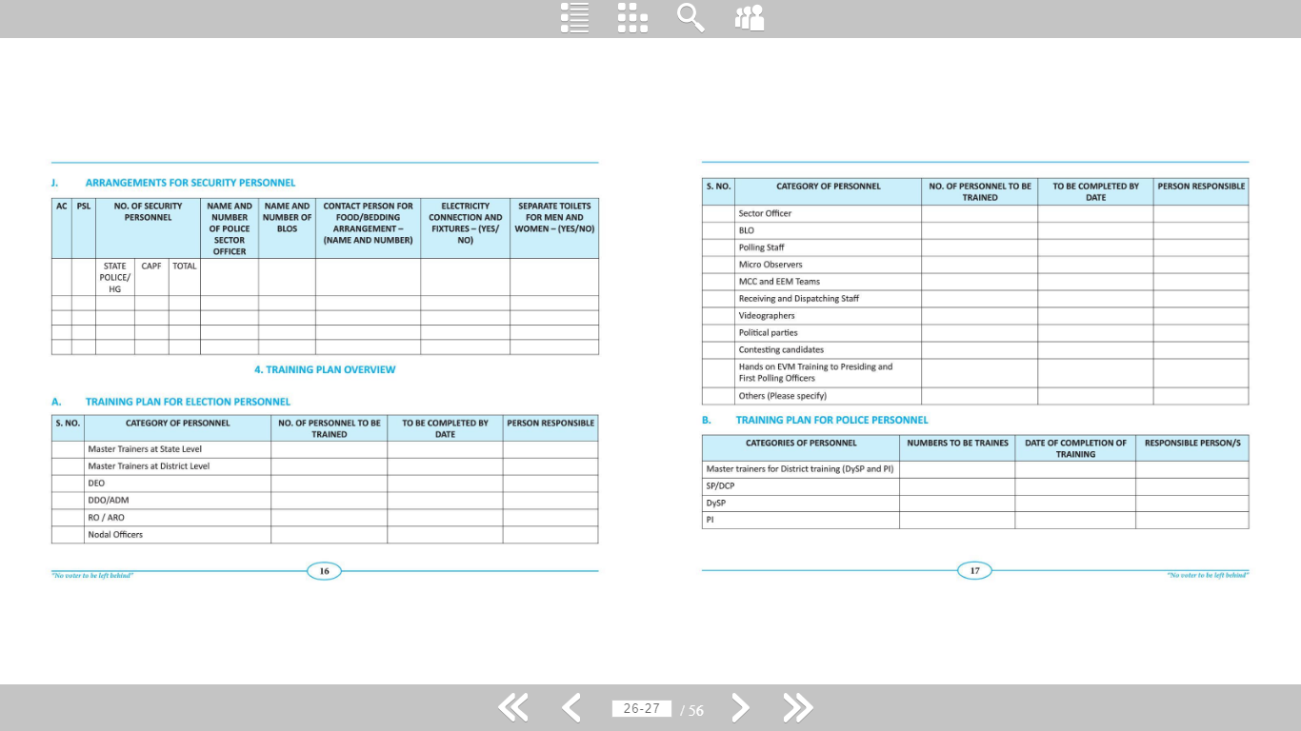
Training plan overview

Slide 52
Training plan overview

Slide 53
Training : polling personnel
DEO to ensure the following with respect to training:-
1-(EVMs)
Selection of venue for training
More emphasis should be given on ‘hands-on’ training rather than classroom lecture mode.
Postal ballot facilitation -centers to be setup at training centers for the benefit of polling staff.
Facilities at Training Centers – Proper facility should be ensured for the polling -staff, proper drinking-water facility, first-aid, medical and toilet- facility

Slide 54
Contd.
2-General (Non-EVM Training)
Facilitation center at training venue for postal ballot paper and EDC.
Duties of (PO,P-1, P-2, & P-3) polling personnel at polling stations.
Making them aware with procedure for challenged and tendered- vote.
Apprise all compulsory declarations to be made by PO at different times.
Polling Agents to be voter in same polling- stations.
PO – Not to go to voting- compartment to assist the voters.
Issues related to identification of documents of electors.

Slide 55
Training : S.O. & Other teams
“Well trained Sector officers can proved to be extended hands of RO”
Training rgrdng entire poll/counting process
Magistrarial traing too
Trainings to different teams like, SST, FST, VVT, EEM etc.

Slide 56
Micro – Observers
DEO to arrange :-
Appointment of Micro -Observers from the pool of Central Govt. PSUs in consultation with observer.
Training of Micro -Observers.
Nodal Officer for Micro -Observers at DEO Office.
Separate Route-chart & Transportation arrangements for Micro- Observers.
Integrating Micro -Observers with Communication Plan.
Briefing of Micro -Observers before sending them to Polling Stations by Observer (if possible)
Micro-Observers’ diaries to be scrutinized by Observers at the reception- centre.

Slide 57
Polling personnel welfare
DEO to ensure the following with respect to polling- personnel welfare:-
Appointment of nodal officer to coordinate and supervise polling personnel welfare measures.
Providing basic amenities at Training, Distribution, Reception, and Boarding venue : Drinking water, toilets, helpdesk, healthcare.
A senior officer to supervise transport facilities of the Polling- Personnel.

Slide 58
Contd.
Tracking of movement of Polling personnel for their safe return to the reception center.
Providing basic-amenities at polling stations: light, toilet, furniture, drinking water, food etc.
Making ex-gratia / compensation payment in case of any injury or death.
Issue of photo identity card to the polling personnel (Presiding Officers, polling officers, counting supervisors and counting assistants etc.) ECI Inst. No. 464/INST/2007/PLN-1, Dated 12.10.2007
Special care while classifying in case of women and physically handicapped persons & persons having mental disability.

Slide 59
: Staff welfare :

Slide 60
6. SVEEP

Slide 61

: Sveep :
Systematic Voters’ Education And Electoral Participation
SVEEP Plan
Identify low turnout PSs
Situation Analysis
IMF
Special campaign
Involvement of Media and CSOs
Involvement of Youth Organizations
Special measures to Females, PwDs, Marginalized groups, vulnerable
Roll of Booth Awareness Group

Slide 62
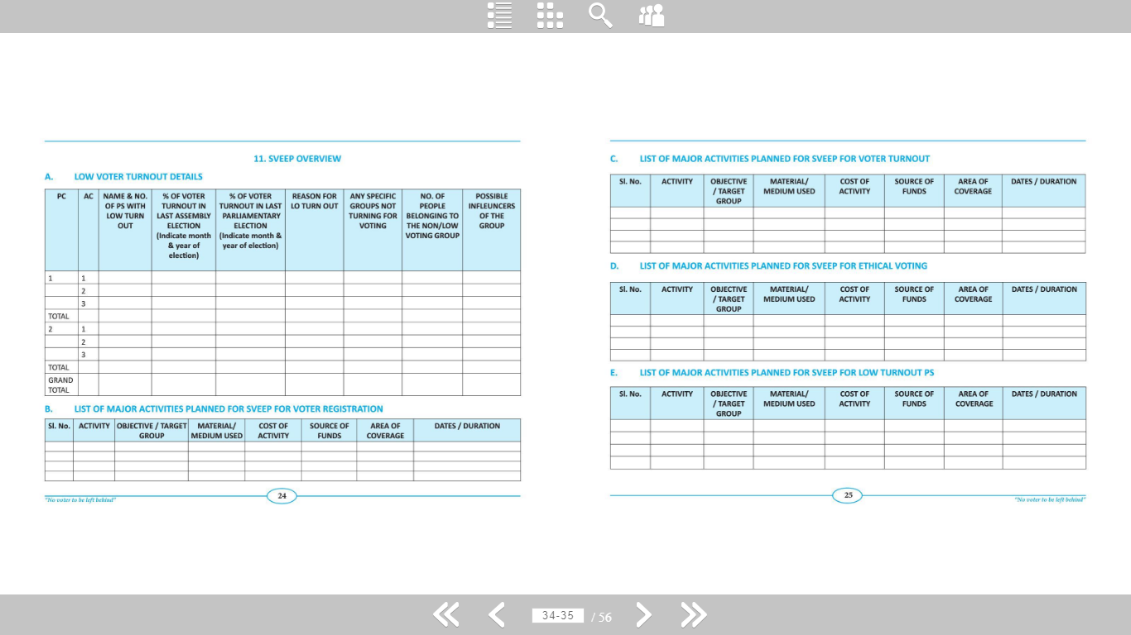
Sveep : overview

Slide 63
Sveep : overview

Slide 64
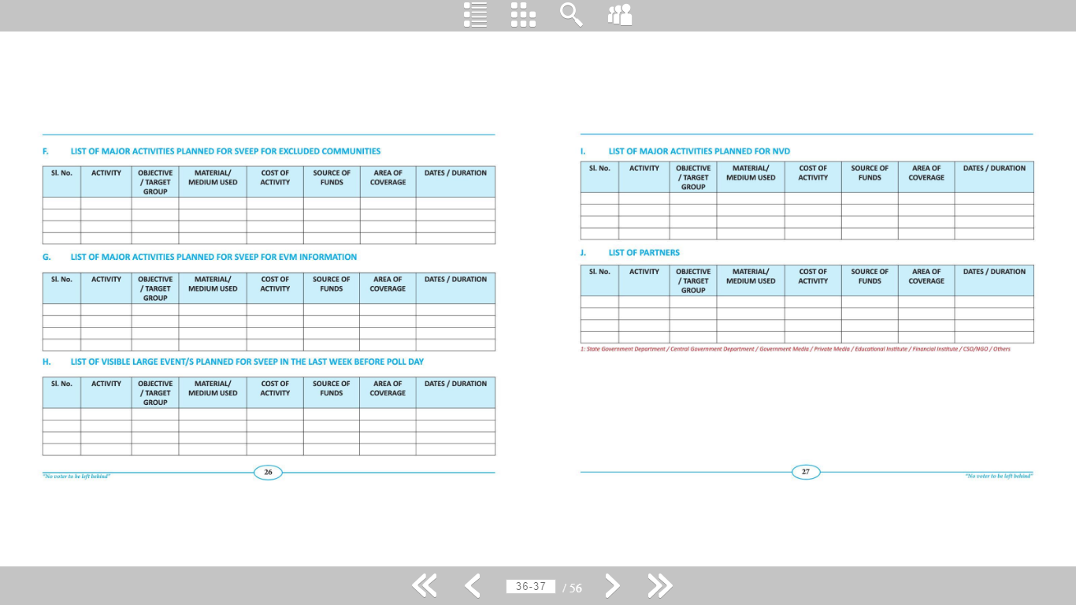
Sveep : overview

Slide 65
Sveep : overview

Slide 66
7. MCC &
EXPENDITURE MGMT

Slide 67
Declaration of the election and enforcement of model code of conduct
In Standing Committee, DEO will discuss the important circulars of the Commission regarding following subjects and enforce Model Code of Conduct for…
Prevention of defacement of property
Restriction on printing of pamphlets / Posters etc.
Tours of ministers
Restriction on presence of political- functionaries after the campaign-period is over
Complaint monitoring system concerning violations of Model Code of Conduct
Restriction on public meetings by ministers/political functionaries in Educational institutes
Restriction regarding govt. Vehicles/Buildings/Officials

Slide 68
Contd.
Use of loudspeaker for Election Campaign
Deletion of references of politicians/ministers on the official website
Permission for the use of vehicles by DEO/RO/Other Officers
Restriction on use of convoy of vehicles
Use of Helicopters during election
Advertisement on Radio & TV
Standing Committee meetings
Formation of Enforcement Squads
Videography of all major meetings, speeches and other important events.

Slide 69
Standing committee meetings
DEO to ensure :-
The standing committee meeting is held by DEO/RO at different stages of election, for example –
At the time of draft publication of the rolls
Before the final publication of the rolls
Preparation of lists of polling stations
To be organized at frequent intervals during conduct of elections.
To be used for informing the Candidates and representatives of various political parties about Poll schedule.
Eliciting their support in maintenance of law & Order
Seeking their co-operation in enforcement of Model Code of Conduct.
Not to be treated as mere formalities.

Slide 70
: Expenditure :
DEO to ensure :-
Monitoring of Expenditure from the date of filing of nomination
Inspection of Expenditure Registers every 3-4 days.
Dummy Candidates to be tracked.
Finalization of rate-charts of items of common use during campaign.

Slide 71
8. MEDIA -
COMPLAINT MONITORING

Slide 72
Media
DEO to ensure the following with respect to Media:-
Establishing a Media cell at the DEO office.
Appointment of one officer in DEO office as the Nodal Officer to interact with media .
Holding meeting with media 4-5 times during elections.
Allowing them coverage of nomination - filing
Keeping them briefed about time -schedule of various activities related with elections.
Encouraging them to report cases of violation of Model Code of Conduct by Govt. officers/Staff/Candidates /Political Parties.
Sharing important information like list of all Polling-stations, candidates contesting elections, Route chart, transportation arrangements .
Allowing coverage by media persons on poll day.
Allowing coverage by media persons on Counting day.

Slide 73
Complaint monitoring
DEO to ensure the following with respect to complaint monitoring:-
Appointment of a Nodal Officer in DEO office.
Appointment of an Inquiry Officer (Constituency wise formation of team comprising a Police and a Civil Officers and Videographer)
ATR to be communicated to the CEO office immediately by DEO.
Daily reporting of complaint- monitoring.
Complaints against Govt. officers/staff/candidates and political-parties to be attended promptly.
Complaints relating to violation of MCC to be attended promptly.

Slide 74
9. FORCE DEPLOYMENT
&
VIDEOGRAPHY

Slide 75
force deployment

Slide 76
force deployment and movement plan (CONFIDENTIAL)
Assessment of requirement of Police Personnel.
Availability of Police Personnel at the district level including special Armed Forces, Home guards, Forest Department, Excise Department personnel and Special Police Officers (SPOs)
Availability of Central Para-Military Forces (CPF)
Deployment of Police Personnel in consultation with the Observer.
Vulnerability mapping and Criticality of polling-stations to be kept in mind while deploying force.
Route - chart for movement of Police- personnel.

Slide 77
Use of videography and digital cameras during election
DEO should ensure the Videography of Critical Events – (with date & time) as follows:-
Violent-incidents
Booth-capturing
intimidation of voter
Riots
Meetings addressed/attended by Ministers
Visits of top National/State Level leaders of recognized parties
Important events such as Nomination, Scrutiny and Withdrawal of Candidatures
Preparation of EVMs by ROs
Closure of strong - rooms before taking out the EVMs for counting process etc…

Slide 78
10. POLL DAY / COUNTING DAY
ARRANGEMENTS

Slide 79
Poll day arrangements
A) Polling Station
Mock Poll in presence of Polling Agents and its reporting as well as certification by PO.
Sending periodical reports about poll %.
Reporting any untoward incident.
Electoral offences committed, adjournment of poll.
B) Sector Officers
Visit of all the Polling Stations, collection of Mock Poll Certificate.
Reporting of Commencement of Poll at the P.S.
Reporting of defective EVMs, making immediate arrangements in such polling stations.
Periodical reporting.
Reporting about close of poll.

Slide 80
Distribution centre & dispatch of polling parties
DEO to ensure:-
Training-facility at the dispatch-center, details of Training counters set up at the dispatch centre for ‘hands- on’ training.
Arrangements of distribution of Election material to the Polling -Parties including EVMs.
Briefing of Polling-Parties by Sector-Officers before their departure.
Sector-Officers informing Polling-Parties about the Bus numbers which they have to board.

Slide 81
Contd.
Boarding of vehicles by the Polling Parties.
Dispatch of Polling- Parties.
Facilities at Distribution / Dispatch centre : - Strong-room for EVMs and other Election material. Control-Room, Drinking-water, Toilets, Food-plaza, Proper barricading of Distribution counters, Medical Team.
Similar arrangements for Micro-Observers.
OK Report by Sector officers by 6.00 pm on day before the poll-day confirming RO that all polling parties have reached .

Slide 82
Reception centre
DEO to ensure :-
Facilities :- Proper lighting, proper barricading of reception-counters, control-room, drinking water, toilets, Food plaza, Strong Room for EVMs and other election material, Medical team.
Proper security, presence of Police personnel.
Provision for scrutiny of Form 17-A, P.O. Diary and other relevant documents in the presence of Observers.
Other facilities like telephone, FAX, internet, computer-section for data-feeding, separate room for Observers, DEO/SP, ROs .

Slide 83
Contd.
A separate special counter should be set up for
Receiving EVMs/VVPATs and other documents from the specific polling-stations about which complaints had been received from political parties / candidates during the course of polling;
Polling stations in which significant event such as violent-incidents, heated arguments with the polling personnel, clash between polling -agents, break-down of machines reported and where the EVM replacement had taken place .

Slide 84
CONTD…
C) AC/District
Communication Plan to be activated (DEO/RO Level)
Being in close contact with the Police Control Room.
Maintenance of Law & Order.
Replacement of defective EVMs.
Periodical reporting to the CEO.
Making arrangements for complaints handling.
Making arrangements for escorting of the polled EVMs back to reception centers.

Slide 85
Counting - centre
DEO to ensure :-
Selection of counting center in consultation with Observer and getting its approval from the Commission.
Facilities :- Proper lighting, uninterrupted power supply, proper barricading, Strong rooms, Drinking Water, toilets, Food plaza, Medical Team, Control Room.
Other facilities like Telephone, FAX, internet, Tabulation centers with computers, Separate room for Observers DM/SPs, ROs.
Proper security, presence of Police personnel.
Earmarking of rooms for particular ACs.

Slide 86
CoNTD...
Arrangements of tables as per Commission’s guidelines in the halls.
Arrangements for Counting Agents.
Arrangements for Food packets for Counting Staff and other officers on duty.
Media center to be established.
Separate arrangements for counting of P.Bs.
Display of votes of each round of counting on notice board.
Announcement of votes of each round of counting by Returning Officer.
Provision for sealing of EVMs and other election materials.

Slide 87
Counting
DEO to ensure proper arrangements for…
Counting of votes
Display of round - wise result &
Declaration of result at counting center

Slide 88
: Miscellaneous :

Slide 89
Sending various statistical information and reports to the CEO
DEO should ensure timely Reporting / Info. related to..
Nomination
Polling personnel
Counting center
Mock poll certificate
Poll percentage on poll day
Counting day information such as results in format 21C, 21D and 21E
Other information such as Index Card, Form 20, RO Report, Check-list, Check Memo etc.

Slide 90
New: Covid-19
Tie-up with Health Deptt for thermal scanning and voting of positives & suspects in the last hour
Covid material procurement: masks, shields, gloves, kits, thermal scanners, soap/sanitizers for polling staff and public.
Postal-ballots to the 3 categories : PWD, 80+ and covid-affected.
Checking of polling -stations for covid precautions-physical distancing.
Training : additional inputs on covid varying from State-to-state.

Slide 91
Contd…..
Miscellaneous :
Printing & material procurement: preparing panel of suppliers instead of L1-bidder.
Food: panel of caterers: smaller operation area, written permission to men & vehicles, local arrangements-lead time, sector-officers to have dry food-stuff, also at dispatch & reception centre.
Videography: panel instead of L1-bidder, rate for 24 hours, also to do photography, may be two persons or one.
Area-wise retainers or panel of electricians, plumbers, carpenters, tank-cleaners etc. – Education Deptt, Panchayats, Panchayat Secretary and Patwari to ensure repairs .

Slide 92
conclusion
DEMP or ACEMP Involves meticulous planning that is necessary in the run up of elections to ensure that all the components are delivered on time to achieve a hassle free conduct of election. It is not a mechanical activity, rather involves deep thought process.

Slide 93
!! THANX !!
Regular : 9978406510
Whatsapp : 9904082842

