Slide 1

MCC
Relaxations/Violation
Presented by Santosh Pathariya

Slide 2

How to access MCC Portal?
MCC Portal is integrated with cVIGIL Application
Web Application (Desktop/Laptop)
Go to https://cvigil.eci.gov.in/
Enter username (Mobile number)
Click on Send OTP or login with password

Slide 3
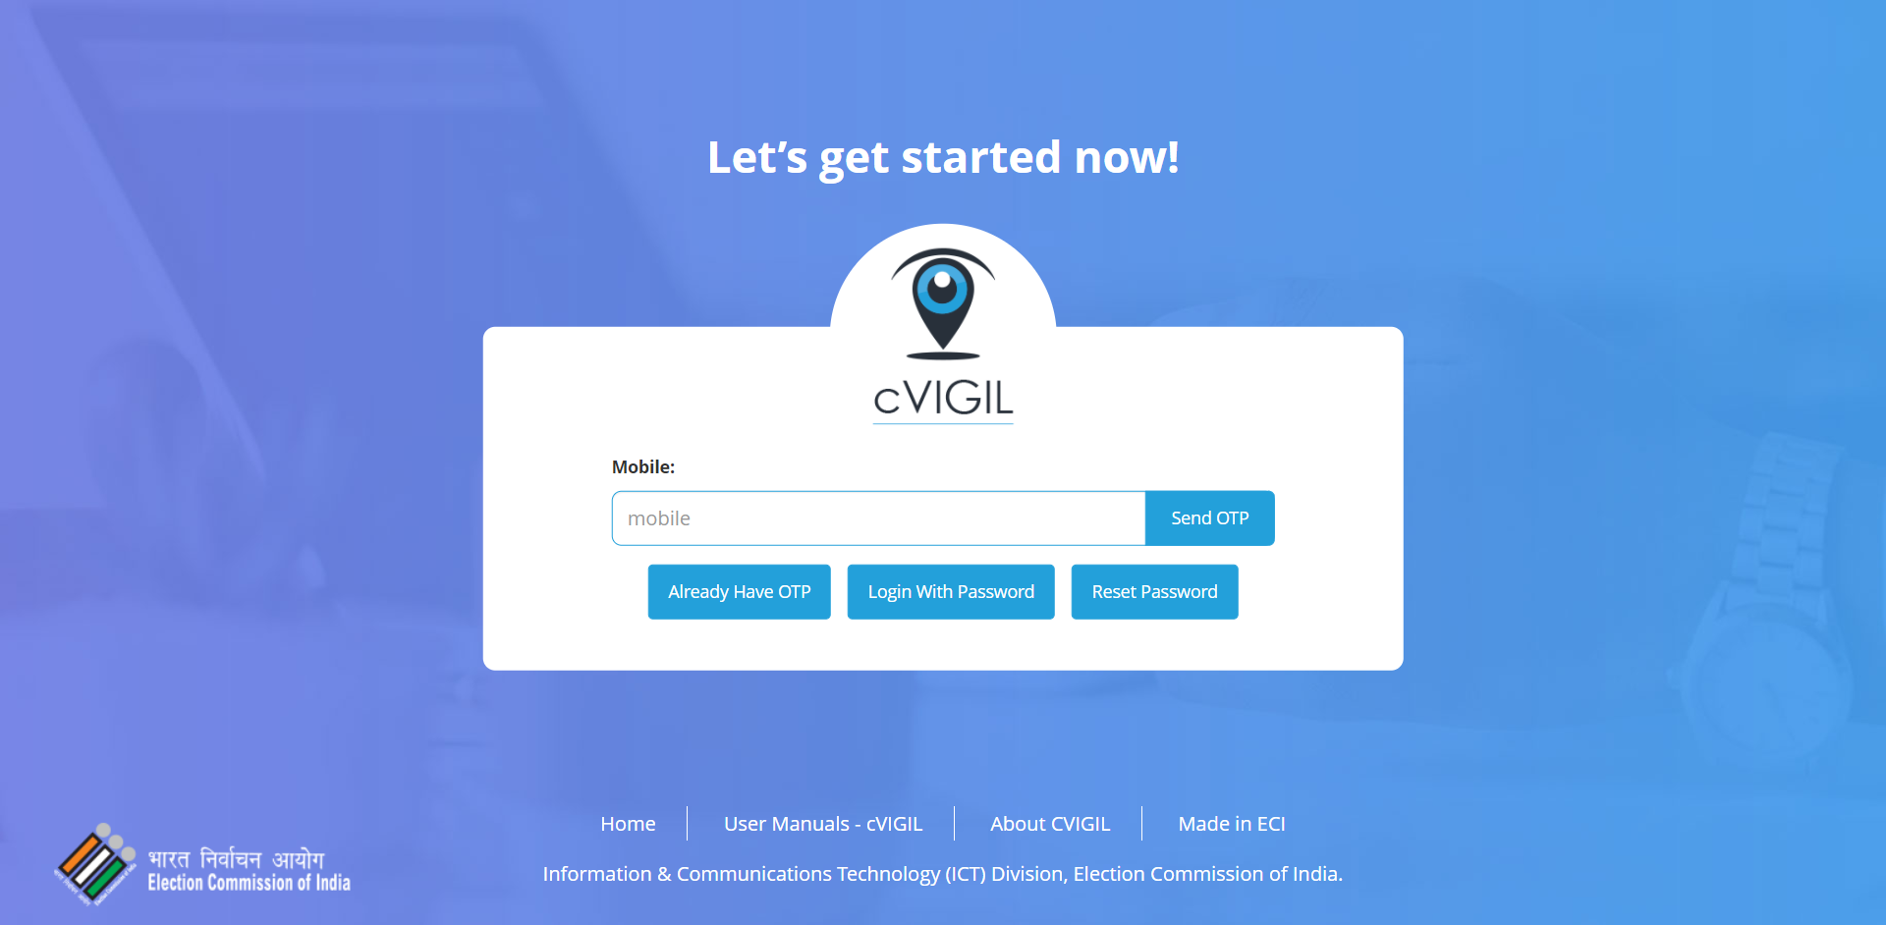

Slide 4
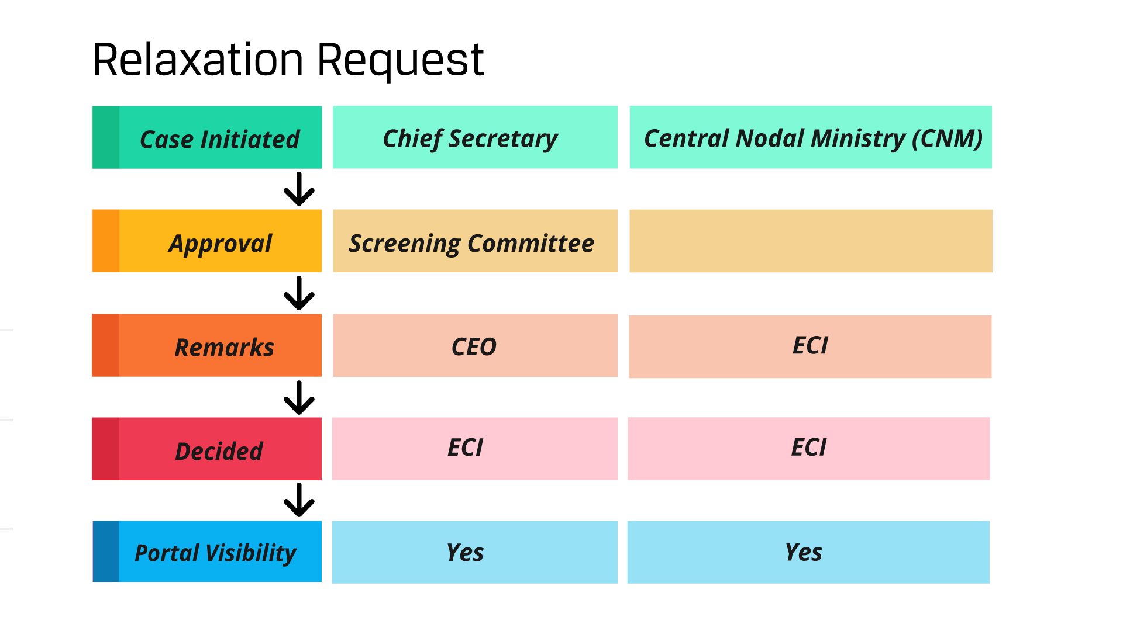

Slide 5
Relaxation Request
Chief Secretary/ Nodal Secretary
State Ministry/Department/PSU
Date of Proposal
Gist of Proposal
Date of meeting of screening committee minutes
Members of Screening committee
Recommendations of the screening committee
Date of approval of competent authority for proposed scheme plan
Whether public interest involved (inevitability of proposal)
Urgency of proposal (Why it should be uploaded now?)
Will it affect Level Playing Field, if no why?
Whether commission's approval is required for this proposal

Slide 6
Relaxation Request
Upload
Covering Letter
Screening committee minutes with analysis
All support documents
Stages:
New
Initial Scrutiny
Further Details Called
Under Examination
Decided
CEO Recommendations

Slide 7
Relaxation Request
Central Nodal Ministry (CNM) Data Entry
Central ministry/ department/ PSU
Date of proposal
Gist of Proposal
Proposal details:
Date of initiation of proposal
Public interest (inevitability)
Urgency of proposal
Level playing field (Will it affect level playing field by giving undue advantage to political party)
Date of recommendation of the secretary
Upload
Proposal of Organising department

Slide 8

TODOs
Review all cases with status to “Proposal to ECI”
Print and Put it on green file
Covering Letter
Screening committee minutes with analysis
All support documents)
Take the approval
Upload Decision letter
Update Status

Slide 9
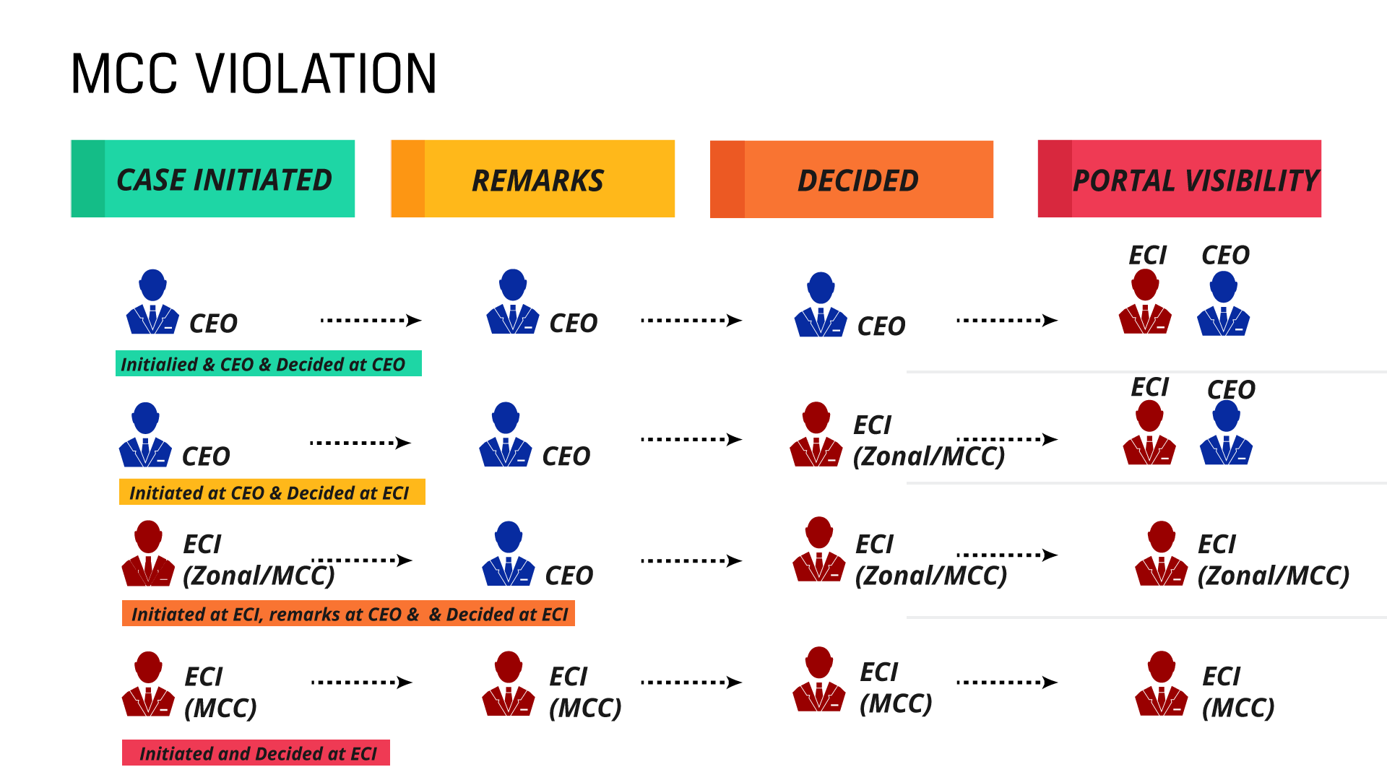

Slide 10
MCC Violations
Source of the complaint
Written Complaint
cVIGIL / Enforcement Team
1950/ Control room/ Phone
Media/press
Others
Type of Complaint
Initiated at State level and decided at state level
Initiated at State Level and Decided at ECI Level
Initiated and Decided at ECI level

Slide 11
Initiated at State level and decided at state level
State level political functionaries
State star campaigner
State ministry/deptt/PSU
State level Govt Officials and Govt. Organizations
NGO/ Individuals
To be filled and updated by CEO on continuous basis
Access:
CEO
MCC Incharge/ Deputy/Joint/ Adll CEO
Technical person

Slide 12
Initiated at State Level and Decided at ECI Level
National level political functionaries
National star campaigner
Central ministry/deptt/PSU
National level Govt Officials and Govt. Organizations
NGO/ Individuals
Reference will be initiated by State CEO where only one state is involved and by ECI where more than one state is involved.
To be filled by:-
CEO of the state - Where the incident/ violation has occurred
Zonal Division - for National level political functionaries including ministers/ CPSUs/ Central Govt - Officials/ Organizations/ NGOs/ Individuals for complaints concerning with national parties in the concerned state.

Slide 13
Initiated at State Level and Decided at ECI Level
MCC Division - for Central Ministries/ PSUs/ Central Govt - Officials/ Organizations/ NGOs/ Individuals for complaints concerning with national parties where more than one state is involved.
Access:
CEO
Zonal Division Incharge/ DEC/ Principal Sec/ Sec/ Under Sec
SO/ ASO/ Incharge of the state
All information should be entered in real time as soon as the stage occurs and information be uploaded. Overall responsibility for updation is of 2nd number in the Access list.

Slide 14
Initiated and Decided at ECI Level
National level political functionaries
Central ministry/deptt/PSU
National star campaigner
National level Govt Officials and Organizations
NGO/ Individuals
To be filled by:-
Zonal Division - in case of incident/ violation happened in their state jurisdiction
MCC Division - for central ministries/ PSUs/ Central Govt/ Officials/ Organizations/ NGOs/ Individuals for complaints concerning with national parties
Access:
Zonal Division Incharge/ DEC/ Principal Sec/ Sec/ Under Sec
SO/ ASO/ Incharge of the state

Slide 15
Categorization of Complaints
Categories | Filled by
National level political functionaries including ministers - Single State | ECI - Zonal Division
National level political functionaries including ministers - Multiple State | ECI - MCC
CPSUs - Single State | ECI - Zonal Division
CPSUs - Multiple State | ECI - MCC
Central Govt - Officials/ Organizations/ NGOs/ Individuals - Single State | ECI - Zonal Division
Central Govt - Officials/ Organizations/ NGOs/ Individuals - Multiple State | ECI - MCC

Slide 16
General Form
Source of Complaint
Date of Complaint
Name of the Complainant
Date of Occurence of MCC Violation
State
District
Area/ Place of the complaint
Name of the Person/ Party/ Organization
Gist of the Case
Upload Complaint

Slide 17
General Form Contd..
Present Status
New
Initial Scrutiny
Notice Served
Upload Notice
Date of issue of the Notice
To Whom
How many days have been given
Special Comment
Notice Reply Received
Yes (Upload Notice Reply Received)
No

Slide 18
General Form Contd..
Decided
Upload Decision
Gist of the Decision
Cancelled
Special Comment

Slide 19
Queries
?

Slide 20
Thank You

