Slide 1
Model Code of Conduct (for conduct of free, fair and peaceful elections)
Presented by
Satrughna Kar, NLMT
@Addl. CEO , Odisha

Slide 2
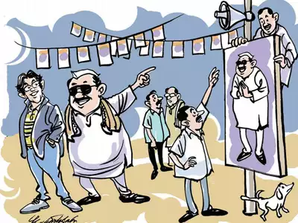
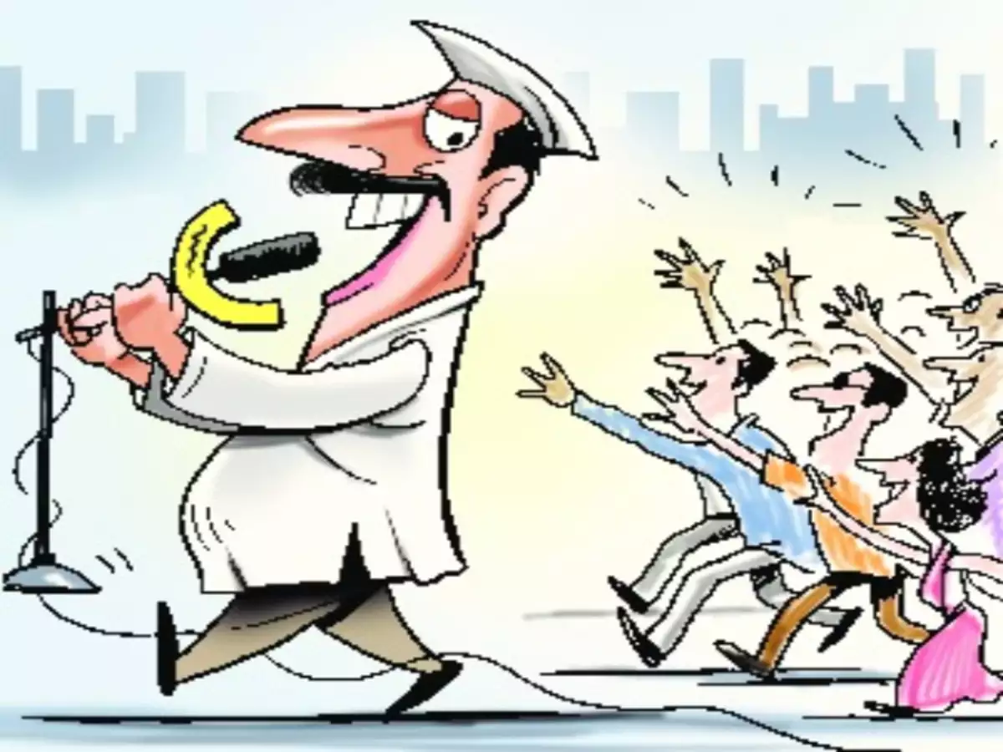
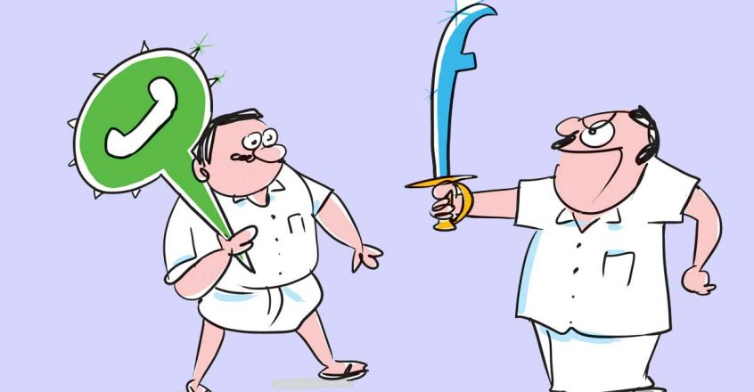
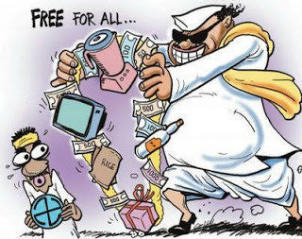
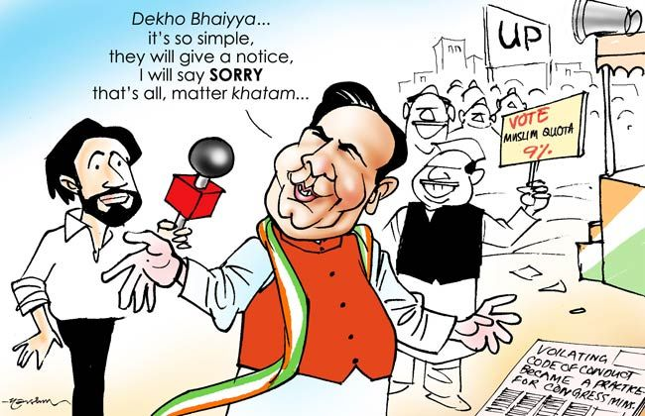
Ye sab kya hai Bhai !

Slide 3
EXPECTED LEARNING OUT COMES !!!
What is MCC ,Broader Objectives ,Key Provisions
WHEN - Period of Enforcement
WHERE- Extent of Application
WHO - Authority to implement
Legal Standing ?
HOW - Enforcement
***Special provisions during COVID-19

Slide 4

What is Model Code of Conduct (MCC)
A set of norms for guidance of political parties and candidates. Also covers the Public Servants.
Aim - conducting free and fair elections
Objective- to provide a level playing field for all parties and contesting candidates
Enforced by the Election Commission of India.
Evolved with the consensus of political parties*
(*one good contribution of the political parties in nation building)

Slide 5
Mile stones in the Evolution of MCC :
2001- EC and Union Government agreed for * Enforcement of MCC from date of announcement of election schedule. ** Max gap between announcement and notification 3 weeks .
1991- consolidated code enforced by EC, implemented (Seshan Era :1990-96)
1960. Adopted for the first time in Assembly Elections of Kerala
1962, third General Election, accepted and implemented by political parties to large extent as circulated by EC
In the present day Not only the political parties and candidates but also the public servants are under the ambit of ECI.
2014- Election Manifestos brought into the key provisions of MCC , included as 8th Para (Ref- Subramaniam Balaji case of TN )

Slide 6

Key provisions of MCC
The eight paras / provisions :-
General Conduct
Meetings
Processions
Polling day
Polling Booth
Observers
Party in power
Election manifestos

Slide 7
Period of enforcement –
General Elections to Loksabha / Assembly | Till completion of election process after declaration of results* *Ref-Commissions L.No.437/LA/2017(policy) Dated25.02.2017 to all CSs and CEOs
Bye-Elections | Till declaration of results Only

Slide 8
Extent of Application of MCC-
In General Election to Lok Sabha | Throughout the country
In Elections to Legislative Assemblies/Councils, | Within the State concerned.
During bye-elections | Applies to whole district(s) consisting of the constituency where bye-election is being held. In case of State capital/metropolitan cities etc. it may be restricted to AC/PC only.

Slide 9
Legal standing of MCC ?
But can be enforced through corresponding provisions in
Corrupt Practices and Electoral Offences in connection with
Elections under RPA-1951 [ Corrupt Practices- S. 123
& Electoral Offences- S. 125 -136 ]
MCC not enforceable by law !
Code of Criminal Procedure, 1973 and
Representation of the People Act, 1951
Indian Penal Code, 1860,

Slide 10
Corrupt Practices : | Under RPA-1951 | Electoral Offences | Nature of offence/ punishment
Bribery: Gift, gratification or promise to stand or not to stand , to vote or not to vote, | Sec.123(1) | 171B & 171E of IPC | Non-cog, Imprisonment upto one year with fine or with both
Undue Influence: (i)Threatening of injury or social ostracisation and excommunication from caste/community (ii) threat of Divine Displeasure/ Spiritual Censure | Sec.123(2)a(i)&(ii) | 171 F of IPC | -ditto-
Appeal to vote or not to vote on grounds of race, religion, community, language , religious/national symbols etc. | Sec.123(3) of
Promoting Enmity between classes ; aggravate mutual hatred or cause tension between different castes and communities, religious or linguistic-; prejudicial to Election prospects of a candidate | Sec. 123 (3A) of | Under Sec.125 of RPA 1951 | Imprisonment upto 3 years , or with fine, or with both

Slide 11
Corrupt Practices : | Under RPA-1951 | Electoral Offences Under Section | Nature of offence/ punishment
Providing illegal conveyance to voters for voting in favour of a candidate | Sec.123 (5) | sec.133 of RPA | Imprisonment upto 3 moths or with fine or with both
Incurring or Authorising Expenses beyond limits fixed under Sec.77 | Sec.123(6) | 171 H of IPC | Fine upto Rs.500
Aiding,Abetting,Taking help of Government servants as Election Agent for furtherance of once electoral prospects… | Sec. 123(7) |  | Imprisonment upto 3 moths or with fine or with both
Booth Capturing by candidate/agent/any other person | Sec. 123(8) | Sec.135A of RPA-1951 | Cognisable, 3yrs to 5yrs with fine

Slide 12
Electoral Offences | Under section RPA-1951 | IPC-1860 | Nature of offence/ punishment
Intimidation of voters | Sec. 135A (C) |  | Cognisable 3-5 yrs and with fine
Impersonation of voters |  | Sec. 171 D
Canvassing within 100 meters of polling stations | Sec. 130 |  | Cognizable Punishable with Fine upto Rs.250/-only
Holding of public meetings during the period of 48 hours ending with the hour fixed for the close of the poll | Sec. 126 (1)

Slide 13
Electoral Offences | Under section RPA-1951 | IPC-1860 | Nature of offence/ punishment
Printing of Pamphlets , Posters etc. without name and address of publisher and printer on the face . | Sec. 127-A |  | Term upto 6 months , Fine Rs.2000/- or both
Govt Servants like DEO/RO/ARO/Pr.O etc. working for furthering prospects of a candidate | Sec. 129 |  | COGNIZABLE Six months , Fine or with Both
Misconduct at Polling Station Repeated disobedience to Presiding Officer after removal in Polling booth on Poll Day during polling hours | Sec. 132 |  | COGNIZABLE Three months , Fine or with Both
Non-Mainetance of Secrecy of sVoting | Sec-128 |  | Upto 3 years with fine or both

Slide 14
Electoral Offences | Under section RPA-1951 | IPC-1860 | Nature of offence/ punishment
Creating obstruction at Election meetings (between notification and poll day) | Sec. 127 |  | Cognisable Upto Six months, fine Rs.2000/-or both
Serving or distributing liquor on polling day and during the 48 hours preceding it | Sec. 135 (c)
Filing of False affidavit during Nomination (Ref-sec.33-A) | Sec.125-A |  | Imprisonment upto six months , with fine
Conducting EXIT POLL (on day of Poll- from beginning of poll till half an hour after close of poll) | Sec.126 |  | Two years / fine or both

Slide 15
OFFENCES RELATING TO ELECTIONS ( All offences triable by JMFC and Bailable),
Offence | Section | Punishment | Cognizable or non-cognizable
Bribery | 171E IPC | Imprisonment for 1 years, or fine, or both, or if treating only, fine only. | Non-cognizable
Undue influence at an election | 171F IPC | Imprisonment for one year, or fine, or both. | Non-cognizable
Impersonating at an election |  | Imprisonment for one year, or fine, or both | Cognizable
False statement in connection with an election. | 171G IPC | Fine | Non-Cognizable
Illegal payments in connection with elections. | 171H IPC | Fine of 500 rupees | Non-cognizable

Slide 16
Why the Election Commission has argued against making the MCC legally binding;
As these provisions already exist in the statutes, no purpose would be served even if Model Code is given legal status.
Aggrieved person/political party may take legal recourse under the relevant laws in relation to any of the above malpractices
Elections must be completed within a relatively short time (close to 45 days), and
judicial proceedings typically take longer, therefore it is not feasible to make it enforceable by law.

Slide 17
MCC is self-regulatory:
The general perception about the MCC is that the code is self-regulatory and given to themselves by the political parties but the fact is that its violation largely attracts penal action.
The Election Commission of India is empowered under para 16A of the Election Symbols (Reservation and Allotment) Order, 1968 either to suspend or withdraw the recognition of party after giving that party a reasonable opportunity to defend itself in the event of violation of Model Code of Conduct.

Slide 18
ECI’s Jurisdiction on MCC:
ECI a quasi-judicial body in the matter related to election and election disputes.
Its decision is subject to Judicial Review by High Courts and the Supreme Court while acting on election petitions.
The jurisdiction of High Court under Article 226 and 227 is excluded during election period in view of Article 329 (b) of the Constitution.
By judicial interpretation, the word ‘election’ under Article 329 (b) connotes the entire election process commencing with the issue of notification calling the electorate to elect their representatives and culminating with the declaration of election result.

Slide 19
SPL Measures taken by ECI to enforce MCC : Model Code related directions shall be issued only by ECI
A clear cut protocol of communication between ECI and Union Government on Model Code:
Cabinet Secretary or Committee of Cabinet shall coordinate references from various departments of Union Governments.
Subordinate offices/PSUs to make references through their main Ministry.
In State Governments:- Screening Committee headed by Chief Secretary and consisted of
1. Secretary/Pr. Secretary of Co-ordination Department
2. General Administration Department and
3. Secretary/Pr. Secretary of the Department concerned for sending the proposal for approval of ECI through CEO of the State

Slide 20
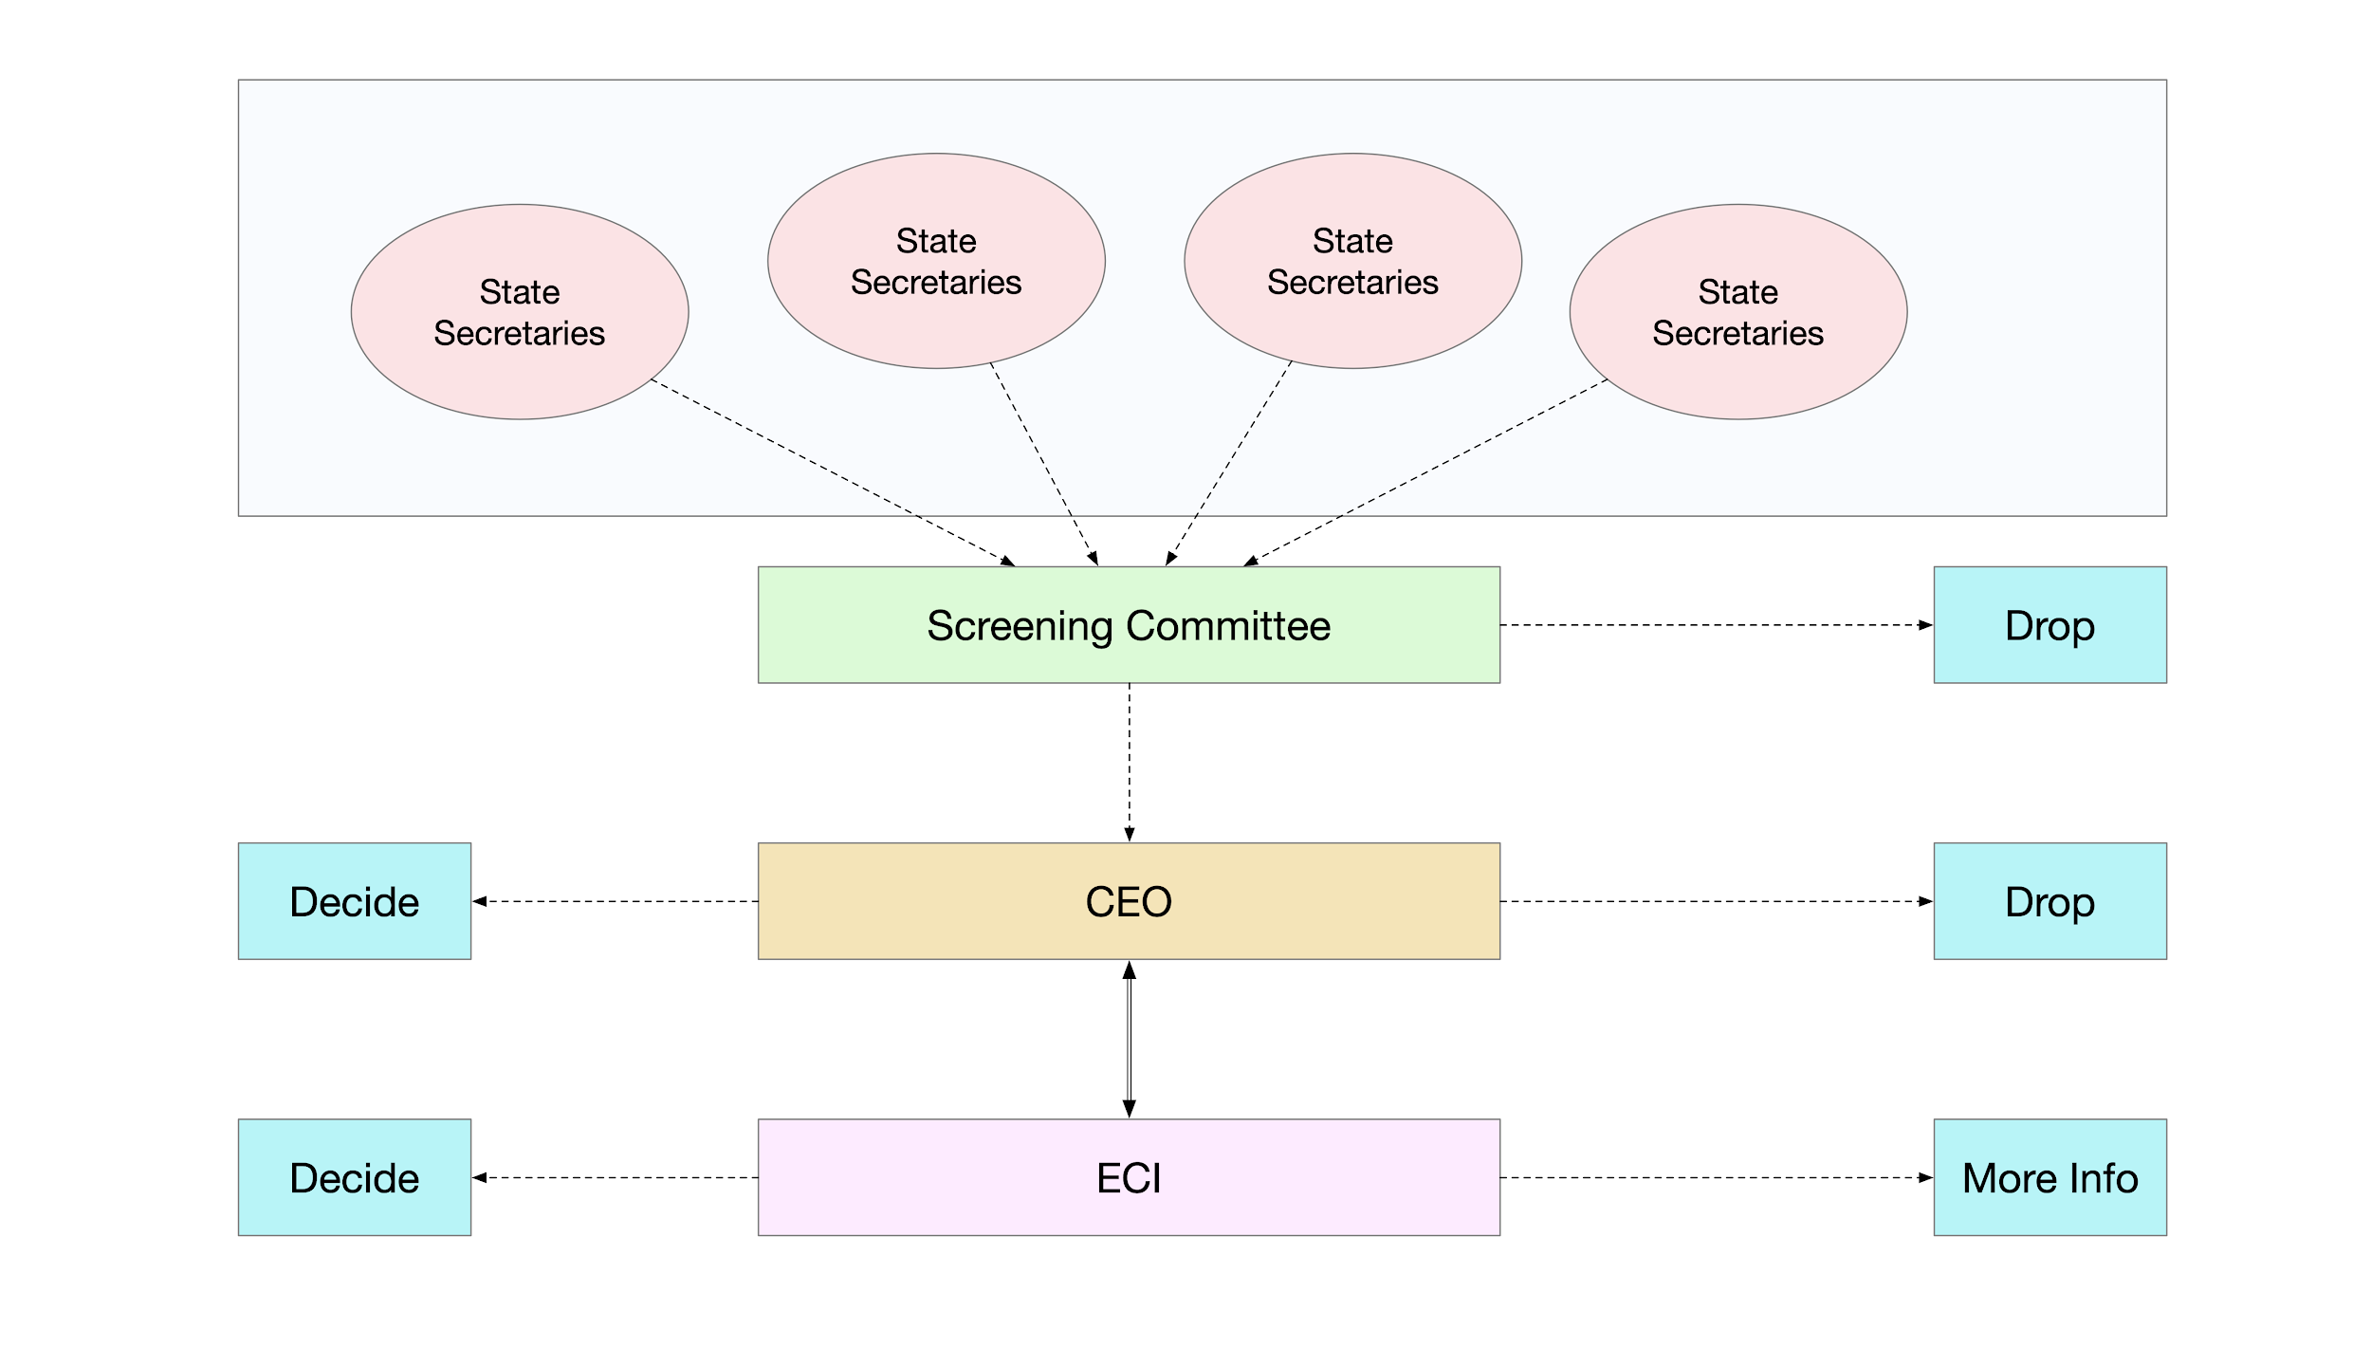
MCC Relaxation Process Flow
MCC Relaxation Process Flow

Slide 21
MCC Relaxation to be considered by ECI :
CEO shall forward only such proposal which have been cleared by Screening Committee, with his specific comments to the Election Commission.
The concerned department shall send the original file to office of the Chief Electoral Officer but only a self-contained reference be sent through Screening Committee with note of urgency as to why the matter cannot wait till MCC period is over.
Chief Electoral Officers shall not send any reference to the Election Commission in cases where clear cut instructions exist to deal with.

Slide 22
Broad areas of application of MCC – HOW ?
MCC on Government Officials : Officials should not only remain impartial but appear to be impartial
Starting with DGP all Police officials associated with election are deemed to be on deputation* to the ECI .
(Sec 28A of RPA 1951)*From Notification of Election to declaration of result.
Transfer/Posting-Ban on transfer of officials involved in election work in any capacity without Commission’s prior approval till completion of election process.
Officers not allowed to continue in present posting ; under home district and 3 out of 4 years criteria in the district
In case of Bye-Elections – cut off date is date of occurrence of the casual vacancy plus 6 months ; on the last day of which if the officer completes 3 years also she/he will be transferred.

Slide 23
No officer shall be associated with election if a criminal case is pending.
MCC ; Shall cover not only officers appointed for specific election duties like DEO, Dy DEO, RO/ARO/ERO/AERO, Nodal Officers of any specific election works but also district officers like ADM, SDM, Dy. Collector/Joint Collector, Tehsildar, BDO or any other officer of equal rank directly deployed for election works.
Applicable to the police department officers of Sub Inspector and all above rank or equivalent ranks, who are responsible for security arrangement or deployment of police forces in the district at election time.
The Police Sub-Inspectors and above should not be posted in their home district.
If a police sub-Inspector has completed or would be completing a tenure of 3 years out of four years on or before the cutoff date, in a police sub-division, then he should be transferred out to a police sub-division which does not fall in the same Assembly Constituency. If that is not possible due to small size of district, then he/she should be transferred out of the district.
A sub inspector in-charge of Thana is covered by this instruction and to be transferred out of district.
In case of metrocity, having less number of districts, territorial consideration may be sub-division in place of district.

Slide 24
Exempted Categories- Police officials posted in functional departments, doctors, engineers, teachers, principals, sector officer/zonal megistrate, officers posted in state headquarters of the department, officers due to retire within next 6 months.
Consultation with CEO must and copy of each of the transfer order to be given him.
Conduct of officials :
No meeting/VC with Ministers/Political functionaries on private tours/visits
Restrictions on tour/leave of officers whose spouses are active in politics

Slide 25
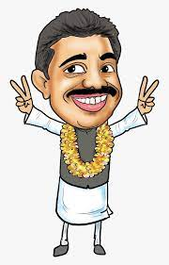
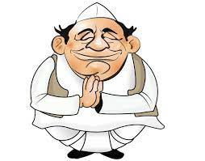
MCC on Political parties and candidates : Advisory on do’s and don’ts for electioneering. (Ref. Letter No.464 Dated 07.01.2007 of ECI)

Slide 26

MCC on Ministers/Chairmen/Members of Commission
No Government official will be called for a meeting
No arrangements on private meetings by Government servant
Expenses on private meetings/journeys will be borne privately.
An official tour shall not be mixed with private tour
No owners at any Republic Day function
Ban on use of official vehicles/pilot car for campaigning-
No beacon lights.
CM/Union Cabinet Minister allowed only one non-gazzetted personal staff during their visits
PM is exempted from above restrictions , as covered under Blue Book of the Union Government .
Meetings/Tours on emergent situations in Constituency allowed
No sanction of grant/payment out of discretionary fund.

Slide 27
MCC for Political Parties/Candidates
Criticism to be confined to policies/programmes/past record of rival candidates/ parties.
No criticism of private life/unverified allegations.
No appeal to caste/communal feelings.
Corrupt practices like bribery, intimidation, impersonation, canvassing within 100 meters of polling stations, holding public meetings during the period of 48 hours, transport/conveyance of voters to and fro polling stations should be avoided.
No political person should continue to stay in the ban period of 48 hours in the AC if not a voter of that AC..* Interesting case study of a leader who stayed during ban period citing health reasons and was subjected to 24x7 surveillance by the SST besides facing the medical board.
No picketing/demonstration in front of houses of individuals
No use of any individuals land/premises for election hearing without his permission
No obstruction in meetings/processions organized by other parties
Holding of meeting/rally/loud speaker/vehicles/public grounds/guest house with proper permission from concerned Government department.

Slide 28


MCC for use of vehicles :
No official vehicles for campaigning .
Max 3 vehicles in 100 mtrs of RO/ARO office during filing of Nominations.
( 2 vehicles during COVID)
No limit for own vehicles of candidate for electioneering purpose
details of all such vehicles to DEO for expenditure monitoring
Max 3 vehicles allowed on poll day for an MLA candidate.
*For LokSabha Candidate - 2 plus no. of assembly segments in the PC

Slide 29
No requisition of campaign vehicles of candidate
Candidate’s vehicle permit cannot be used by others in his absence.
Max 5 persons including driver can accompany the candidate. In default vehicle to be taken out of campaign exercise and shall not be used further in campaign. S.171 H of IPC 1860
Recognized political parties may be given permission for one vehicle per 25 ACs for distribution of publicity materials to their offices.

Slide 30
MCC for use of vehicles :..contd.
Vehicle permit for district officer bearers of recognized political party (ECI letter No. 464/INST/2011-EPS Dt. 23.03.2011)
From DEO
For visit to multiple ACs within the District
permit shall be in the name of the person, having registration No. of the vehicle.
The expenditure on this vehicle shall be booked/distributed in the election expenses of the party’s candidate(s) of the district where they have visited.
This permit should not be used for travel in other districts.

Slide 31
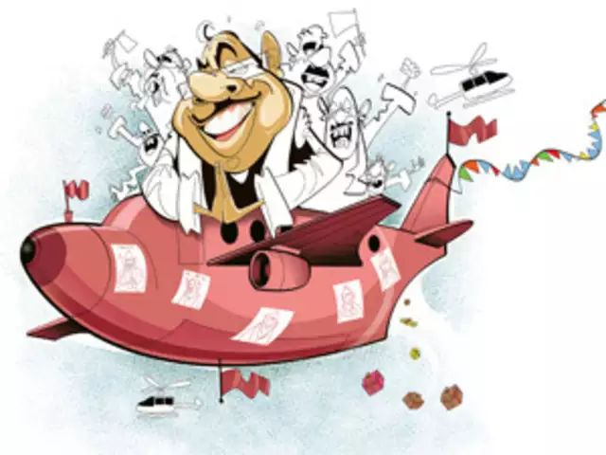
MCC on Use of Helicopter/Aircrafts
Exception:– Prime Minister ,
for security Reasons as covered under Blue Book .
Restriction on use of Air crafts and Helicopters owned by Government/ PSUs by Political Functionaries including Chief Ministers.
Hiring of private air crafts / helicopters allowed with proper account keeping by Political parties/Candidates .
Political parties to intimate three days in advance, regarding their itinerary and the details of persons who will travel and the materials that will be carried in the helicopter/aircrafts
DEO to maintain logbook and report on daily basis to CEO under intimation to Commission on such flights.

Slide 32
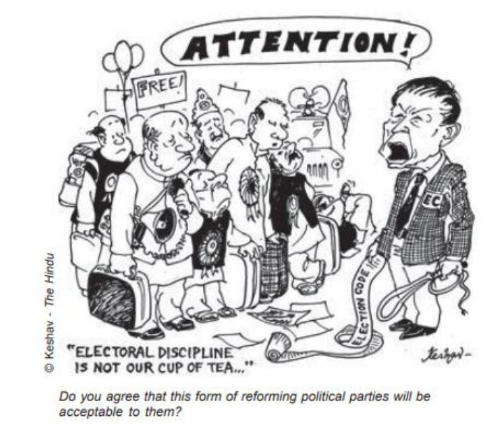
MCC on Printing of Pamphlets , Surrogate advertisements , Traceable advertisements , PAID NEWS :
Name and address of Printer & Publisher on face of the advertisement. Contravention will attract penalty of imprisonment upto 6 months or fine upto Rs.2,000/- Under S.127A of RPA 1951
Surrogate Advertisement or Paid News – Aims at promoting Election Prospects of a particular candidate ; expenses to be booked in the account of the candidate if done with permission/ authority from the candidate.
If done without written authority of the candidate S. 171 H of IPC,1860

Slide 33
MCC on Multimedia campaigns / advertisements – Media Certification and Monitoring Committees (MCMC)
Content of Advertisement to be pre-certified and approved at district and State Level Committees as per the requirement.
Application by registered Political parties not later than 3 days prior to the date of telecast of the Advt..
For Unregistered Political Parties/ candidates not later than 7(seven) days .
First approve the transcript, get it vetted by the MCMC and then submit the Final product in Electronic form.
State Level MCMC in the o/o CEO – Chaired by Addl.CEO/Joint CEO, RO of any PC of the State capital and one expert on media matters not below the rank of Class –I officer of Ministry of I & B members.
Appeal to be heard by the Committee headed by CEO.

Slide 34
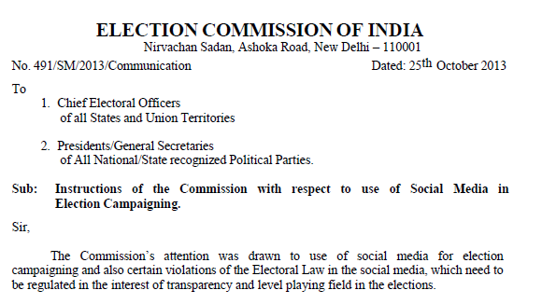
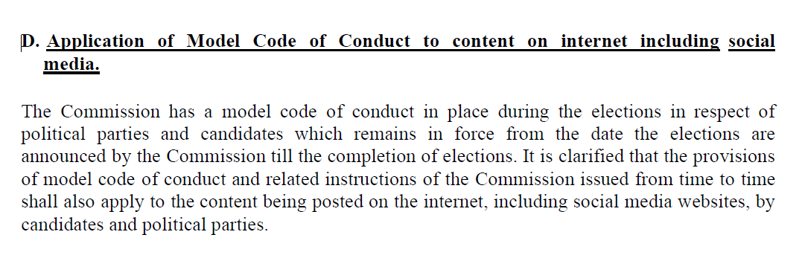

Slide 35
MCC for State/Central Government :
Announcement of new project/programme/financial grant which have effect of influencing the voters is prohibited.
Commission’s prior approval needed for announcement of relief programmes.
Works already started on the ground are allowed.
Emergency relief work can be taken up.
Regular recruitment/promotion through UPSC/SSC allowed.
No holding/advertisement at the cost of public exchequer, though there is no objection to publication of photographs/messages related to departed leaders.

Slide 36
Special guidelines for elections/bye-elections during COVID-19 :
Activities | Earlier (Normal times ) | Now (During COVID-19) limited to
During nominations No. of vehicles allowed within 100 mtr periphery of RO’s | Three | Two
No. of persons allowed to enter RO’s place including candidate | Five | Three
During processions/road shows No. of vehicles in convoys | 10 vehicles in a gap of 100 mtrs | Five vehicles within a gap of half an hour
Use of face mask , sanitizer , social distancing norms and other guidelines as issued by the State Government’s Disaster Management Authorities are to be obeyed. ………..CONTD

Slide 37
Activities | Normal times / earlier | During COVID-19 limited to
In case of door to door campaign the no. of the persons including the candidate (excluding the security personnel) , if any. | No limit | Five
No. of Star Campaigners | 40 for Recognised Parties 20 for other /unrecognized political partries | 30 10
Maximum no. of voters in any Polling Station | 1500 | 1200

Slide 38
Citizen Vigilance and monitoring of MCC violations: cVIGIL
Android and iOS based Mobile App available on Google play store and App Store
Citizen takes a photo/audio/records 2 min video which is geo tagged and uploaded to generate a unique civigil ID
The Control room assigns received complaint to a field unit – FS
RO takes action and may Drop(Not found correct), Dispose(Found correct) and Escalate (Found correct and require further investigation) to NGSP Portal
Sender informed of action taken on complaint
Safeguards – i) 5 Mins ii) No uploading of pre-recorded video/audio/image iii) Active only with in the boundary of the state holding elections

Slide 39
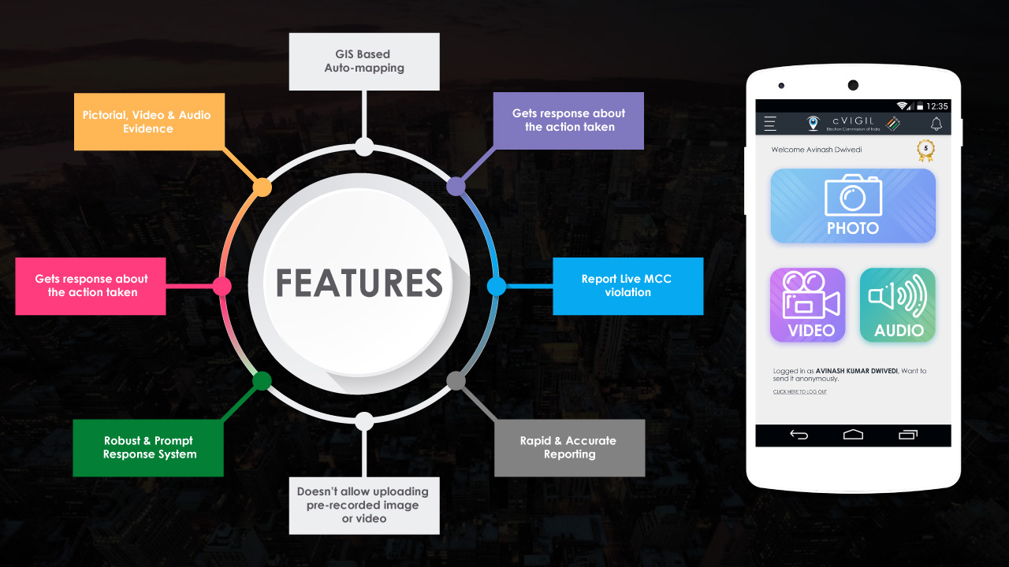
Features

Slide 40
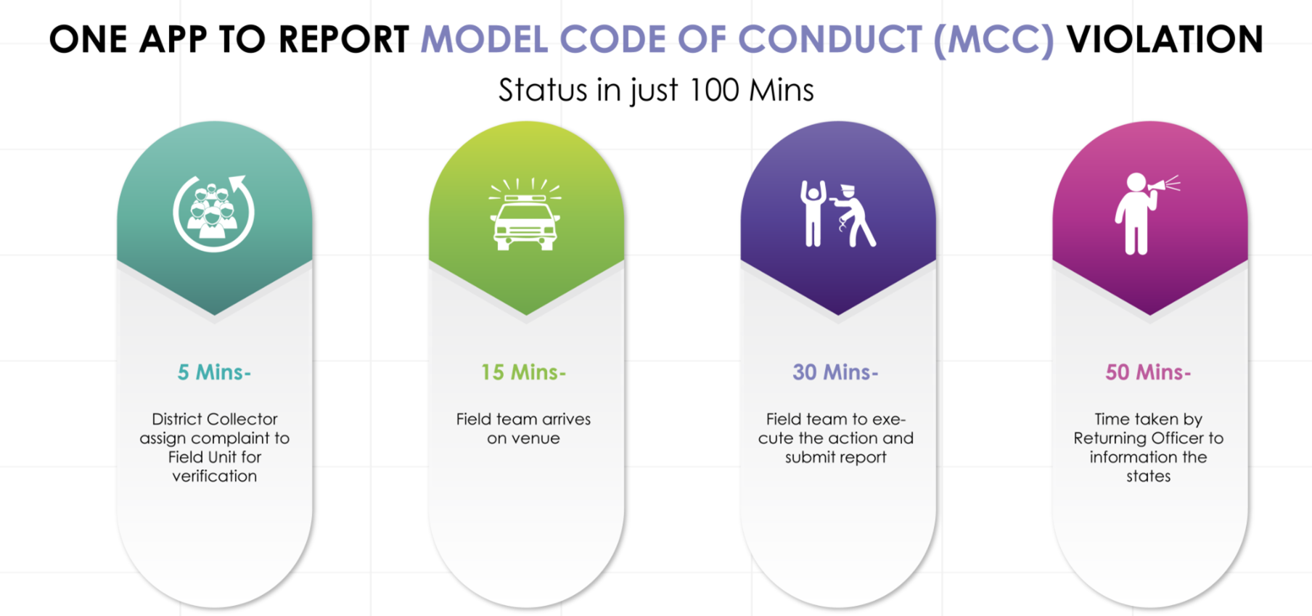
How it works?

Slide 41
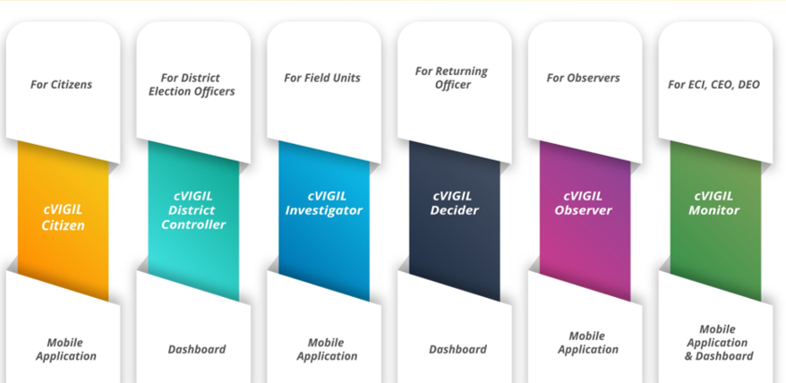
cVIGIL Module

Slide 42
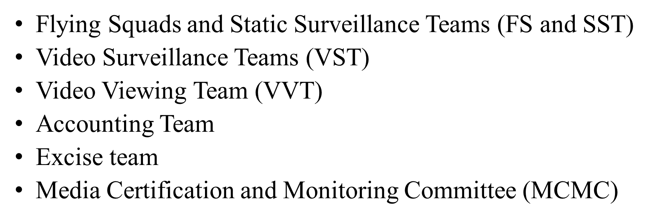
Enforcement Teams :
3 per AC
One per AC
One per AC
One per Ac
One per Ac
One

Slide 43
A Few Questions to recapitulate

Slide 44
Q.1 . Is the MCC enforceable by Law ? Q.2 What is the area of applicability of MCC during Bye-Elections ? Q.3 Suppose an RO has been transferred by Government before enforcement of MCC but has not taken over charge at new place , can he take charge after announcement of elections ? Q.4 Whether Ministers or any other political functionary can use pilot car with beacon light affixed with siren ? Q.5 Can the candidate or his agent use private fixed wing air craft/ helicopter on days of poll and counting where he is contesting for supervising the process? Q.6. Is the PM entitled to use the Government Aircraft and Vehicles during Elections ? Q7. A welfare scheme has been sanctioned earlier and budget provision already made but not announced. Can it be announced during MCC period ? Contd.

Slide 45
Q 8. Whether MSP of Paddy or wheat or any agricultural produce be determined without referring the matter to EC during MCC ? Q.9 Can a vehicle with Party symbol depicted on its “Stepney cover” be allowed to ply during 48 hours to close of Poll in a constituency going for poll ? Q.10 Who is the authority to issue permits to “Star campaigners ” of political parties to avail benefits under sec 77(1) of RPAct.1951 ? Q. 11. what is the maximum no. of vehicles the candidate for an election to House of People entitled for on poll day ? Q.12. Can we purchase liquor in the evening from an off-shop in 110-Pipili AC (of Odisha) on 25th Feb 2021 if the Bye-Election to the AC is on 26th Feb 2021 ? Q.13. Can a political person continue to stay during the 48 hours ban period in the poll bound AC ? ……contd..

Slide 46
Q.14. Whether the provision of security cover for the “ Particular Person” (PP) can be availed by the PP covered under Z+ security during enforcement of MCC ? Who will bear the cost of the propulsion of the Bullet Proof car provided to such persons ? -Ans. Yes , Government will bear the cost (Ref. Commission’s Letter No. 437 / 6 / 2007 / PLN Dt. 24 Oct.2007) Q.15. Whether MCC applies to a candidate before filing of his Nomination ? -Ans. MCC applies to all persons including those who intend to be a candidate . MCC comes into force on the date of announcement of election schedule i.e. release of Press Note by Commission. Election Expenditure shall be counted from the date of filing of Nomination including materials which are prepared before the filing of nominations but used after filing . (Ref. Commission’s L.No.437/6/INST-CC&BE.Dt.21.01.2012 to all CS&CEOs)

Slide 47
Q.16. What is the Composition and function of MCC “Screening Committee” at State Level ? -Ans. Headed by CS, Secy/Pr.Secy of the concerned department and Secy/Pr.Secy of the Coordination Department as members will send the proposal (self contained rerence) to CEO not directly to Commission . Should invariably contain “ Note on Urgency’’ stating why the proposal can’t wait till completion of poll / election. (Ref. Commission’s Letter No. 437 / 6 / POL / LET/FUNC/2017- CCS ,dt.31.10.2017) Q.17. What are the latest instructions of Commission on “Election Manifestos’’ of Political Parties. Ans. Program / policies and promises made therein must be in consonance with the Para-VIII of MCC. Three copies of the Manifestos in Hindi / English may be sent to CEO within 3 days of its release (Ref. Commission’s L.No.437/6/INST-CCS dated 27.12.2016 to the President / GS of all recognized National and State political Parties) . * Not to be released during the 48 hours ban period on eve of poll.

Slide 48

for the patient hearing

