Slide 1
EVM & VVPAT (M3) Introduction

Slide 2
Need for Electronic Voting Machines
simplifies the election process for the benefit of both Election Officials and voters.
It’s use obviates the huge expenditure involved in printing millions of ballot papers, storing and transporting them to booths etc.
only one ballot paper is fixed below the transparent acrylic sheet of the BU.
contd...

Slide 3
Need for Electronic Voting Machines
can be reused in subsequent elections by simply pressing a button to erase the votes recorded in the earlier poll and changing the ballot paper in the BU.
The voter has to only press a button against the candidate of his / her choice to cast a vote. An audio-visual signal confirms to the voter that the vote has been recorded.

Slide 4
EVM consists mainly of two units
Control Unit (CU)
Ballot Unit (BU) with cable for connecting it with the Control Unit.
A Ballot Unit caters up to 16 candidates.
A cascade of 24 Ballot Units can be connected to one Control Unit (Catering to 384 candidates including NOTA).

Slide 5
Special Features of the Electronic Voting Machine (EVM)
Unique Serial Number
Each Control Unit (CU) has a unique Serial Number, which matches with the metal strip number and Bar Code on the rear side of the CU.
Real Time Clock (RTC)
The real time clock is used to display the current time and date. The current date and time is displayed with power on and on pressing the Total button. Any malfunction of the RTC shall be displayed by CLOCK ERROR.
contd...

Slide 6
Special Features of the Electronic Voting Machine (EVM)
Status of Battery Power
Battery Power status is displayed. If change of battery is required, it also displays CHANGE BATTERY.
Authentication
Every Ballot Unit that is connected for voting is authenticated before use.
Diagnostics
Unit is used for self-diagnostics that ensures proper working.
contd...

Slide 7
Special Features of the Electronic Voting Machine (EVM)
Power Save Mode
The unit goes into power save mode when it is idle, thus enhancing the life of the battery pack.
Print
The result of poll data can be printed, if required.
Braille
Moulding of Braille numerals on the Ballot Unit for visually challenged persons.

Slide 8
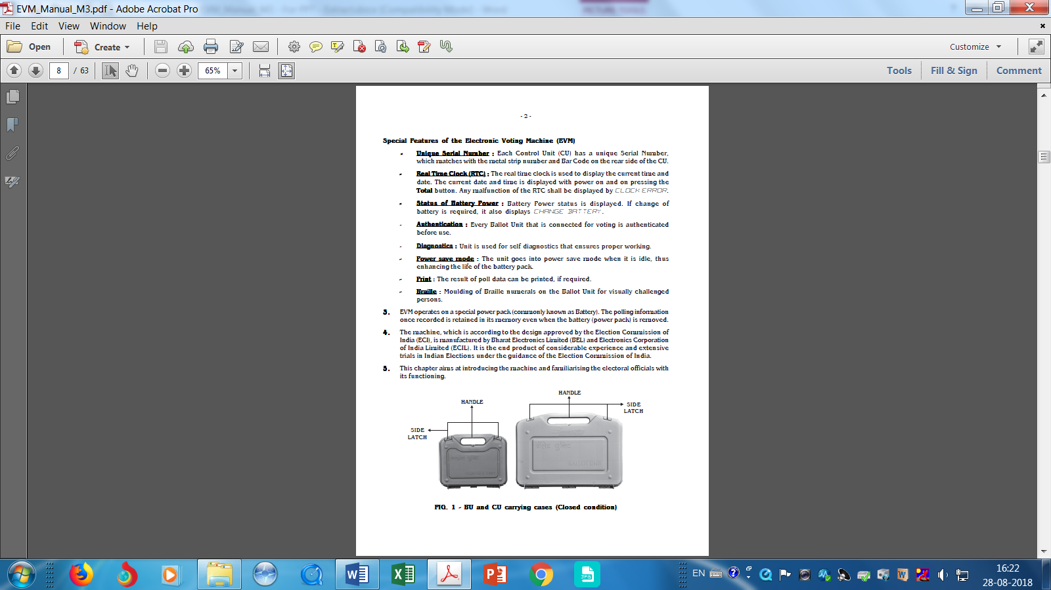
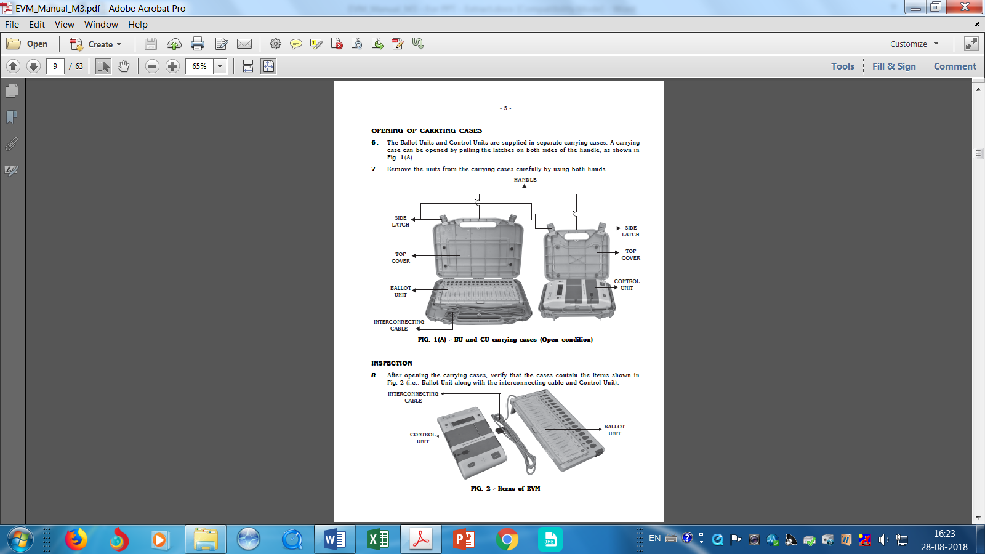
BU and CU Carrying Cases

Slide 9
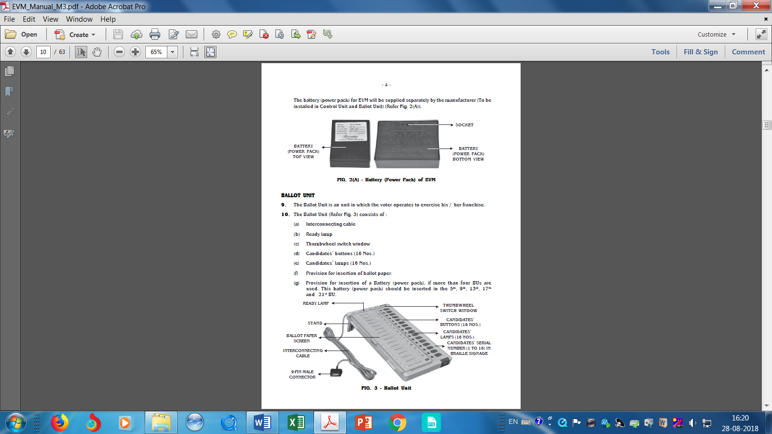
Inspection

Slide 10
BALLOT UNIT
an unit in which the voter operates to exercise his / her franchise.
it consists of :
Interconnecting cable
Ready lamp
Thumbwheel switch window
Candidates’ buttons (16 Nos.)
Candidates’ lamps (16 Nos.)
Provision for insertion of ballot paper.
Provision for insertion of a Battery (power pack), if more than four BUs are used. This battery (power pack) should be inserted in the 5th, 9th, 13th, 17th and 21st BU.

Slide 11
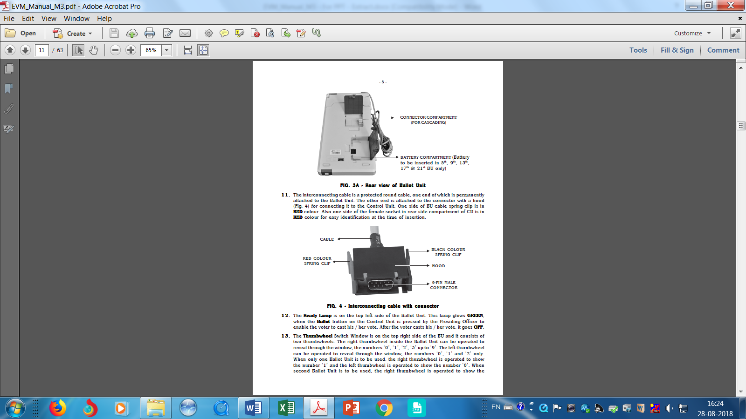
Ballot Unit

Slide 12
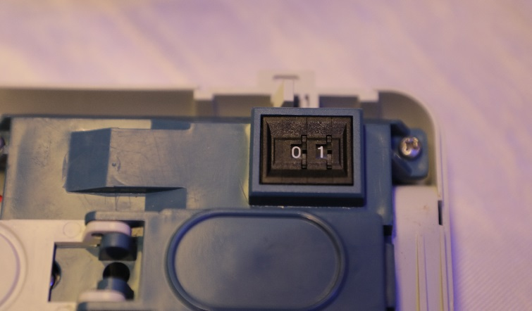
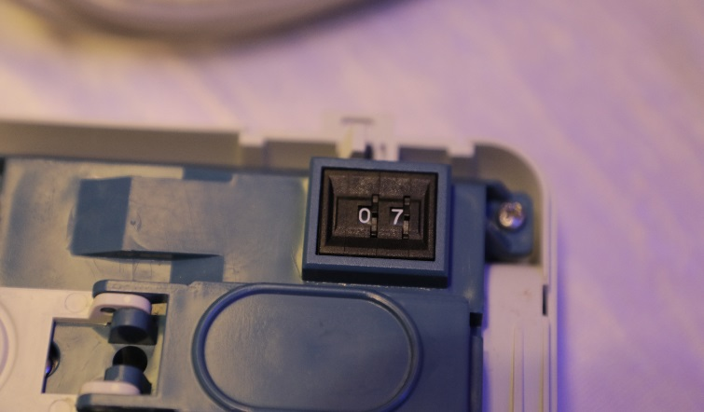
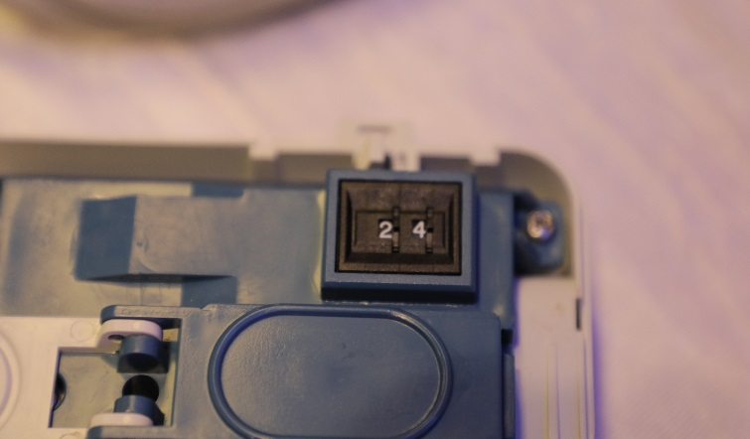
Thumbwheel Switch Window
on the top right side of the BU
consists of two thumbwheels
The right thumbwheel - the numbers ‘0’, ‘1’, ‘2’, ‘3’ up to ‘9’
The left thumbwheel - the numbers ‘0’, ‘1’ and ‘2’ only

Slide 13
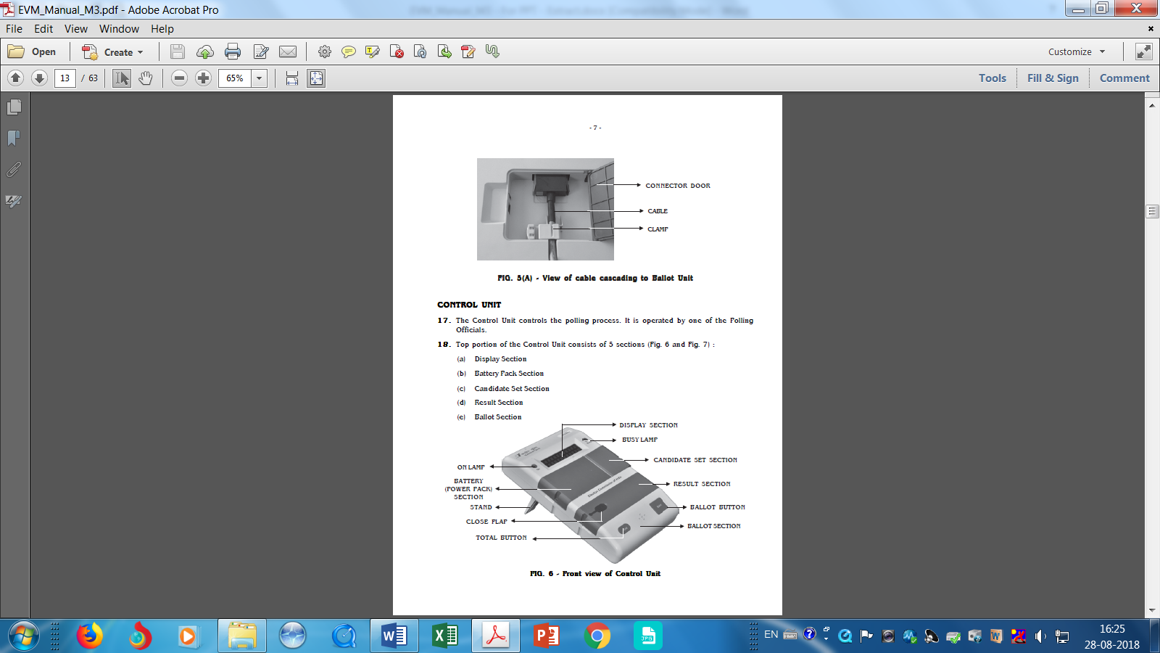
Connecting another BU
A 9-pin socket is provided at the bottom side of the Ballot Unit for cascading the Ballot Units (in case of more than 16 contesting candidates).

Slide 14
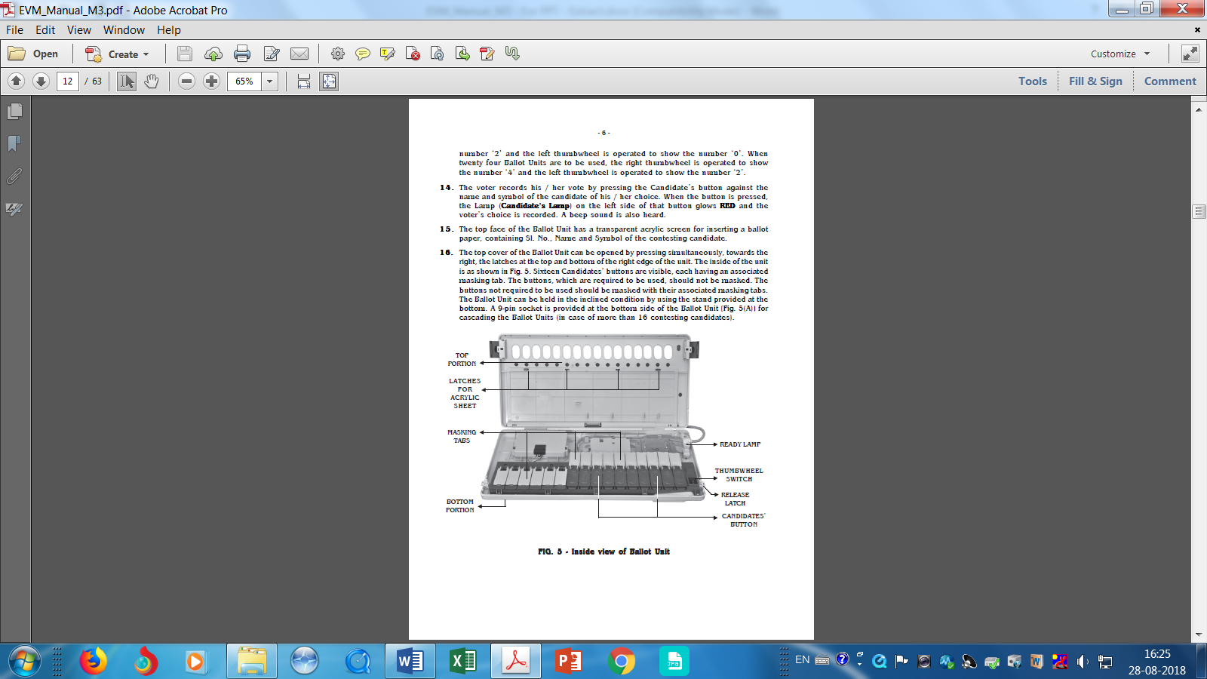
Inside View of Ballot Unit

Slide 15
CONTROL UNIT
controls the polling process
Top portion of the CU consists of 5 sections
(a) Display Section
(b) Battery Section
(c) Candidate Set Section
(d) Result Section
(e) Ballot Section

Slide 16
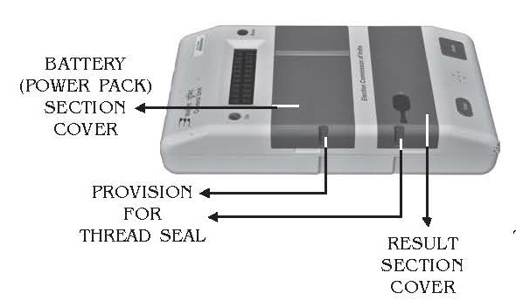
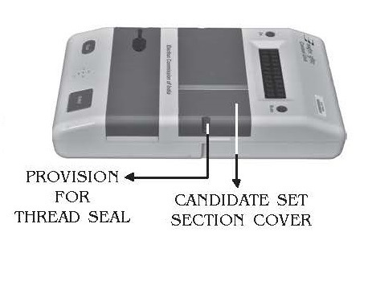
Side View of Control Unit

Slide 17
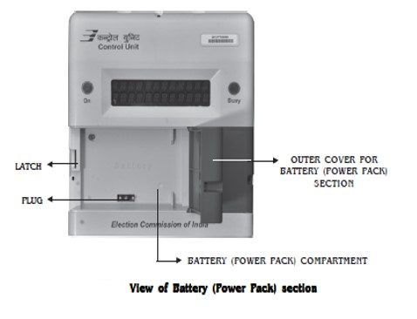
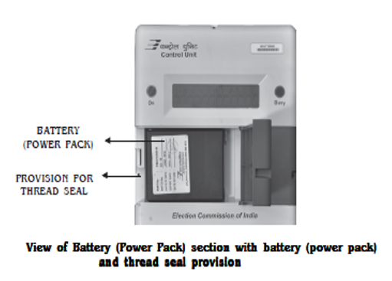
The Display Section
consists of
two lamps, ON & BUSY,
a display panel, which consists of 24 red coloured 17 segment alpha-numeric characters in two equal rows
The Battery (Power Pack) section has an outer door, which opens from left to right

Slide 18
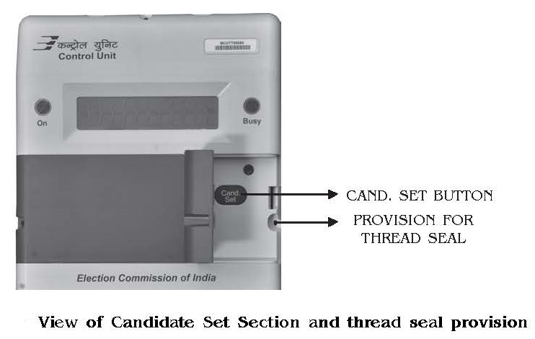
The Candidate Set Section
has an outer door, which opens from right to left

Slide 19
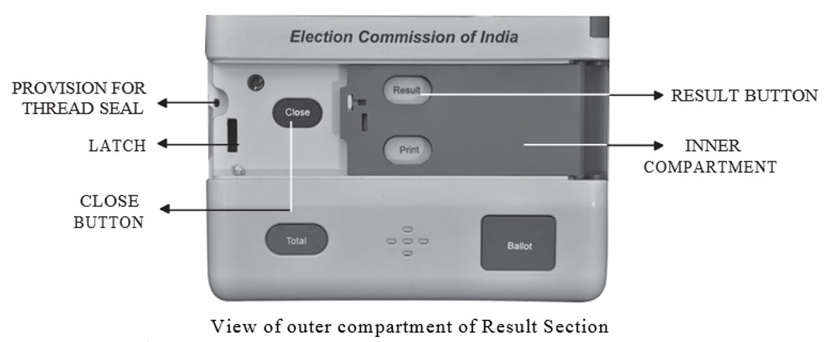
Result Section – View of Outer Compartment

Slide 20
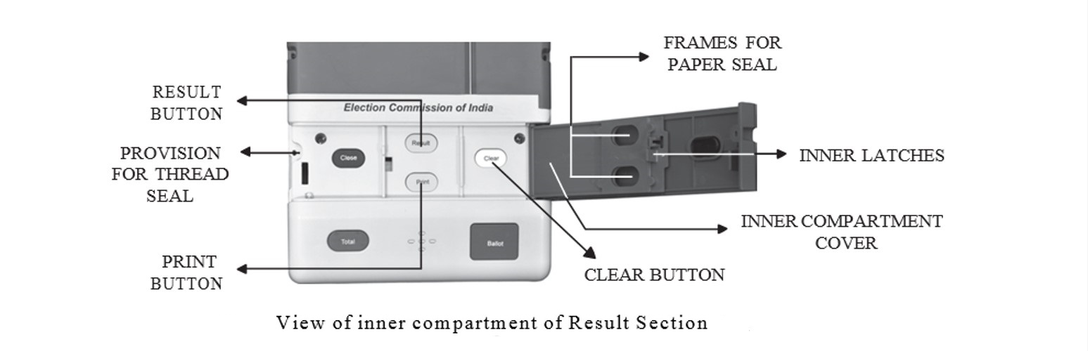
Result Section – View of Inner Compartment

Slide 21
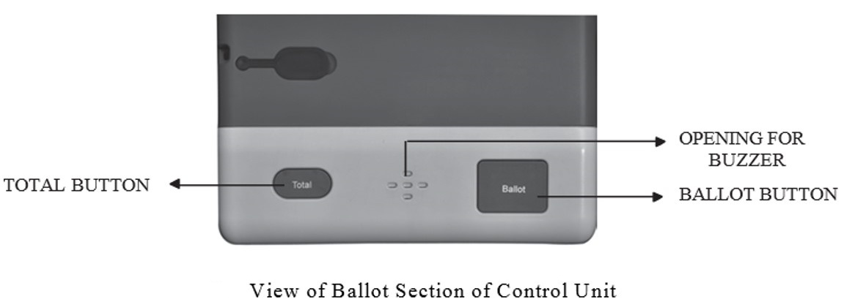
Ballot Section

Slide 22
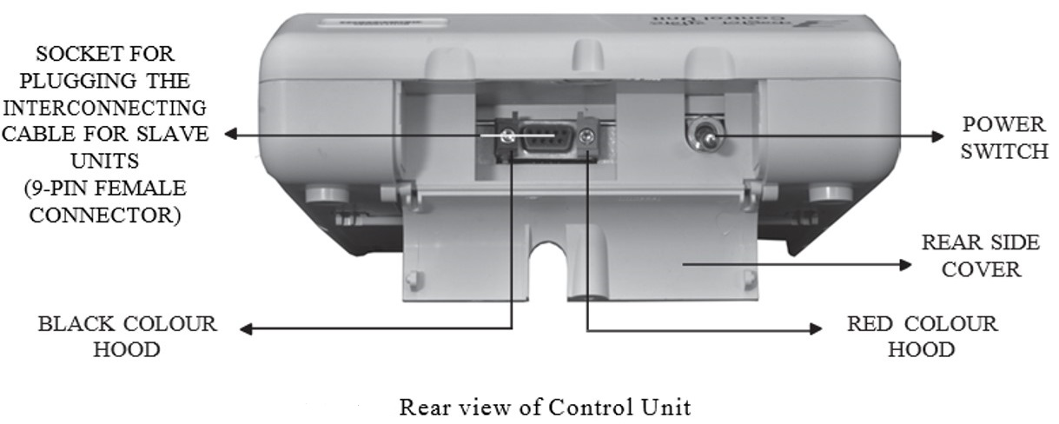
The Rear Side Portion

Slide 23
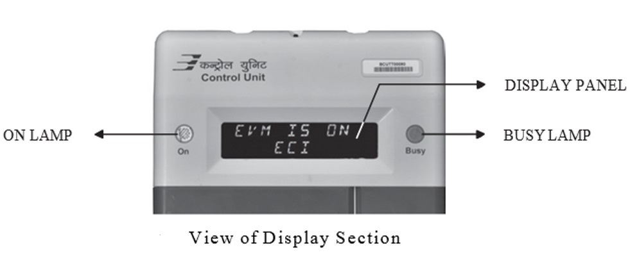
ON Lamp & Busy Lamp

Slide 24
DISPLAY PANEL
Displays the data on two rows each having 12 characters

Slide 25
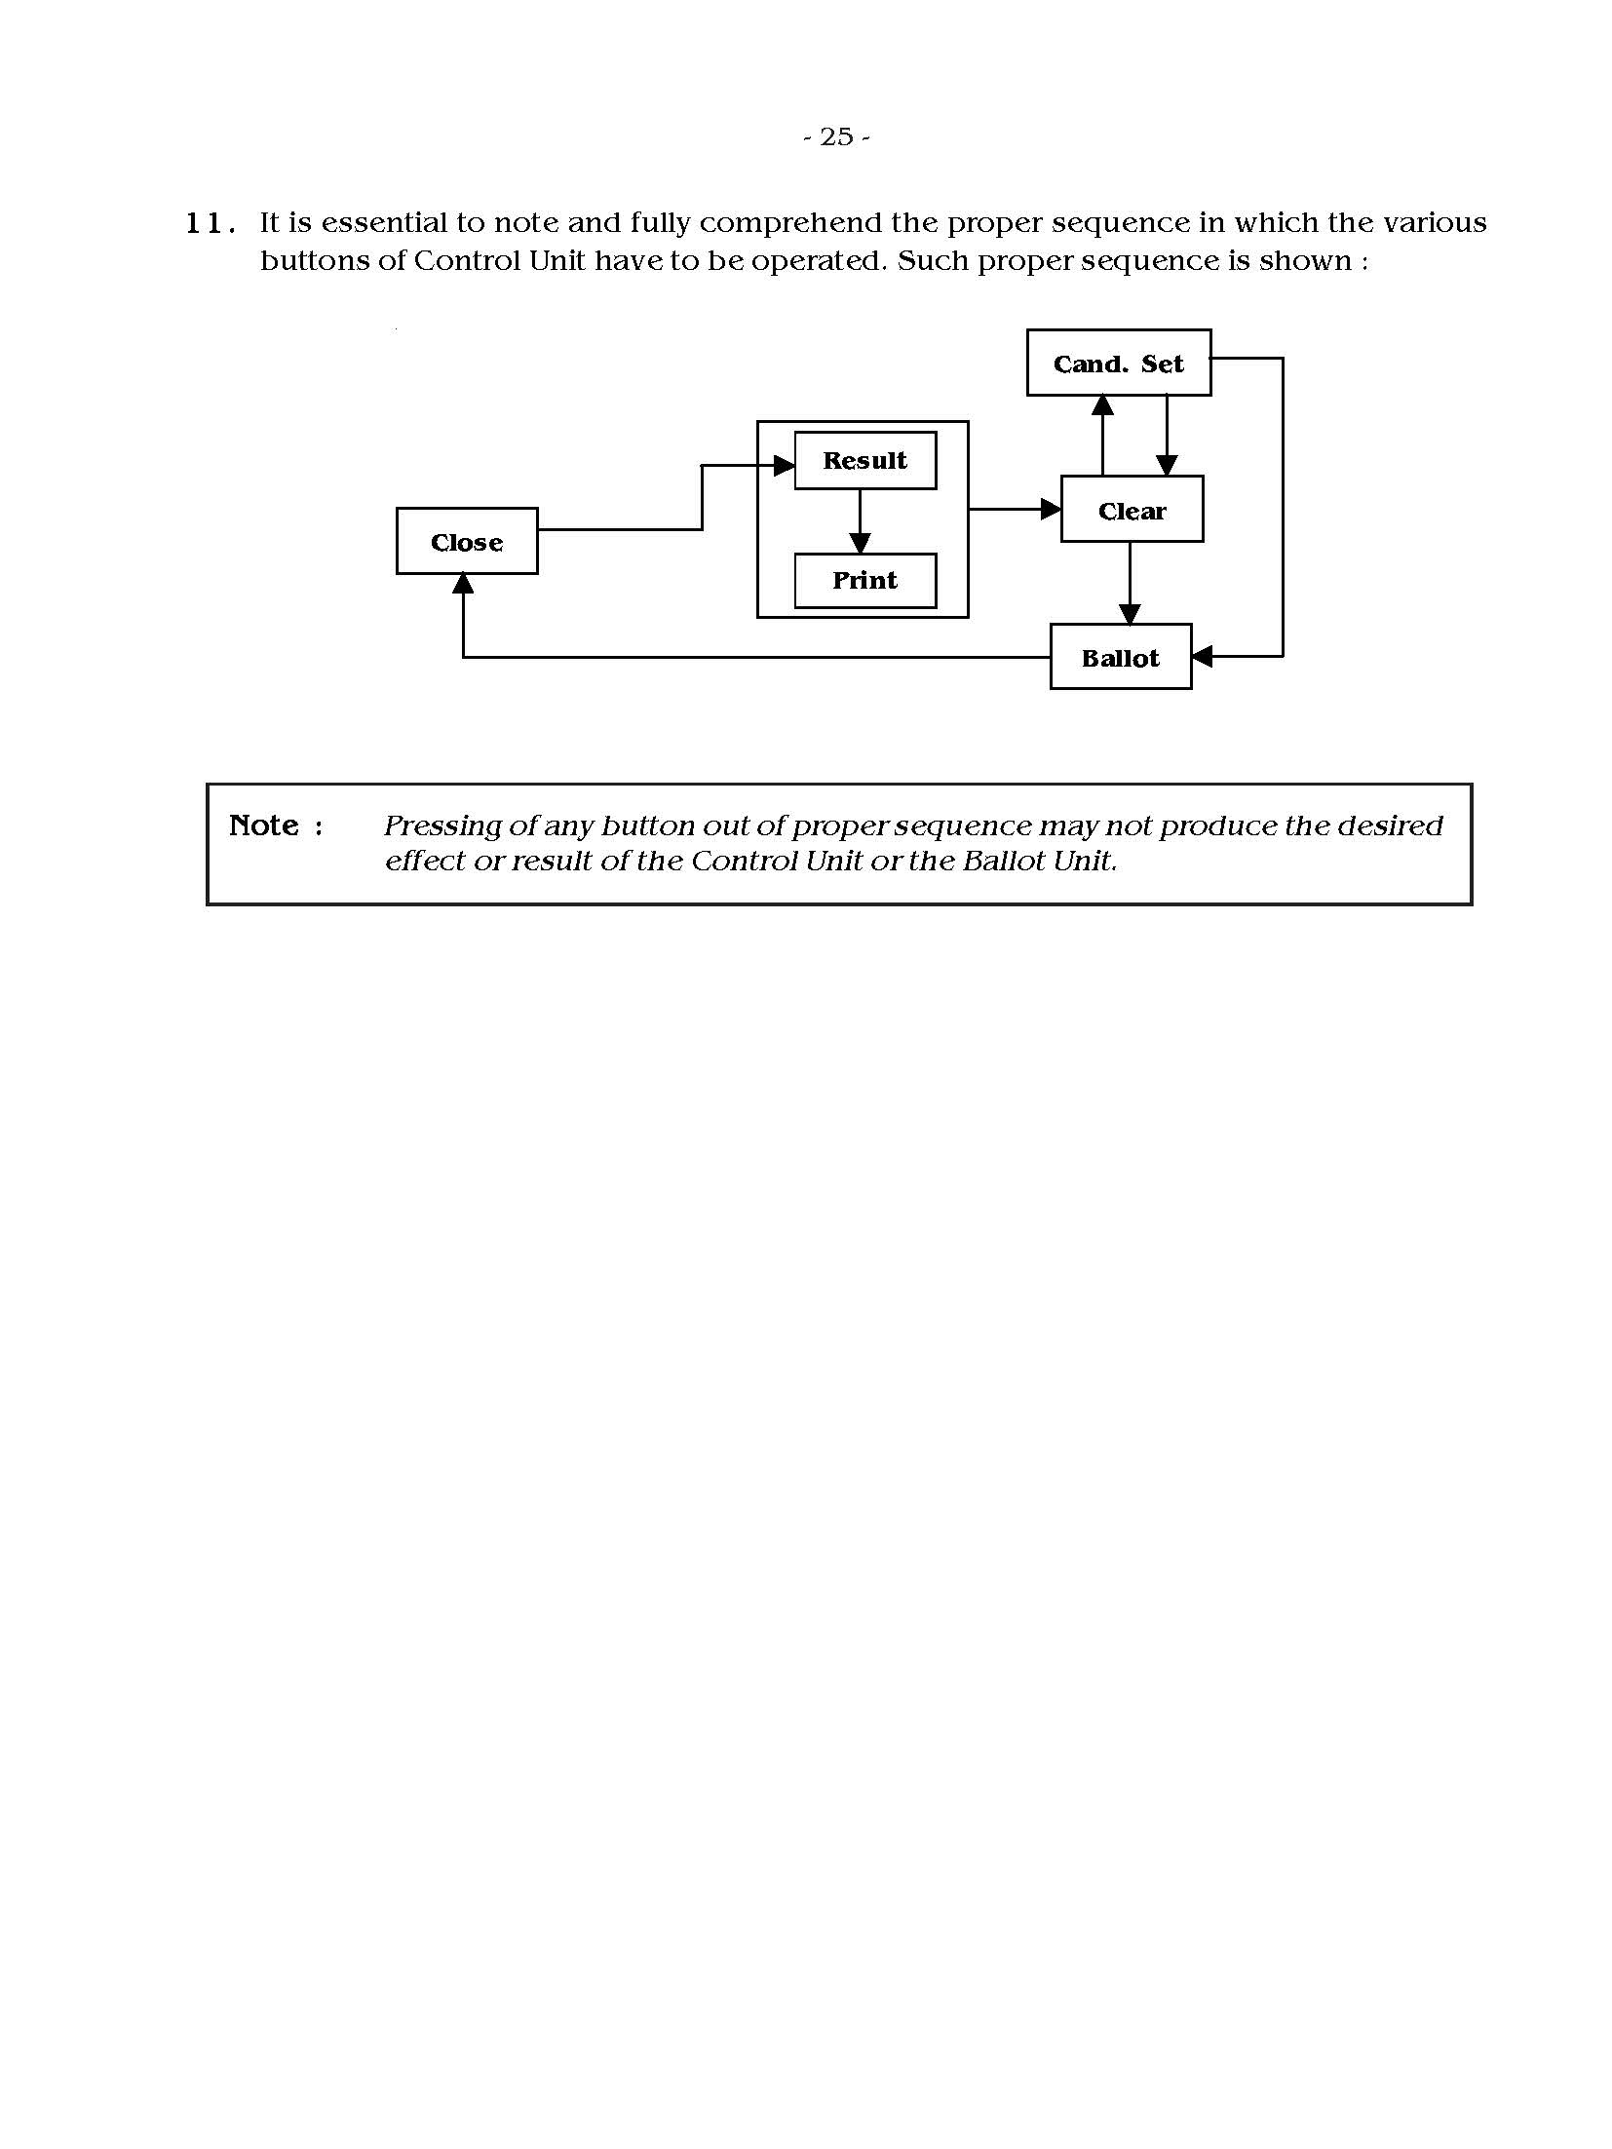
Proper Sequence in which Various Buttons of CU have to be operated
Note: Pressing of any button out of proper sequence may not produce the desired effect or result of the Control Unit or the Ballot Unit.

Slide 26
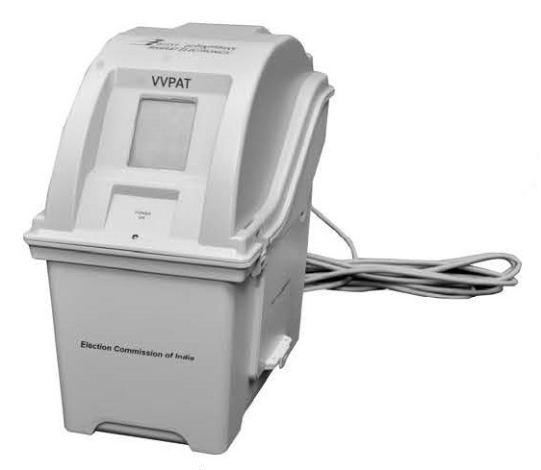
VVPAT (M3)

Slide 27
What is VVPAT?
Voter Verifiable Paper Audit Trail
When a vote is cast, a slip is printed containing the serial number, name and symbol of the candidate and remains exposed through a transparent window for 7 seconds.
Thereafter, this printed slip automatically gets cut and falls in sealed drop box of the VVPAT.
A printer based accessory used in the set up of EVM
Prints the voter's franchise on thermal paper ballot slip for voter verification when EVM is used in elections as well as an audit trail.
To print selection of voter on a printer for the voter to physically verify the vote cast.

Slide 28
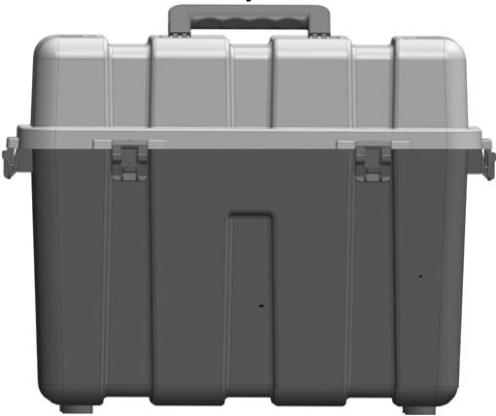
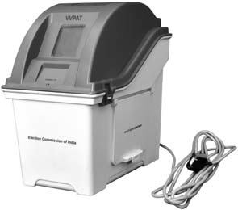
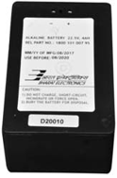

The VVPAT system with carrying case consists of following list of items
VVPAT unit with connecting cable for CU.
Battery pack (the battery is placed inside the battery compartment within the VVPAT unit)
Paper roll (the paper roll is loaded in the paper roll compartment within the VVPAT unit).

Slide 29
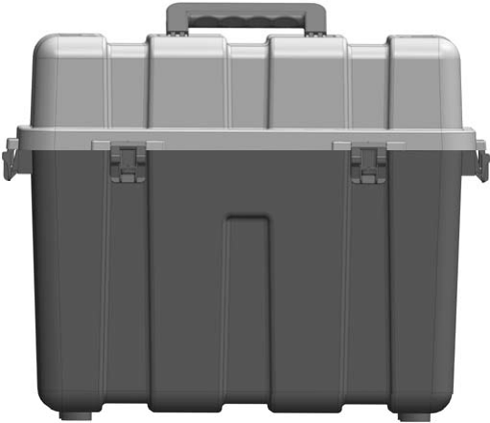
VVPAT Carrying Case
is made of plastic
It has a handle to hold and carry and provides for four latches to lock the door and seal it.

Slide 30
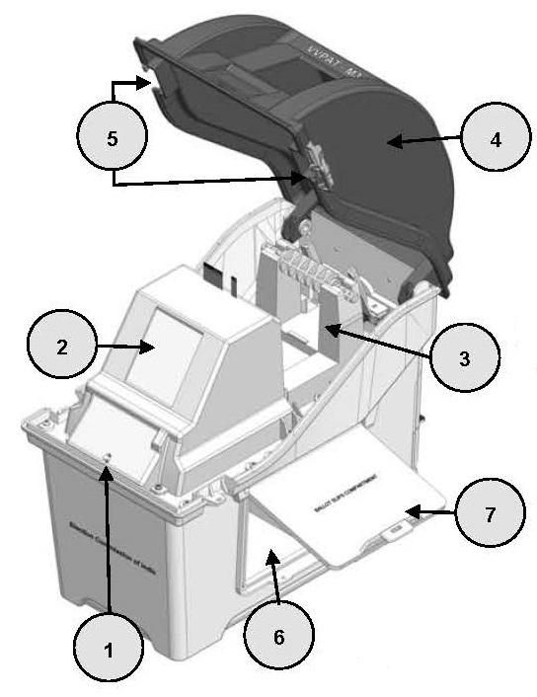
Exploded View of the VVPAT - 1
1. Power-ON LED
2. Ballot Slip Viewing Window
3. Paper Roll Compartment
4. Paper Roll Compartment Door
5. Latches for Paper Roll Compartment Door
6. Ballot Slips Compartment
7. Ballot Slips Compartment Door
contd...

Slide 31
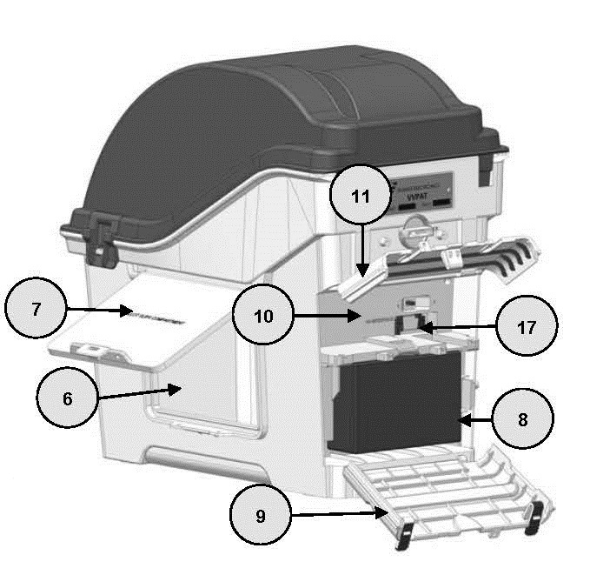
Exploded View of the VVPAT - 2
Ballot slips compartment
Ballot slips compartment door
Battery compartment
Battery compartment door
Connector compartment
Connector compartment door
BU connector
contd...

Slide 32
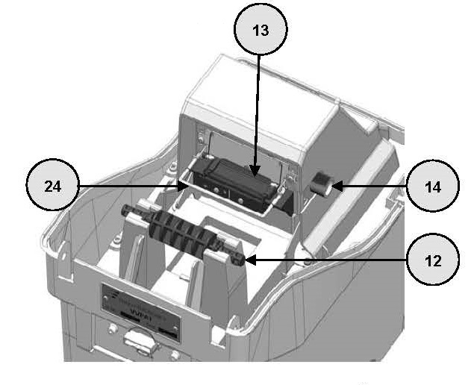
Exploded View of the VVPAT - 3
Spindle
Paper Insertion Guide
Paper Feed Knob
Paper Deflector Mechanical Assembly
contd...

Slide 33
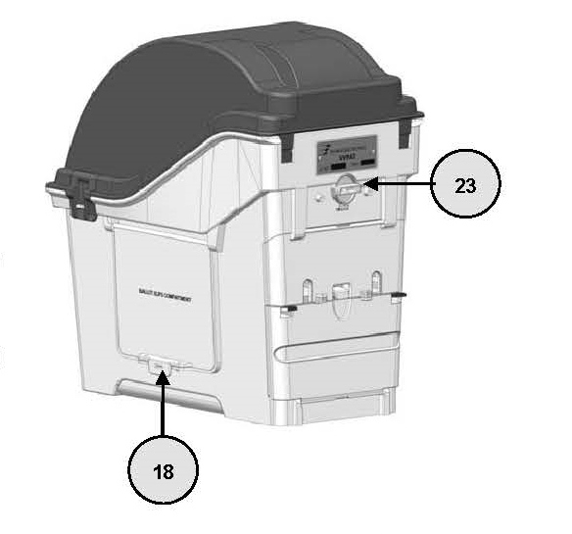
Exploded View of the VVPAT - 4
18. Latch for Ballot Slips Compartment
23. Lock - Unlock Switch for Paper Roll
contd...

Slide 34
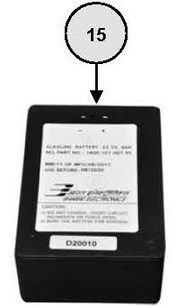
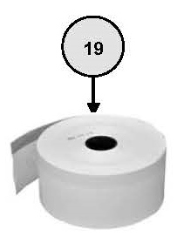
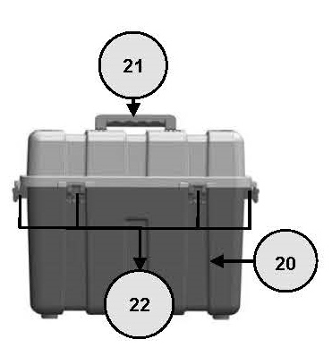
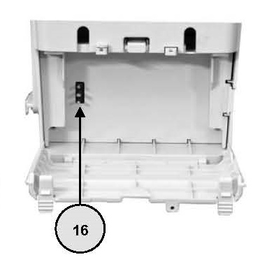
Exploded View of the VVPAT - 5
15. Battery pack
16. Three pin battery connector
19. Paper roll
20. VVPAT carrying case
21. Handle for carrying case
22. Latches of carrying case

Slide 35
VVPAT System
VVPAT System consists of four independent compartments:
Paper Roll Compartment
Printed Paper Slips Compartment
Battery Compartment
The battery is used for providing the power to the VVPAT system for its normal operation. The VVPAT unit works with a special VVPAT Battery provided by the manufacturer.
Connector Compartment

Slide 36
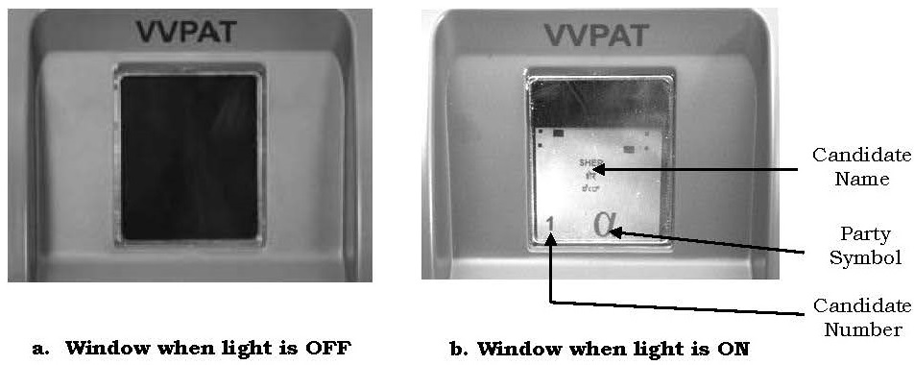
Ballot Slip Viewing Window
Normally the items behind the window is not visible and the window appears black.
When a voter presses the key on the BU to cast his / her vote, a light within the viewing window turns on illuminating the printed ballot slip for 7 seconds for viewing by the voter.

Slide 37
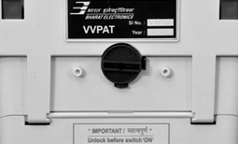
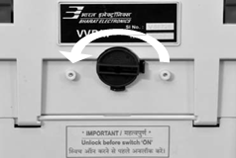
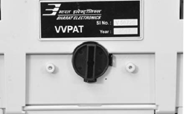
Special Features of the VVPAT Knob
Paper Roll Knob
Lock Position
Lock to Unlock Position Anti-clockwise
Unlock Position
Note : The paper roll lock is used for locking the paper roll during transit after sealing of VVPAT is done. “Do not use it as an ON/OFF switch”. The CU has to be switched ON and switched OFF to switch ON & OFF the VVPAT.

Slide 38
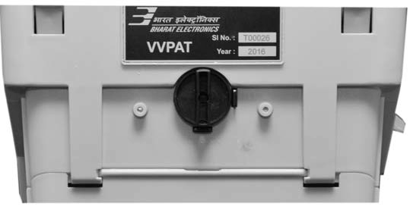
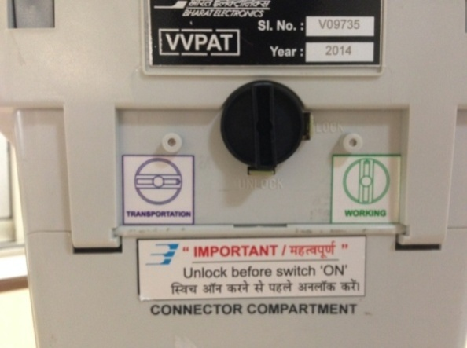
Operations of VVPAT
Unlocking the Paper Roll
The paper roll has to be unlocked before the use of VVPAT. For this, the paper roll lock knob has to be in the unlock position.

Slide 39
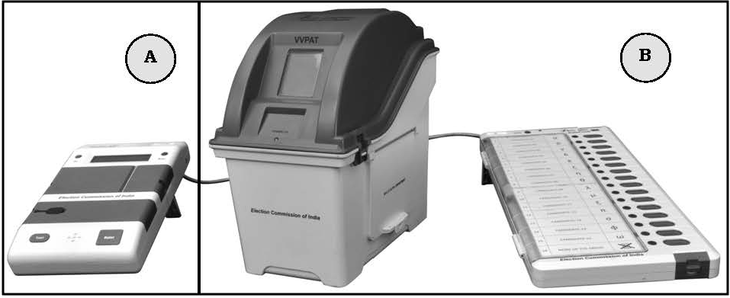
Relative Placement of CU, BU and VVPAT - 1
Note: Since the VVPAT has optical sensors, it should not be operated in direct sunlight and bright light such as flash light.
A
PO’s Table
B
Voting Compartment
contd...

Slide 40
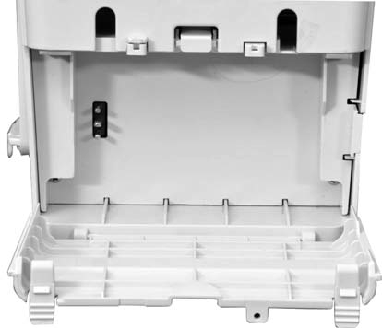
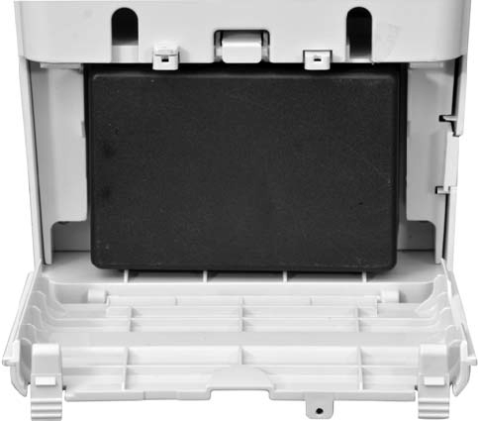
Battery Pack Installation
3-pin connector for battery insertion
Battery pack after insertion

Slide 41
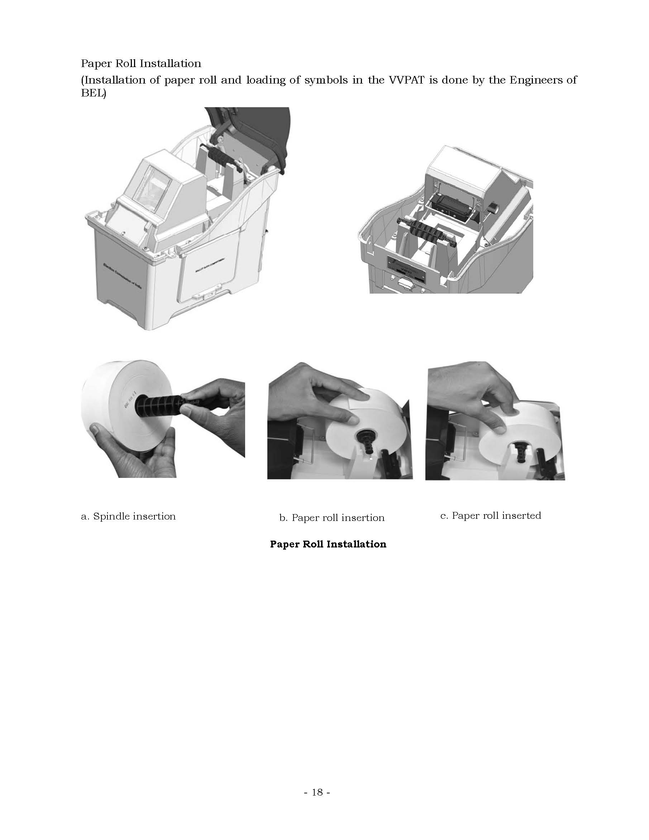
Paper Roll Installation - 1
Opened Paper Roll Compartment
Installation of paper roll and loading of symbols in the VVPAT is done by the Engineers of the Manufacturing Co.
contd...

Slide 42
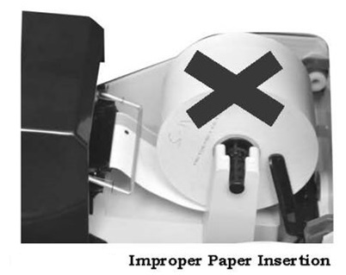
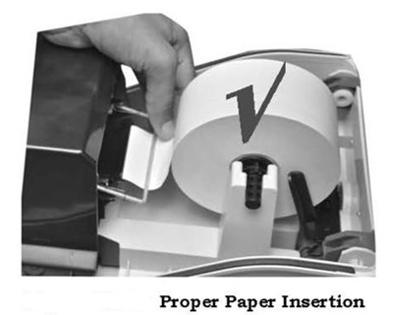
Paper Roll Installation - 2
While inserting the paper roll, ensure that the band of black marks are facing downwards as shown. An improper paper insertion will not result in any printing.

Slide 43
Power-ON Sequence of VVPAT - 1
After the connections of VVPAT with EVM, the Control Unit is switched ON.
The standardization of spot intensity is done for all the sensors. In this process, the paper is moved slightly.
Once the standardization process is over, the extra fed paper gets cut and falls down as Standardization Slip.
VVPAT prints the Power-ON Self Test (POST) Report and five Diagnostics Reports.
contd...

Slide 44
Power-ON Sequence of VVPAT - 2
VVPAT is ready for use if all the reports generated during Power-ON shows the result status as PASS. In case of any error in the VVPAT, the corresponding result status will be FAIL in the Diagnostics Report. In that case, the Battery Report is not cut.
Note: Symbol loading will be done by authorized engineers of the manufacturers and Commission's instructions in this regard shall be followed.

Slide 45
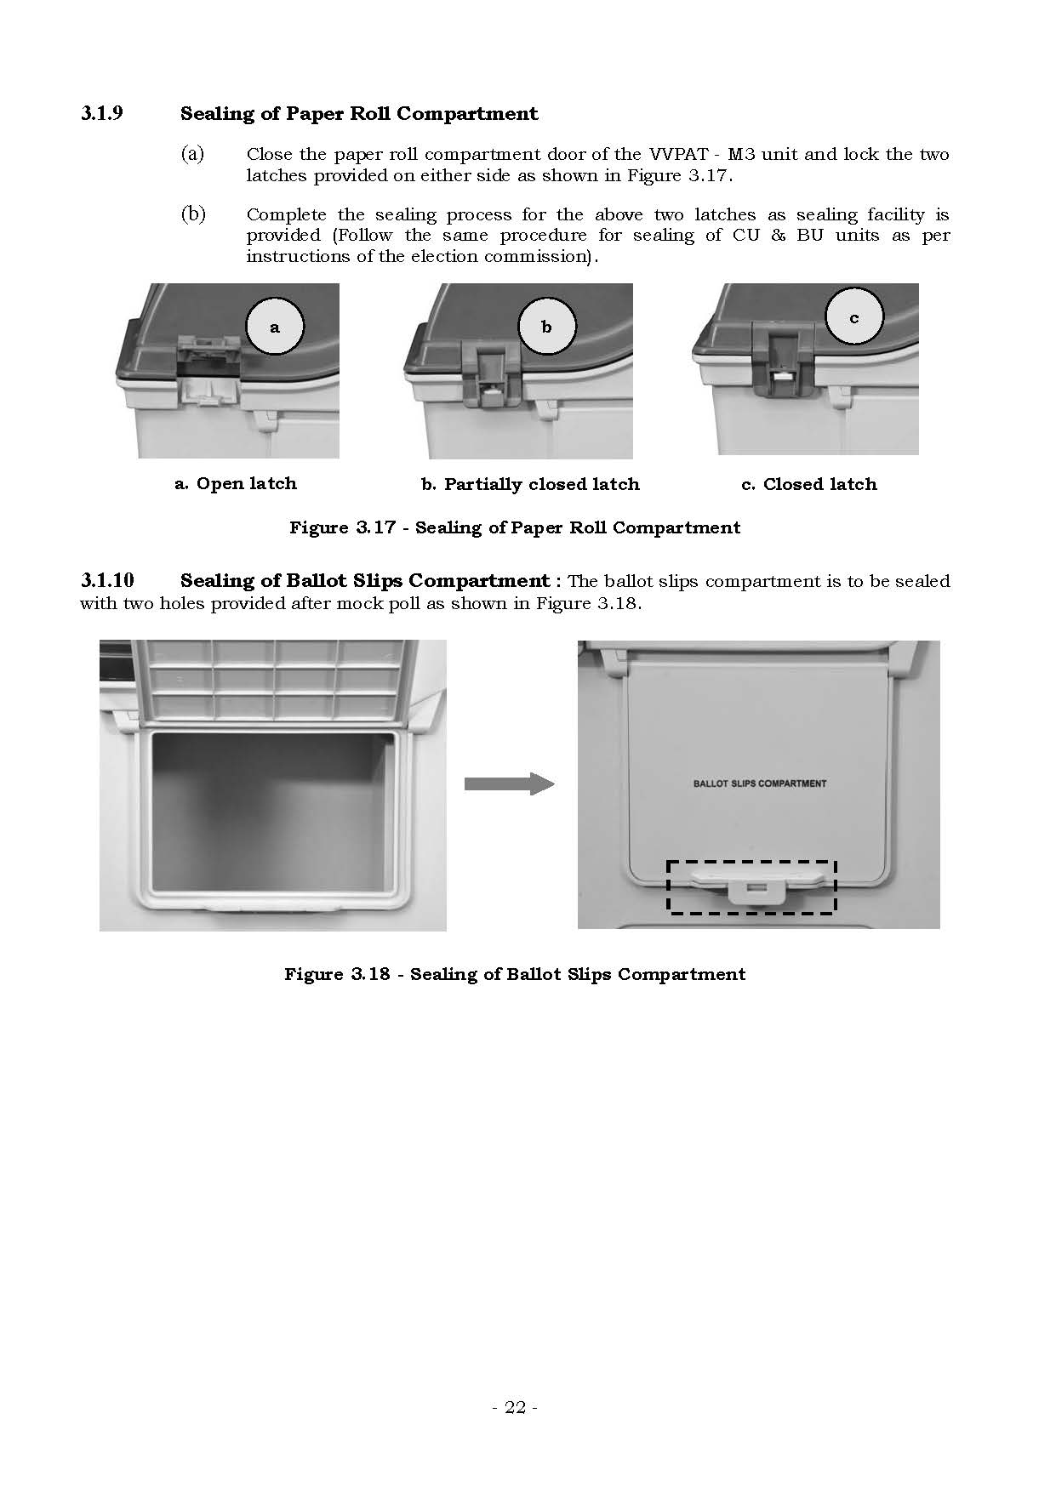
Sealing of Paper Roll Compartment

Slide 46
Sealing of Ballot Slips Compartment
The ballot slips compartment is to be sealed with two holes provided after mock poll.

Slide 47
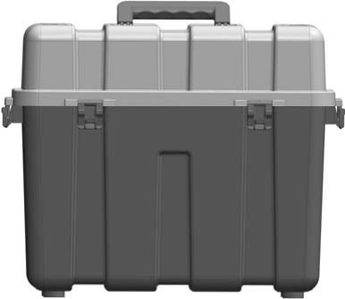
Sealing of Carrying Case
The carrying case should be sealed with four latches provided.
Latches to seal the Carrying Case

Slide 48
COMMISSIONING OF VVPAT BY RETURNING OFFICER (RO) - 1
VVPAT - M3 unit testing, preparation and commissioning procedures required to be done at the RO's office - till the stage of dispatching.
The important activities at this stage are :
Preliminary checks of items supplied with VVPAT at RO's office
(ii) Preparation of VVPAT for the Election :
(aa) Setting up of VVPAT
(ab) Battery pack installation
(ac) Paper roll installation to be done by Engineers of BEL
(ad) Preparation of Ballot paper data (candidate's name, number and symbol) for the VVPAT unit to be done by Engineers of BEL
(ae) Loading of ballot paper data into the VVPAT unit and testing to be done by Engineers of Manufacturers.
contd...

Slide 49
COMMISSIONING OF VVPAT BY RETURNING OFFICER (RO) - 2
(iii) Connecting of EVM with VVPAT system.
(iv) Testing and verifying of EVM with VVPAT system.
(v) Sealing of Paper roll compartment & Battery compartment after testing.
(vi) Packing of the VVPAT items into carry case and instructions to be given to poll staff before unit is dispatched.
Note : At the time of commissioning of VVPAT, mock poll activity is done as per ECI's guidelines.

Slide 50
Setting up of VVPAT by PrO at Polling Station
Essential Activities
Preliminary material checks after transportation of EVM & VVPAT unit to the polling booth,
Procedure for connecting EVM (CU and BU) with VVPAT unit,
Mock poll procedure, clearing of the mock poll data,
Sealing of VVPAT ballot slip compartment after mock poll verification,
Actual poll procedure,
Closing of poll procedure and
VVPAT packing and instructions to be given before dispatch to Strong Rooms / Counting Centre.

Slide 51
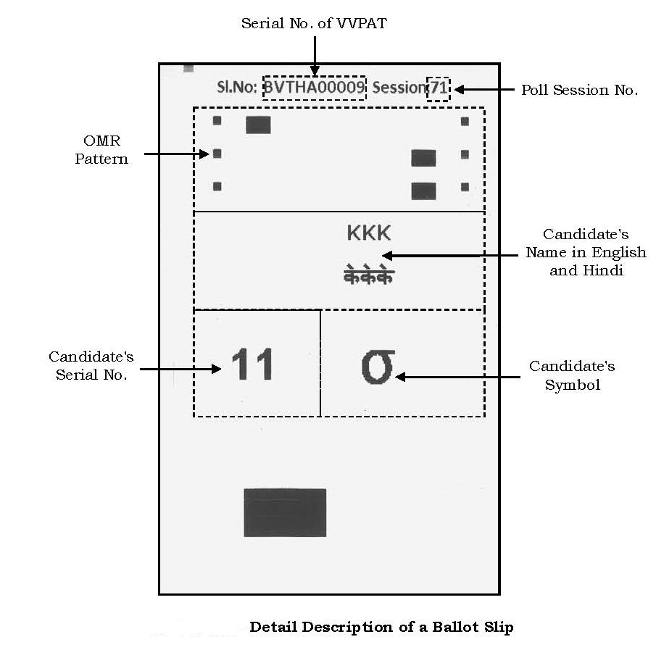
VVPAT Ballot Slip Description
OMR Pattern – may be used for automated Result counting of VVPAT – M3 Ballot Slips
Serial No. of VVPAT – M3 Unit – Unique serial no. of each VVPAT – M3 unit
Poll Session No. –
starts from 0
with each power ON, it gets incremented by 1 (one). It is reset to 0 (zero) after uploading Ballot Paper symbols to VVPAT or after session no. 99

Slide 52
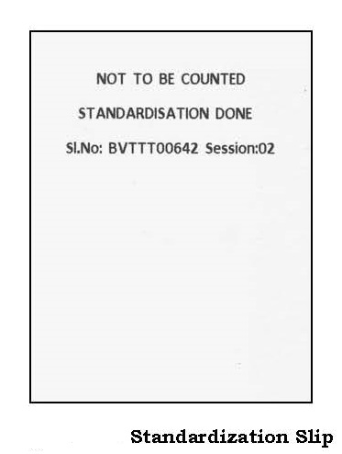
VVPAT – M3 – POST – Report Description
Standardization Slip
When VVPAT – M3 is switched ON, the standardization slip is generated prior to the printing of POST Report.

Slide 53
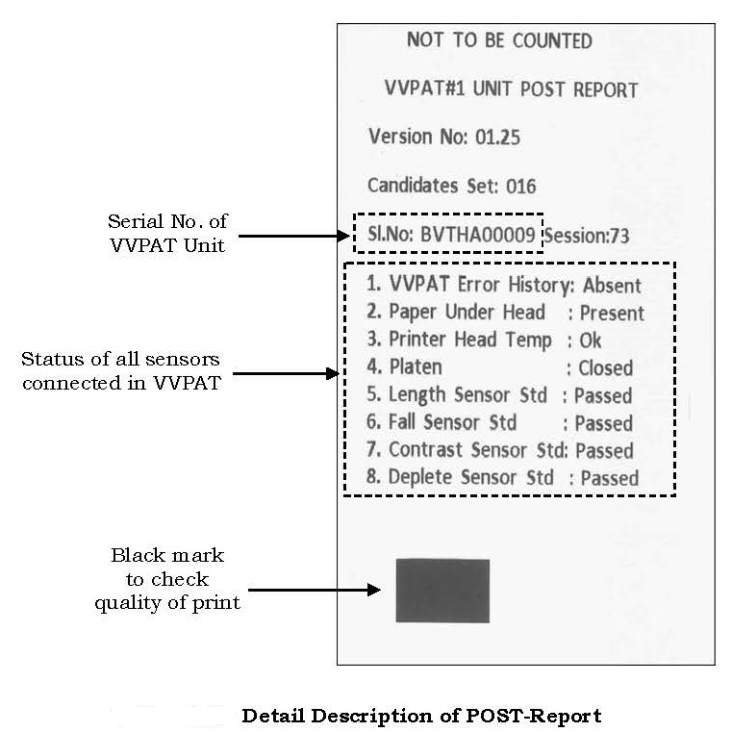
VVPAT – M3 – POST – Report Description
POST Report
VVPAT – M3 unit generates a POST-Report with every “Power-ON” operation.
The Status of all sensors can be:
VVPAT – M3 Error History – Absent / Present
Paper under Head – Present / Absent
Printer Head Temperature – OK / Over
Platen – Open / Closed
Length Sensor Std – Passed / Failed
Fall Sensor Std – Passed / Failed
Contrast Sensor Std – Passed / Failed
Deplete Sensor Std – Passed / Failed

Slide 54
VVPAT Diagnostics Reports Description - 1
After POST Report, the VVPAT generates five different types of diagnostics report with every ‘Power-ON’ operation.
The reports are specific for Length Sensor, Fall Sensor, Deplete Sensor, Contrast Sensor and Battery.
Each report shows the result of sensors / battery as Pass / Fail.
contd...

Slide 55
Thanks!
Yogesh Thakkar GAS
Deputy Collector & SDM Dhanera
Banaskantha, Gujarat
(M) 8980035014
yogesh.thakkar82@gmail.com

