Slide 1
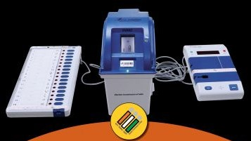
Administrative Procedure
EVM & VVPAT
Pramod Kumar Sahoo
Odisha Administrative Service
NLMT

Slide 2
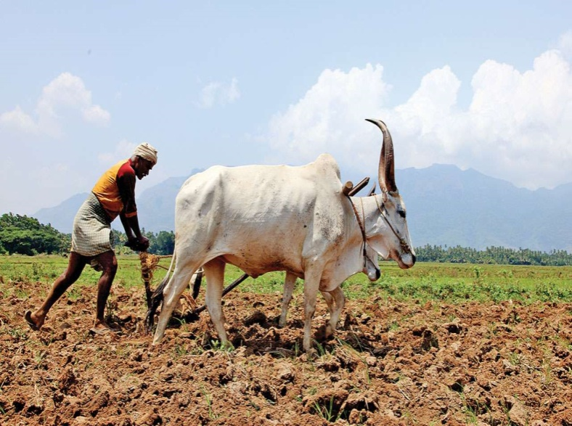

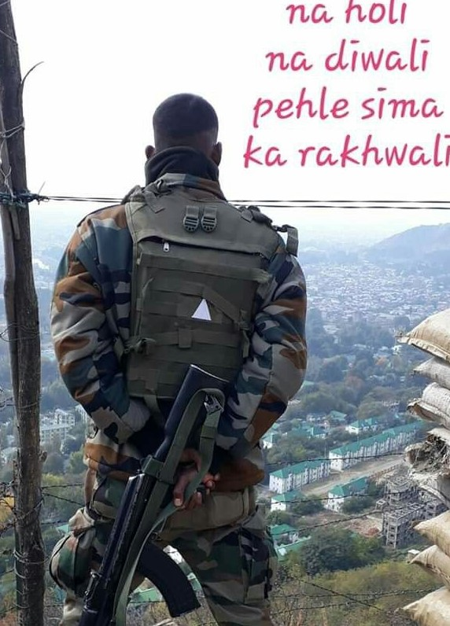

?

Slide 3
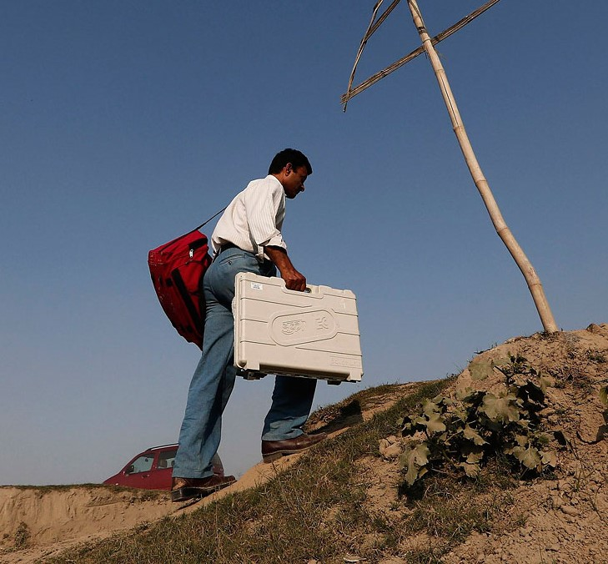

Slide 4
What is the first thing to arrive in and the last thing to leave the district in an Election process ?

Slide 5
EVM & VVPAT
Learning Objectives
Background, Features, Storage & Safety of EVMs
First Level Checking
Training and Awareness
First Randomization
Second Randomization
Commissioning of EVMs
Dispersal Day
Poll Day
Counting of Votes in EVMs
Critical Mistakes / Errors

Slide 6
Background & Features of EVMs
First used - 1982 (Parur A.C., Kerala) - Challenged in court- Court held “No Law supporting use of EVMs”
R.P. Act- 1951 amended -Dec- 1988 ( with insertion of Sec-61A) –First time giving a legal sanction to its use
C.E. Rules,1961 – Amended in 2013 : Rule-49-A - Use of VVPAT for printing of Paper trail of a vote ( First used-Noksen A.C, Nagaland)
Manufactured by BEL/ECIL – both are Central PSUs who have high standard security protocols
5. Highlights of M3 EVMs :
(a) 24 BUs can be connected & cater to 384 Candidates
(b) CU Battery Life – in % age
(c) Self Diagnostics - at every switch “ON”
(d) Battery section/Cand. Section - Separate sealing
(e) No need to change CU due to “low battery”

Slide 7
SECURED DESIGN & FEATURES of EVMs
Population
9.Real Time Clock. Time and date stamping @ every key press
10.Strong“mutual authentication capability”
3.No Radio Frequency / Wireless Transmission or reception possible
4. Secured Development& Manufacturing
5.One Time Programmable (OTP) chip
6. Most Advanced Encryption Techniques
7.Dynamic Coding @ every Key Press
8.Automated self diagnostics at every switch ON
1.Standalone Machine
2.Unauthorized Access Detection Module
Notes:
The transmission of signals from BU to CU is encrypted dynamically. This means every time even same button is pressed in BU the signal is transmitted with a different encryption formula, ruling out any possibility of reverse engineering of software code. There is also another feature of date and time stamping of every key pressed. This helps in giving a complete audit of keys pressed.

Slide 8
FEATURES OF M3 EVMs
1. Stand Alone Machine:
EVM is a machine not connected with external world through wire or Wi-Fi or blue tooth or any network.
2. Unauthorized Access Detection Module (UADM):
UADM embedded in the machine disables EVM permanently, if any attempt made to access microcontroller or memory.
3. Most Advanced Encryption Techniques:
Encrypted communication between Control Unit, Ballot Unit and VVPAT cannot be deciphered by tapping cables.
4. Automated self diagnostics :
It checks EVM’s standard features each time it is Switched ON.
5. Strong Mutual Authentication Capability:
The strong mutual authentication capability ensures that any unauthorized device cannot interact with EVMs.
6. No Radio Frequency Transmission or Reception Capability:
Any tampering of ECI-EVM by coded signals by wireless, Bluetooth or Wi-Fi is ruled out, as EVM does not have any radio frequency (RF) communication capability, hence, cannot communicate through any wireless protocol.

Slide 9
FEATURES OF M3 EVMs
7. One Time Programmable (OTP):
The programme (software) used in these machines is burnt into a One Time Programmable (OTP) chip at the time of manufacturing so that it cannot be altered or tampered with.
8. Dynamic Coding of Key Presses:
Every key press is coded dynamically making it impossible for anyone to decode the signals between Control Unit or Balloting Unit or VVPAT.
9. Real Time Clock for date and time stamping :
Every authorized or unauthorized key press is recorded with date and time stamp on real time basis.
10. Secured Development & Manufacture :
- By Premium PSUs- BEL & ECIL: Both deal with manufacturing of sensitive equipment critical to the safety and security of the Nation.
- SOFTWARE Developed in-house, vetted by TEC. Never sub-contracted.
- Secure Manufacturing: 4-level Physical/Process access Control, Regular frisking, Outside e-gadgets prohibited, CCTV Coverage, Access Data and Process Data logging, Alarm and Alert generation.
- Third Party Testing by Directorate of Standardization Testing and Quality Certification (STQC)

Slide 10
VARIOUS FORMS OF ELECTRONIC VOTING IN OTHER COUNTRIES
Electronic Voting (Fully /Partially)
18 Countries using electronic voting in some form through EVMs (Direct Recording Machines), some with Paper Trail.
India, USA, Canada, Australia, Belgium, Bulgaria, Italy, Switzerland, Mexico, Brazil, Chile, Peru, Venezuela, Armenia, Namibia, Nepal, Bhutan, Bangladesh.
Electronic Counting
13 Countries are using e-technology for counting of votes
Argentina, Brazil, Venezuela, Dominican Republic, Lithuania, Bulgaria, Belgium, Australia, South Korea, Philippines, Mongolia, Bhutan, Namibia.

Slide 11
ECI EVM | Foreign EVM
Stand alone | Mostly networked
Manufactured in Premium PSUs | Manufactured entirely by private entities
Verified and certified by an independent Technical Experts Committee (TEC) | No such robust and independent certification/ checks
Data is stored internally and not transferrable by any device | Voting data recorded in the DRM is transferred by means of CD, etc
Full end to end security protocol and administrative safeguards for the use, storage, transportation and tracking | No such protocols, e.g. in Ireland
Administrative and physical security as per legal framework across the country. | No such legal framework, e.g. in the Netherlands
Voter verifiability and auditability of every vote cast | Lack of such facility in the NEDAP machines- “Un-Constitutional”- by German Supreme Court - as lacked public examinability.
11
Notes:
In the notes we have clearly spelt out how ECI EVMs are far superior to any EVMs worldwide. While most EVMs used in foreign countries are internet connected only a few country like Germany, Netherlands Ireland, Brazil, Namibia etc. used standalone EVMs. However Germany , Netherland and Ireland stopped using EVMs as these were privately manufactured and they had no independent certification system unlike a very robust verification and certification system through independent TEC in case of ECI EVMS. Also voting data in these NEDAP EVMs was transferred using CDs, unlike our EVMs where it is stored internally. Also these countries lack full end to end administrative safeguards as well as legal framework. Finally their EVMs also lack auditability

Slide 12
EVM CHALLENGES
Commission organized an EVM Challenge 3rd – 8th August 2009 :
  Political Parties, Petitioners before various Courts and some individuals, who had alleged tamperability of ECI-EVM, invited to participate in the Challenge.
  100 EVM brought from 10 States were offered for demonstration of alleged tamperability in presence of technical expert group, representative of manufacturers and ECI Officers.
  None of the persons could actually demonstrate any tamperability of the ECI-EVM.
Commission organized a Second EVM Challenge on 3rd June 2017 :
  All National and State Political Parties invited to participate in the Challenge.
  Parties allowed to pick EVMs of their choice from the 5 poll-gone States (UP, Punjab, UK, Goa, Manipur), which were securely held in the Strong rooms under 24*7 armed security.
  Parties given opportunity to demonstrate EVM manipulation/tampering in the votes recorded in the EVMs of their choice, as variously alleged earlier.
NO Political Party participated in the Challenge.
Only 2 parties i.e. NCP & CPI-M reported to venue, only TO UNDERSTAND THE EVM PROCESS better and were given detailed briefing.
The credibility and integrity of ECI-EVMs has always remained perfectly intact and unscathed.

Slide 13
PAST JUDGEMENTS
Karnataka High Court 1999
‘This invention is undoubtedly a great achievement in the electronic and computer technology and a national pride’.
Madras High Court 2001
‘There is also no question of introducing any virus or bugs for the reason that the EVMs cannot be compared to personal computers.’
Kerala High Court 2002
The High Court recorded its appreciation on the efficiency of the mechanism of detecting votes cast by impersonators. Upheld by the Hon’ble Supreme Court in 2003.
Bombay High Court: Order dated - 23rd Feb.- 2018 :
The Bombay High Court ordered a detailed Forensic Examination of the EVMs from CFSL, Hyderabad for checking any manipulation etc. The CFSL report clearly ruled out any tampering, alteration or manipulation in the EVMs.
High Court of Madhya Pradesh: Order dated – 05th December - 2018:
In Writ Petition (Civil) No. 28016/2018 Naresh Saraf Vs ECI & Anr, Hon’ble High Court of Madhya Pradesh expressed satisfaction at the Security and Storage Protocols for EVMs and VVPATs established by the ECI and rejected petition to give directions for any changes.

Slide 14
PAST JUDGEMENTS
High Court of Gujarat: Order Dtd. 19th March-2019 :
“....as will be evident from the extensive reproduction of the status report on EVMs/VVPATs, the system of registering vote of the voter and reflection of his vote has become more transparent and apparent to regain the voter’s confidence in the system. What essentially was the object of introduction of the VVPATs was the restoring of the voter’s confidence by logging and registering of his vote correctly in the EVM. The Voter Verifier Audit Trail as the name suggests assures the voter of his vote having been correctly recorded in the system..” Once the object of the audit of the voter’s vote, from his perception is achieved, who is the end consumer of the franchise, the mere apprehension voiced by the candidate, pales into insignificance
High Court of Delhi: Order dated 03rd August, 2021 :
Dismissed plea seeking to stop the use of EVMs
Imposed a fine of Rs. 10,000/- on the petitioner terming the petition as a ‘Publicity Interest Litigation’ based on hearsay and ‘baseless allegations and averments’.

Slide 15
Hon’ble Supreme Court: Dismissed Ballot Paper Request
Order dated - 22nd Nov., 2018:
In Writ Petition (Civil) No. 1332/2018, Nyaya Bhoomi & Anr Vs ECI, Hon’ble Supreme Court dismissed the petition requesting for return to Ballot paper system.
Upon hearing the counsel the court made the following order-“Having heard learned counsel for the petitioners and upon perusing the relevant material, we are not inclined to entertain the writ petition. The same is, accordingly, dismissed.”
Order dated - 08th April, 2019 :
“We are certain that the system ensures accurate electoral results.”
“Verification of VVPAT slips of 5 Polling Stations per Assembly Constituency or Assembly Segment in a Parliamentary Constituency would lead to greater satisfaction.”
Review Petition against above order dismissed on 07.05.2019.
Order dated 21.05.2019:
The Supreme Court on 21.05.2019 dismissed a PIL seeking counting of VVPAT slips of all EVMs while rebuking the petitioner NGO for making a “mockery of democracy” by moving the court despite a clear ruling by the apex court directing counting of VVPAT slips of five Polling Stations per assembly segment.

Slide 16
Why Going Back to Ballot not a Solution
1st G.E. – Oct, 1951 – Feb, 1952 (V.T.-45.67 %)
2nd G.E. – Feb, 1957 – July, 1957 (V.T.-47.74 %)
2000 invalid votes in each Constituency – when ballots used.
Counting of Ballot Papers was always prone to manual errors.
Ballot papers are made of wood pulp – A great cost to environment.
India has 93.7 Cr registered voters - unmatched in scale and complexity.
Voting process is bound to be more efficient and accurate
After use of VVPATs – Only 25 complaints received u/r 49MA, - all FOUND TO BE FALSE.
Slip counting request entertained by R.O. since 2017. All counts matched.
Mandatory Verification of VVPAT – Not a single case came where, slips count for Candidate ‘A’ getting transferred to candidate ‘B’.

Slide 17
Storage & Safety of EVMs & VVPATs
Storage-At newly constructed Godowns at District level/Sub district Level (Single entry/exit, damp-proof, Vacuum Cleaner, Fire extinguisher & Fire Alarm, Exhaust Fan, CCTV & DVR
Security – From ½ Section Armed Police ( Normal Period) - 1 Sec. (FLC onwards) -1 Platoon [CAPF + State Armed] ( Poll day onwards till Counting), Counting time-3 Layered Security
No opening of Warehouse/Strong Room in case it is involved in any Election Petition or court cases.
Double Lock System : Non Election Period - With DEO & Dy. DEO, During Election – With R.O. & A.R.O.
Separation of Storage : EVMs pertaining to Trg. & Awareness, Reserve, FLC reject, different A.Cs / A.Ss are stored separately in different rooms. Further, after Poll depending upon A,B,C,D, categorization EVMs are stored in separate Strong rooms
Protocol during Transport : Hard Top Covered, GPS installed Containers are used for Intra-Dist., Inter-Dist., Inter-Sate Transportation of EVMs & VVPATs

Slide 18
Storage & Safety of EVMs & VVPATs
(Standard Protocol for Opening of Warehouse / Strong Room)
Virtual Stock : A Pan Indian Virtual stock of EVMs and VVPATs is maintained through E.M.S. ( earlier ETS)
Master Stock Register (MSR) of EVMs/VVPATs district wise are maintained.
Inspection & Reporting : Monthly / Quarterly Inspections by DEOs and Reporting to ECI through CEO.
Presence of Political Parties : During Opening & closing / F.L.C. / 1st Randomization
Presence of Contesting Candidates / their Agents : During 2nd Randomization / Commissioning of EVMs/ Polling Day/ Storage till Counting day / Counting Day/ Transportation after Counting & during lodging in DEO’s strong room
Videography for every Opening & Closing of ware house / strong room
In exigency like flood, fire etc. - shifting of EVMs/VVPATs is allowed by the Commission, but DEO has to intimate to CEO on same day, CEO to inform ECI with justification

Slide 19
First Level Checking
Planning & Schedule :
CEO/DEO to finalize schedule after consultation with BEL/ECIL
Bye Elections - within 01 month of occurrence of vacancy
G.E. to State Legislative Assembly – P-120 Days,
G.E. to Lok Sabha - P- 180 days
FLC – to be completed prior to the Issue of Notification for the Election
Ensure presence of Political parties-Communicate them 2 days in advance
Timing - 9.00 a.m. to 7.00 p.m. ( including Holidays)
Responsibility, Supervision & Inspection :
DEO – Responsible for over all FLC process.
Addl. DEO / Dy. DEO may be appointed as FLC supervisor.
Daily inspection of Venue & Process by DEO
DEO/CEO to monitor through Web Cast/CCTV coverage

Slide 20
First Level Checking
Reporting :
Update FLC Status in EMS on daily basis
DEO to send FLC Completion Certificate ( Annexure-11 : Mannual- Aug,2020)
External Inspection
Bye Elections : EVM Nodal Officer of State
G.E. : L.A. / Lok Sabha - EVM Nodal Officer of Other State
Requirement of EVMs & VVPATs
G.E.-125% -EVMs/135 % -VVPATs of the total P.S.
Bye Elections-200 % (Both EVMS/VVPATs) of the Total P.S.

Slide 21
First Level Checking
Arrangements in the Hall for FLC :
Spacious, well lit, well ventilated, dust free hall
Facility for drinking water, toilet, first aid, fire extinguishers, fire alarm etc.
All Covid-19 Protocol to be followed as per ECI guidelines vide Ltr. No.464/SOP/2020/EPS- Dtd.24-08-2020 (Thermal Checking, Hand Sanitization, Use of Gloves, Safe Distance etc.)
FLC area to be fully barricaded and sanitized by police, Entry- Through Door Frame Metal Detector (DFMD)
Entry strictly through I-Card
S.O.P. to be pasted at a Conspicuous place
Free from any Electronic/Electric components (Cell phones, camera, spy pens and all other devices etc. shall kept at the Collection Centre made outside the hall).
Two mobiles allowed – For the officer marking “FLC-OK” and another mobile to BEL/ECIL Engineer to mark “FLC-Reject” in EMS using Mobile app).

Slide 22
F.L.C. PROCESS
Photocopies of record/ registers shared with political party representatives
Electronic Result in CU is tallied with VVPAT Slip count and results shared with representatives
Signing on seals by Engineers and representatives
Mock Poll on All EVMs/VVPATs
2
4
6
8
1
3
5
7
Complete physical check up (switches, cable, latches etc) & functional test
Additionally 1200 votes in 1%, 1000 in 2% & 500 in 2% on randomly selected EVMs & 96 Votes in each VVPAT.
CU sealed after FLC using ‘Pink Paper Seal’
EVMs/VVPATs stored in Strong Room under 24X7 security
Notes:
FLC entails complete physical and functional check. Dummy symbols loaded on each EVM & VVPAT which is then subjected to a mock poll. Additionally 1% randomly selected EVMs undergo a mock poll of 1200 votes, 2% of 1000 & 2% of 500 votes. Results of mock poll are printed and shared with representatives. CU is then sealed with Pink Paper Seal and EVMs moved to the Strong Room.

Slide 23
First Level Checking
Manpower for FLC :
Randomized list of Engineers sent by BEL/ECIL
Sr. level Engineers at State level / Dist. Level
One Manager for each 4-5 districts
Unskilled Labourers (To help in moving of EVMs/VVPATs) & other Officers assigned duty / Engineers / Political party representatives are allowed
Work Done During F.L.C.
Cleaning of Machines
Visual Inspections & Only Mechanical Repair if, necessary ( No Electronic Repair)
Full Functionality Checks :
- Diagnostics Test
– All Switches-Doors, Sealing points, Scratches on Acrylic Screen etc.
- Response of all Switches
- 01 Vote for each of the 16 Candidate buttons in BU+CU
- VVPAT : 6 Votes against each Cand. Buttton ( Tally with Electronic count in CU)
- Pasting Green “FLC Ok” stickers signed by Engineers
- Pasting Red “FLC Reject” Stickers signed by Engineers ( in Reject machines that are sent to Factory within 7 days of F.L.C.)
Pink Paper Seals signed by Engineers, Pol. Rep. to be affixed over CUs ( Now as per direction of ECI Dtd.30-07-2021 newly approved Pink Paper seals are to be used)

Slide 24
First Level Checking
Mock Poll during F.L.C.
Done on 5% of the Machines
Sl. No./Names & Symbols are to be loaded in VVPATs using new SLUs ( using TV Monitors)-As per Ltr. No.51/8/INST/2021-EMS, Dtd. 5th Aug, 2021 of Commission.
1200 Votes in 01%, 1000 Votes in 02% & 500 Votes in 02 % Machines
Done in presence of Pol. Parties – Representatives
They may be asked to select machines randomly
Signatures of Representatives to be obtained in Registers
All VVPAT paper slips to be cross checked with Electronic results
Daily basis destruction of Mock poll Papers slips by shredding machines

Slide 25
CASE STUDY:
Opposition Political Party has complained through media :
“ Dist. Administration has favored ruling party by giving them access to EVM & VVPAT warehouse ahead of General Elections. Chances of manipulating EVMs can’t be ruled out”

Slide 26
Question ?
Which is not an activity of F.L.C. ?
Mechanical Repair
Cleaning of Parts
Electronic Repair
Conducting Mock Poll

Slide 27
Training and Awareness
UpTo - 10% of FLC-Ok EVMs/VVPATs of total number of P.S.
Affixing Yellow Sticker -“Training/Awareness”.
To be marked as such in EMS & separate Physical Storage
Sharing list to political parties.
Depute thoroughly Trained authorized Official
Ensure use of dummy symbols in BU
In VVPATs, only Engineers will load Symbols
No demo of VVPAT in open area - exposed to sun/bright day light
Maintain register for Participants
Delete Electronic data & Paper slips from EVMs & VVPATS after each day’s use. Also destroy Mock poll slips by Shredding
After each day’s training/awareness activity – Ensure storage in a secure Govt. Office/building , if not possible in the nearest Tehsil/Block H.Qr.

Slide 28
Training and Awareness
Use of print media and local cable-network for awareness.
A short film on How to Cast Your Vote using VVPAT with EVM in regional language
For VVPAT- A dummy VCB to be erected & at least 500 Mock Poll slips shall be generated
In case of shortage, if some Trg. & Awareness EVMs are to be used in Election - de-novo process of FLC, randomizations and commissioning
R.Os/A.R.Os/ Sector Officers/ Poll. Officers / Counting Personnel – Require Rigorous Trg. on EVMs & VVPATs relating to their Roles
Copy of Brochure Mannual on EVMs & VVPATs – August - 2020 be shared with all officers during Trg.

Slide 29
1st Randomization of EVMs & VVPATs
Through EMS at DEO level (After announcement of Election by ECI)
Presence of representative of Recognized Political Parties
Generates list of EVMs to match Poll day requirements + the Reserve
120 % of the EVMs & 135 % of the VVVPATs to be kept as Actual + Reserve ( Bye Elections-140% & 150%)
Randomized list of EVMs / VVPATs - shared with Political Parties
R.Os/A.R.Os take charge of EVMs after 1st Randomization
EVMs &VVPATs are stored in A.C. Strong Room after receiving the same in EMS using Mobile App

Slide 30

RANDOMIZATION
PS1
1st Randomization
2nd Randomization
District
AC 1
PS2
AC 2
PS(n)
AC (n)

Slide 31
RANDOMIZATION- “Foundation of EVM Security”
Till 1st randomization- no one knows which EVM is going to which AC
Till 2nd Randomization- no one knows which EVM will go to which PS
Till Nomination finalization- no one knows the sequence of names on the ballot paper
Added to this is the 3 stage Randomization of Polling Officials-increases further aspects of confidentiality
Hence, till candidate setting no one (not even RO / DEO / CEO / Commission) knows which button on which BU will be assigned to which candidate, making even an attempt to tamper absolutely futile.
Notes:
As you can appreciate, till first randomisation no-one can predict which EVM will go to which AC. In addition, no-one knows the sequence of names on the ballot paper till the finalisation of list of contesting candidates as the names are placed alphabetically first for National & State Parties, followed by other Recognised Parties, followed by independents. Hence till candidate setting no-one, not even RO or DEO or CEO or the Commission could know which button on which BU will be assigned to which candidate. Again till 2nd randomisation no one knows which EVM will go to which Polling Station.

Slide 32
Storage & Safety Of EVMs/VVPATs
Election Period (After 1st Randomization till Dispersal)
After 1st Randomization, EVMs are sent to R.O’s Strong Room and stored till Commissioning (Cand. Setting). The virtual stock transfer is also ensured through EMS. Double Lock Keys are maintained with R.O & A.R.O.
After Candidate Setting (Commissioning), EVMs are again stored in Strong Room A.C. wise
EVMs are taken out only on the day of Dispersal of polling parties.
Candidates or their Agents and ECI Observers are present through out this process and minutely monitor the same.
Gen. Observer & Police Observer to submit report on Storage & Safety arrangement of EVMs within 3 days of reaching the A.C ( Annexure-III, ECI Ltr.no.51, 17th Aug-2021)
Notes:
Elaborate security protocol, both during election as well as non-election period, clubbed with the transparency protocol mandating written intimation to political parties and candidates every time the warehouses are opened ensure that no-one can access the EVMs at any time. This security protocol is strengthened multifold while storing polled EVMs with CAPF, CCTV & Candidates Watch.
In addition, ECI undertakes annual physical verification of entire EVM stock across the country.
However, All Political parties are also requested to kindly keep an eye on EVM warehouses even during non-election period

Slide 33
2nd RANDOMIZATION
EVMs are Randomized Second time using EVM Management System(EMS)
2nd Randomization
- Done after Finalization of List of Contesting Candidates
- Done just before ‘Candidate setting’
-To allocate EVMs available in an AC to specific polling stations.
Done in presence of Candidates/Election agents
The list is shared with Candidates against acknowledgement

Slide 34
Commissioning of EVMs & VVPATs
Can be done only after Withdrawal of Candidature
Intimation to Candidates with acknowledgement – that they have to oversee, participate ( in mock poll) and put signatures in the registers meant
Arrangements in the premises :
Separate & Large Hall for separate A.Cs
COVID-19 Standard protocols to be followed
Single entry & exit, guarded by armed police, 24 X 7 CCTV coverage, entry through DFMD, frisking and production of I-Card
Supervision of the preparation by RO
Preparation of EVMs and VVPATs under videography
Only authorized Engineers of BEL/ECIL and Officials assigned with duty
Separate Teams for each EVM for Mock Poll

Slide 35
Commissioning of EVMs and VVPATs
Preparation of Units :
  Balloting Unit -
    Engr. to open outer covers & certify that all parts are original and necessary tests are carried out
    Placing of Ballot Paper properly below Acrylic Cover
    Sealing the Top cover by thread & Address Tag
    Setting of thumb wheel and unmasking buttons ( Cand.+NOTA)
    Sealing of BU with Pink Paper Seal & Address Tags ( with seal of R.O.)- Use latest Pink Paper seals as approved by ECI vide Ltr.. Dated-20-09-2021.
  Preparation of VVPAT :
    Installation of paper roll ( Refer Annex-18, EVM Mannual, Aug-2020)
    and power pack
    Load Sl. Nos., Names & Symbols [ As per Rule - 49 B (4) (c) of C.E.Rules-1961 ] of the Candidates + NOTA by authorized engineer of BEL/ECIL using new SLUs.
    New SLUs (with TV Monitors) shall be used - As per Ltr. No.51/8/INST/2021-EMS, Dtd. 5th Aug, 2021 of Commission.
    R.O. to check Print outs and certify on the correctness
    Sealing of Paper Roll Compartment (not Battery comp.) with Address Tag

Slide 36
Commissioning of EVMs and VVPATs
  Preparation of Control Unit -
    Installation of new Power Pack
    Candidate Setting – Connect CU with VVPAT ( with unlock position)- Connect VVPAT with BU - Switch “ON” the CU-Press Cand. Setting button-Display Panel shows “Set Cand.”
    Press Last unmasked button (NOTA) in BU – Now Cand. is SET
    Mock Poll with 01 vote to each cand.
    Sealing of “Battery” and “Candidate Set” compartment separately with Address Tags
  Mock Poll during Commissioning
  Other than 01 vote to each cand. in all VVPATs
  5% EVMs including VVPATs are picked up for test vote @ 1000 votes in each
  Encourage Cand. / Rep. to randomly pick and Do mock poll themselves & acknowledge in resisters
  Prepare Mock Poll Certificate ( as per Format-I, Ltr.Dtd.13th August,2021 of ECI )
  After Commissioning, store EVMs in Strong room in presence of Candidates

Slide 37
Question ?
(1) Which does not happen during Commissioning of EVMs ?
Display of Sl. No., Name & Symbol loaded in VVPATs through Monitor
Placing of New Battery & Paper Roll in VVPAT
Fixing of Pink Paper Seal over CU
1000 Votes casted in each of the 5 % Randomly picked EVMs
(2) Which is correct w.r.t. Preparation of EVMs ?
Masking of Candidates’ buttons on BU
Placing of Ballot Paper under Acrylic Sheet of CU
Placing of Thumb Wheel of VVPAT at correct number
Placing of Pink Paper Seal on BU

Slide 38
Dispersal of EVMs and VVPATs
Advise for Presiding Officer –
  To remove BU / CU / VVPAT from respective carrying cases carefully ( Ensure that there is no bright Sun/Bulb with high lumens over head when opening VVPAT )
  To verify that Pink Paper Seal of BU & CU are intact
  Balllot buttons of BU upto NOTA are unmasked
  Thumb Wheel of BU is properly set
  To verify machine no. on the metal plates
  To compare P.S. no. in Address Tags of BU/CU/VVPAT with that of allotted one
  In case of discrepancy – Bring it to the knowledge of R,O,/A.R.O.
  Switch ON the CU without connecting BU/VVPAT – Check Candidates/Battery status etc.
  Ensure - No Testing with VVPAT ( Paper Roll lock set - Horizontal )– From Dispersal till start of Mock Poll.

Slide 39
Dispersal of EVMs and VVPATs
Advise for Presiding Officer –
  To Go through Brochure for Pres. Officer vide Annnexure-13 of the Manual of EVM & VVPAT-August,2020 ( Pg-115)
  To go through Trouble shooting manuals (Annexure-22), Aug, 2020 Manual ( Pg-136)
  To obtain ( along with other Poll materials ) - adequate nos. of Black envelops, plastic box & Pink paper seals, Address tags, Green Paper seal, Special Tag, Small roll of ½ inch Transparent Cello Tape (to securely fix the cables with Table -legs),Declaration Form-U/R-49 MA
Intermediate Strong Room (P-2/P-3 dispatch and P+1 arrival)
  Earmark strong room in Govt. building at the cluster points and intimate Candidates
  Sealing of the strong room by Sector Officer/Agents
  1/2 Section CAPF security
  Maintenance of log book

Slide 40
Voting Compartment & Pacing of EVMs
Work for Presiding Officer –
  To Go through Ch.-10 ( Pg-44) and Annnexure- 20 ( Pg-128) of the Manual of EVM & VVPAT-August,2020
  A Three-fold corrugated Opaque plastic sheet having dimension of 24” X 24” X 30” is supplied to each Polling party ( for using single BU ). For each addl. BU, there shall be addition of 12” to the width.
  Place the BU(s) and VVPAT inside the Voting Compartment
  Place the Control Unit at the disposal of 3rd P.O.
  Connect BU with VVPAT, connect VVPAT with CU
  Ensure that wires are properly connected to the destination latches and are not hanging by putting pressure on the latches
  Fix the hanging cables between BU and VVPAT to the legs of the Table ( of 30” height) using ½” Cello Tape
  Also ensure that cables in no way do obstruct movement of Voters
  Ensure that no direct light from open window or high wattage incandescent bulb/Tube light is overhead the VVPAT

Slide 41
Poll Day Protocols
MOCK POLL : No Poll can be held without Mock Poll
  To Go through Brochure for Pres. Officer vide Pg-116-118 of Annnexure-13 of the Manual of EVM & VVPAT-August,2020
  BU,VVPAT in Voting Compartment and CU on table of 3rd PO should be placed before Mock Poll and should not be disturbed after Mock Poll
  Keep Paper roll knob to “Vertical” Position and switch ON the CU – Observe that there is no ERROR msg. in the CU display and the Test slips ( including 08 point Test Slip) comes out in the VVPAT as normal
  Start Mock Poll 90 minutes before scheduled poll time, if 2 or more polling agents available. Otherwise, wait for 15 minutes
  Show the CU Total ( Zero) and empty chamber of VVPAT to Agents
  Give at least 50 votes (ensure votes recorded for each of the contesting candidates including NOTA) & Press “CLOSE”
  Press RESULT & note down Mock Poll votes to each Candidates
  Remove VVPAT mock slips from VVPAT and tally with CU result.

Slide 42
Poll Day Protocols : Mock Poll……..
  Compare both the Results and show to Agents, prepare the Mock Poll Certificate & get their signatures in prescribed Mock Poll Certificate (Part-I) as per ECI Ltr.No.51; 13th August,2021.
  Stamp VVPAT mock slips with stamp ‘MOCK POLL SLIP’.
  Insert slips in a Bio-degradable opaque plastic pouch / black envelope and seal it in Plastic Box & seal it with Pink Paper Seal.
  Clear mock poll result from CU & Switch it OFF
  Ask the Polling Officers to Sign in the Mock Poll Certificate
  Fix Green paper seal (newly approved – ECI Ltr. No.52/Dtd.30 July,2021) inside the inner door of the Result section
  Seal inner result section with Spl. Tag.
  Seal outer cover of Result section with address Tag
  Seal the outer door of result section of CU with self adhesive Green Paper seal. There shall be no use of A B C D (Outer Paper Strip) seal anymore ( Ltr. No.52/Dtd.20-09-2021 – ECI)

Slide 43
Poll Day Protocols : Mock Poll……
  Procedure of Sealing of the outer door of result section of CU with self adhesive Green Paper seal :
  - The New Green Paper Seal has a white side, which has two colour marks – Red and Green
  - Insert the seal into the Inner door of the Result Section in such a way that Green colour remains visible on top of Result button & Red colour remains visible on top of Print button of CU
  - After closing Outer Door, the loose ends of Green Paper Seal with self adhesive A and B remains protruded towards Up & Down
  - Remove Wax paper from A, and paste it over the outer door
  - Remove Wax paper from B, and paste it over the outer door (on top of the underlying A.
  Seal the VVPAT drop box.
  Replacement Protocol – In case of any of the units-BU / CU /VVPAT goes out of order, Replace the corresponding Unit Only. ( Inform the unique IDs to Sector Officer for updating in E.M.S.)
  Sector Officer to collect report from Pr. O. in Part-IV, ECI Ltr. No. 51/ 13th August, 2021 on details of EVM(s) replaced during Poll, and hand over to Returning Officer.

Slide 44
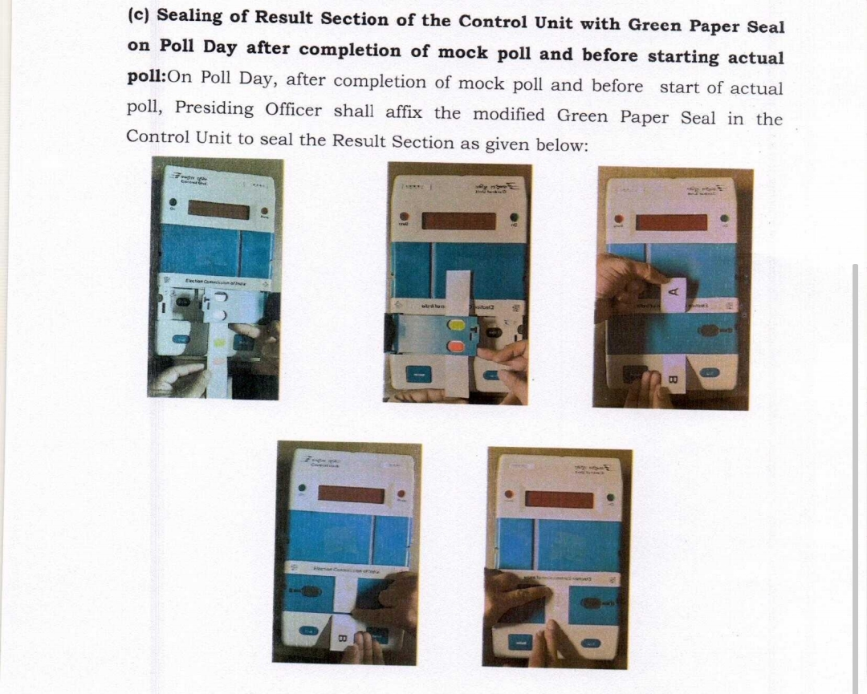
Procedure to Seal with Modified Green Paper Seal
MOCK POLL :
  Procedure of Sealing of the outer door of result section of CU with self adhesive Green Paper seal :
  - The New Green Paper Seal has a white side, which has two colour marks – Red and Green
  - Insert the seal into the Inner door of the Result Section in such a way that – Green colour remains visible on top of Result button & Red colour remains visible on top of Print button of CU
  - After closing of Outer Door, the loose ends of the Green Paper Seal with self adhesive A and B remains protruded towards Up & Down
  - Remove Wax paper from A, and paste it over the outer door
  - Remove Wax paper from B, and paste it over the outer door (on top of the underlying A.
  Seal the VVPAT drop box.
  Replacement Protocol – In case of any of the units-BU / CU /VVPAT goes out of order, Replace the corresponding Unit Only. ( Inform the unique IDs to Sector Officer for updating in E.M.S.)
  Sector Officer to collect report from Pr. O. in Part-IV, ECI Ltr. No. 51/ 13th August, 2021 on details of EVM(s) replaced during Poll, and hand over to Returning Officer.

Slide 45
Case Study
  VVPAT Machine during the Mock Poll found showing Error. Sector Officer contacted ARO in charge of Commissioning. The later verified & confirmed that 1000 voting was cast during Mock Poll on the same VVPAT and it was working perfectly !!!
  On the Day of Poll, during Mock Poll at 6.30 a.m. two complains were received from two different Sector Officers that VVPAT Machines are printing wrong Paper slips. That is printing is not reciprocal to the buttons pressed in the Ballot Units.

Slide 46
Poll Day Protocols
Start of actual poll on schedule time
  Presiding Officer to refer Brochure on handling EVMs during Poll and Closure of Poll from Manual of EVM & VVPAT-August,2020 ( Pg-119)
  Before the first voter signs in Register of Voter in Form-17A, PO-1 shall check with Pr.O. and record in INK in Form-17A that “Total in CU checked and found to be Zero”
  Responsibility of Presiding Officer during Poll
  Keep ready a Dummy Ballot ( having dummy names/dummy symbols) unit for demonstrating people needing assistance
  Also to keep ready a Dummy Braille Ballot for visually challenged voters
  Inspect BU in presence of Agents from time to time and also when a voter is suspected to be doing mischief inside the compartment
  Pres. Officer may refer to Annexure-22 at Pg.-136 of Manual, Aug-2020 on Handling of BU/CU/VVPAT Failures / Errors during Poll

Slide 47
Poll Day Protocols
  In Case of Complain U/R-49MA
  Take declaration from Voter
  Make a second entry in 17-A and permit the Elector to record a Test vote
  Observe printing in presence of agents
  If Voter is True – Stop further voting
  If Voter is false – Mention the name of the Candidate to whom the test vote has gone; in the remark col. Of the Second entry in 17 A and obtain sign./thumb of the Voter there
  Enter the same in item.6 of Part-I, 17 C

Slide 48
Poll Day Protocols
  In case a Voter denies to Vote : After signing Register: 17-A
  (During Poll) :
  Write “ Refused to Vote / Left without Voting” in the Remarks col. In 17-A
  Obtain the sign./thumb impression of that Voter
  If Ballot button of CU is pressed by that time - Allow another voter to vote as usual
  Alternatively – Switch OFF the CU and again switch ON - This will make the Ballot button functional
  ( When the last Voter denies)
  Switch OFF the CU
  Disconnect from VVPAT
  Again Switch ON the CU
  The Busy lamp will go off. Now you can press CLOSE.

Slide 49
Poll Day Protocols
  If Printed VVPAT slip remains hanging :
  Do not attempt to cut or pull down the slip
  There is no vote recorded in the memory of CU
  The details of the incidence i.e. Time of occurrence, total votes befor occurrence, name & sl.no. of the voter, whether s/he voted or left after replacement etc. - be noted in Presiding Officer’s Diary
  After change of VVPAT, the voter should be allowed to cast her vote
SOP for replacement during actual poll
    In case of low battery in CU or VVPAT - replace power pack of CU or VVPAT
  In case VVPAT found non-functional, replace VVPAT only and NO mock poll is required.
  In case BU or CU found non-functional, replace entire set (BU+CU+VVPAT). Conduct mock poll (1 vote to each contesting candidate including NOTA). ( Report IDs of the units to S.O. for updating in E.M.S.)
  Sector Officer to collect report from Pr. O. in Part-V, ECI Ltr. No. 51/ 13th August, 2021 on details of EVM(s) replaced during Poll, and hand over to R.O

Slide 50
Poll Closure
Don’t forget to press CLOSE button after close of Poll fill up Report in Format-Part-III, ECI Ltr.51/ 13th August,2021
Note Down Date & Time in the Presiding Officer’s Diary
Press TOTAL to know the total votes recorded in the day
First Switch OFF the CU, Keep Paper Roll Knob of VVPAT horizontally
Disconnect the cables carefully from among Units
Remove Battery of VVPAT ( Not of CU)
Complete Part-I of Accounts of Votes in Form-17 C (containing details of Votes recorded in EVMs & Test Vote etc.) & distribute copies to the Polling Agents under acknowledgements
Keep BU, CU & VVPAT in respective carrying cases and using thread seals, fix address tags. Tags to have particulars of Election, Unit ID & P.S. with dated sign. & seal of Pres. Officer

Slide 51
Poll Closure
Polling Agents should be asked to put their seals (if they so desire)
Complete all other reports such as - Presiding Officer’s Diary and 16- Pt. report for Observer containing all details relating to EVMs, all statutory , non-statutory reports, insert in designated covers
Carry back the EVMs and other Polled materials along with Sector Officer / Armed security cover
Deposit polling materials including EVMs/ VVPATs + Mock Poll Slips + One copy of 17-C (to store in strong room) at Collection center at the reception counter
Also submit Envelope containing all three (03) Reports i.e. Mock Poll Certificate ( Part-I), Power Pack Replacement Report (Part-II) & Close Button Report(Part-III) as per ECI Ltr. No. 51/ 13th August, 2021
Delay in submission of Polled EVMs & VVPATs, Election materials and Records at Collection Centres will be viewed seriously by Commission.

Slide 52
EVM & VVPAT in case of Re-Poll
EVMs and VVPATs are to be drawn from Reserve list and intimated to Candidates
Address Tags to clearly mention that the units are for Re-Poll
Paste “Re-Poll EVM/VVPAT” pre-printed stickers on the carrying cases
After Re-Poll, the EVM strong room shall be re opened
Re-polled EVMs are to be kept along with the old EVMs/VVPATs ( having stickers – ‘TO BE COUNTED’)
Old EVMs are to be pasted with stickers – ‘ NOT TO BE COUNTED’ to avoid confusion during Counting
Enter unique IDs of the Re-Poll EVMs in E.M.S.

Slide 53
Case Study :
A Voter without signing / putting thumb impression in Register of Voters, is proceeding to Voting chamber. Pres. Officer to allow / disallow him/her ?
While pressing the Total Button at the close of the Poll, the CU displayed 997 Votes. But the Polling Officer I/C of Voters Register ( 17-A), verified and stated that there are only 945 votes cast as per 17 A. Presiding Officer is in trouble as to how the difference came ?

Slide 54
STORAGE & SAFETY OF EVMs/VVPATs
(After Polling, up-to Counting Period)
EVMs are escorted back to the strong room post poll and remains under double lock ( 01 key with R.O and other with A.R.O.)
Multi Layered storage Racks can be used to keep EVMs sequentially
Candidates are allowed to put their own locks
Two tier-round the clock security arrangements for the strong rooms having polled EVMs
IP controlled CCTV with DVR, Videography for each opening & closing
The CPF secures the innermost perimeter immediately outside the strong room and the State Armed Police secures the outer perimeter
Separate Log books for Security personnel as well as for authorized Officers
Candidates are also allowed to keep vigil (beyond innermost perimeter) over the storage outside the inner circle
Gen. Observer of ECI to submit report 2 days before Counting, on arrangement of Strong room ( Annexure-IV, ECI Ltr.no.51, 17th Aug-2021)
Notes:
Elaborate security protocol, both during election as well as non-election period, clubbed with the transparency protocol mandating written intimation to political parties and candidates everytime the warehouses are opened ensure that no-one can access the EVMs at any time. This security protocol is strengthened multifold while storing polled EVMs with CAPF, CCTV & Candidates Watch.
In addition ECI undertakes annual physical verification of entire EVM stock across the country.
However, All Political parties are also requested to kindly keep an eye on EVM warehouses even during non-election period

Slide 55
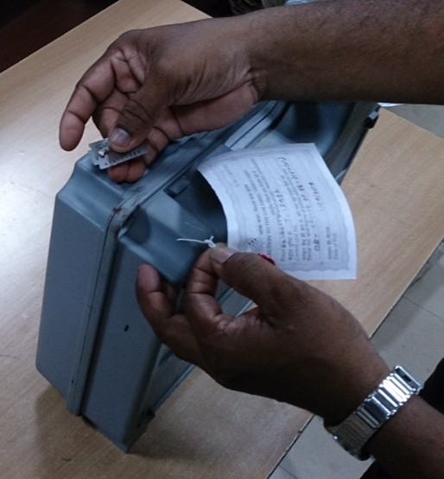
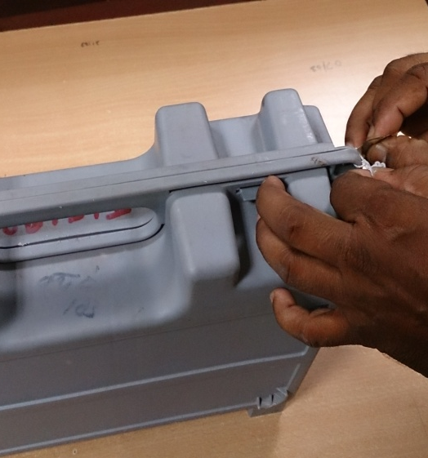
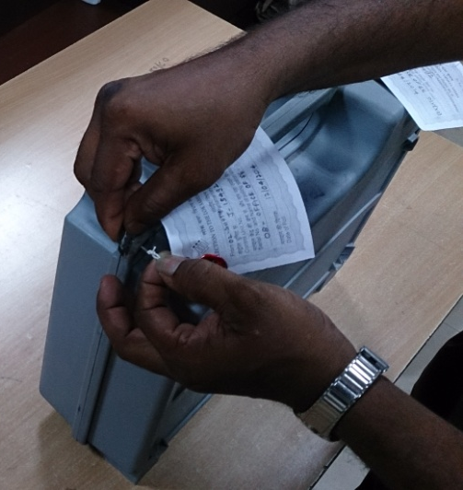
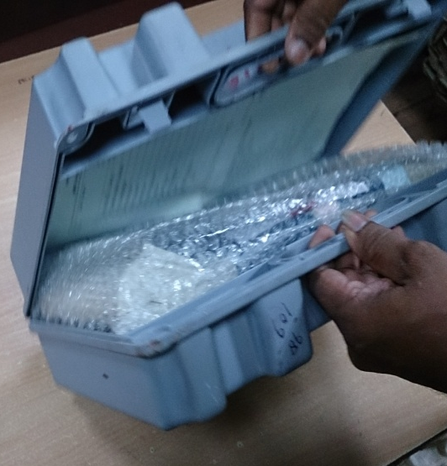
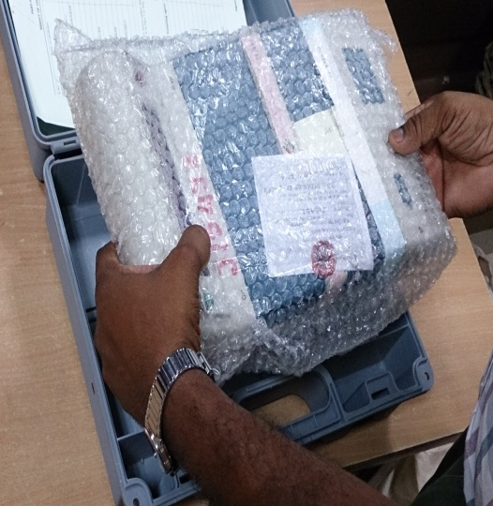
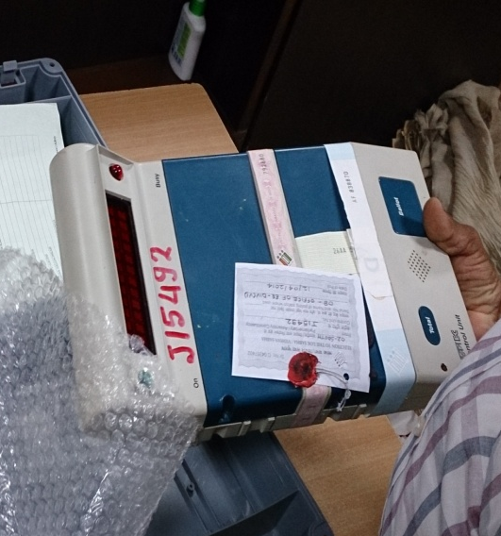
COUNTING – Retrieving Result from EVM

Slide 56
Counting of votes recorded in EVMs
EVMs to be distributed sequentially, i.e PS no. 1 to Table 1 and so on. Nodal officer to ensure.
Keep account of such distribution with you
Along with CU, sealed cover containing Form 17C (Account of Votes) to be brought to counting table.
Remove the seals from carrying case, take out CU. Place on table for inspection of seals by Candidates/ agents before counting of votes.
If seal is properly intact and there is no tampering, votes will be counted.
Proceed further
Decide if clerical errors or actually tampered with. If tampered with, keep aside and inform ECI immediately
Check - it is the same CU supplied to the PS
Seal on Cand set Section is intact.
Green Paper Seal in Result Section & Special Tag on Result Section are intact.
S. No. on green paper seal to tally with paper seal account prepared by PrO in Form 17C:Part I: Item 10.
Only CU required for Counting . BU to be brought into hall only if inspection required

Slide 57
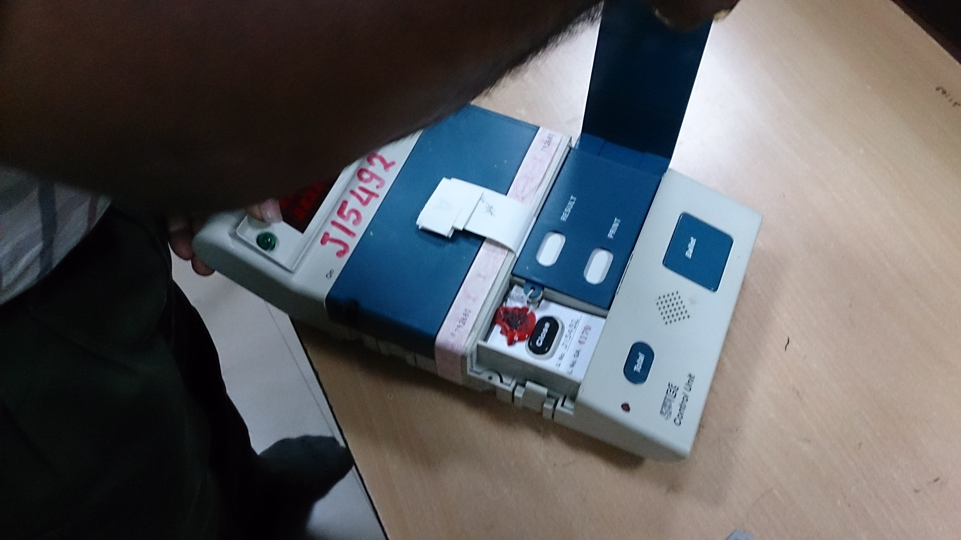
CU : Before Retrieving Result

Slide 58
Counting of votes recorded in EVMs
Switch ‘On’
Press the ‘Total’ and check whether total vote shown in CU is matching with S.N.6 of part-I of Form 17C
(If Matching)
Pierce Green paper seal over Result I button provided in inner cover of result section
Press the Result button
No. of votes to each candidate will be displayed for that P.S. Lift the unit and show it to all agents so that they can note down.
Counting supervisor to note result in Pre Stamped Part –II –of Form 17C.
If required, press again to show result to candidates/agents
After result is noted, close cover of result section and Switch “OFF” CU
If not, check if clerical error. In case of dispute, Set EVM aside. Report ECI for further direction

Slide 59
SPECIAL CASES TO DEAL WITH DURING COUNTING
Malfunctioning of EVM :
(Non Display of Result from CU)
If Control Unit of a Polling Station does not display the results, Install new Power Packs. If still not displaying - Keep inside carrying case and put under custody of RO
Result from such Control Unit(s) will not be retrieved using Auxiliary Display Unit or Printer.
After completion of counting of votes from all the Control Units - Printed paper slips of the respective VVPAT shall be taken up for counting

Slide 60
SPECIAL CASES TO DEAL WITH……
( Where “Close” button is not pressed )
If CLOSE button was not pressed by the Presiding Officer, CU will show “INVALID” - when Result button is pressed.
CU will be kept inside carrying case and in custody of RO; while continuing with counting of other EVM’s.
Only when counting of all the EVM’s is over - RO and Observer to check the margin of votes
Margin between the leading and the second candidate may be more or less than votes polled in this EVM.
Both cases – Press “Total”
If matches – Press CLOSE button – Explain to Agents- Report ECI in Annexure-A ( R.O’s H.B.-2019)
If doesn’t match-
(1) Report to ECI in Annex-B ( If margin is MORE than vote in CU)
(2) Report to ECI in Annex-C ( If margin is LESS than vote in CU)
( As per Latest Technology in M3 EVMs, there is auto seizure of Ballot Button after 12.00 mid night of the day of Poll)

Slide 61
STORAGE & SAFETY OF EVMs/VVPATs
After Counting Up To 45 Days ( E.P. Period)
All polled EVMs including VVPATs to be kept under DEO’s custody.
If this strong room is located away from the counting center, intimate and allow all candidates to follow the transporting vehicles to DEO’s Strong room and see its storage
Strong Room/ Warehouse with only one entry point.
Entry secured by a double lock system.
Keys held jointly by two separate officers, nominated by the DEO.
24X7 security arrangement, fire extinguishers and all other strong room protocols to be followed
After 45 Days :
After E.P. period – Do not touch the EVMs & VVPATs till confirmation of E.P. position from the Hon’ble H.C.
Within 10 days – send all defective units to BEL/ECIL for repair ( if not involved in E.P.)
If No E.P. filed/ No other court case is pending – use EVMs & VVPATs for any other purpose/other election as decided by ECI
If E.P. is filed – wait till the E.P. is disposed, and also confirm that no appeal is filed before Hon’ble Supreme Court.
All polled EVMs including VVPATs to be kept under DEO’s custody.
If this strong room is located away from the counting center, intimate and allow all candidates to follow the transporting vehicles to DEO’s Strong room and see its storage
Strong Room/ Warehouse with only one entry point.
Entry secured by a double lock system.
Keys held jointly by two separate officers, nominated by the DEO.
24X7 security arrangement, fire extinguishers and all other strong room protocols to be followed
After 45 Days :
After E.P. period – Do not touch the EVMs & VVPATs till confirmation of E.P. position from the Hon’ble H.C.
Within 10 days – send all defective units to BEL/ECIL for repair ( if not involved in E.P.)
If no E.P. filed/ No other court case is pending – use EVMs & VVPATs for any other purpose/other election as decided by ECI
If E.P. is filed – wait till the E.P. is disposed, and also confirm that no appeal is filed before Hon’ble Supreme Court.
Notes:
Elaborate security protocol, both during election as well as non-election period, clubbed with the transparency protocol mandating written intimation to political parties and candidates everytime the warehouses are opened ensure that no-one can access the EVMs at any time. This security protocol is strengthened multifold while storing polled EVMs with CAPF, CCTV & Candidates Watch.
In addition ECI undertakes annual physical verification of entire EVM stock across the country.
However, All Political parties are also requested to kindly keep an eye on EVM warehouses even during non-election period

Slide 62
Critical Mistakes
1. First Level Checking of EVMs and VVPATs
Non-updating of FLC-OK or FLC-Reject status in EMS through Mobile-App on day to day basis.
FLC of VVPATs without using Dummy Ballot Paper on BU.
Non-Uploading of 16 candidates (including NOTA) Dummy Symbols in the 1% VVPATs used for testing with 4-BUs having 64 dummy symbols (including NOTA)
Irregularity on use of Dummy Symbols
2. Commissioning of EVMs and VVPATs
Non-checking of candidate symbols uploaded in VVPAT during commissioning.
In case of M3 EVMs non connecting M3 VVPATs at the time of commissioning – It will not accept a VVPAT at a later stage.
3. Transportation of VVPATs
Paper Roll Knob placed vertical - when transporting the VVPAT from one place to another – VVPAT may malfunction

Slide 63
Critical Mistakes
4. Dispersal
Switching on and testing of VVPAT in broad daylight - VVPAT may go into error mode
5. Mock-Poll on Poll Day
Not pressing the CLOSE button of CU after mock-poll.
Not matching the mock-poll result of the CU with the VVPAT Paper Slips.
Not removing the mock-poll paper slips from VVPAT
Non-deletion of mock-poll data from the Control Unit.
Not noting down the Sl. No. of Defective & Replaced unit

Slide 64
Critical Mistakes
6. During Poll
Placing BUs and VVPATs under direct bright light or near window.
Conducting mock poll, in case of replacement of VVPAT only.
In case of non-functioning of CU or BU - replacing only respective CU or BU and not conducting mock poll
Non-pressing of CLOSE Button after completion of Poll
Damaging any seal of BU/CU/VVPAT – Creates suspicion in the minds of Candidates/Agents
7. General
Repeatedly switching ON and OFF the VVPAT resulting in depletion of the battery as well as paper roll.
Not switching OFF the CU while connecting or disconnecting the EVMs/VVPATs

Slide 65
Meaning of Imp. Msg./Errors in EVMs
For errors in BU/CU/VVPAT - Msg. will be displayed in CU only.
In CU, after pressing Ballot Button , it is showing -
“PRESSED ERROR BU” – It means any Button in the BU is Jammed. It requires cleaning/removal of the same
“ BU NOT CONNECTED” – Connection with BU is not proper
“BU NOT RESPONDING”- Either cable between BU and VVPAT or between VVPAT and CU are not connected properly. There may be mistake in Thumb wheel Positioning of BU.
“VVPAT NOT RESPONDING”- Paper Roll Knob of VVPAT not kept in Vertical position / VVPAT Battery is low.
“INVALID” – CU Button is pressed out of sequence ( C-R-C)
“CLOCK ERROR” – Malfunctioning of Real Time Clock
“ ELECTION EXCEEDED ” – When Poll Date is over

Slide 66
Meaning of Imp. Msg./Errors in EVMs
On press of Ballot Key on CU, if there is any error w.r.t. VVPAT the following message will appear on CU :
VVPAT Error 2.1- Abnormal Head Temperature
VVPAT Error 2.3- Printer Time out Error
VVPAT Error 2.4- Printer Low Voltage Error
VVPAT Error 2.5- Printer Incorrect Command Error
VVPAT Error 2.6- Cutter Error
VVPAT Error 2.7- Fall Error
VVPAT Error 2.8- Printer Memory Error
VVPAT Error 2.9- Contrast Error
VVPAT Error 2.10-Length Error
VVPAT Error 2.12- Platen Open Error
VVPAT Error 2.13- No Paper Error
VVPAT Error 2.14- Deplete Error

Slide 67
References :
R. P. Act – 1951
C. E. Rules – 1961
Handbook for Returning Officer - 2019
Manual on EVM & VVPAT – August, 2020
ECI Ltr. No.51/Dtd.13-08-2021 ( Poll day Reports)
ECI Ltr. No.51/Dtd.17-08-2021 ( Storage & Safety)
Latest Instructions on EVM & VVPAT issued by ECI from time to time

Slide 68

THANKS
Any Questions ?
Contact details : 9437337662
e-mail ID : pk4653175@gmail.com

