Slide 1

Electronically Transmitted
Postal Ballot System (ETPBS) pre-counting

Slide 2
ETPBS – Pre-Counting Steps
Step 1: The Outer covers (Form 13-C) which is having QR Code on lower right hand side, it will be read by the QR Code Reader and necessary valid checks will be performed for possible duplicates and verification of the service voter. A unique serial number will be provided by the computer. This serial number will also be manually marked by RO on the envelope being verified.
Step 2: If no duplicate and correct verification is found, then only outer envelope (Form 13-C) will be open.
Step 3: Open the outer cover (Form 13-C) and take out the two documents which are required to be found inside. The first one is declaration (Form 13-A) and the second one is inner cover (Form 13-B) containing the postal ballot paper.
Step 4: RO should take out the declaration from Outer Envelope, Form 13-A and the inner cover in Form 13-B.

Slide 3
ETPBS – Pre-Counting Steps cont.
Step 5: Now scan two QR Codes on Form 13-A one by one and after that scan the QR Code which is on lower right side on Form 13-B.
Step 6: Note down the Sl. No. generated in all the above Covers respectively.
Step 7: If the QR Code reading does not raise any anomaly, keep Form 13-B envelope and Declaration back in Form 13-C envelope and keep the envelope in a tray meant for valid envelopes to be taken up for counting. If the QR Code reading indicates any discrepancy such as the documents not being genuine or multiple copies of the document have been received, such envelopes shall be kept in a separate tray meant for rejected envelopes.
In case of rejection of envelopes/documents on QR Code reading, the ARO in-charge of the team should see and satisfy himself about the discrepancy shown in QR Code reading that results in rejection.

Slide 4
Electronically Transmitted Postal Ballot System – Pre Counting
Pre-Counting
Scan
Form 13-C
(Outer Envelope)
Scan
Form 13-A
(Declaration)
Scan
Form 13-B
(Inner Envelope)

Slide 5
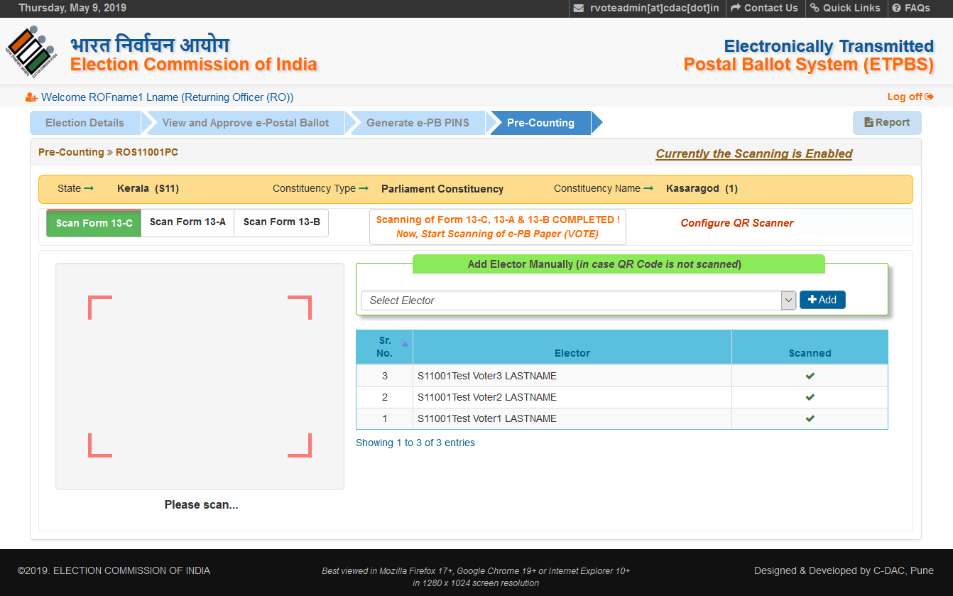
Scan: Form13-C

Slide 6
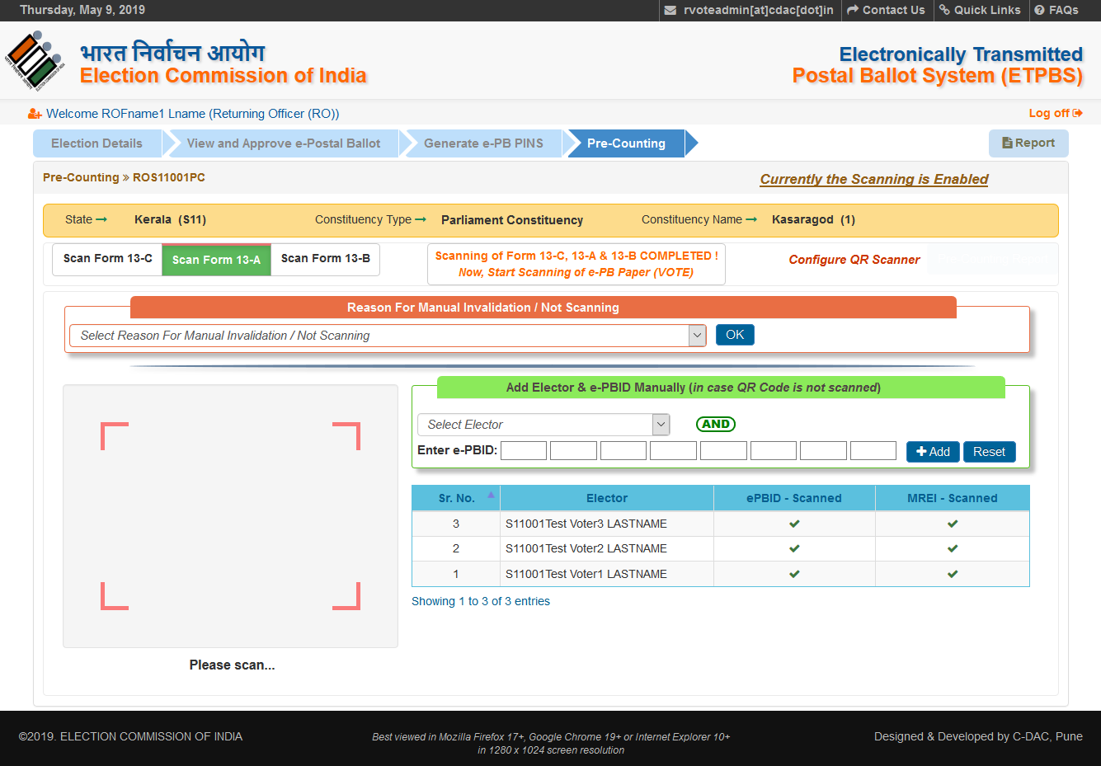
Scan: Form13-A

Slide 7
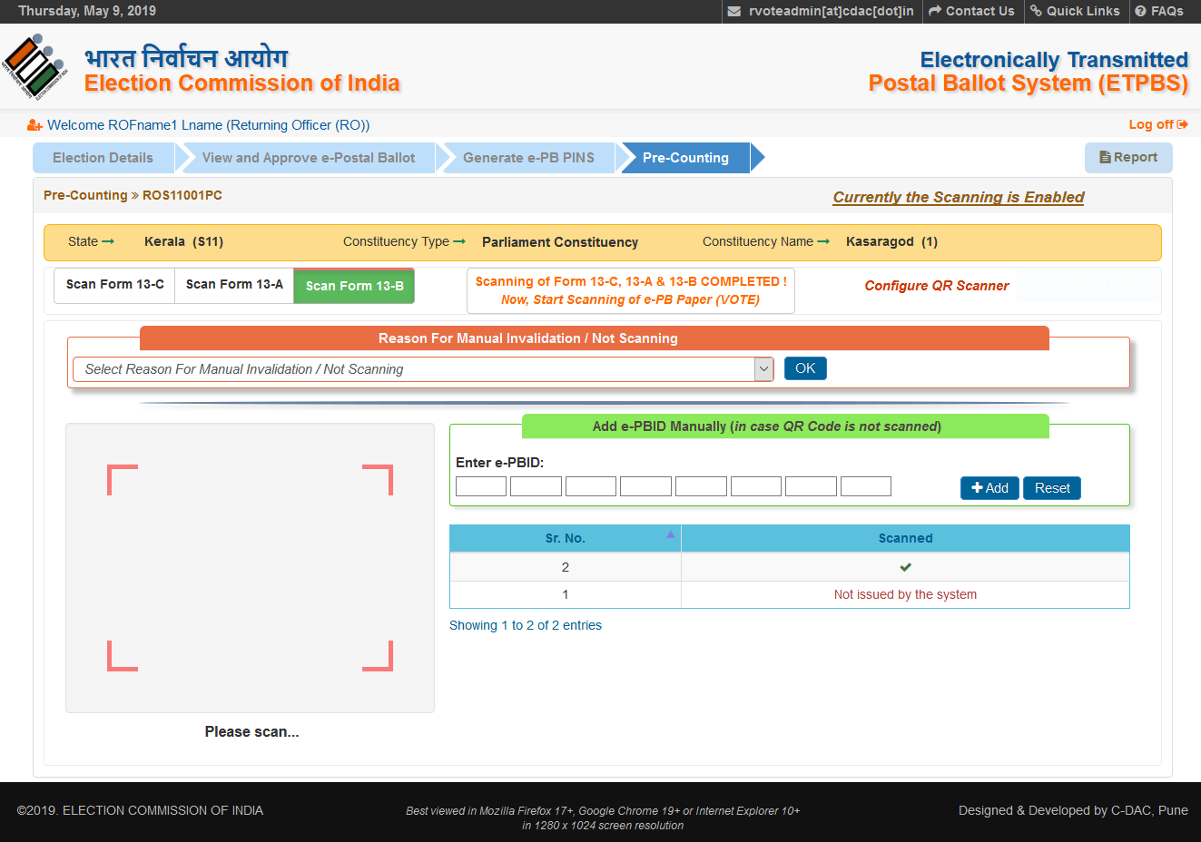
Scan: Form13-B

Slide 8
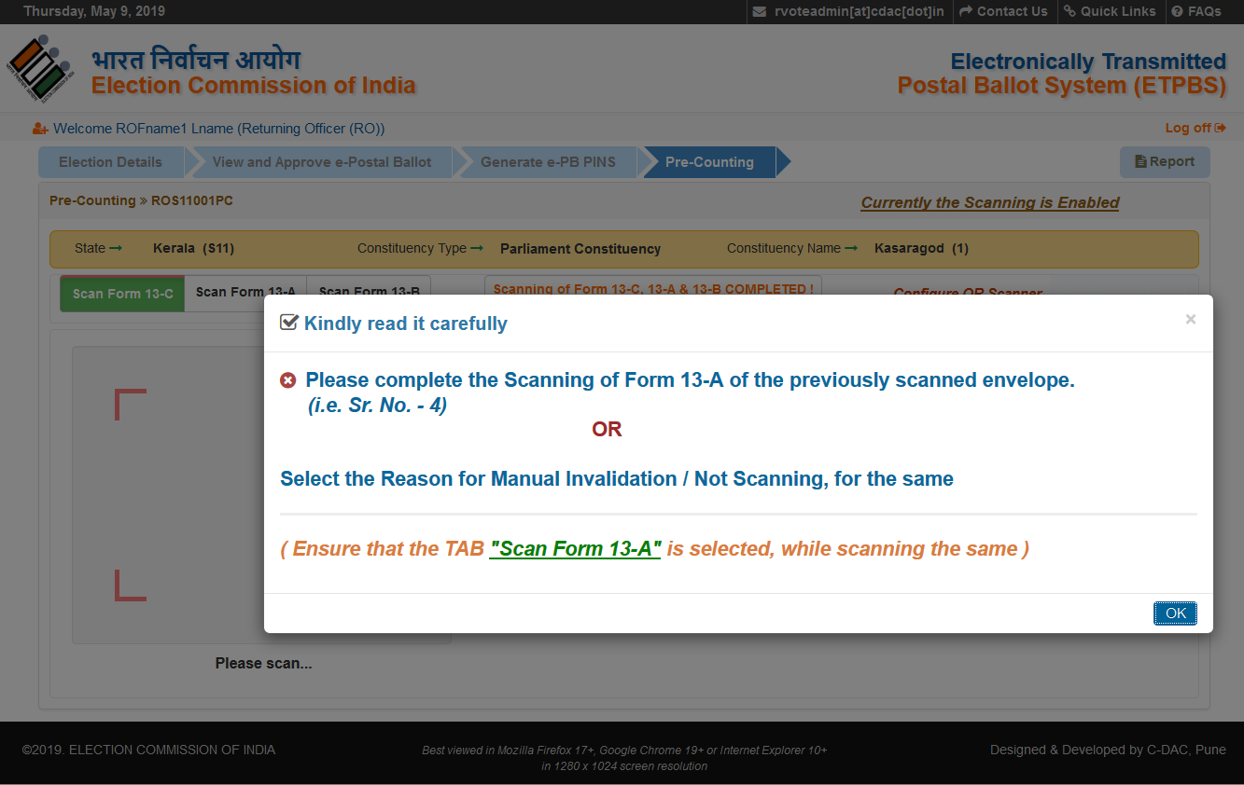
Scan: Form13-C & then Immediately Scan New Form-13C

Slide 9
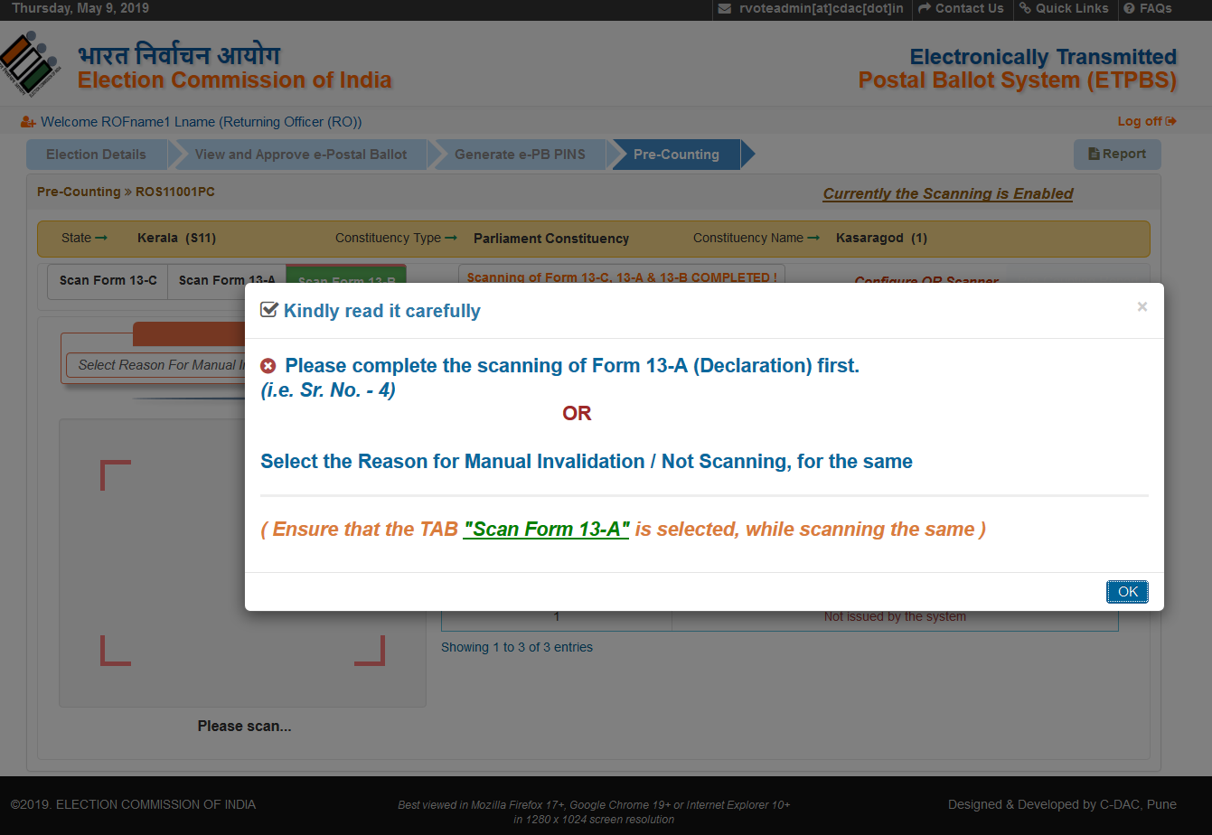
Scan: Form13-C & then immediately Scan Form-13-B (Leaving the Scanning Form 13-A)

Slide 10
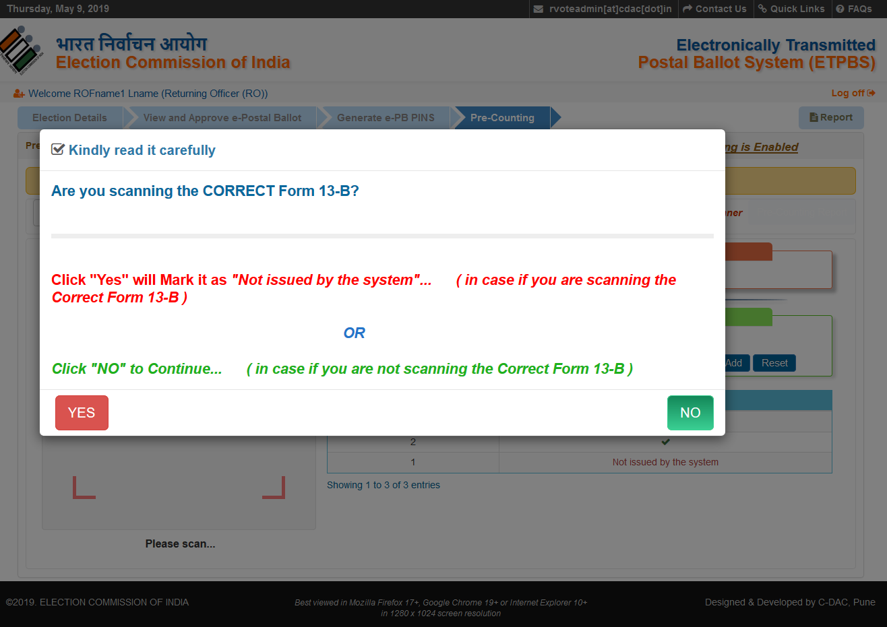
Scan: Form13-C, Scan: Form 13-A & then by mistake Scan Form-13-C instead of Form 13-B again

Slide 11
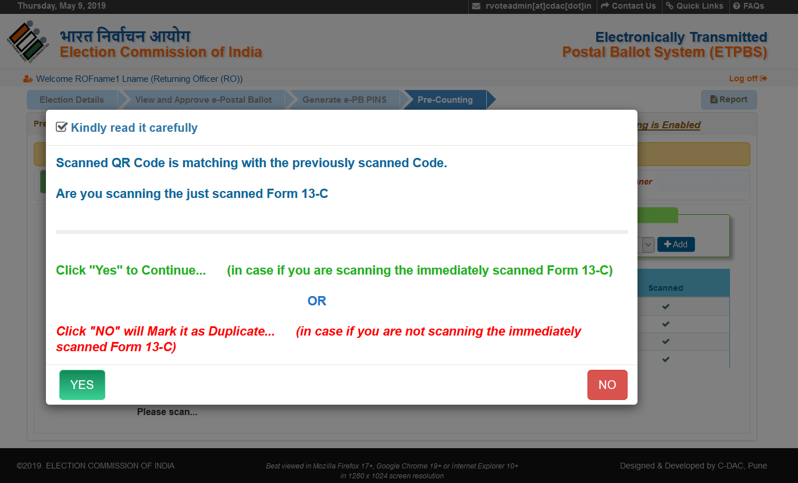
Scan: Form13-C, Scan: Form 13-A & Scan: Form 13-B & then by mistake Scan Form-13-C, just Scanned

Slide 12
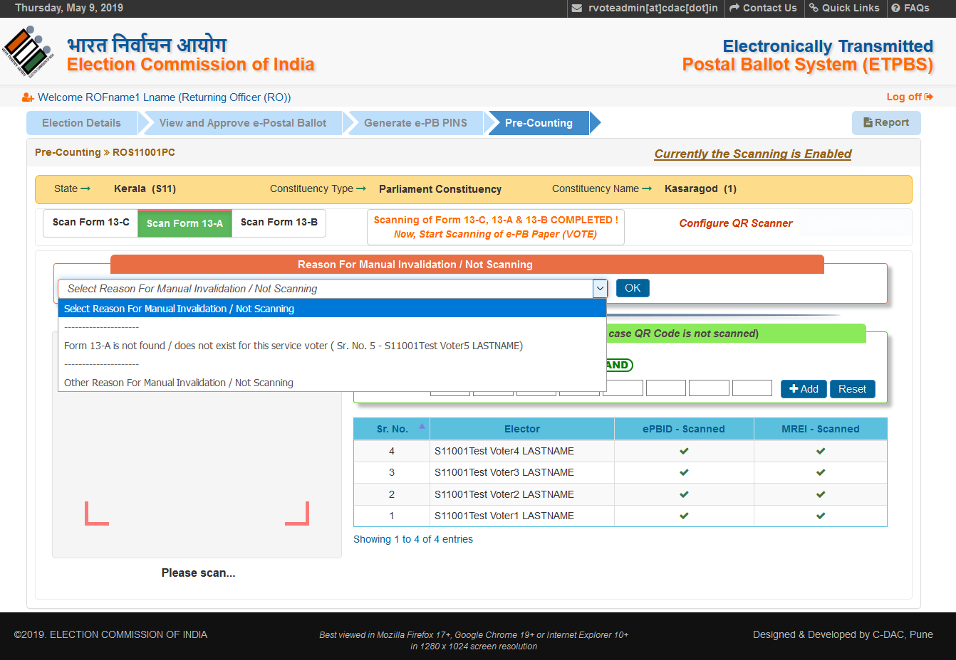
Scan: Form13-C & then Form-13-A Does not Exist (Manual Invalidation)

Slide 13
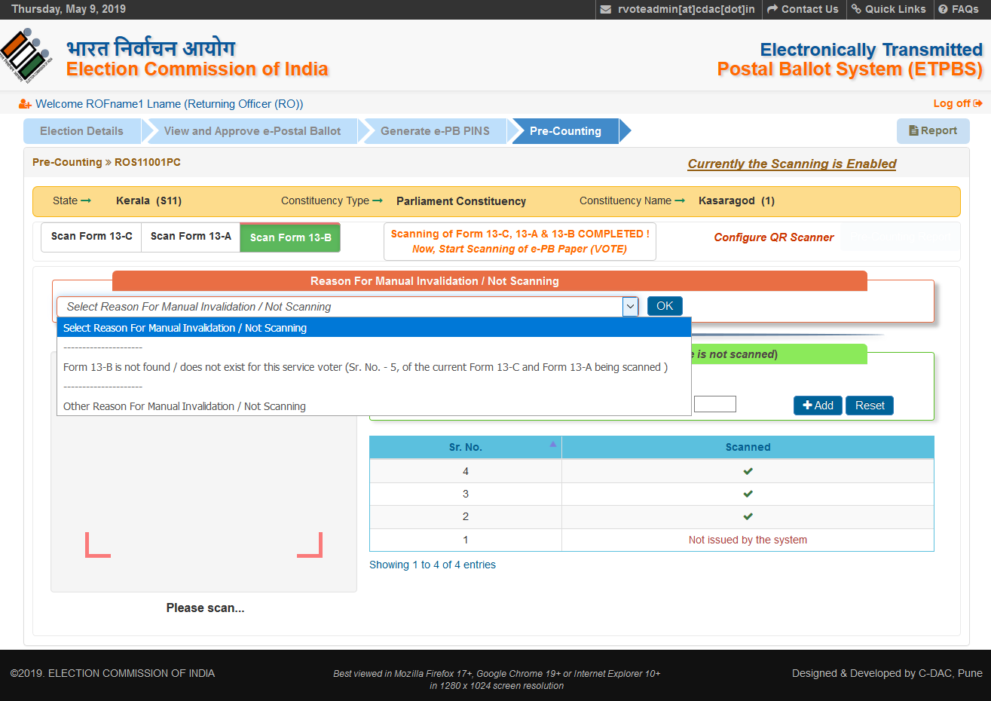
Scan: Form13-C, Scan Form 13-A & then Form-13-B Does not Exist (Manual Invalidation)

Slide 14
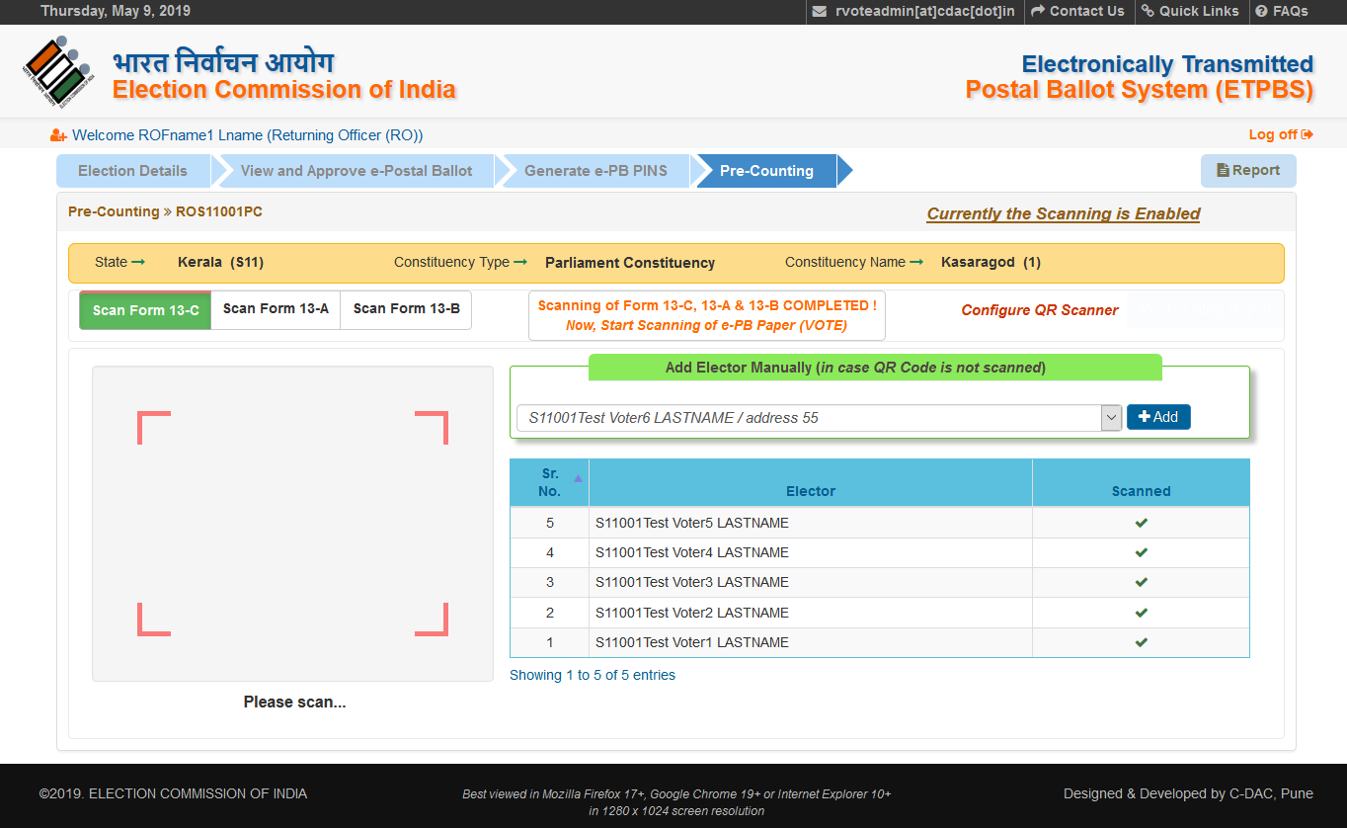
Add Elector Manually: Form 13-C (in case QR Code in not Scanned)

Slide 15
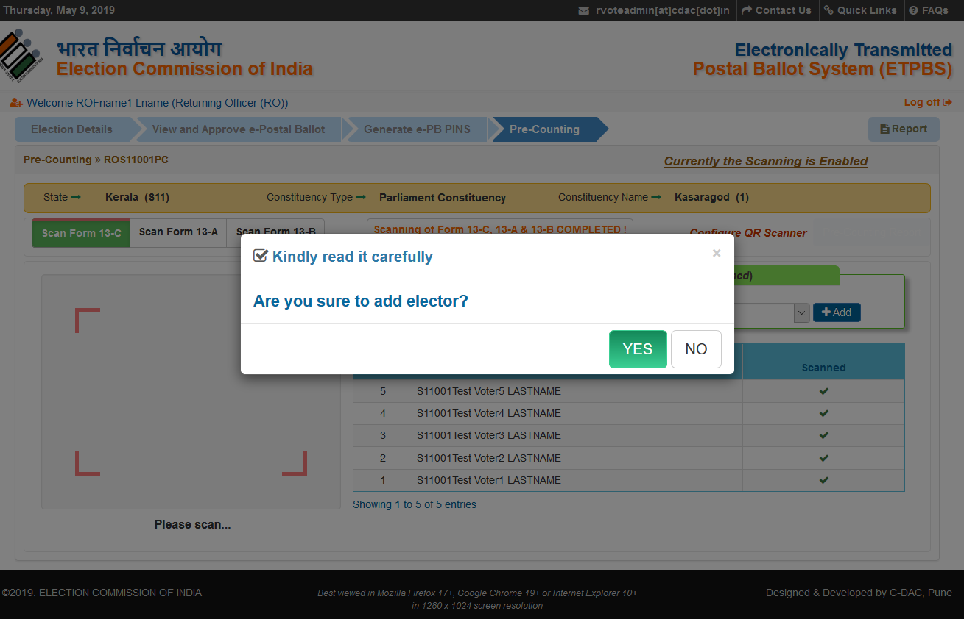
Add Elector Manually: Form 13-C (in case QR Code in not Scanned)

Slide 16
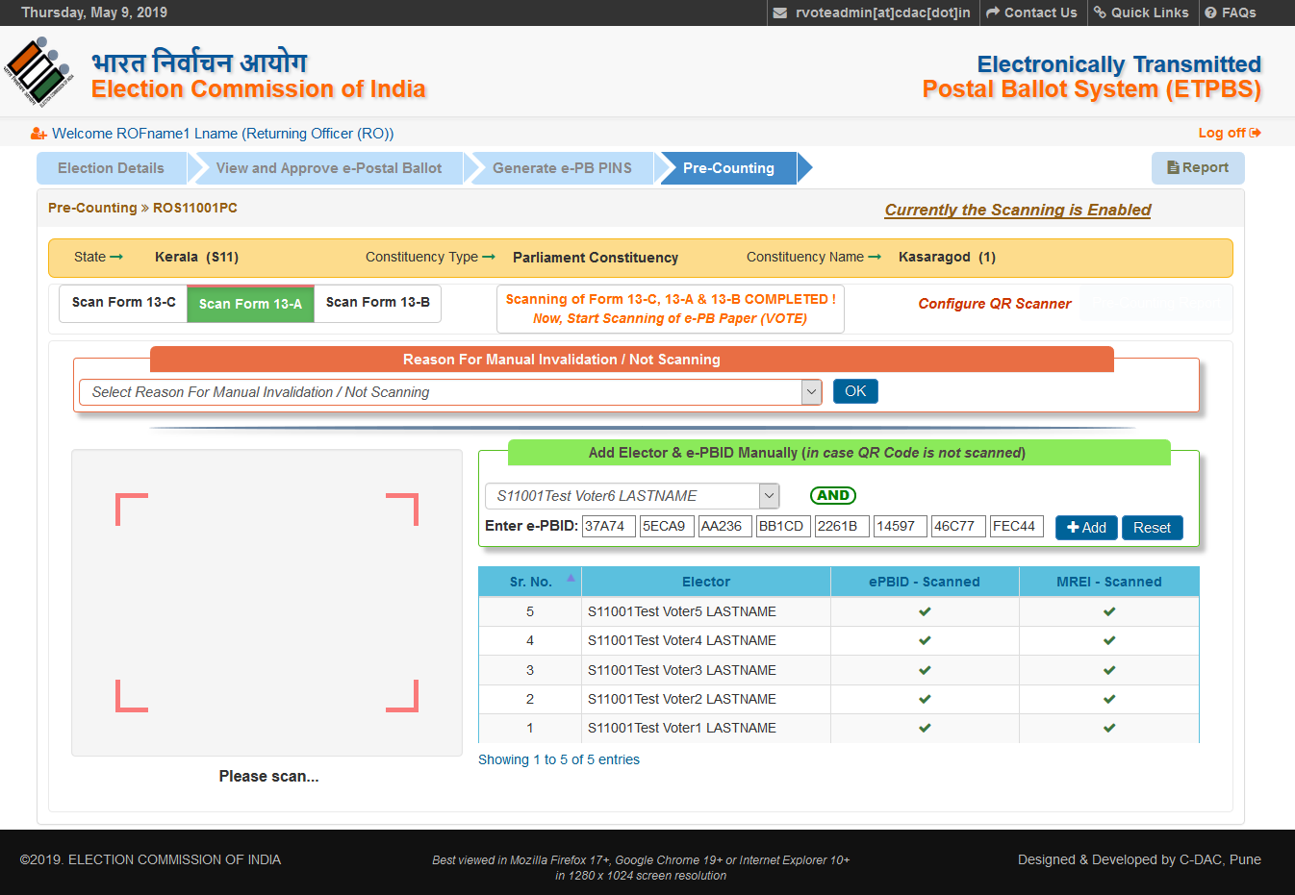
Add Elector & e-PBID Manually: Form 13-A (in case QR Code in not Scanned)

Slide 17
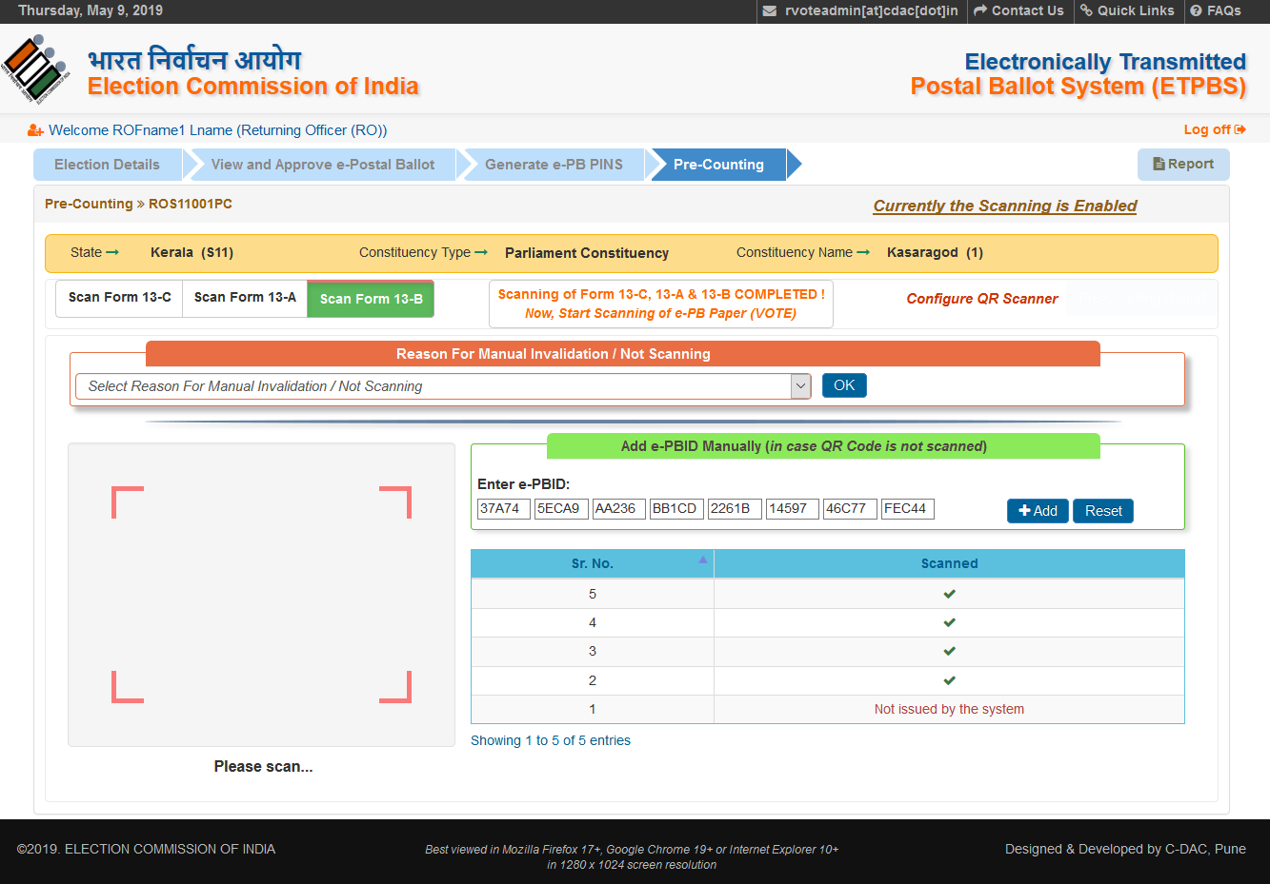
Add e-PBID Manually: Form 13-B (in case QR Code in not Scanned)

Slide 18
Thank You

