Slide 1

MANUAL
ON
Electronically Transmitted Postal Ballot System(et PBs)

Slide 2
Abbreviations used in this document : 1. ETPBS : Electronically Transmitted Postal Ballot System 2. SV : Service Voter 3. e-PB : Electronic Postal Ballot 4. e-PBID : Electronic Postal Ballot Identification Number
Stake Holders:
1. SERVICE VOTER 2. RECORD OFFICER / UNIT OFFICER OF
THE SERVICE VOTER 3. CEO 4. DEO 5. ERO 6. RO

Slide 3
PREFACE - Following topics are covered 1. Registration & Enrollment in Service Voter List 2. How to transfer the SV list from service voter portal to ETPBS portal by ERO 3. RO creates PB template using desktop application. 4. RO Uploads Ballot template pdf, Verifies e-PB & Generates PIN in ETPBS portal. 5. On Counting day, RO scans Form 13 C-A-B using ETPBS portal

Slide 4

1. ERO : REGISTRATION & ENROLLMENT IN SERVICE VOTER LIST

Slide 5
Service Voters' Portal
http://servicevoter.nic.in/
Service Personnel applies for Service Vote in portal through Record Officer
ERO receives the application via CEO -> DEO
ERO enters remarks and record marked as NOT OK & returns to Record Officer
ERO verifies the application
Incomplete
Complete
ERO accepts the application
Form 2 for Armed forces;
Form 2A for Armed Police Force;
ERO Enrolls the service voter

Slide 6
2. ERO : TRANSFER SV LIST FROM SV PORTAL TO etPBS PORTAL

Slide 7

Voter List needs to be transferred from Service Voters' portal to ETPBS portal:
http://servicevoter.nic.in/
Once ERO uploads the SV list, it appears in the respective RO login
1. ERO Logs into servicevoter.nic.in and downloads the SV list
ETPBS portal
ETPBS WEBSITE
Download to computer
2. ERO logs into ETPBS portal (etpbs.in), browse the file and uploads the SV list and finalize.
UPLOAD

Slide 8
Portal used by ERO:
Service Voter portal address : http://servicevoter.nic.in
ETPBS LIVE portal address : https://etpbs.in/
ETPBS Test site address : http://117.239.180.198:86

Slide 9
HOW TO CREATE e-POSTAL BALLOT TEMPLATE ONCE FORM 7A IS FINALISED

Slide 10
e-PB GENERATION PREREQUISITE - 1
Desktop application is used to Generate e-PB template
Download the desktop application setup from this Link :
https://drive.google.com/open?id=1fbMXioflJ96hljbOTbP90BzGblchngxX
Install the desktop application (In the final installation window select “Create a desktop shortcut”)
Restart the computer before opening the application

Slide 11
Scan Candidate Photo
e-PB GENERATION PREREQUISITE - 2
Once contesting candidates are finalized, Scan photograph of the candidate one by one and save in JPG format with file size less than 12 KB.
File Type : .jpg File size : < 12 KB approximately

Slide 12

Ballot Template preparation Desktop application
Double click the Ballot Generation software icon

Slide 13
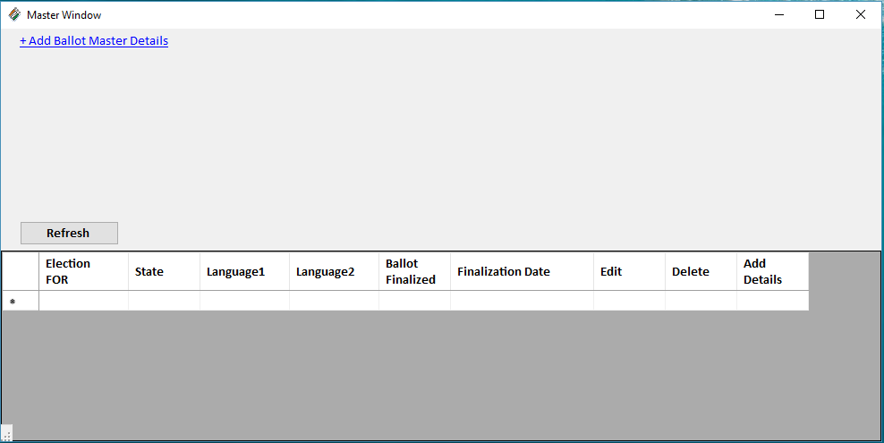
Postal Ballot Master
2) Click Add Ballot Master button

Slide 14
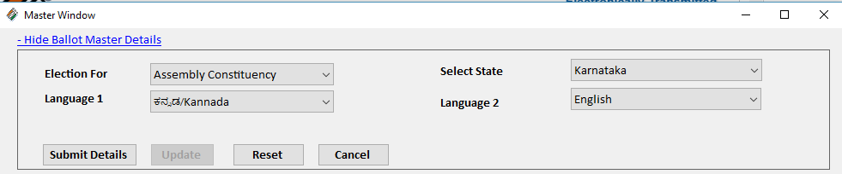
Postal Ballot Master
3) Enter Ballot Master details and click SUBMIT DETAILS
4) Master details are saved and appear in the below grid. Click “ADD CANDIDATES”

Slide 15
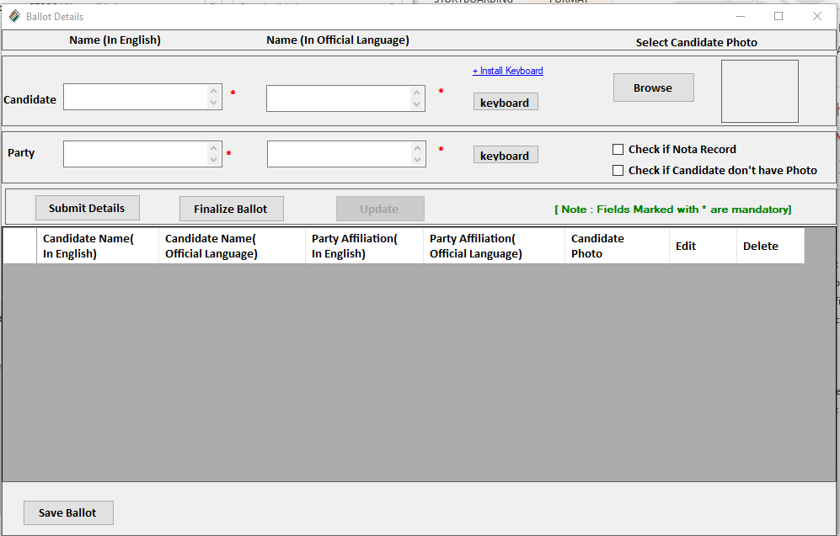
ADD CANDIDATE FORM

Slide 16
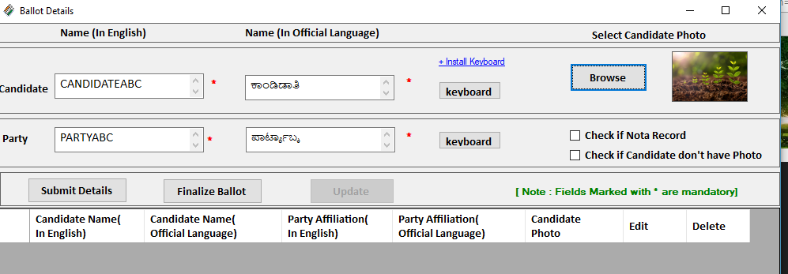
ENTER CANDIDATE DETAILS IN THE SAME ORDER AS IT APPEARS IN FORM 7A
Enter Names in column 1 & 2 in English of 1st candidate as in Form 7A. Pressing tab after entering English Name the corresponding local official language will appear in the adjacent text box. Verify the name in local language. Correct in case of any mistake.
Click “Browse” and upload the scanned photo of candidate. If the candidate doesn’t have a photo check the option “Check if candidate doesn’t have photo”
Click “Submit Details” button to save the candidate
1
3
2
4

Slide 17
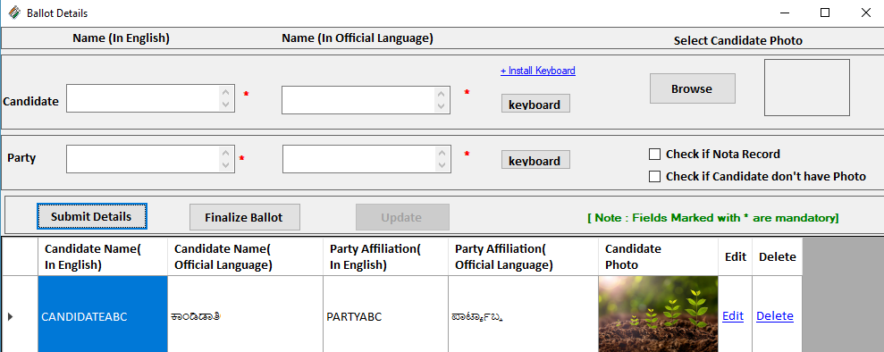
ONE CANDIDATE DETAILS IS SAVED SUCCESSFULLY
Note: If the auto translation to state official language is not correct, type the name in Unicode elsewhere and paste the text in the Official language Textbox of the software.

Slide 18
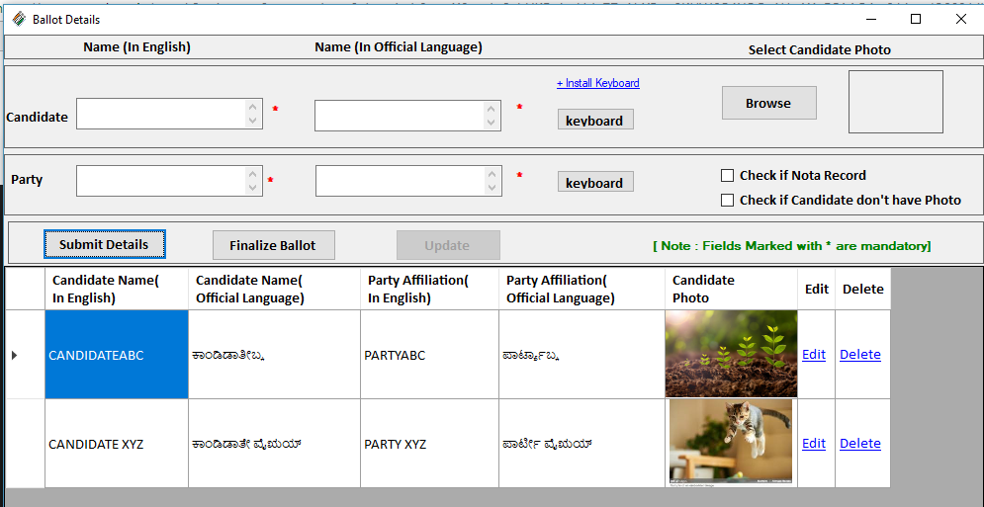
ENTER NEXT CANDIDATE DETAILS IN THE SAME ORDER AS IT APPEARS IN FORM 7A
Repeat steps from (5) to (7) till all candidates are entered

Slide 19
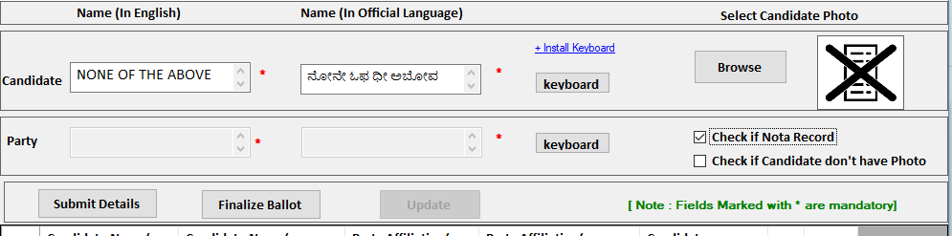
ENTER NOTA
8. Finally
- > Enter “NONE OF THE ABOVE” in candidate field
- > Select “CHECK IF NOTA RECORD”

Slide 20
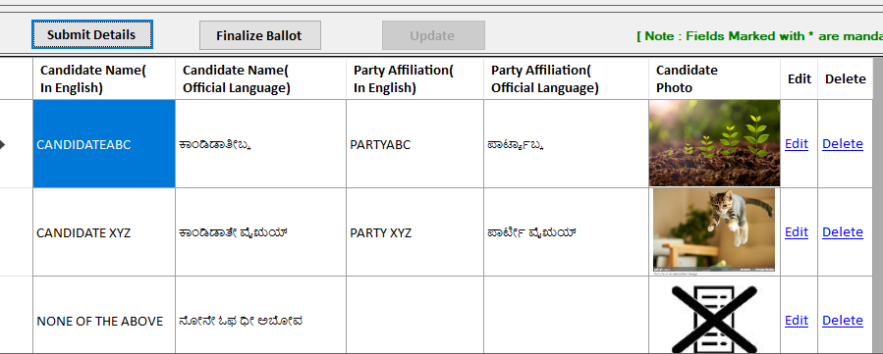
ALL THE CANDIDATES’ ENTRIES ARE OVER

Slide 21
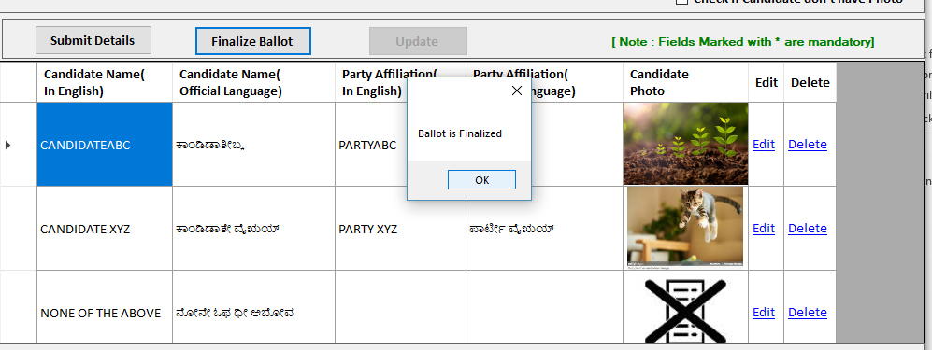
FINALISE BALLOT TEMPLATE
8 (i). Check the following before clicking FINALISE button (a) The serial of candidates in the list (b) Details of the candidate. After verification if its correct click “FINALISE BALLOT”

Slide 22
HOW TO EDIT AFTER FINALISE BUT BEFORE UPLOAD TO ETPBS PORTAL

Slide 23
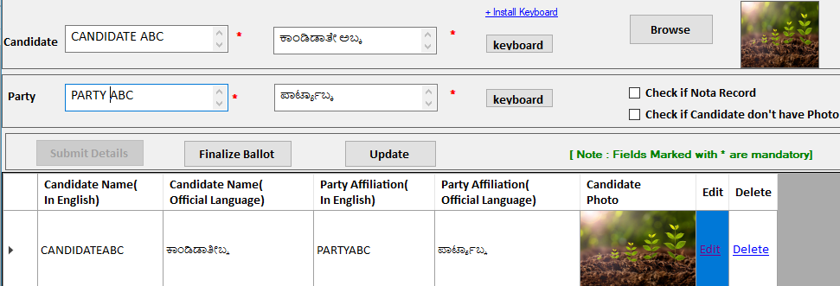
9 (i). EDIT CANDIDATE DETAILS
Open the desktop application and click “EDIT” button shown against the candidate and modify the details and click “UPDATE” to save the changes.
1
2

Slide 24
9(ii) FINALISE BALLOT AFTER UPDATE
After making any change the ballot has to be finalized by clicking “FINALISE BALLOT”

Slide 25
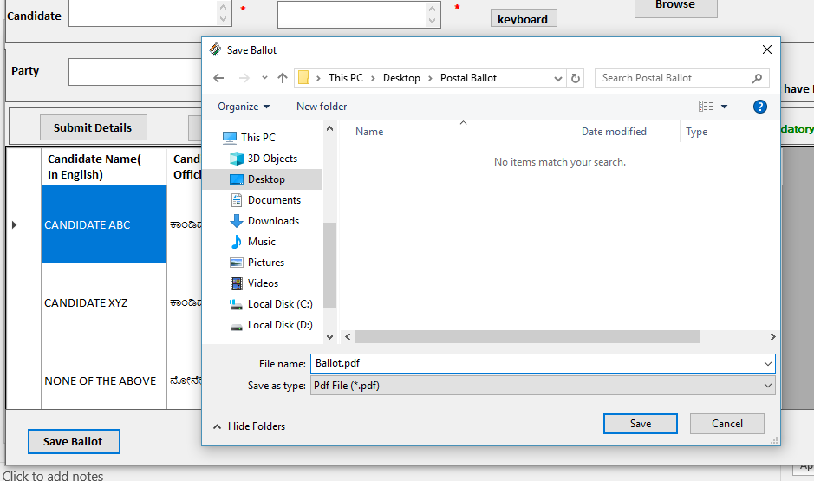
9(iii) SAVE BALLOT TEMPLATE IN PDF FILE
Once the Ballot is finalized, click “SAVE BALLOT”. Wait for the “Save Ballot” window to appear and click “Save” to save the Postal Ballot pdf file in a NEWLY CREATED Folder.
2
1

Slide 26


CHECK THE Ballot pdf FILE SAVED IN THE FOLDER
-> Size of the pdf must be < 2 MB

Slide 27
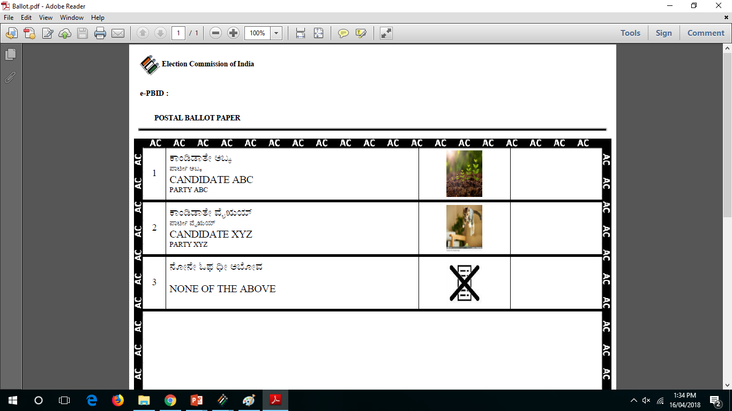
e-POSTAL BALLOT pdf looks like this:

Slide 28
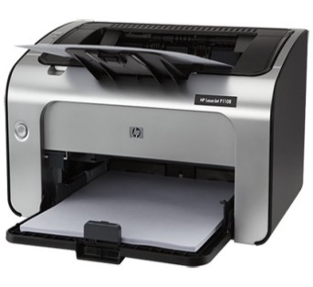

PRINT THE e-POSTAL BALLOT & VERIFY THE DETAILS

Slide 29
EDIT P.B. AFTER GENERATING PDF
-> Delete the already created Ballot pdf file from the Hard disk
-> Repeat steps 9(i) to 9(iii) and generate the new Ballot pdf

Slide 30
BEFORE PROCEEDING TO NEXT STEP… SIGN THE BALLOT TEMPLATE SEND IT TO DEO OFFICE AND CEO & WAIT FOR THE APPROVAL.

Slide 31
4. ONCE APPROVED BY DEO AND CEO Upload e-PB & Generate PIN

Slide 32
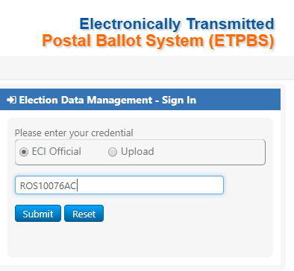
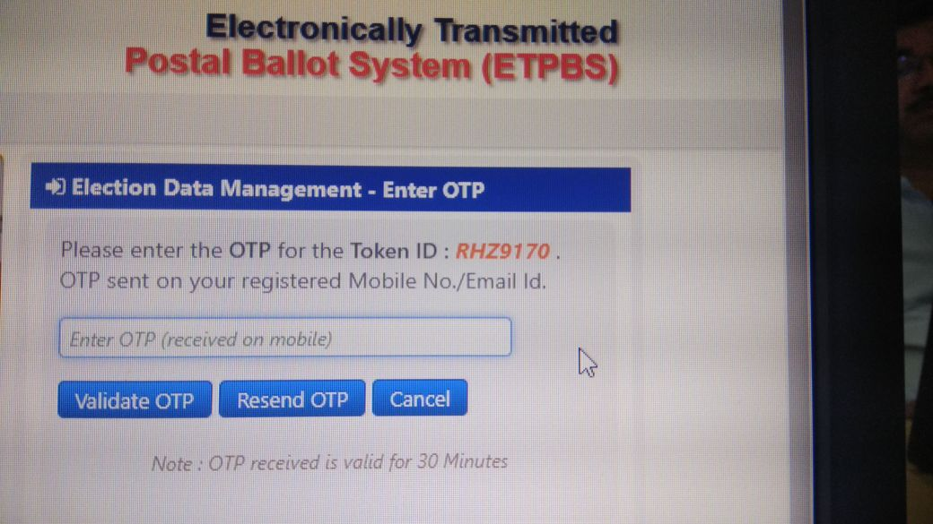
RO Login to ETPBS portal
1. Select ECI Official
AFTER CENTRAL ADMINISTRATION OFFICER (C-Admin) activates RO operation,
2. Enter Login ID
3. Click SUBMIT
RO receives the OTP
4. Enter OTP
5. Click VALIDATE OTP

Slide 33
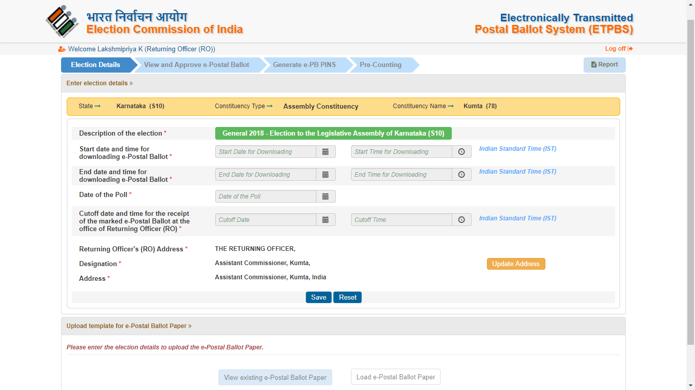
STEP-1 ENTER ELECTION DETAILS
Tab : 1
Fill the details:
Start date of download
End date of download
Cutoff date & time of receipt of Ballot at RO office RECEIVED FROM CEO
RO address
2. Upload PB template pdf file generated using the desktop software

Slide 34
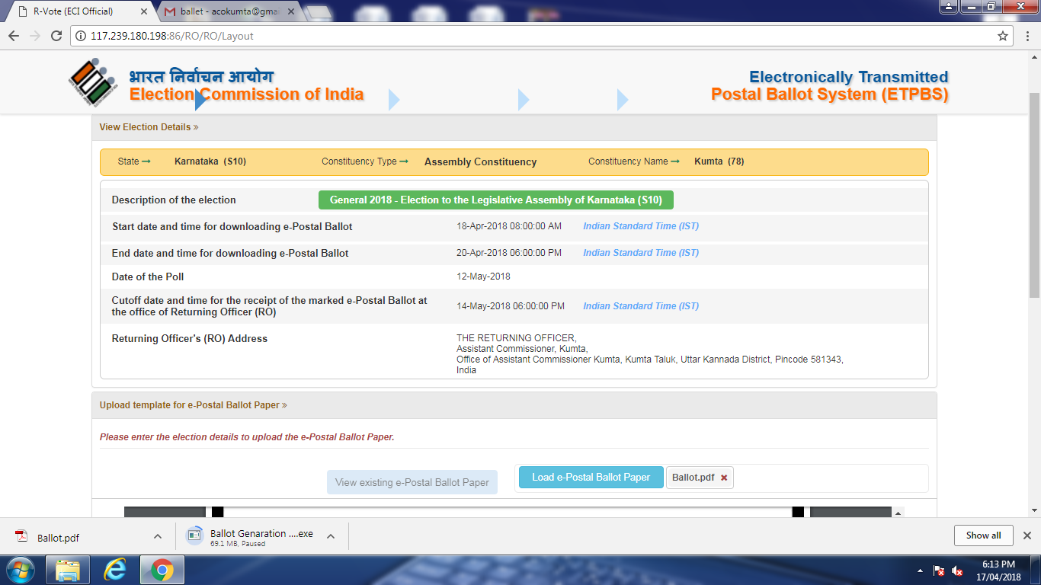
3. Uploaded file name
4. Click to PREVIEW

Slide 35
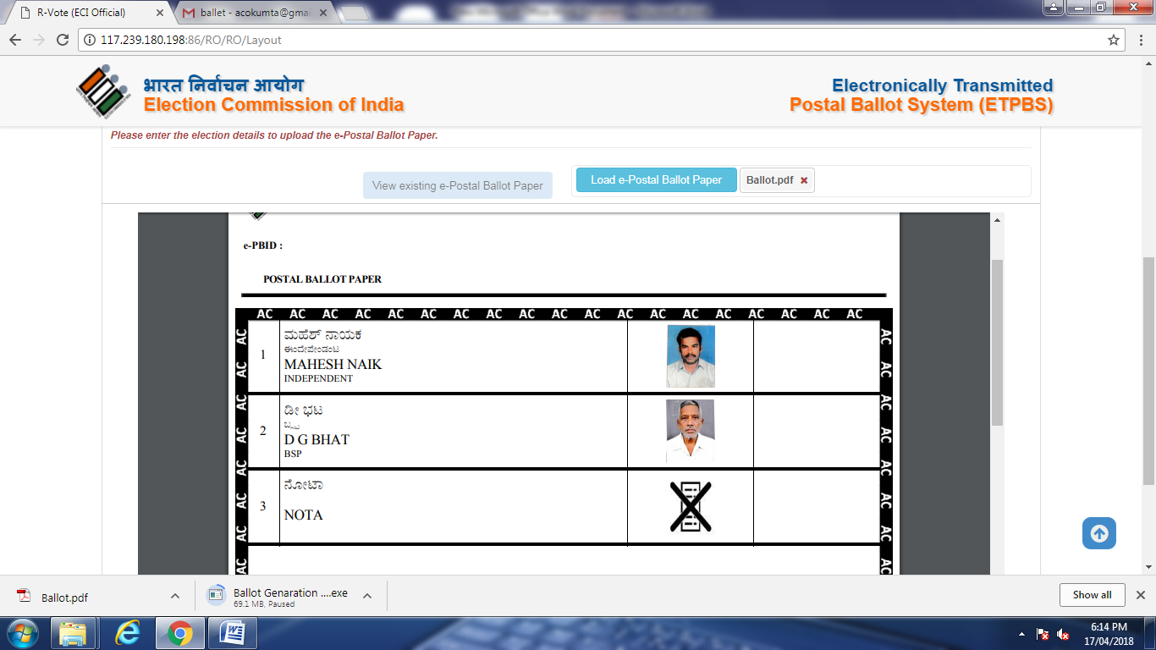
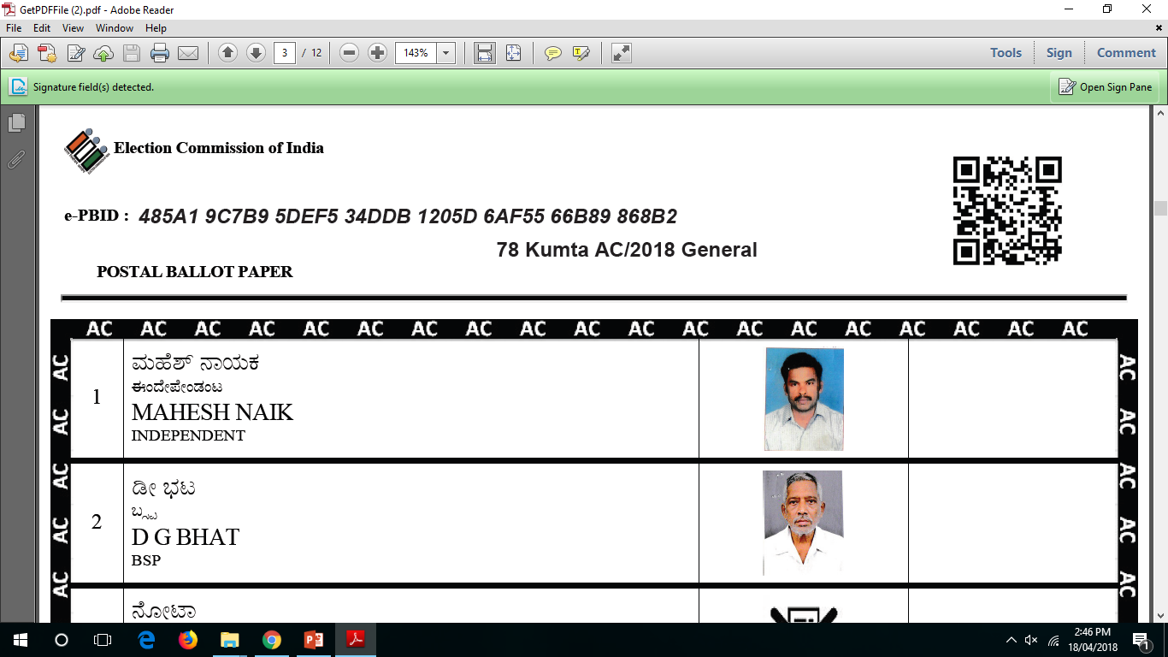
5. VERIFY the PB thoroughly before moving ahead

Slide 36
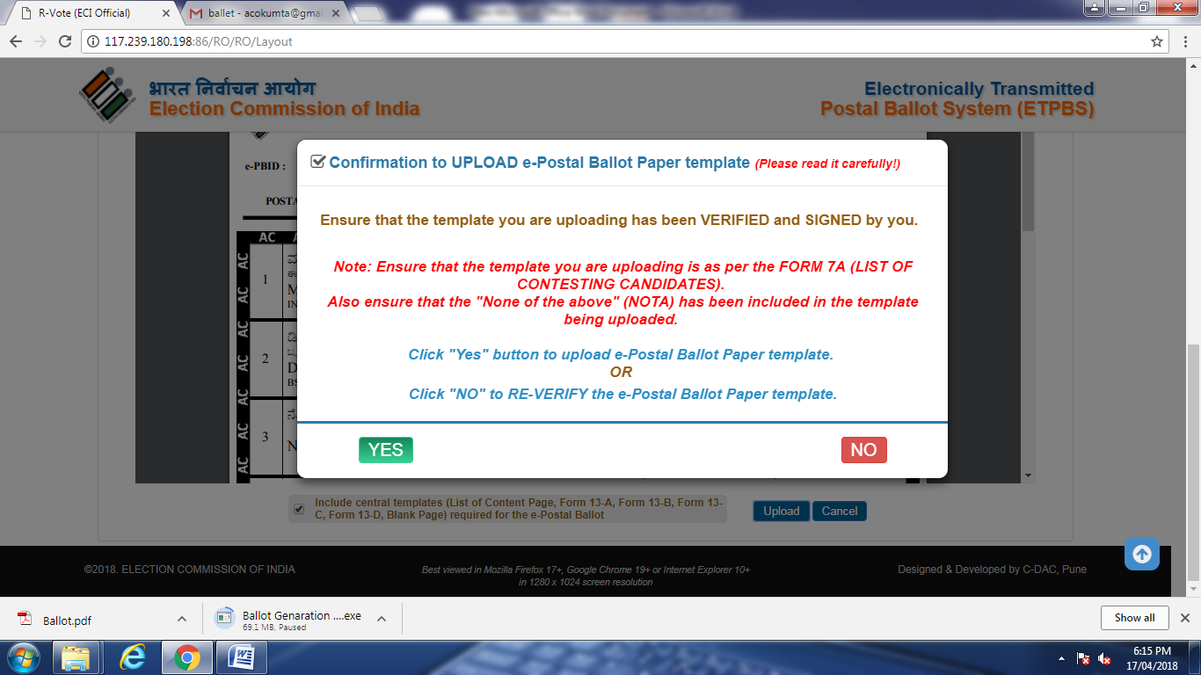
6. Check this option
7. Click to UPLOAD template

Slide 37
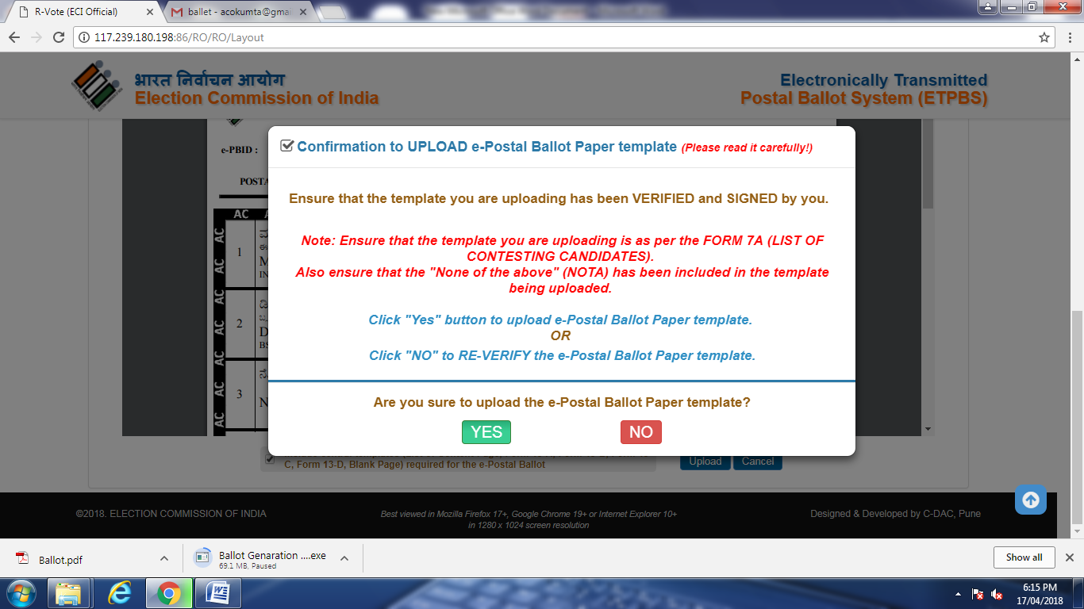
Click “YES” in both the windows to UPLOAD THE PB
8. Confirmation # 1
9. Confirmation # 2

Slide 38
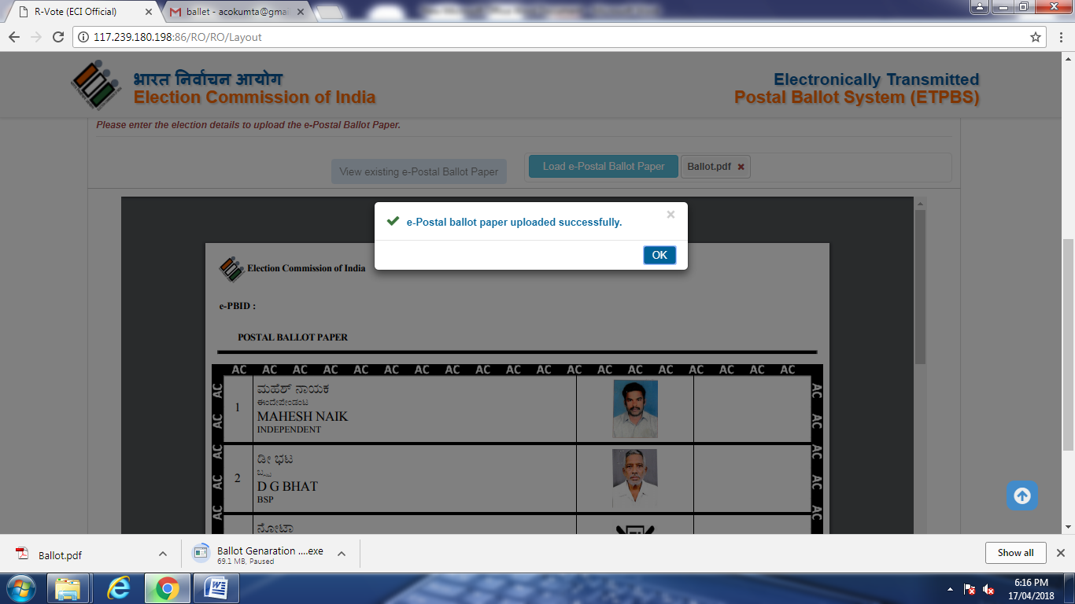
10. e-PB upload successfully

Slide 39
STEP 2. View & Approve e-Postal Ballot
Tab : 2

Slide 40
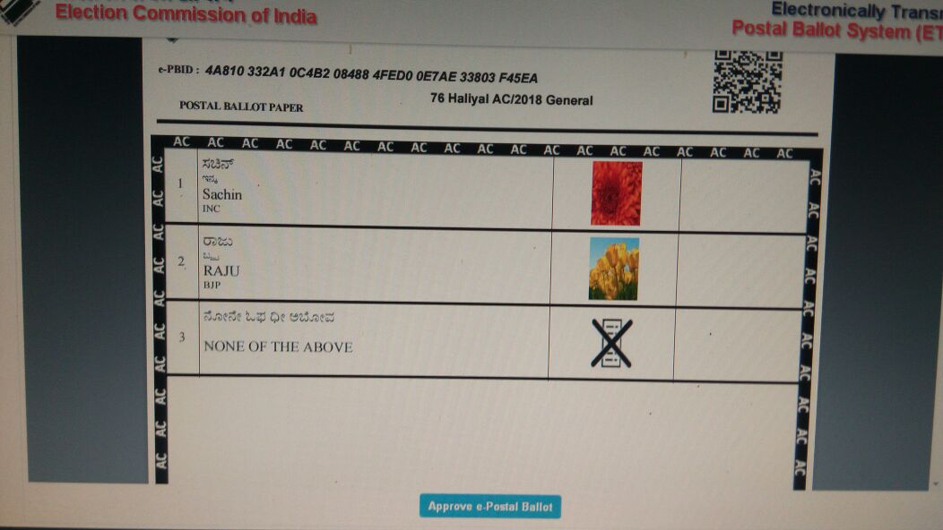
11. VERIFY the following
A. The Postal Ballot
B. Form 13-A Declaration
C. Form 13-B Inner Envelope
D. Form 13-C Outer Envelope
E. Form 13-D Instruction to SV
12. Click to APPROVE e-PB

Slide 41
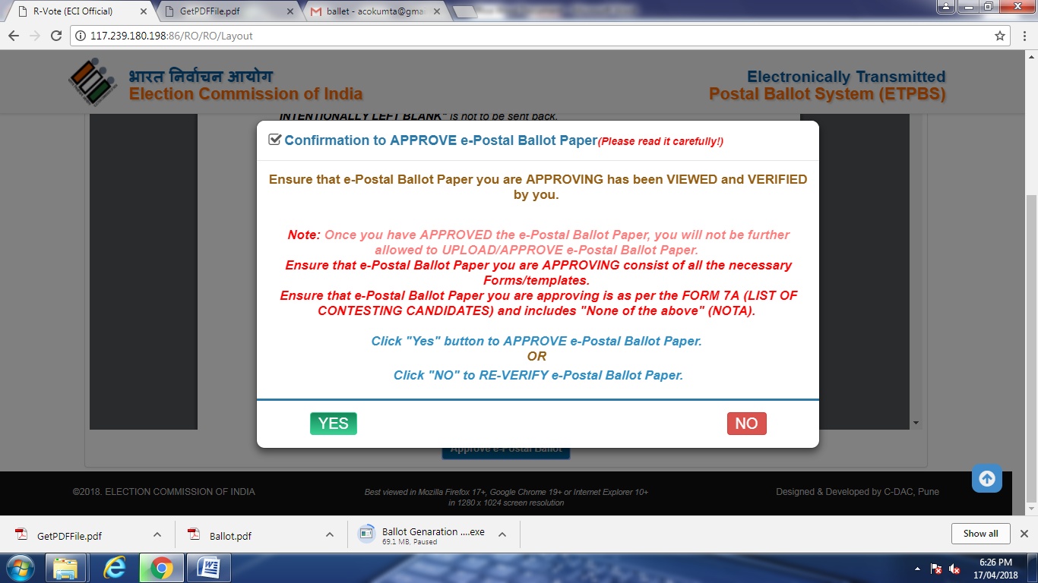
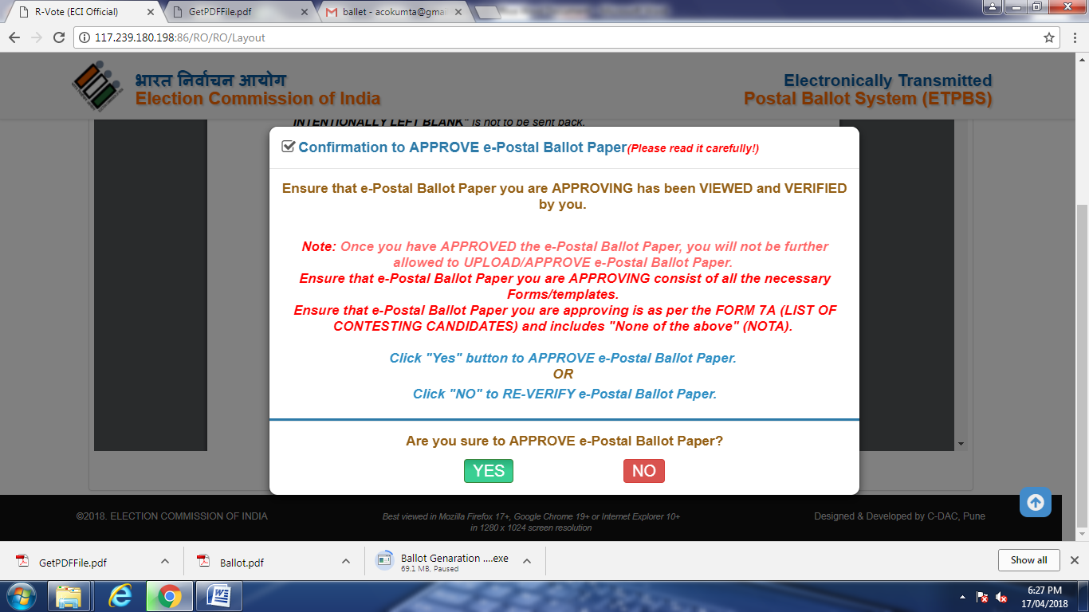
Click “YES” to APPROVE THE PB
12. Confirmation # 1
13. Confirmation # 2

Slide 42
STEP 3. Generate e-PB PIN
Tab : 3
SV list uploaded by ERO will be listed here
14. Click the “GENERATE e-PB PINS” button
ULTIMATELY THE POSTAL BALLOT IS ELECTRONICALLY
SENT TO THE RECORD OFFICER WITH PIN TO DOWNLOAD THE SAME.

Slide 43
5. e-PB PRE-COUNTING : Separate SOP document provided
List of QR Code Scanner that can be user for pre-counting of ETPBS: 1. NPoS N-620/N-629
2. Honeywell Xenon 1900
3. iBall 2D-S209
4. MINDEO MD 6100AT
5. Unitech MS846
6. Honeywell HH400
7. ESYPOS EBS 3312
8. DATALOGIC QuickScan QD2430

Slide 44
THANKS

