Slide 1
ELECTION EXPENDITURE MONITORING
(EEM)
PRESENTED BY
SATRUGHNA KAR, NLMT
@Addl.CEO,Odisha

Slide 2
Democracy is something that gives the weak the same chance as strong . * Mahatma Gandhi
Monitoring Election Expenses is therefore required to ensure a level playing field for all the Contesting Candidates.

Slide 3
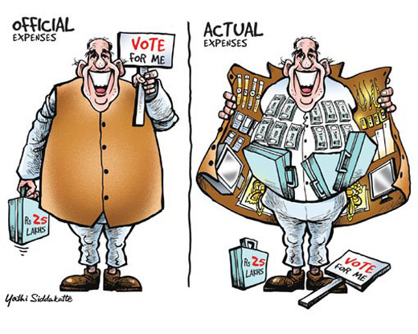
NOTHING OFFICIAL ABOUT IT…
Limit for a candidate
No limit on political party expenditure

Slide 4
ELECTION EXPENDITURE
Two types on the basis of legal provisions
Illegal expenditure : Distribution of money, gifts, liquor or any other item among electors with the purpose of influencing them
Legal Expenditure
[public meetings, posters, banners, vehicles etc.]
Rule 90 of the CE Rules, 1961
Ceiling (Manipur)
PC- ₹77/- lakhs
AC-22.00 Lakhs
Such type of expenditure by the candidate
needs to be stopped
7

Slide 5
Ensure capture and inclusion in election expenses
ILLEGAL
Ensure capture, Seizure and legal action
Surrogate advertisement, Paid News
Cash, gifts, liquor, food etc. for voters
Where do Candidates Spend Money?
Payments to agents offering votes in bulk
Advertising
Public rallies
Travel and logistics
Campaign material
Personnel
Ensure accounting and adherence to expenditure limit
LEGAL
Election Expenditure Monitoring

Slide 6

LEGAL PROVISIONS
Representation of the People Act, 1951
Conduct of Elections Rules, 1961
Instructions of the ECI
Indian Penal Code, 1860
Income Tax laws

Slide 7
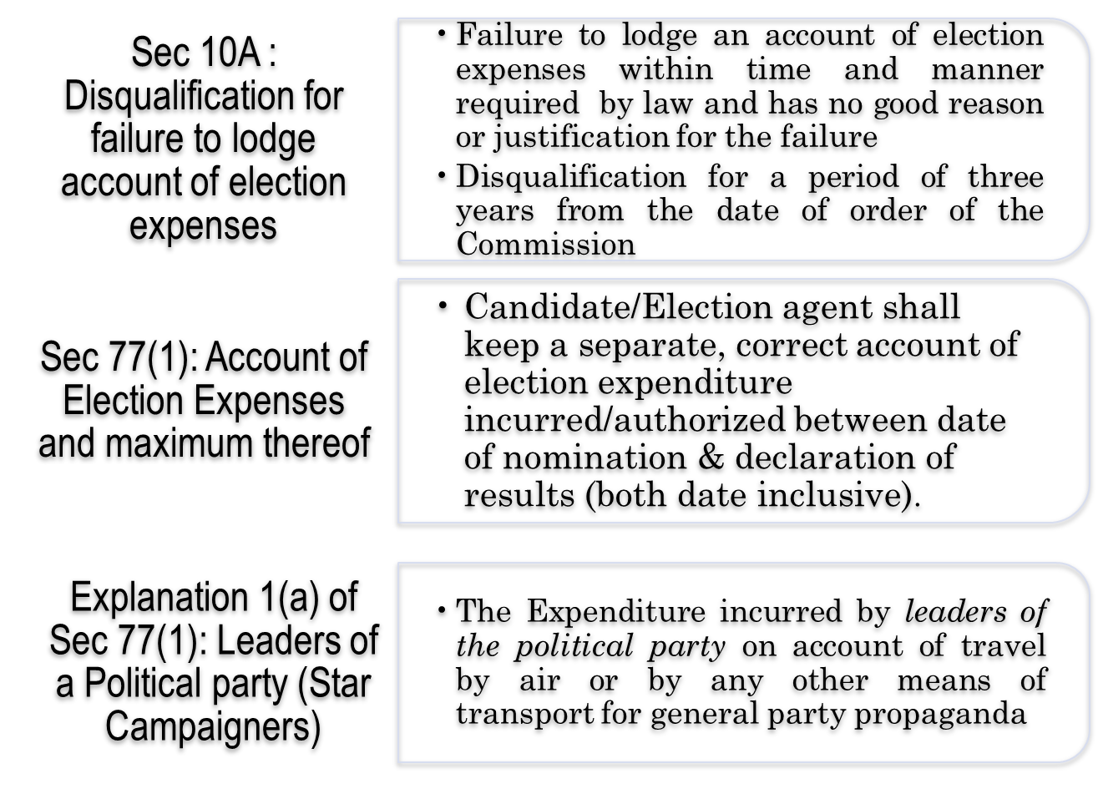
MAJOR LEGAL PROVISIONS- RP Act, 1951

Slide 8
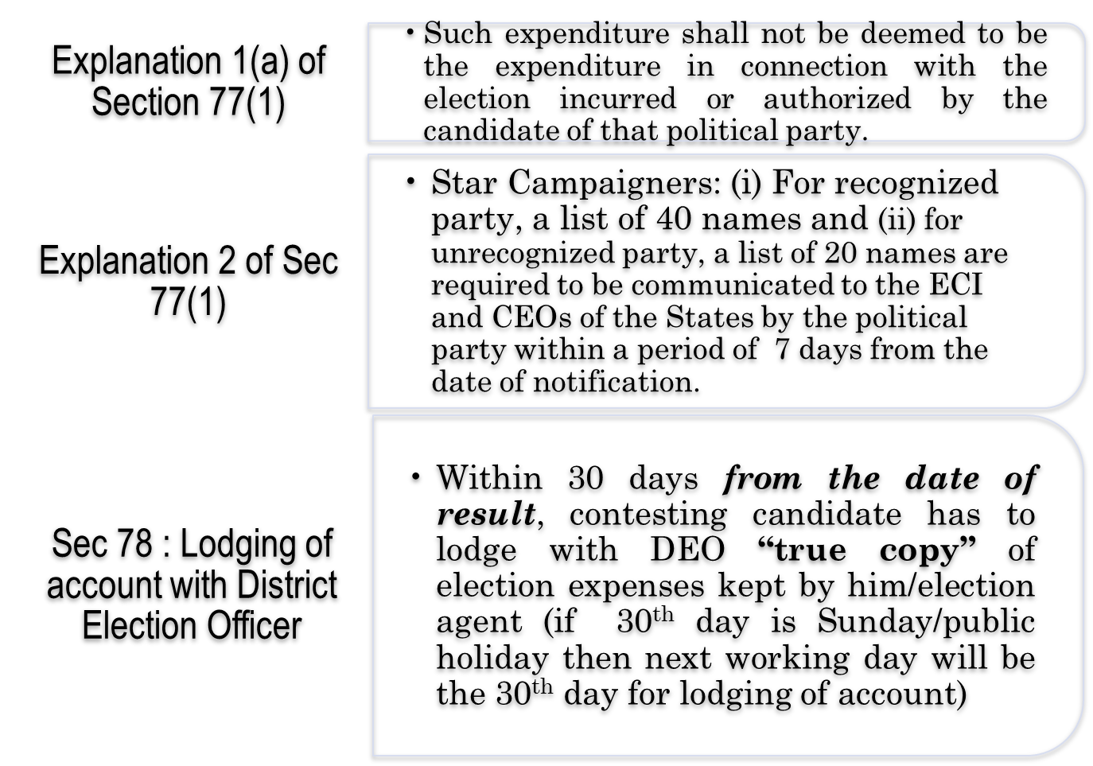
MAJOR LEGAL PROVISIONS - RP Act,1951

Slide 9

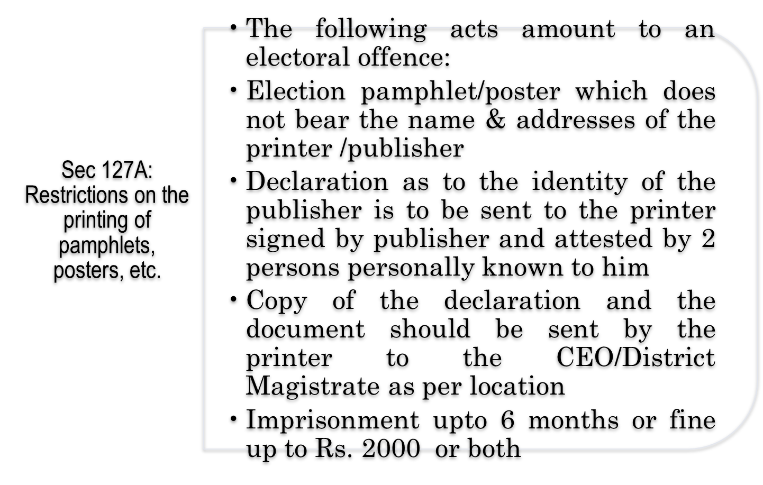
MAJOR LEGAL PROVISIONS- RP Act, 1951

Slide 10
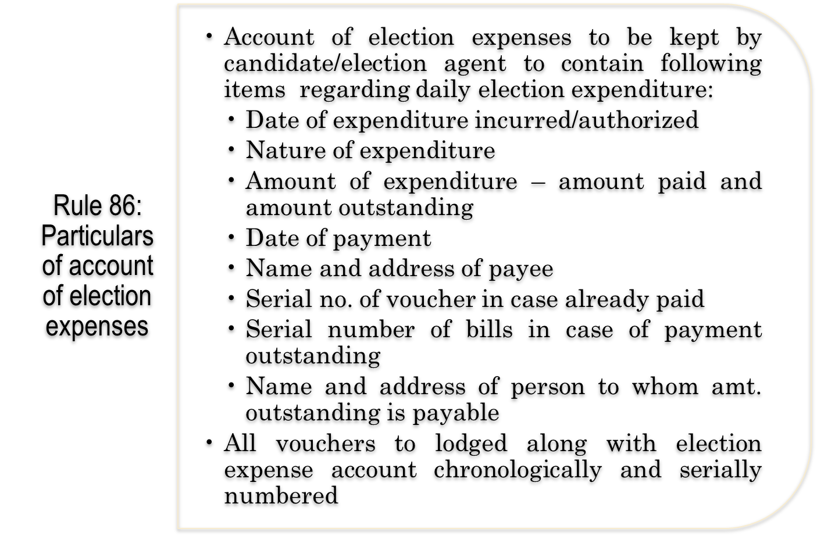

LEGAL PROVISIONS- CoE Rules, 1961

Slide 11
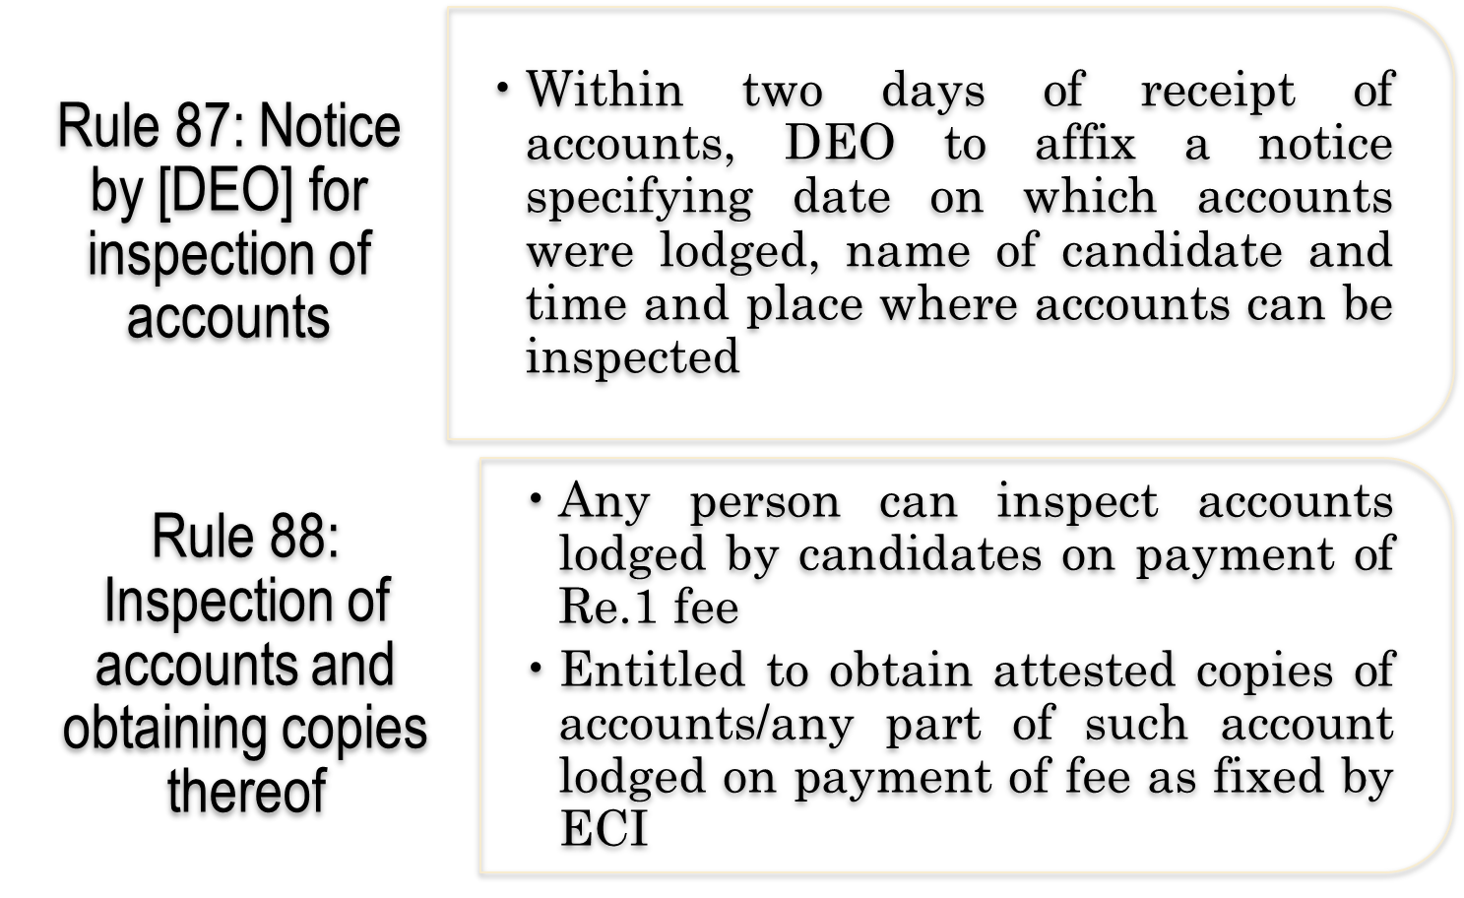
MAJOR LEGAL PROVISIONS - CoE Rules, 1961

Slide 12
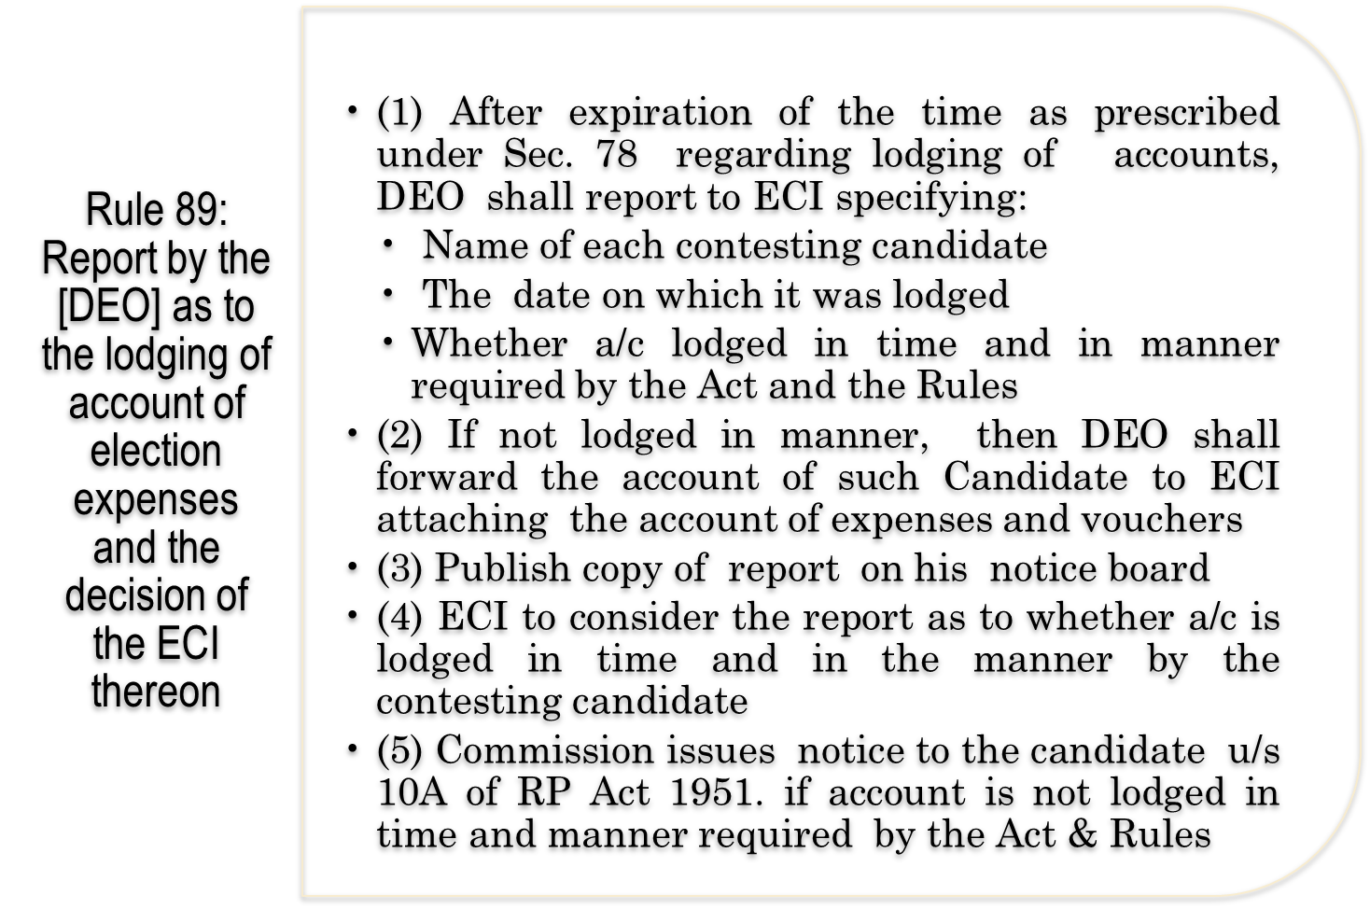
MAJOR LEGAL PROVISIONS- CoE Rules, 1961

Slide 13
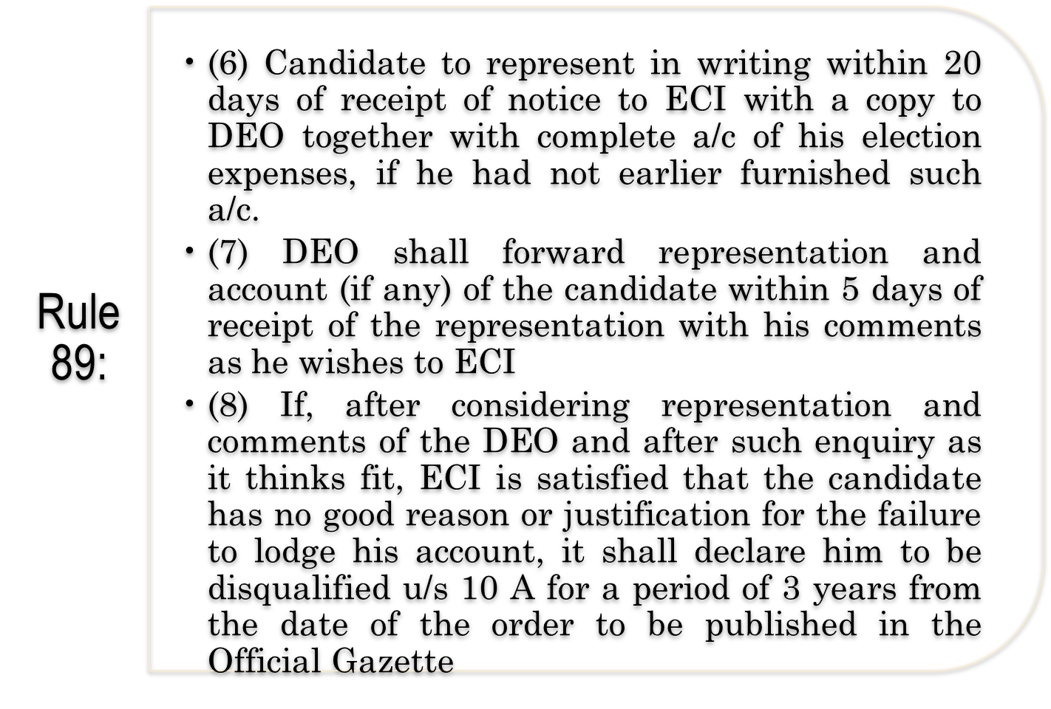
MAJOR LEGAL PROVISIONS- CoE Rules, 1961

Slide 14
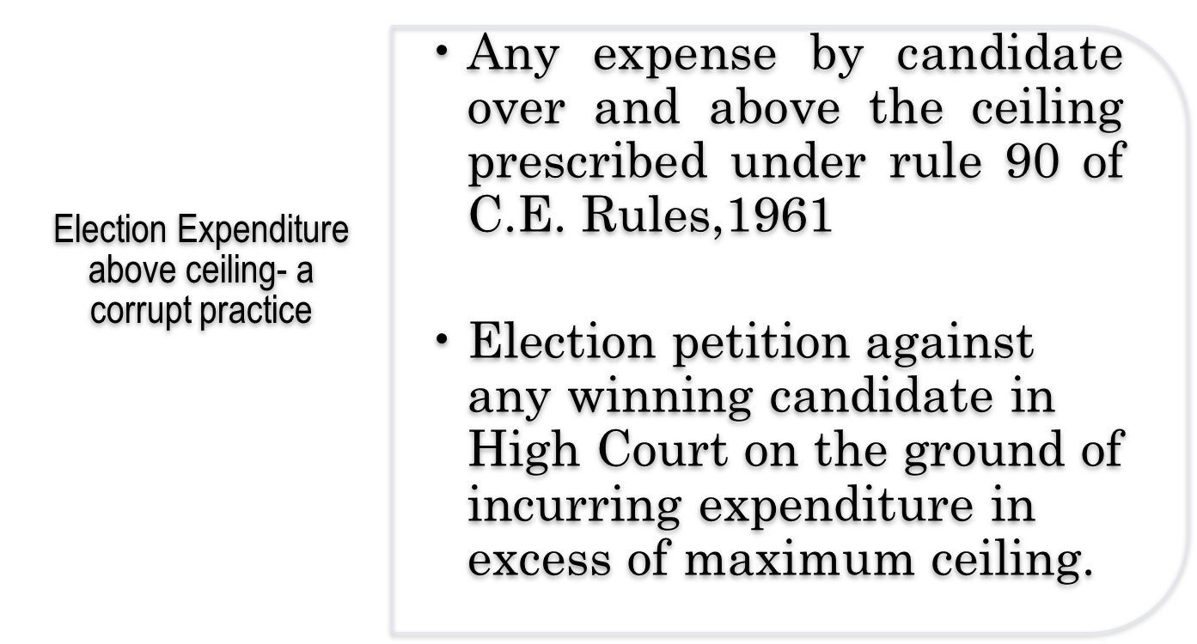
MAJOR LEGAL PROVISIONS- CoE Rules, 1961

Slide 15
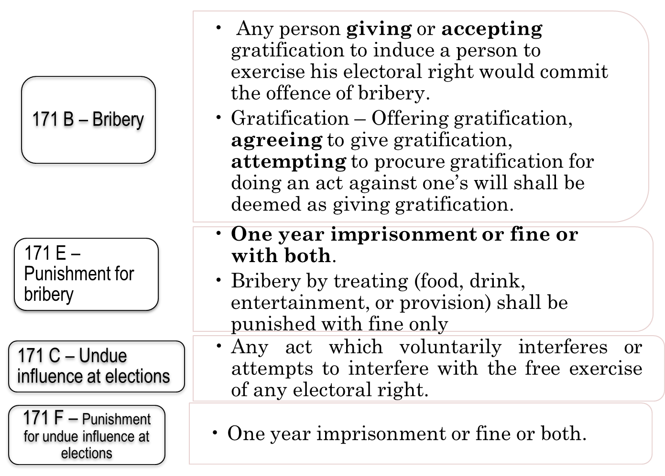
INDIAN PENAL CODE, 1860

Slide 16
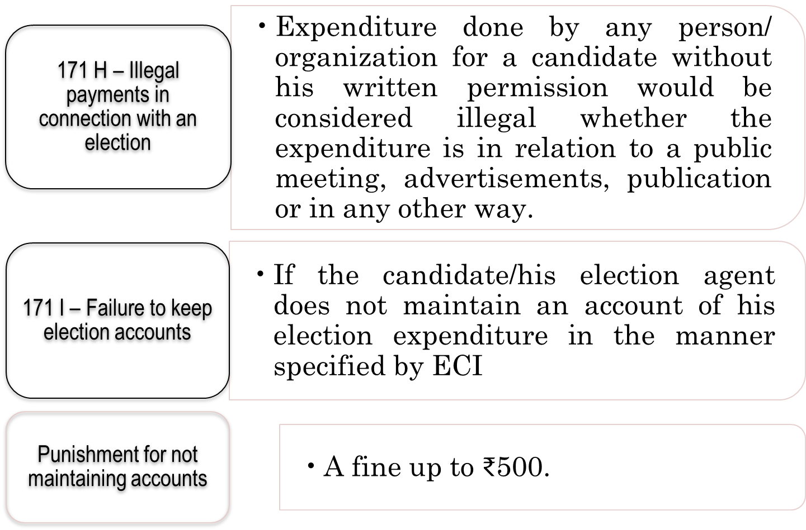
INDIAN PENAL CODE, 1860

Slide 17
ELECTION EXPENDITURE: CASE LAWS
The Hon’ble Supreme Court decision in SLPs- Ashok Shankarrao Chavan Vs. Dr. Madhavrao Kinhalkar & Ors.(2011), Madhu Kora Vs. Election Commission of India (2012) and Smt. Umlesh Yadav Vs Election Commission of India & Ors.(2013) dated 5th May, 201
“Sec. 10A clothes the ECI with the requisite power and authority to enquire into failure to submit the account of election expenses in the manner prescribed and as required by or under the act”
SCI upheld the Commission’s decision to disqualify Umlesh Yadav u/s 10A, a returned candidate from 24-Bisaulli AC, Uttar Pradesh, General Election to Uttar Pradesh Legislative Assembly, 2007.

Slide 18
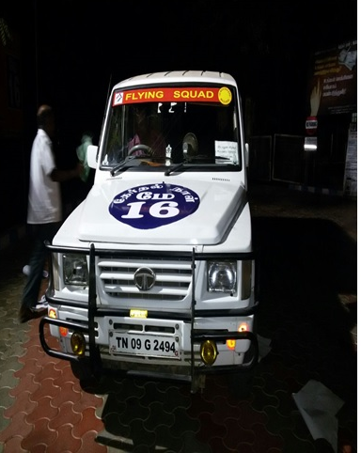

Expenditure Monitoring Mechanism
21

Slide 19
Monitoring Measures-1 Separate Bank Account by candidate
The candidate has to open a separate bank account for election expenditure, at least one day prior to filing of nomination papers.
It can be opened in joint name of the candidate and election agent, anywhere in the state.
This bank account cannot be opened jointly by the candidate with spouse or other relatives, if they are not the election agents of the candidate.
The account can be opened in any bank, including co-operative banks and Post Office.
At the time of filing of nomination, the candidate will communicate the account number of this bank account to the RO in writing.
All the election expenses of the candidate should be met from this bank account

Slide 20
Monitoring Measures-2
Information from Banks
Banks are required to send details of “Suspicious Transaction” to the Financial Intelligence Unit
Large deposits and withdrawals, exceeding Rs.10,00,000
Any transactions from accounts of candidates over Rs.1,00,000
Use of bank accounts for multiple transactions to other accounts
This information is passed on to the Income Tax Department

Slide 21
Monitoring Measures -3 Inspection Of Accounts of the candidate
Candidates are required to produce their accounts for inspection 3 times before the Expenditure Observer (EO).
The Candidate has to maintain 3 registers:
i) Day-to-day Accounts Register (white)
ii) Cash register (pink)
iii) Bank Register (yellow)
( *Have a look of EXP Register)

Slide 22
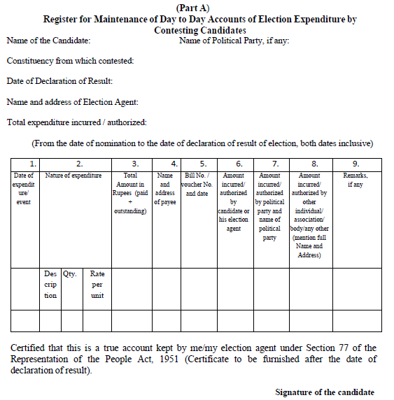
Daily Accounts
WHITE REGISTER

Slide 23
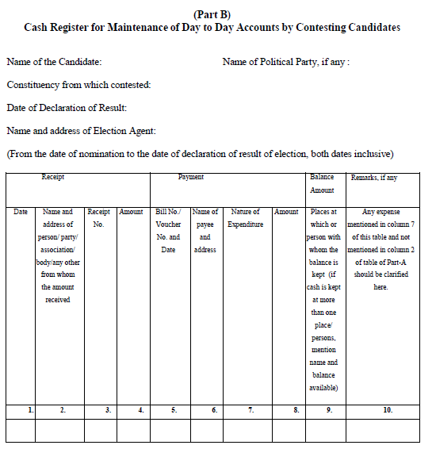
CASH REGISTER
PINK

Slide 24
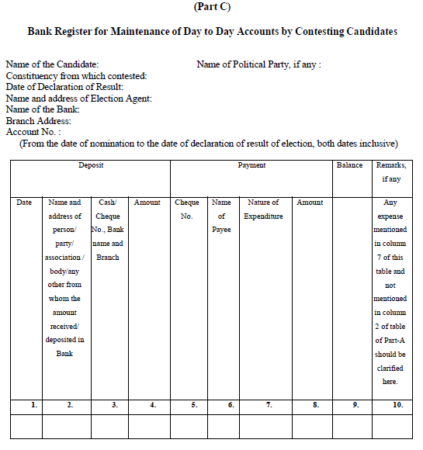
BANK REGISTER
YELLOW

Slide 25
INSPECTION OF ACCOUNTS…contd
A photocopy of the accounts maintained by the candidates should be obtained after each inspection and RO will display a copy on the notice board
Scanned copy of the day to day a/c of candidate to be uploaded in the DEO`s portal with link to CEO`s website after each inspection.
Notice to be issued to candidate in case of failure to produce accounts for inspection and FIR to be filed if failure continues (Sec 171-I of IPC),
Withdrawal of permission for use of campaign vehicle, if the failure continues in spite of notice,
Intimation of such withdrawal of permission to the Flying Squad to take the vehicle out of campaign,
Any member of public can obtain copy of Shadow Observation Register after inspection, notices and replies by candidates on payment of ₹1/- per page.

Slide 26
ECI : Expenditure Observer (EO)
DEO
Expenditure Monitoring Cell
RO
AEO
MCMC
(Dist./ State Level)
Complaint monitoring
Control Room & 24x7 Call Centre
Accounting Team
(SOR / FE )
Booth Awareness Groups(BAG)
VVT
SST
VST
F S
Public meeting/Rally
Excise Deptt
Income Tax Deptt.

Slide 27
EXPENDITURE MONITORING MACHINERY
Expenditure Observer (EO)- @ 1 for each district (Not more than 5 ACs)from ECI
Asst. EO - @ 1 for each AC ,Gr.B officer appointed by DEO
Flying Squads and Static Surveillance Teams (FS and SST) -@ 3 for each AC
Video Surveillance Teams (VST) -@ 1 for each AC
Video Viewing Team (VVT) -@ 1 for each AC
Accounting Team - @ 1 for each AC
Excise team/ IT Team- At District Level
Media Certification and Monitoring Committee (MCMC)- @ 1 for each district
32

Slide 28
EXPENDITURE OBSERVER (EO)
Overall supervision of expenditure monitoring functioning of different teams engaged in EEM in each AC and inspects the accounts of the candidates.
Three visits to the AC/ District assigned :
1st – On the day of Notification, stays for 3 clear days, Coordinates with DEO/SP and various law enforcement agencies of Income tax, Police, BSF/SSB, State Excise
2nd- On the Day following LD of withdrawal, stays for entire campaign period till end of poll / counting if asked by ECI ( Inspection of Candidates accounts 3 times and comments on discrepancies)
3rd- On 25th Day of result declaration, Stays for clear 8 days to assist DEO for scrutiny of account statements of candidates , attends Accounts Reconciliation meeting of DEO on 26th Day,

Slide 29
ASSISTANT EXPENDITURE OBSERVER (AEO)
AEO appointed and trained by DEO , from the district , deployed from the date of Notification, Assists EO in inspection of accounts
Preferably a local Officer but not from the same AC
Maintains the Shadow Observation Register & Folder of Evidence
Supervises and ensures that all complaints are addressed
Monitors FS/SST/VST/VVT/Accounting Team
Co-ordinate with the RO’s office on campaign activities of candidates
Daily Reporting to EO in Annexure B-6 on activities of the teams
Extra AEO in case of ESC

Slide 30
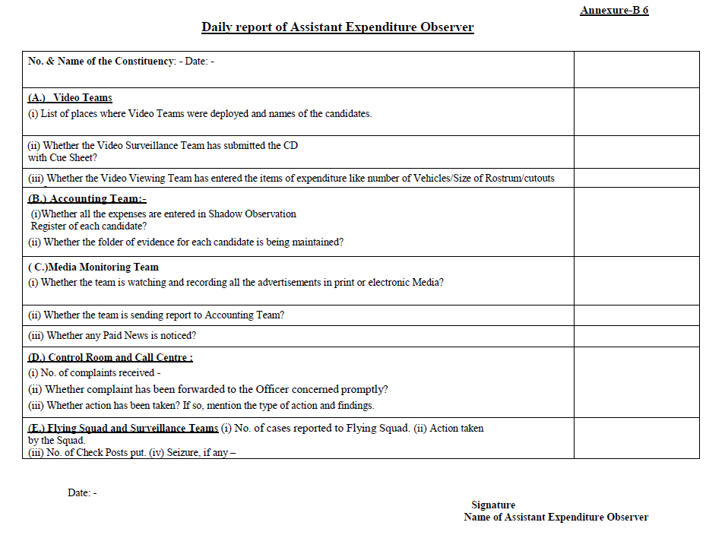

Slide 31
Flying Squads (FS) and Static Surveillance Teams (SST)
3 or more Flying Squads(FS) and Static Surveillance Teams(SST) in each Assembly Constituency/Segment.
FS-More in Expenditure Sensitive Constituencies(ESC) if required.
SST- required at Expenditure Sensitive Pockets (ESP).
Headed by a Magistrate (Adequate numbers/ gazette notification).
Video Recording.
GPS enabled FS vehicles/ Mobile tracking.

Slide 32
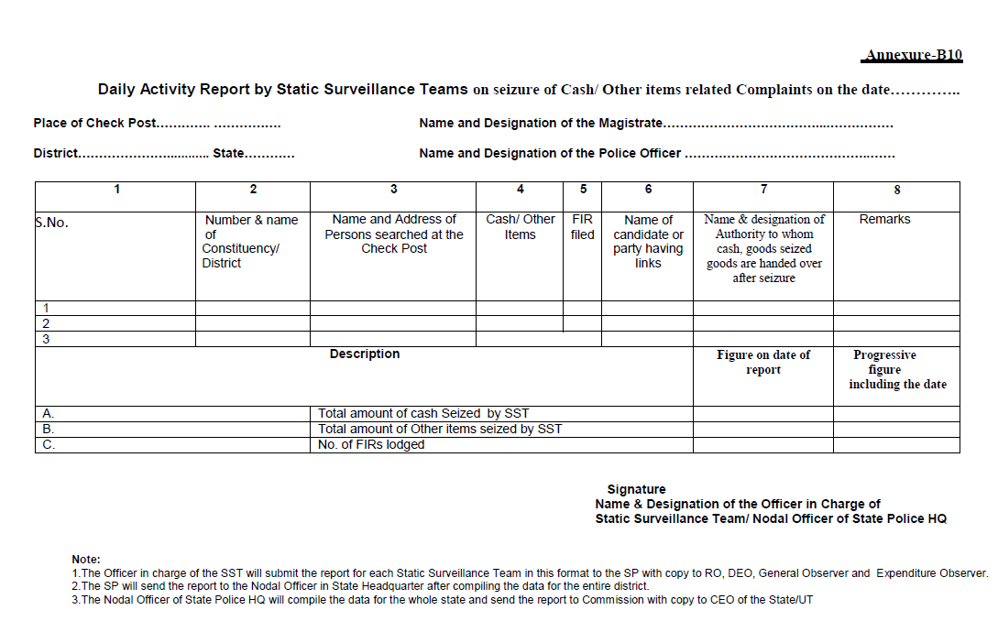

Slide 33
Flying Squad
Take action on complaint and report back
Gather and record evidence of seized cash or other inducements….Shall not be entered in SOR and not treated as Election Expenditure of candidate , Recording to be kept in FE
Submit daily report of seizure etc.
Surround the place in case of storage of money.
Anecdote- 2009 SGE,Odisha as ARO/EM Berhampur, seizure of Rs.13.5 Lakhs from a Hotel Room – allegation of Cash for Vote from ECI Observer

Slide 34
SOPS for Flying Squads and Static Surveillance Teams
ECI instructions vide Order in File no.76/Instructions/EEPS/2015/Vol.II to all CEOs dated 29th May, 2015 (please see pg.283-288 of Compendium of Instructions on EEM August 2020 Edn-6)
``During checking, if any cash exceeding Rs.50,000 is found in a vehicle carrying a candidate, his agent, or party worker or carrying posters or election materials or any drugs, liquor, arms or gift items which are valued at more than Rs.10,000, likely to be used for inducement of electors or any other illicit articles are found in a vehicle, shall be subject to seizure``. Case Study of 38-Balasore AC , Odisha on seizure of vehicle carrying party flags and banners etc.in Bye-Election 2020
Star Campaigner carrying cash upto Rs.1.00Lakh exclusively for his/her personal use OR any party functionary carrying cash with Certificate from Treasurer of the party on amount and its used should not be seized by SST….Keep a copy of the Certificate and let go.
Cash more than 10 Lakhs found in a vehicle without suspicion of commission of any crime or linkage with any Candiade/Agent /Party functionary – SST to pass on to IT Authority
Notes:
1) Based on the assurance given to the Supreme Court in the case of Election Commissioner vs. Bhagyoday Janparishad & Ors. in Nov.2012

Slide 35
SOPs …contd
ECI Instruction No. 76/Instruction /EEPS/2016 Vol.II dated 4th April 2016
Complaints regarding storage of cash or other valuables
Co-ordinate with Income Tax Dept.
FS to rush to the spot and deploy at a distance
FS to check people entering or exiting the said premises
Neither EO or FS to enter premises before IT team
DEO/SP to provide necessary assistance for search

Slide 36
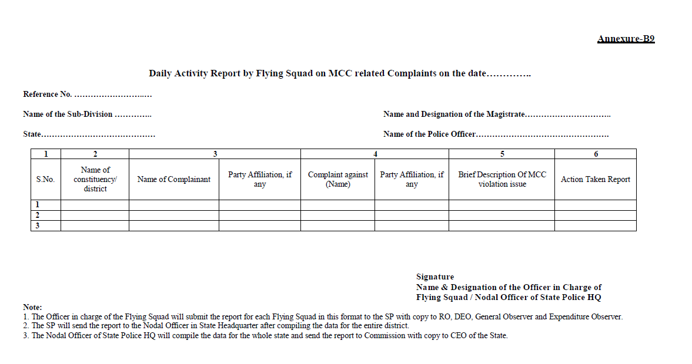

Slide 37
Video surveillance team
Video Surveillance Team (VST)
Properly trained to identify and capture MCC and expenditure related events like public meeting etc in adequate minute details as required,
This team will prepare a video cue-sheet.
It will capture the photo in such a way that the evidence of each vehicle, furniture, rostrum, banner, cutout etc. can be seen clearly and the expense thereon can be estimated,
At the end of shooting, the team may also record in voice mode the estimated number and type of vehicles, Chairs, furniture, approx size of rostrum/banner /poster/ cutout etc. used in the event.
37

Slide 38
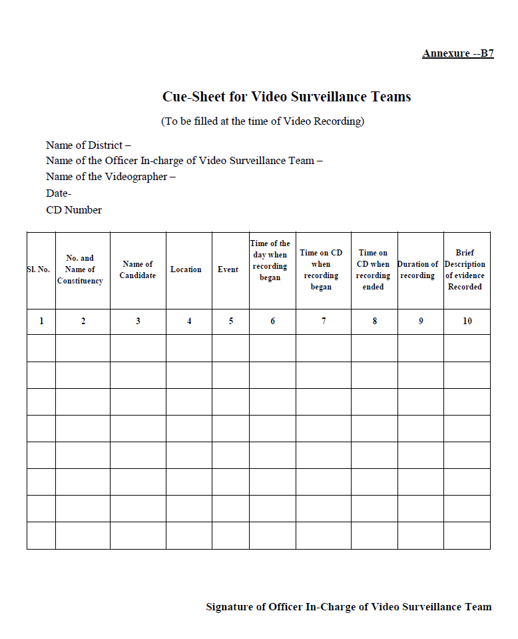

Slide 39
Video Viewing Team (VVT)
MCC related report to General Observer and RO
Submit report containing candidate wise expenditure to Accounting Team/ Asst. EO, on public rally including the vehicle numbers, number of chairs, size of Dias, audio system, posters, banners, helicopter expense, media advertisements and Paid News, names of candidates
View Video CD provided by VST for identifying election expenditure and MCC related issues,
39

Slide 40
Accounting Team
Works under Asst. EO, in preparation of Shadow Observation Register and maintaining videos/ CD evidences carefully in Folder of Evidence
Will enter expenditure incurred by the candidate on major expenses and corresponding notified rates against each item( major public meetings/rallies) in the Shadow Observation Register, reported by various teams and calculate the total expenditure of the event observed for each candidate.
To maintain proper back-up which can be called by Commission later.
40

Slide 41
SHADOW OBSERVATION REGISTER (SOR) & FOLDER OF EVIDENCE (FoE)
SOR for each contesting candidate in a constituency. To record all expenses incurred on major events (public meetings/rallies etc.) towards election campaign
All expenditure recorded to be supported by CD/Video evidences(proper referencing) kept in FoE and to be cross- checked during Inspections
Signatures of candidate/ authorized agent to be taken in SOR
The SOR & FE to be handed over to the Dy.DEO by the EO for safe custody before leaving the constituency, under receipt.
*Have a look of the SOR

Slide 42
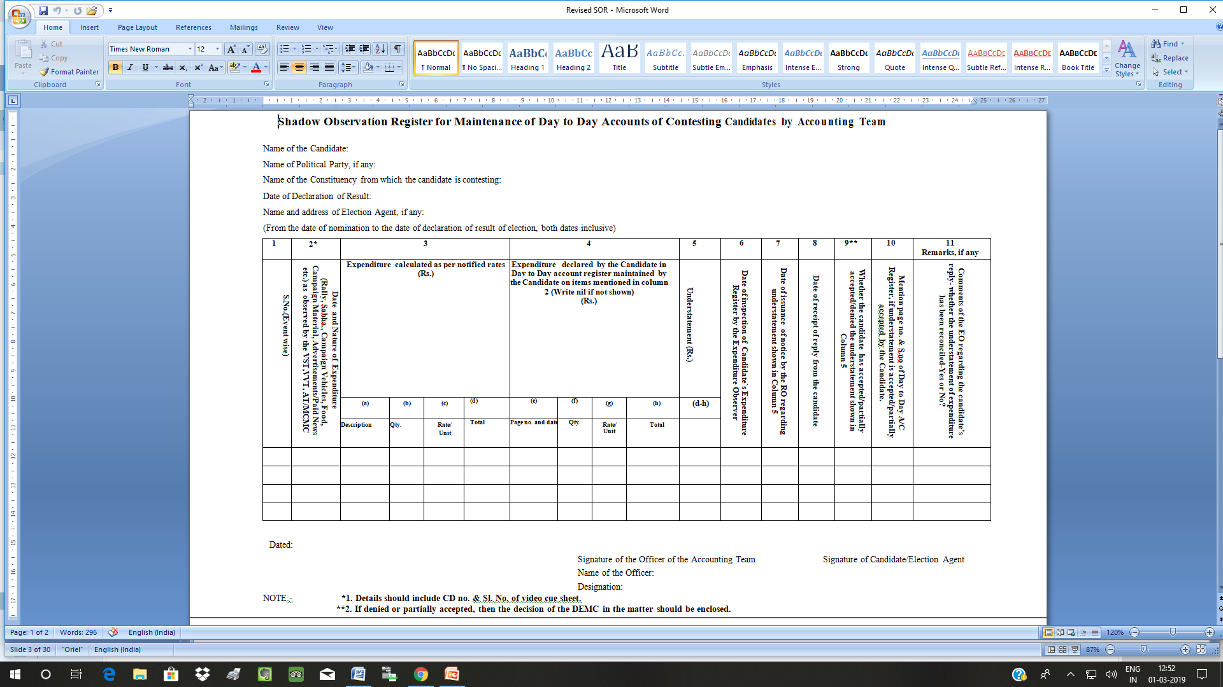

Slide 43

Excise Team MONITORING PRODUCTION, STORAGE AND DISTRIBUTION OF LIQUOR
From the date of announcement of election till completion of election, the production, off-take, stock limits of stockiest and retailers of IMFL/Beer/country liquor are to be monitored district wise;
Opening and closing of liquor vending shops are to be closely monitored;
Intensive vigil over inter state movement of vehicles at RTO check-posts and border check-posts by special enforcement staff of Excise Dept.;
To conduct raids to seize illicit liquor;
Inter state coordination of Excise Commissioners of the bordering states;
District level Nodal Officer to submit report every alternate day to DEO, Exp. Observer and State Level Nodal Officer, who will compile the state level report to Commission and CEO;
All distilleries/ warehouses shall be put under 24x7 CCTV monitoring with police guard so that no liquor is released without license.

Slide 44
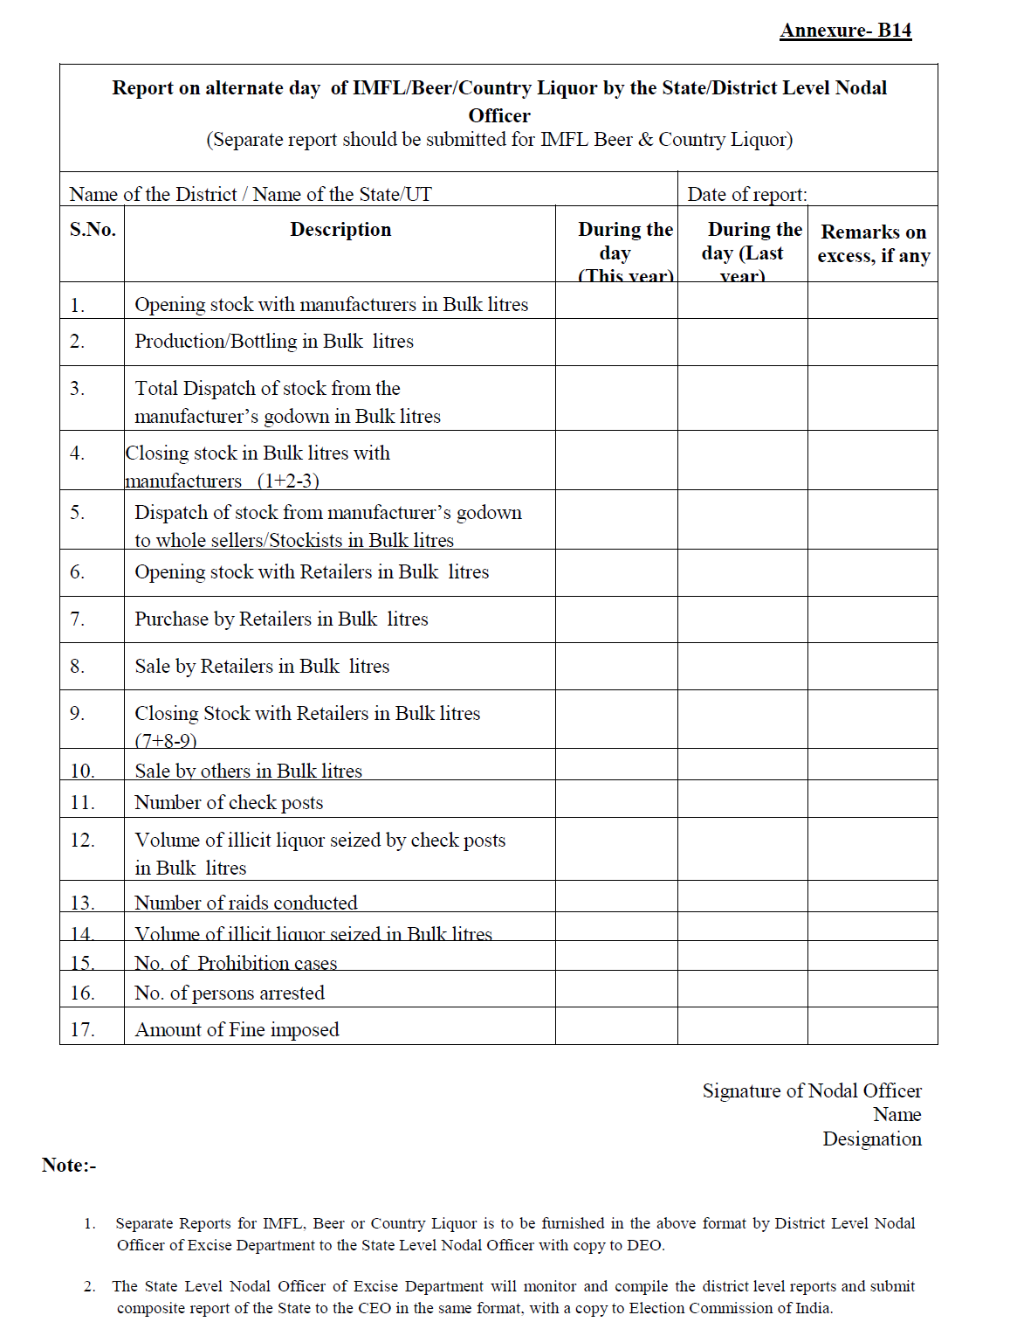

Slide 45
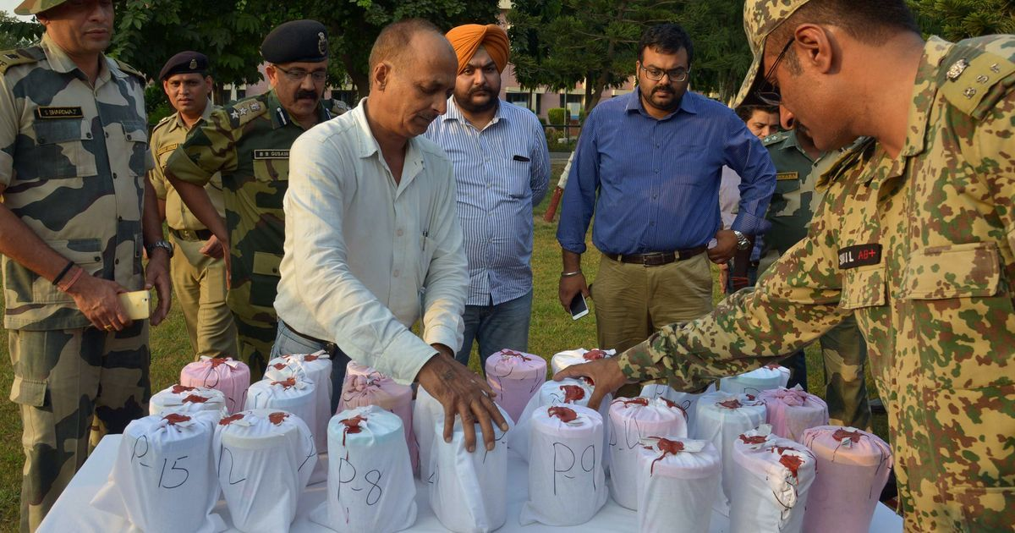

Slide 46
CHECKLIST FOR RO -1
BEFORE ANNOUNCEMENT OF ELECTIONS :
Have the updated list of disqualified candidates (for corrupt practices and not lodging election expenses) from Commission’s website www.eci.nic.in
Keep ready the formats and registers for Candidates like Expenditure Register , SOR , Video Cue sheet, Reporting Formats for FS/SST
Compendium of EEM August 2020 Edn-6 guidelines in local language , Highlight the latest instructions of ECI Dt.19 March 2020 on Publication of Criminal Antecedents, ( Order dated 13.02.2020 of Hon’ SC in Contempt Petition No.2192 of 2018 in WP(C) No.536 of 2011
Annexure- C 12 : Amended Form 26*** ( 28 Feb 2019) for Affidavit of candidate to be filed along with Nomination Paper regarding criminal cases , assets and liabilities. For party Candidates Para 6A ; candidate to give details of Criminal cases to party
Identify Expenditure Sensitive pockets in the Constituency
Identify Master Trainers of police and excise of the district for training of the EEM teamPursue EEM cases of last elections where FIR was filed and finalise.

Slide 47
CHECKLIST FOR RO -2
BEFORE ANNOUNCEMENT OF ELECTIONS :
vii. Identify Executive Magistrates for FS / SST…. Decide Jurisdiction of operation.
viii. Plan proper training in 2 to 3 phases
ix. Arrange vehicles (GPS fitted) and logistics for the teams
x. Lead a campaign for ethical voting , make aware the voters through Booth Awareness Groups(BAGs)
B. AFTER ANNOUNCEMENT OF ELECTIONS :
Activate the Control Room / Complaint monitoring Cell.
Ensure functioning of the teams FS ,VST, VVT, MCMC and Accounting Team from date of announcement of Elections
Monitor movement of the team with GPRS fitted vehicles
FS to attend MCC related complaints within half an hour of receipt of complaint.

Slide 48
CHECKLIST FOR RO -3
AFTER ANNOUNCEMENT OF ELECTIONS :
v. Activate the Control Room / Complaint monitoring Cell. Attend to c-Vigil complaints within 30 minutes.
Observe expenses incurred by political parties till completion of elections . This will be reported to CEO partwise after declaration of results.
vii. File FIRs in appropriate cases as detected by FS, SST or E.O.
C. AFTER ISSUANCE OF NOTIFICATION OF ELCTIONS :
SST to be geared up
Obtain List of Star Campaigners from CEO ( within 7 days , now for COVID-19 extended to10 days of notification
Scan the affidavit of Assets and Liability submitted by candidates and upload in CEO’s website within 24 hrs .

Slide 49
CHECKLIST FOR RO -4
AFTER ISSUANCE OF NOTIFICATION OF ELECTIONS :–
Hold meeting with all Contesting Candidates / agents immediately after allotment of symbols and explain the legal provisions of EEM and penalties for non-compliances. Sec 10 A of RPA 1951, failure to lodge accounts : Disqualification for 3 yrs from the date of order of ECI.
v. Notify dates for inspection of accounts by the Expenditure Observer during campaign period and issue notice to the defaulting candidates as directed by EO.
vi. Supervise complaint monitoring system and ensure enquiry within 24 hours.
vii. Ensure availability of documents on the website and provide to requiring public on payment of prescribed fee.
viii. Ensure filing of FIR / Complaint promptly after seizure of vehicle/goods/cash etc.by the FS/SST,

Slide 50
CHECKLIST FOR RO -5
AFTER ISSUANCE OF NOTIFICATION OF ELECTIONS :
ix. Interact with EO/AEOs and ensure smooth functioning of the teamwork.
x. Issue notice to candidate in case of complaints/defaults pointed out by the EO/DEO and receive replies from candidates / agents.
xi. Notice within 24 hrs of receiving complaint or default by candidate for non- compliance as per date line .
xii. Ensure receipt of reply from candidates within 48 hrs- Withdraw the Campaign Vehicles in case of repeated default .
xiii. Ensure submission of information in Format CA to CEO ( Annexure- I- 6 ) instructions of ECI Dated 19th March 2020 regarding Criminal Antecedents of the candidates sponsored by Political Parties as declared in item no.5 & 6, 6A of the Amended Form 26 Affidavit.
*****

Slide 51
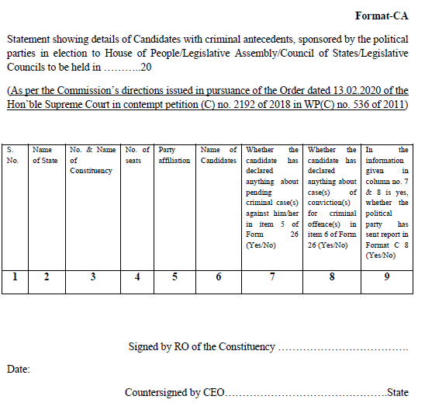
Format - CA
Please See
page
340
of EEM
Compendium,
Aug 2020

Slide 52
Grievance Redressal:
Dy. DEO to look into all grievances regarding misconduct of or harassment by FS or SST.
Release of cash/goods etc.- Committee – (i) CEO, Zila Parishad/CDO/PD, DRDA (ii) Nodal Officer of EEM, o/o DEO(Convener) (iii)Dist. Treasury Officer- wide publicity
Suo-motu examination of each case
Procedure of appeal to be mentioned in seizure document and informed
Information reg. release of cash etc to be kept by Nodal Officer
Release of Rs.10 Lakhs and more to be informed to the IT Dept.
In no case shall seized cash/goods be kept beyond 7 days after date of poll, unless FIR/complaint filed (responsibility of DEO)
Notes:
Manipur
Punjab-Taragarh

Slide 53
RECAP
Number of visits made by EO ? Number of inspections made by EO during campaign period ?
SOR & FE ?
Amended Form 26 – why so important ?
Order dated 13th February , 2020 of Hon’ble Supreme Court in Contempt petition No.2192 of 2018 ?
Separate Bank Account to be opened by candidate ; when , where, how , with whom ?
Is mention of PAN Number mandatory in Form 26 ?
Shall the seized cash be shown as Election Expenditure of the candidate and entered in SOR ? (Hint.P.277 EEM Aug 2020 Annex-G4)
SOP for seizure and release of cash and other items- Conduct and caution for the teams ( instruction of ECI dt.29th May 2015 - Annex-G7 pg.282-288 )
Composition of DLC and grievance redressal mechanism in EEM?

Slide 54
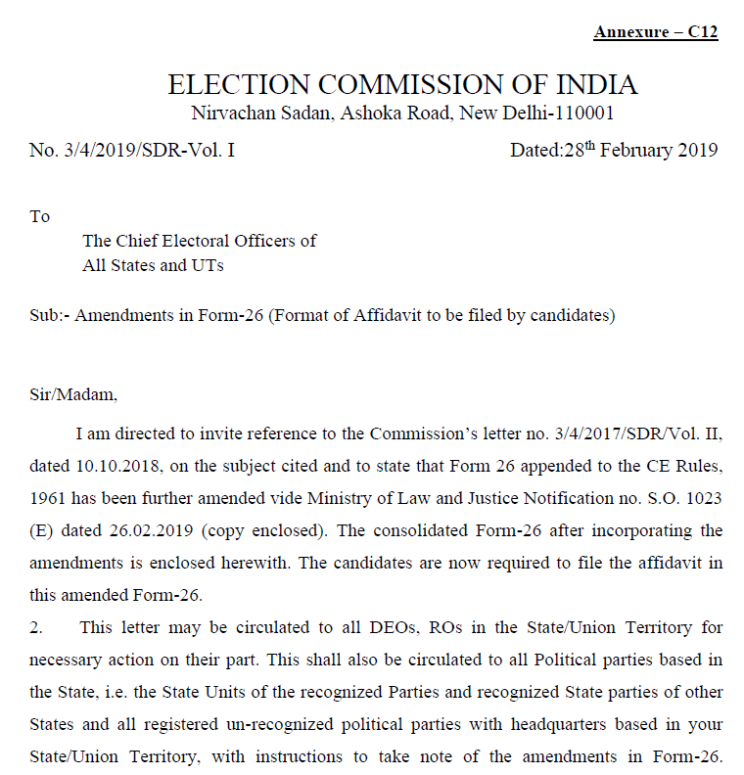
AMENDED FORM-26
Affidavit to be filed by Candidates
w.e.f. 28 Feb 2019

Slide 55
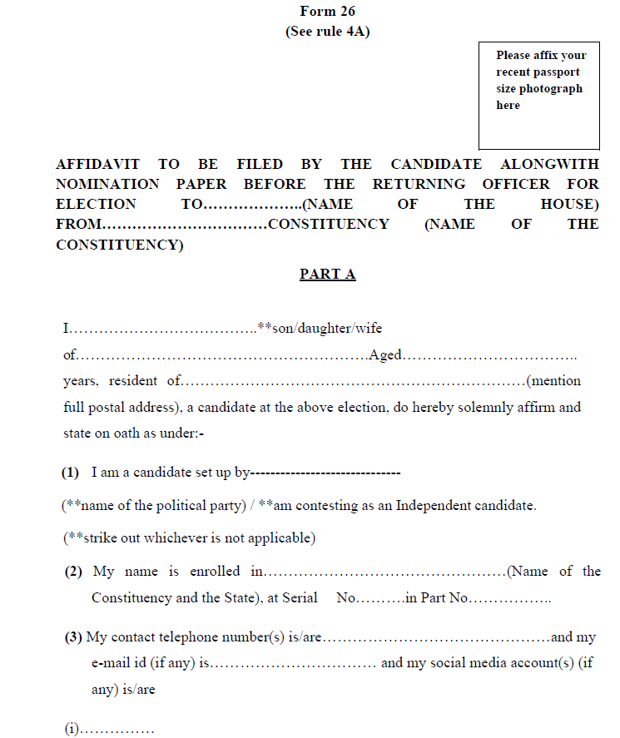
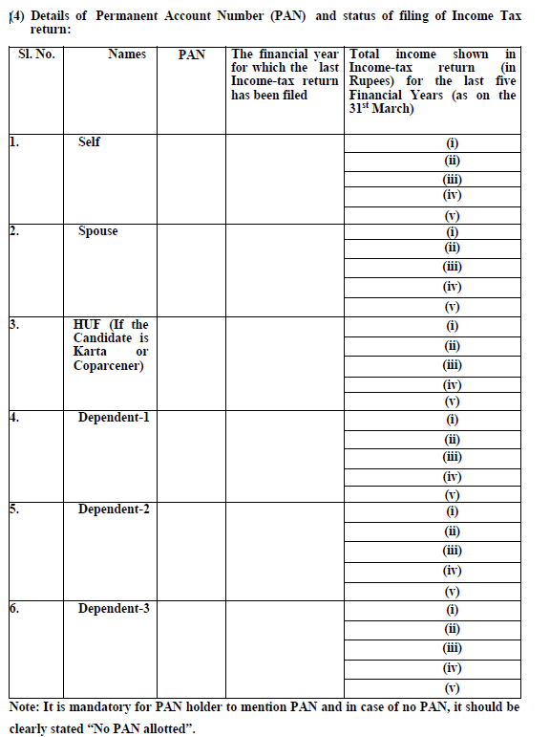
Social Media A/C to be made public
PAN Mandatory

Slide 56
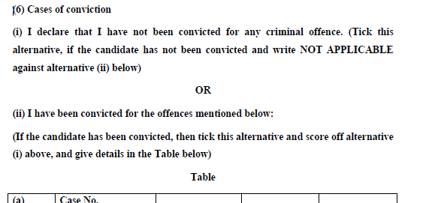
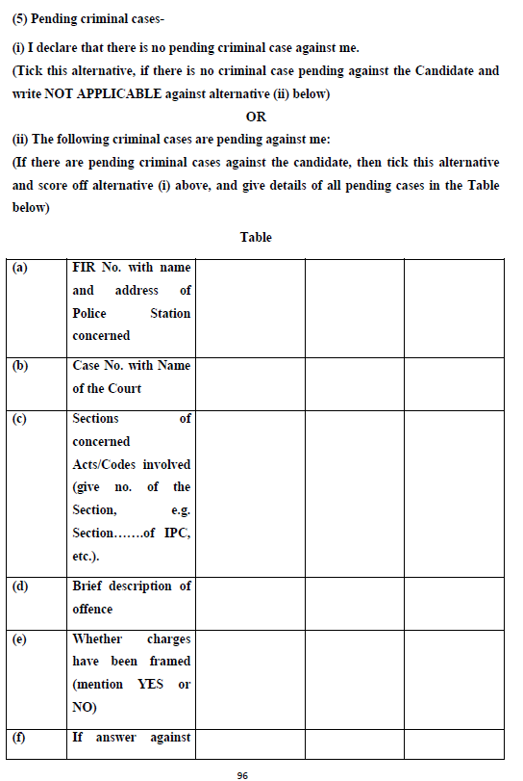
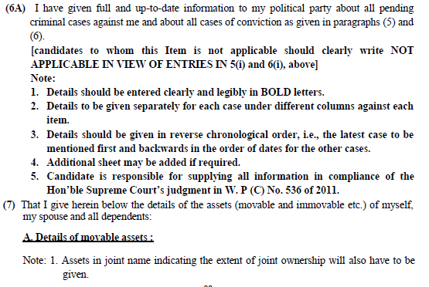
Declaration on Pending Criminal Cases ; Col.5
Pol.Party Candidates to intimate Party :

Slide 57
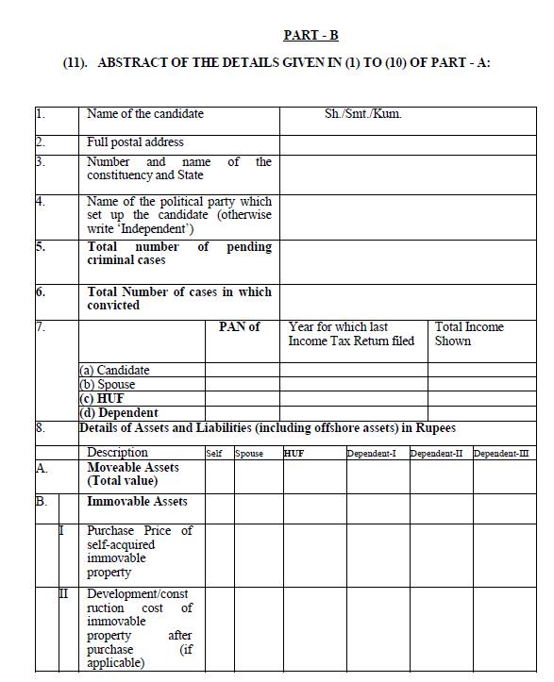
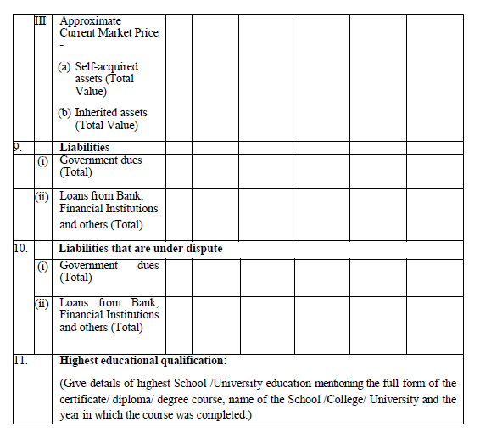
Abstract of all 11 points of the Part A of the Affidavit : in Part B

Slide 58
THANKS
DISCLAIMER :
THE PPT PRESENTATION IS ONLY FOR FACILITATING THE TRAINING . PLEASE REFER THE MANUAL ON ELECTION EXPENDITURE MONITORING , AUGUST 2020 EDN OF ECI AND LATEST INSTRUCTIONS OF COMMISSION ISSUED FROM TIME TO TIME IN CASE OF ANY DOUBT.

