Slide 1
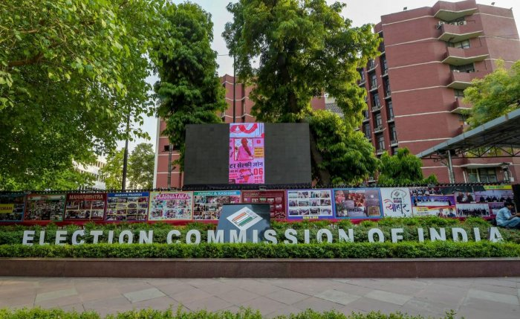

IT
Division
Election Commission of India
Notes:
Photo by bantersnapson Unsplash

Slide 2


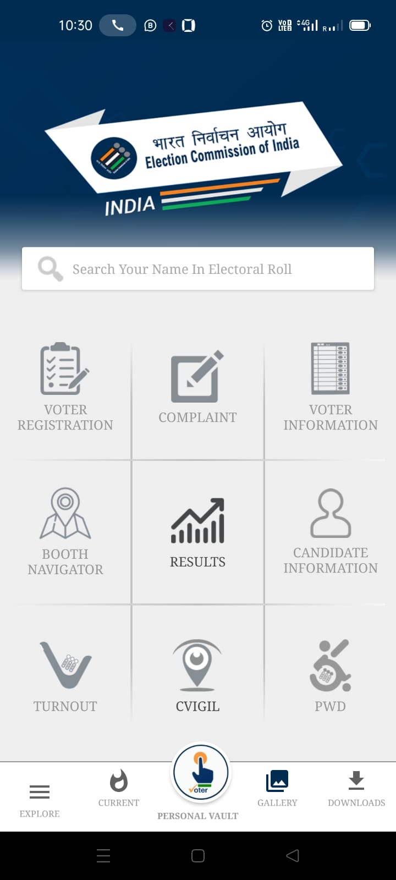
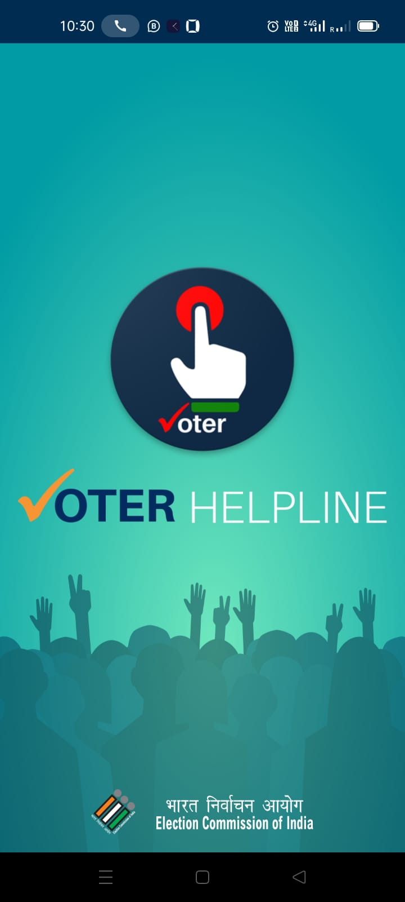

Voter Helpline App
Purpose
to launch
Voter Helpline App
Voter Helpline is an umbrella app for all voters from Registration to Results and from Candidate to Counting.

Slide 3




We can apply for new voter registration, correction request of details, change request of address, request for objection/deletion of name in electoral roll and the request for the replacement of voter ID card.
We can find the way to the polling station of an elector by using his / her voter ID number. This application fetch the live location and uses google map to find the best route to the polling station for that elector.
This feature gets enable on poll day to provide an estimated voting percentage in the poll going constituency. This option is available with multiple filters.

Slide 4



Citizen can register complaint regarding any issue he/she is facing in his registration process, against any election official, and many more with a reference ID to track complaint.
This feature help the user to know the result of the ongoing/last elections. This application directly pulls the data from our counting application and shows the live trends on the of counting.
cVigil option provides the facility to any user to report against any action against model code of conduct. Here user can make the complaint by registration of his mobile number or anonymously.

Slide 5



This option is available for the voter education. Here user can access the video and written material required for the voter education to understand the election process and election machinery.
Here user can see the details of the candidate that have applied for the nomination in the election. Here data of the candidates are available with multiple filters. User can also see the details of the affidavit provided by the candidate during nomination.
This service is initiated by the election commission of india to provide the door step service to the voter that are physically challenged. Here applicant can apply for registration, marking of PwD, request for wheelchair on poll day and many more.

Slide 6
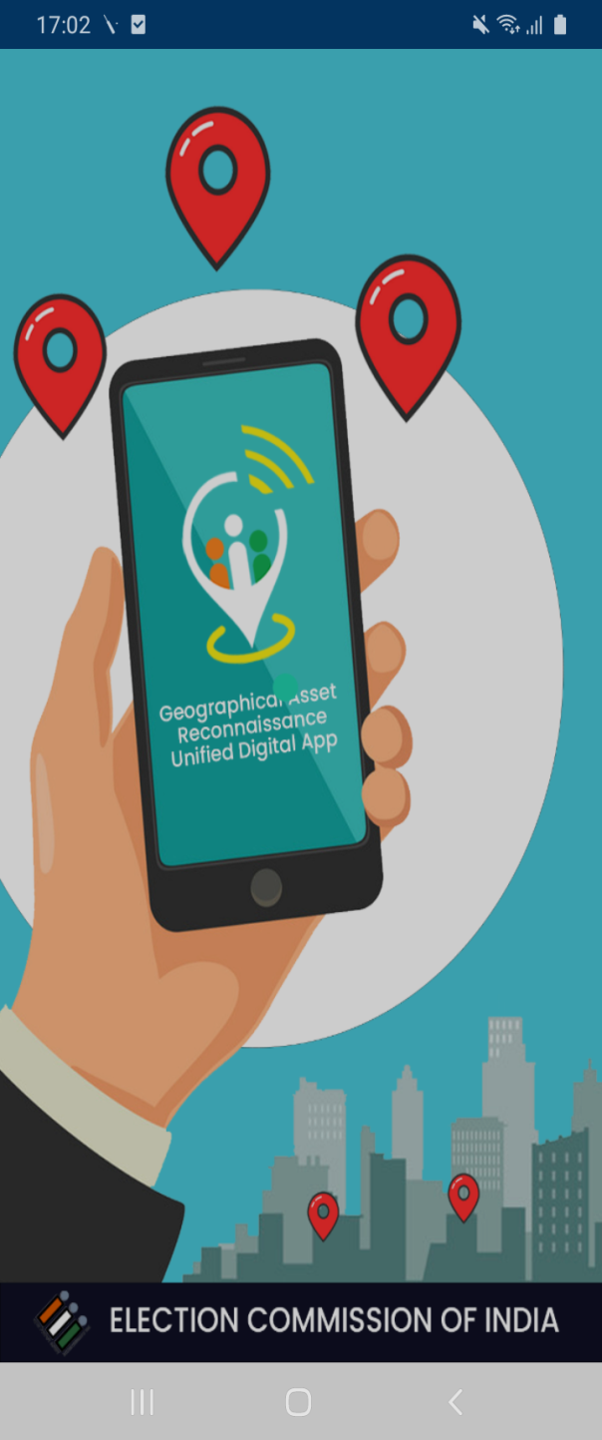
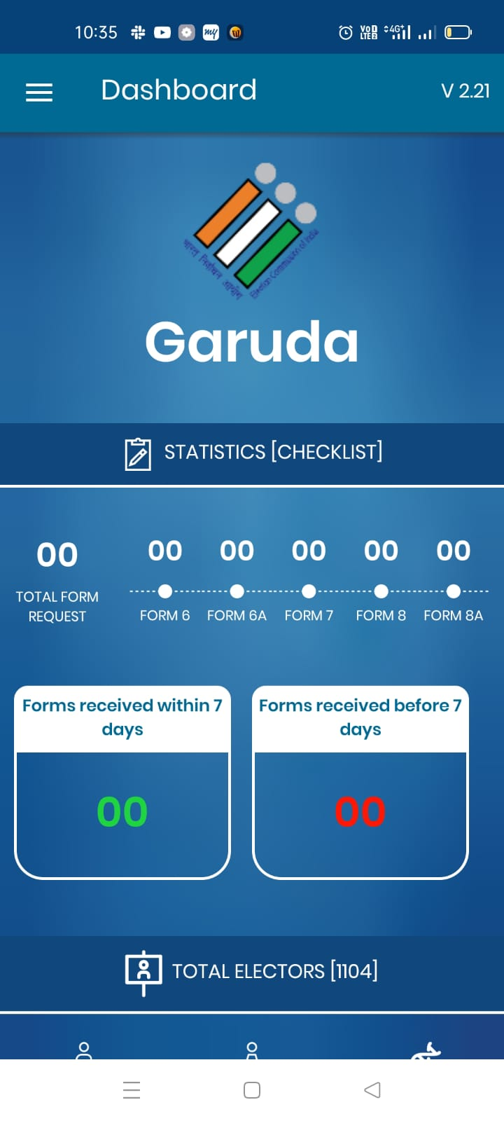
Garuda App
Purpose
to launch
GARUDA App
Dedicated App for Booth Level officers. App offers all BLO related services. This App helps AMF/EMF, GIS location, images etc. directly from BLO’s. Field verification and Form submission are key features of the App

Slide 7

Capture GIS coordinates (Latitude/Longitude) of Polling Stations
Introduction
Android based mobile application that integrates all the functions of BLO.
All the features of the erstwhile BLONET App have been integrated with revamped design and user friendly interface.
Simple, secure and easy to use
Collect Feedback on AMF and EMF
Submit forms on behalf of elector
Checklist/Field verification
Add/Update & photos of Polling Booth

Slide 8
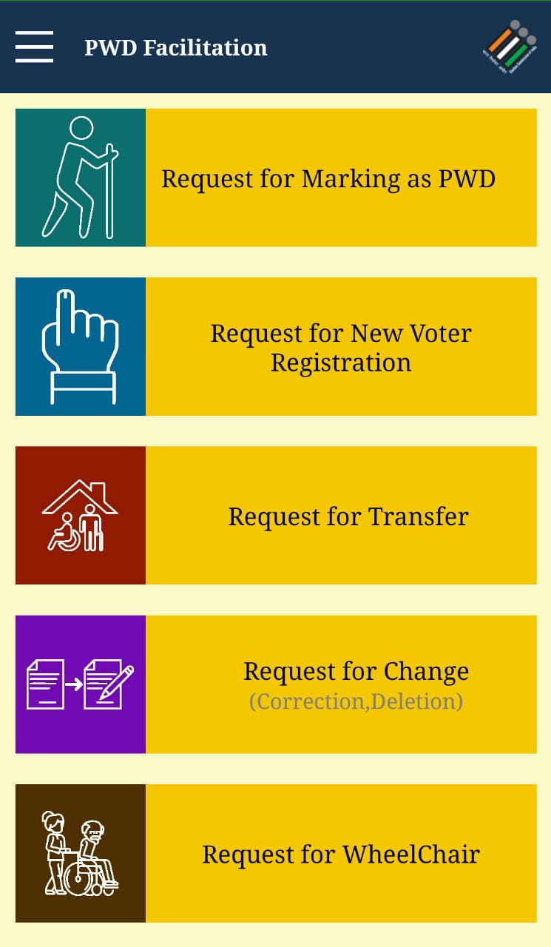

PwD App
Purpose
to launch PwD App
Customized electoral service to provide doorstep facility for the people with disability.

Slide 9
Features
Electoral Search
Know Your Polling Station
Register complaints
Search Polling Officials
Booth Locator
Track status
Marking as PwD
New Registration
Request for Transfer
Request for Correction / Deletion
Request for wheelChair

Slide 10
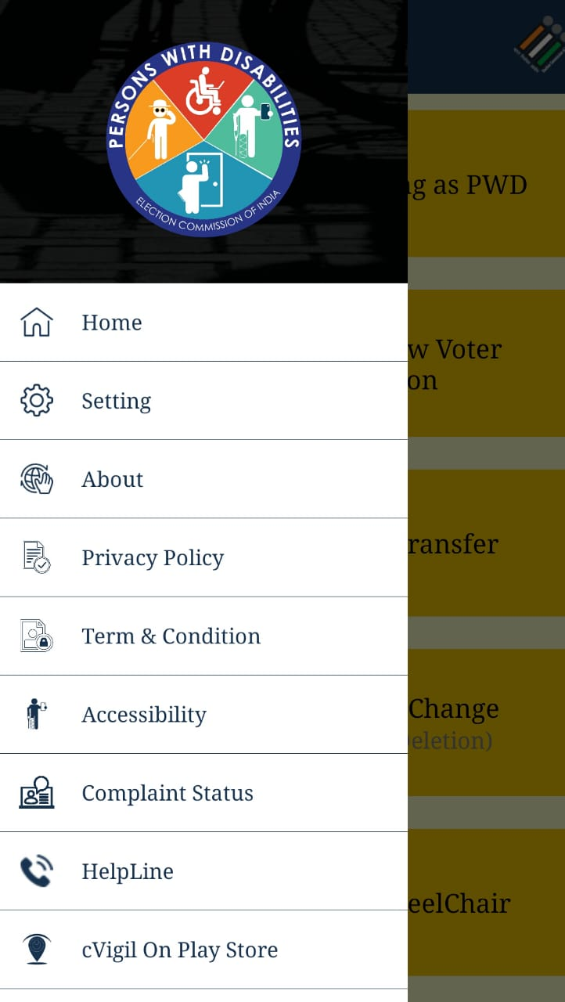
PwD App
Customized electoral service to provide doorstep facility for the people with disability.
App is available in multiple regional languages.
The PwD app includes the features of marking as PwD, request for new registration, request for migration, request for correction in EPIC details, request for wheelchair and many more.
It utilises the Accessibility features of mobile phones for voters with blindness and hearing disabilities.

Slide 11


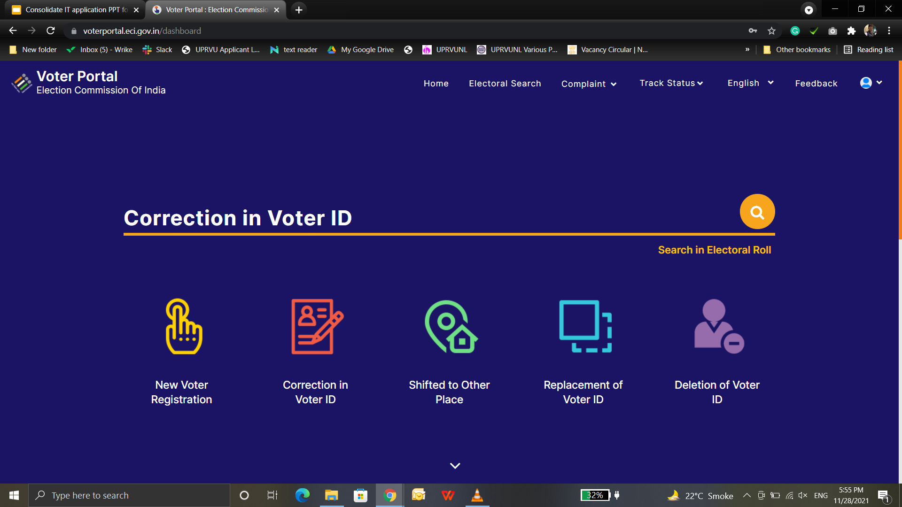
Voter Portal
Seamless interface to apply New Voter registration, alteration in entries, deletion, change of address, overseas, replacement of EPIC (Form-001).
Form Submission
Register
Complaint
Electoral
Search
Status
Tracking

Slide 12
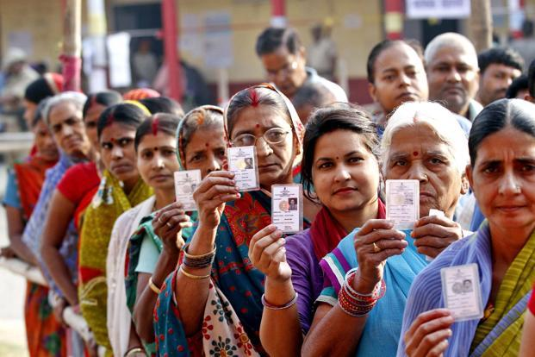
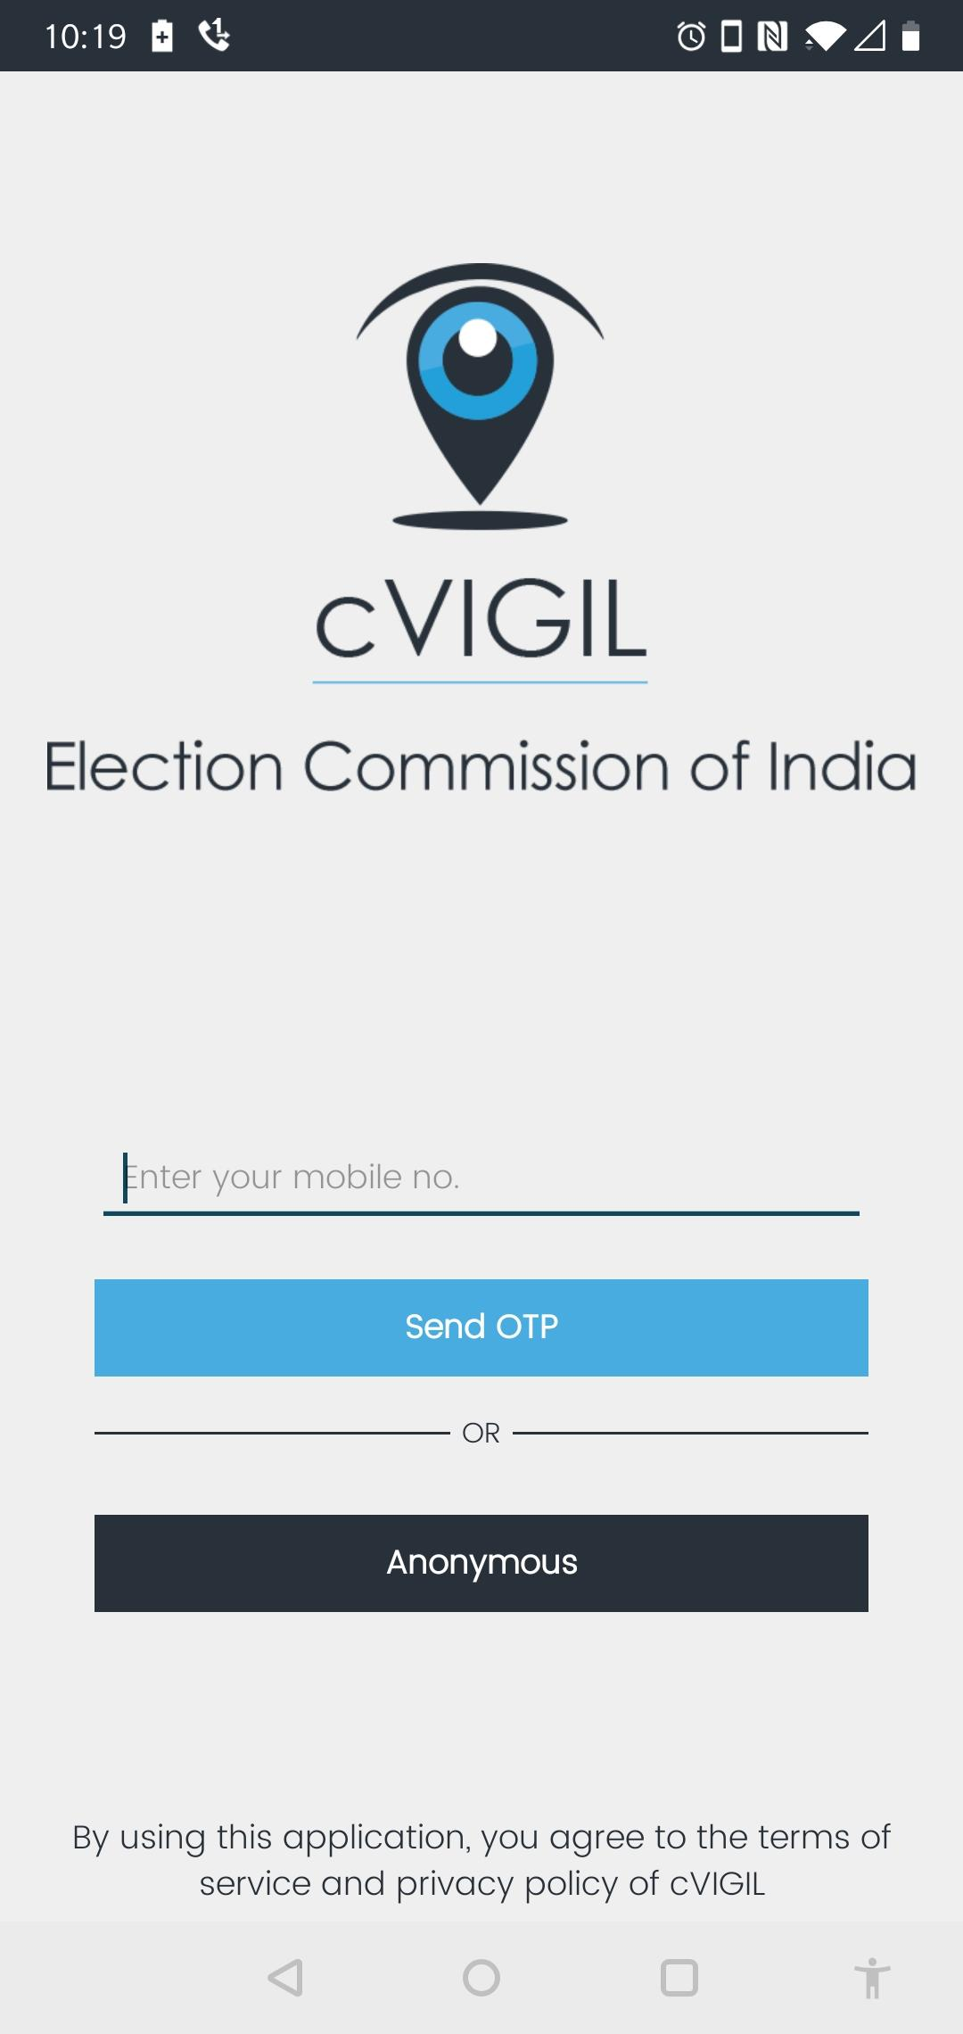
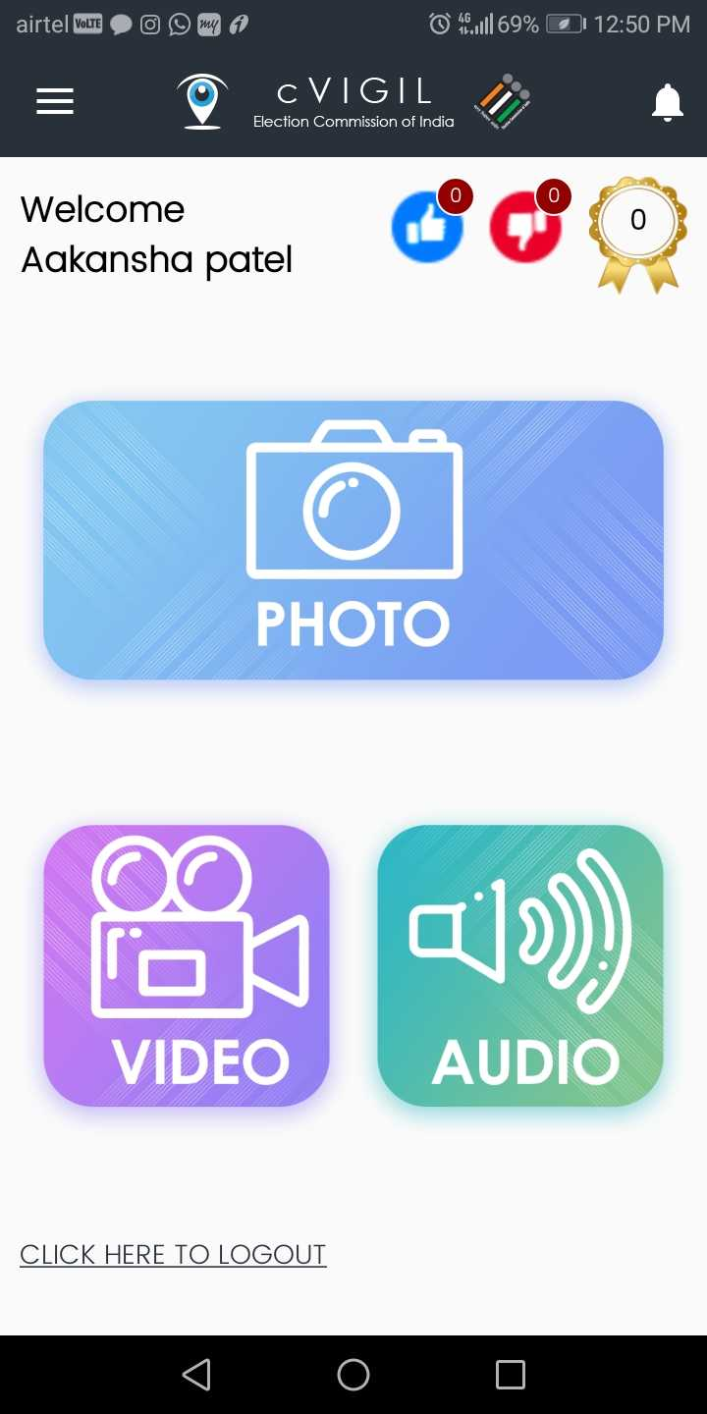
MOBILE BANKING APP PRESENTATION
cVigil
App
(Mobile App for Citizen Vigilance)
Notes:
Geographical Asset Reconnaissance Unified Digital App

Slide 13

cVigil
cVIGIL provide time-stamped evidentiary proof of Model code of conduct / Expenditure Violation by empowering every citizen to click a photo, audio or video using his or her smartphone. Application has below unique features
1
Pictorial, audio and video evidence
2
GIS based auto tracking
3
Robust and prompt response system
4
Get response about the action taken
5
Rapid and accurate reporting
6
Report live MCC violation
7
Doesn’t allow pre-recorded images and videos
Notes:
Photo by STILon Unsplash

Slide 14
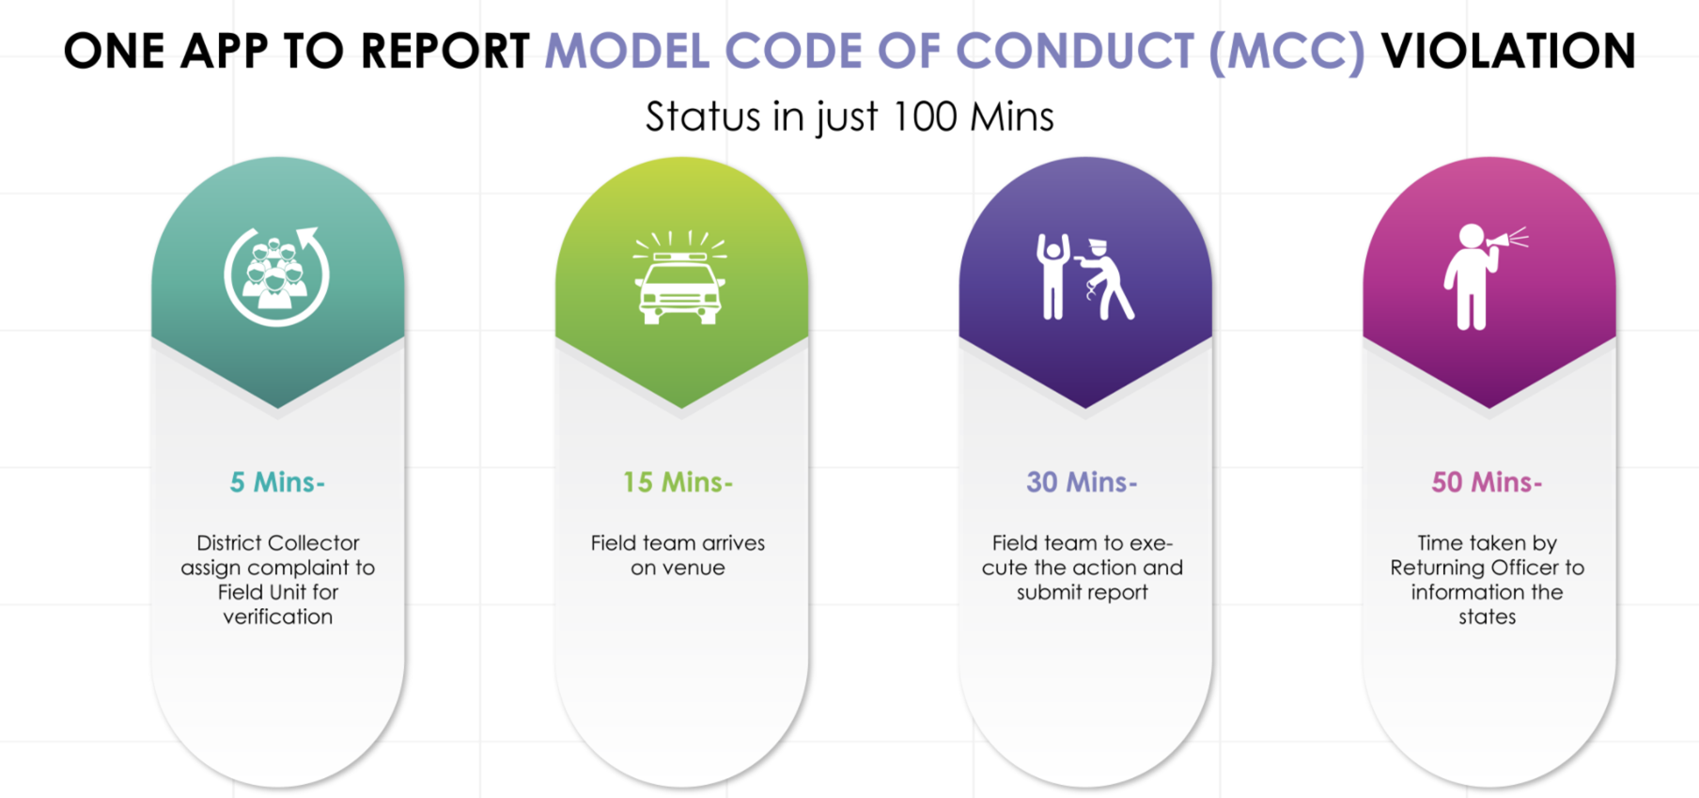
cVigil
How it works ?
Notes:
Photo by STILon Unsplash

Slide 15
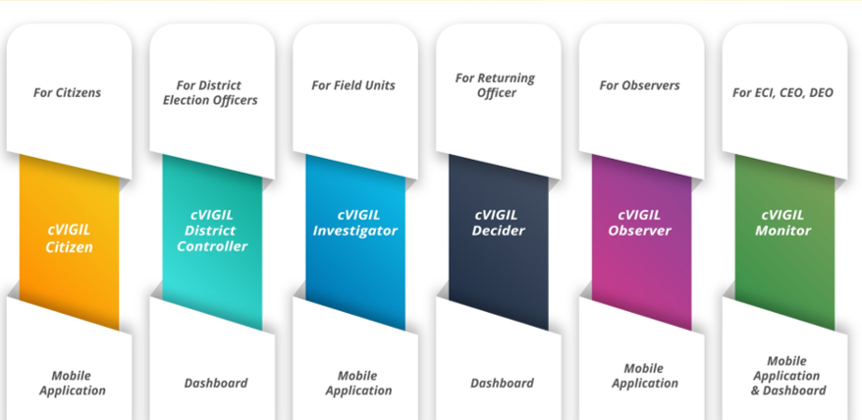
cVigil
cVigil modules
Notes:
Photo by STILon Unsplash

Slide 16
cVigil
cVigil Users
Citizen
Log a complaint
View status of complaint
Monitor
ECI/CEO/DEO can view complaint
Highlight the case
DCC
Assign complaint to FST
User management
FST
Accept the case
Submit report
Decider(RO/ARO)
View the cases
Decide on the case
Observer
View the complaint
Comment on submitted report
Notes:
Photo by STILon Unsplash

Slide 17
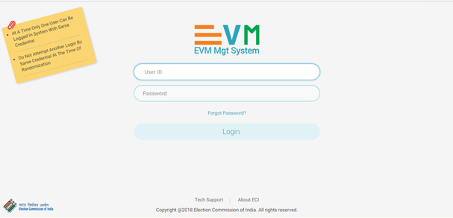
EVM Management System
Single integrated application for EVM Life cycle
Movement of EVM from one to another district
Replacement of EVM at various level
Randomization at District and constituency level

Slide 18
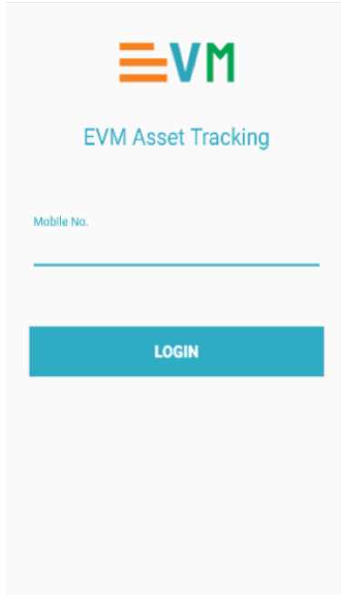
Features of EMS (Mobile App)
Worked as a extended scanner
Sending / receiving scanning
Marking of FLC ok or defective
Marking of units for awareness
Only FLC units can be used in election
Receiving of units in respective Assembly Constituency
Receiving back units in normal warehouse after poll

Slide 19

ENCORE
ENCORE is an integrated application to perform various pre-poll, post poll and poll day activities like candidate nomination, scrutiny, permission, voter turnout, counting and many more...
Notes:
Photo by Headwayon Unsplash

Slide 20
ENCORE
Candidate Nomination
Digitization of nomination form to create database of candidate that used in various election process
Candidate Scrutiny
Process of marking nomination as Accepted / Rejected / Withdrawn.
Affidavit Portal
This allows citizens to view the complete list of Candidate Nominations who have applied for the elections and their affidavits
Election Permission
Permission module allows the candidates, political parties or any representatives of the candidate to apply for the permission.
Election Counting
Application is being used to capture data entry round wise for counting and result dissemination
Voter Turnout
Poll day activity performed by RO’s to provide 2 hourly report of estimated voter turnout in different slots.
Expenditure Monitoring
The Online application of expenditure provides for capturing of expense by candidate over public meetings, posters, banners, vehicle, and ceiling for candidate expenditure.
Index Card
This enables RO’s to fill the Index card online after counting that contains each detail of elections since election declaration to results.

Slide 21

Online Nomination
Online scheduling of meeting for document submission.
A facility that has been provided to the candidates for making online data entry of their personal details in nomination forms and affidavit (Form-26) through ECI Suvidha portal i.e. from “suvidha.eci.gov.in”.
Online security deposit facility and generation of e-affidavit.
Data validation & alert to avoid mistakes.
Notes:
Photo by Brooke Cagleon Unsplash

Slide 22
Candidate Nomination &
Scrutiny
Apply multiple nomination.
A facility that has been provided to the Returning Officer to digitize the nomination form received physically for the nomination. Here RO can perform all the nomination management process followed during nomination and post nomination like nomination, upload of affidavit, multiple nomination, scrutiny, marking of validity, allotment of symbol and finalization of list.
Digitization of physically received forms.
Upload Affidavit and counter affidavit.
Notes:
Photo by Brooke Cagleon Unsplash

Slide 23
Permission Management
Assignment of Nodal in Master Data for similar type of permission.
Permission module allows the candidates, political parties or any representatives of the candidate to apply online for the permission for meetings, rallies, temporary offices, and others through SUVIDHA Portal.
Quick response in case of multiple approving authority.
Easily digitization of physical form.
Notes:
Photo by Brooke Cagleon Unsplash

Slide 24
Nodal App
for
Nodal Officer
Easy for quick response of the assigned nodal officer.
This app is designed for the Nodal officer of the different department assigned for the permission during the MCC to approve the permission. This app help the nodal officer by making data accessible and efficient to take decision.
Nodal can accept / reject with comment and add the NOC if required.
Nodal can view the RO decision and attached document.
Notes:
Photo by Brooke Cagleon Unsplash

Slide 25
Candidate App
for
Candidate
Easy for quick access
This app is designed with purpose to provide status of all the applied nomination and permission requests.
Candidate can view the status of all the applied nomination and permissions.
Can view and download the attached document of permission.
Notes:
Photo by Brooke Cagleon Unsplash

Slide 26
Affidavit
Portal
Displays complete candidate profile
A facility that has been provided to all the citizens to view the details of the candidate. Here citizen can view details of all accepted, rejected, withdrawn and contesting contestant details. The affidavit provided by the candidate is also available in attachment in the public domain.
Contesting candidates list as per FORM 7A
Scrutiny status with affidavit and counter affidavit.
Notes:
Photo by Brooke Cagleon Unsplash

Slide 27
Voter
Turnout
Easy way to display the two hourly voter turnout in public domain.
This simple and time-bound mechanism provides real-time dissemination of Voter Turnout trends to Election officers and Citizens directly through ECI Voter Turnout App. The turnout is auto-compiled as and when the Returning Officers enter the data.
Data available with multiple filters.
Detailed turnout entry of Votes in PS wise entry in end of poll.
Notes:
Photo by Brooke Cagleon Unsplash

Slide 28
Counting Module
Table wise entry of EVM Votes
The ENCORE counting application is an end-to-end application for returning officers to digitize the votes polled, tabulate the data each round-wise and then take out various statutory reports of counting.
Round wise result dissemination to public portals
Multiple user to make table wise entry with seperate postal ballot entry.
Notes:
Photo by Brooke Cagleon Unsplash

Slide 29
Result
Website
Detailed data of votes like EVM votes, postal votes, total votes and percentage of votes
A facility that has been provided to the for all the citizens to view the disseminated result of the counting day. The timely publication of the round-wise information is vital for establishing a single source of authentic data.
Single Source of authenticated data
Graphical representation of the trends with filters of party wise & constituency wise data.
Notes:
Photo by Brooke Cagleon Unsplash

Slide 30
Index Card Module
Detailed report of voter turnout in each assembly.
A facility that has been provided to the Returning Officer to fill the Index card online after counting. It contains each and every detail of elections from the schedule of elections to the declaration of results.
Data available in multiple report format.
Correction facility available similar to physical index card.
Notes:
Photo by Brooke Cagleon Unsplash

Slide 31
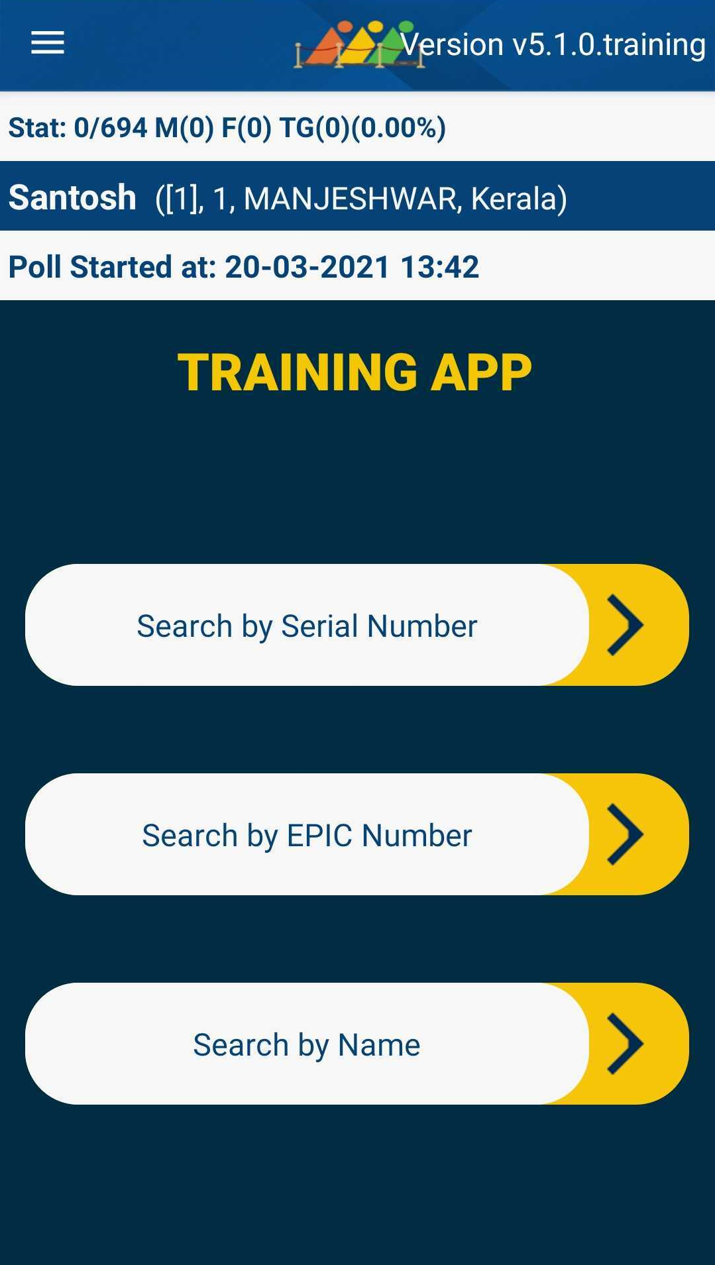
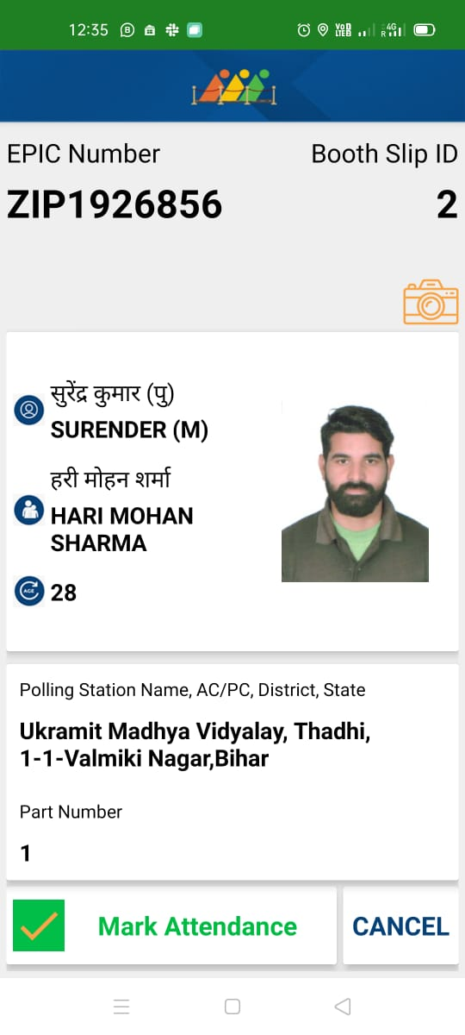
Booth App
Purpose
to launch
Booth App
This application helps the polling officer to identify the elector with the help of serial number, name or EPIC number. This also captures the live voter turnout data from the polling station.

Slide 32
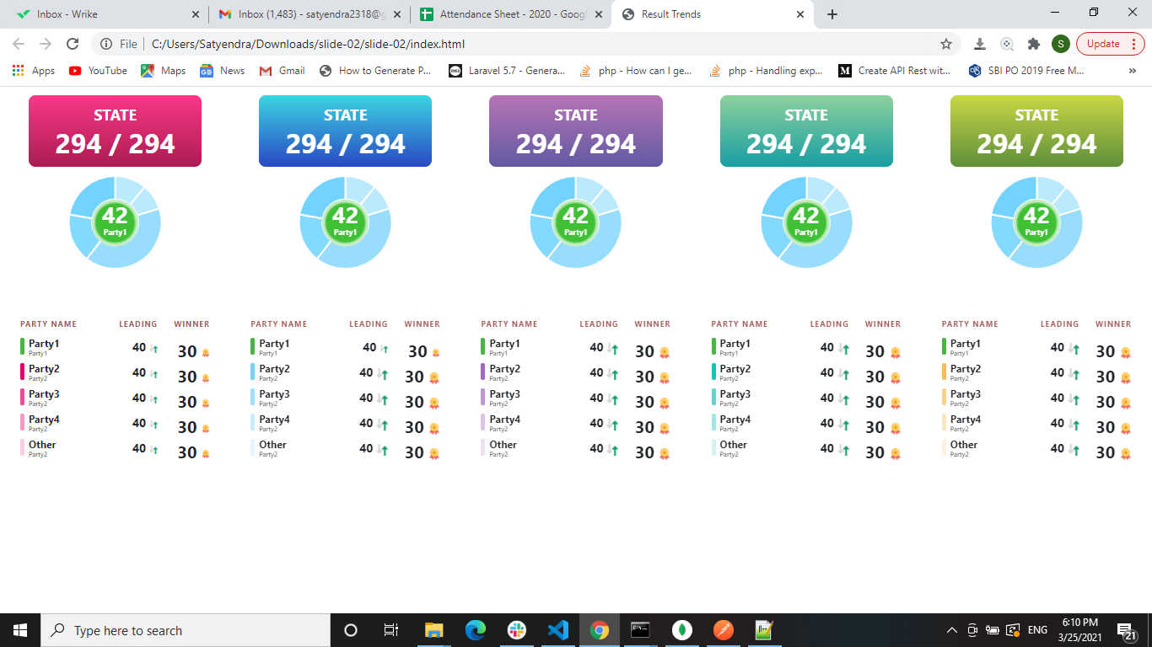
Election Trends TV
Auto scroll, no manual intervention required.
Display result automatically in public places using large TV Panels.
Graphically-rich micro-details of trends & results are published in real-time.
Display round wise results.
Customized and configured as per requirement.

Slide 33
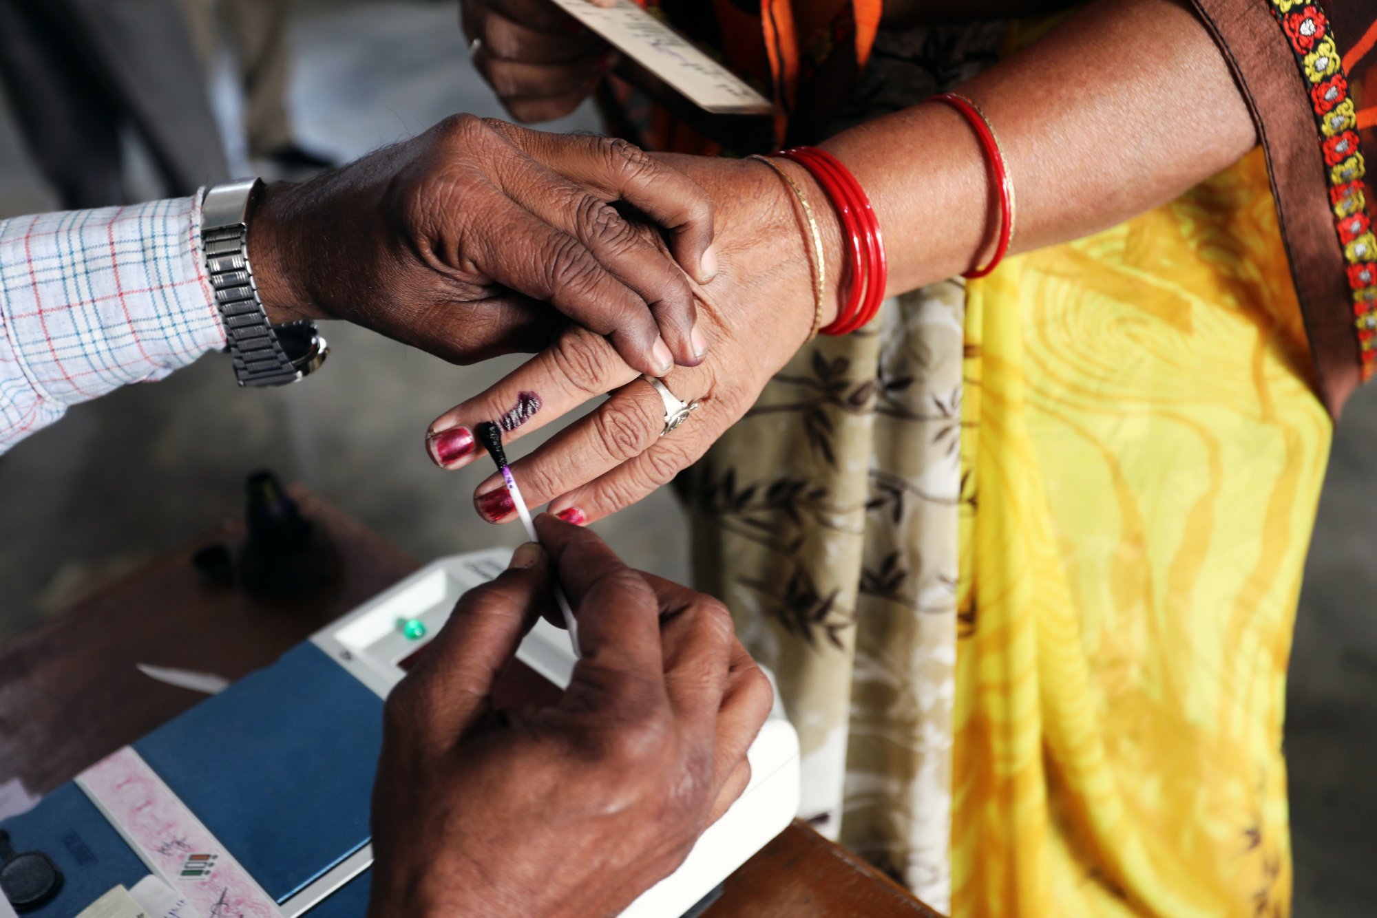
Thank You
Election Commission of India
Notes:
Photo by fauxels from Pexels

