Slide 1
National Level Master Trainer (IIIDEM/ECI)
COUNTING
&
DECLARATION OF RESULTS

Slide 2
OBJECTIVE
Counting of votes is the most important stage of election process.
The result of entire election may be nullified by wrong, irregular or careless counting.
With the use of EVM, the counting process has become simple, easier, accurate, transparent and fast.
All votes cast by means of voting machines are valid votes and as such there is no invalid or rejected vote.
However, perfection in every step of counting process is required so that no doubts remain in the minds of candidates or their agents with regards to result of counting.

Slide 3
COUNTING STAFF
Carry Photo Identity card issued by District Election Officer/RO.
Reach designated counter at the counting centre sharp at 6.00 am on counting day.
Collect Appointment Order of counting hall and table.
Take position at allotted table.
Display Photo Identity card on their body.
Not carry mobile/camera, since these devices are not allowed beyond frisking gate.

Slide 4
COUNTING STAFF
No Electronic Devices such as Mobile phones, Laptops, ipads, etc. are not allowed in the counting hall.
Strictly follow discipline and to obey lawful direction of RO/ARO, including maintaining secrecy of voting.
Shall not leave the counting hall until the result is declared, without the permission of RO/ARO.
Every directions of RO shall be strictly followed and proper decorum is maintained.
100% accurate counting result are entered in the records.
No errors of omissions or commissions are to be committed.

Slide 5
Major legal provisions related to counting & election results
R.P. ACT 1951
Sec 64: Counting of Votes
Sec 64A: Destruction, loss etc. of ballot papers at the time of counting
Counting under supervision and direction of the Returning Officer
RO shall immediately report the matter to ECI who may direct the counting to be stopped.
Contesting candidate /election agent/ /counting agents have a right to be present.
Or if satisfied the result of election will not get materially affected, may allow counting to be completed.
ECI may further declare poll to be void, order re-poll for that polling station.

Slide 6
Major legal provisions related to counting and election return
Major legal provisions related to counting & election results
RP ACT 1951 ( Contd)
Sec 65: Equality of Votes
Result to be decided by draw of lot by RO.
Sec 66: Declaration of Results
In the absence of any direction to the contrary from ECI, RO to declare the result on completion of counting.
Sec 67: Report of the Result
RO to report result to ECI & to Appropriate Authority (i.e. Secretary State Legislature/ Parliament, who shall get it published in official Gazette immediately.

Slide 7
Major legal provisions related to counting & election results
Sec 128: Maintenance of secrecy of voting
Applicable to officer/clerk/agent/person performing duty in connection to Election ( during poll or counting).
RO/ARO should take an oath to maintain secrecy of voting & read it out aloud before the commencement of counting of votes.
Sec 129: Officers, etc. at elections not to act for candidates or to influence voting
Applicable to DEO/RO/AROs/Polling staff.
Imprisonment up to 6 months /fine/both .
Sec 136: Other offences and penalties thereof [Sub sections to (1)-(4)]
Guilty of electoral offence: tampering with EVM/ballot box or ballot paper /nomination paper etc fraudulently
Imprisonment up to 6 months or 2 years /fine /both
Violation punishable with 3 months imprisonment or fine or with both.

Slide 8
Major legal provisions related to counting and election return
Major legal provisions related to counting & election results
CONDUCT OF ELECTIONS RULES, 1961
Rule 66A: In relation to counting of votes where EVMs used, the provisions of Rules 50-54 have been made applicable. And in lieu of Rule 55, 56 and 57, Rules 55C, 56C and 57C have been made applicable.

Slide 9
Major legal provisions related to counting and election return
Major legal provisions related to counting & election results
Conduct of Elections Rules, 1961
Rule 51: Time and place for counting
To be fixed by RO at least one week before date of poll
Rule 52 : Appointment of Counting Agents
Subject to ECI directions, a candidate may appoint counting agents which shall not exceed 16 for each place of counting
Notice to be given in writing to each candidate/his election agent
Appointment to be made in FORM 18, in duplicate. One copy for RO for record and other copy to agent for production before RO, not later than one hour before the time fixed for counting
Revocation in FORM 19
No entry in counting hall unless second copy of FORM 18 is given to RO after signing the declaration

Slide 10
Major legal provisions related to counting and election return
Major legal provisions related to counting & election results
Rule 53: Admission to the place of counting
No body else except RO/ARO, counting staff, candidates, their election agents and counting agents public servants on duty, persons authorized by ECI
Rule 54: Secrecy of voting
RO to read out provision of section-128 aloud before commencement of counting.
Whosoever misconducts himself or fail to obey lawful direction of RO shall be removed from counting hall.

Slide 11
Major legal provisions related to counting and election return
Major legal provisions related to counting & election results
Rule 55C: Scrutiny and inspection of EVMs before counting
Counting staff and counting agents to inspect and ensure that the CU is not tempered and all seals are intact. In case not, report matter to ECI
Rule 56C: Actual counting
1. Press the result button and see the display of votes count.
2. Note down the same in part-II of form 17C. Counting supervisor to sign on it along with candidates or their election agents or counting agents
3. Corresponding entries to be made in form-20
Rule 57C: EVMs after counting.
After, result is recorded in part-II of form 17C, the CU to be sealed with the seals of the RO and candidates/ counting agents.

Slide 12
Major legal provisions related to counting and election return
Major legal provisions related to counting & election results
Rules 60 provides for continuous counting
Rule 61 provides for re-commencement of counting after fresh poll
Rule 63 provides for recount of votes
Rule 64 provides for declaration of result of election
Rule 66 provides for grant of certificate of election to returned candidate
Rule 65 provides for counting at 2 or more places for one constituency

Slide 13
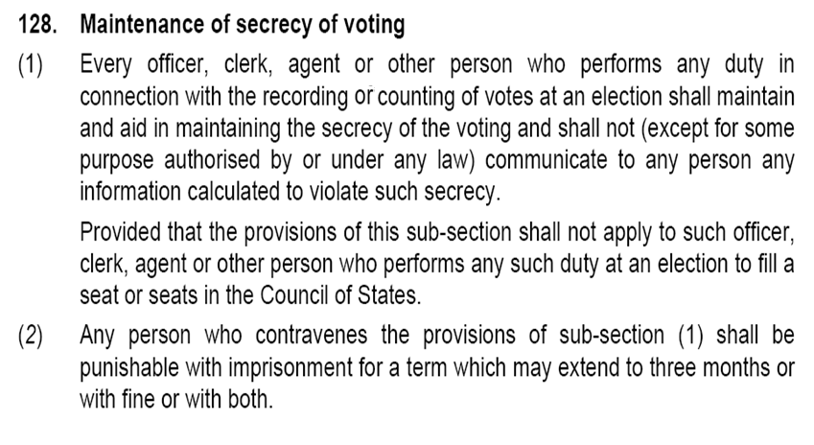
R.O.P.A.
Everyone present in the counting hall should be instructed to maintain secrecy of vote.
Read aloud the provisions of Section 128 of the Representation of the People Act, 1951.

Slide 14
INFRASTRUCTURE

Slide 15
Infrastructural and security arrangements at counting centers
Counting of votes for entire AC to be preferably done at one hall/ place
If more than two halls or places are required, ECI’s written prior approval is required
In case 2 halls are approved, allot in advance the PS to be counted in each hall. Intimate candidates accordingly
For Each AC or assembly segment there should be a strong room and a spacious counting hall with separate entry and exit.
Each counting centre to have distinct number and each hall to be distinctly numbered

Slide 16
Infrastructural and security arrangements at counting centres
Should be spacious enough to accommodate infrastructure and officials and agents
Should have adequate lighting with proper standby arrangements (generator, etc.)
Adequate fire extinguishing equipment
Should be a permanent structure. If unavoidably temporary, take ECI approval
Infrastructure at Counting Centre

Slide 17
Infrastructural and security arrangements at counting centres
No. of tables in counting hall depends upon
No. of polling stations to be counted.
Space available
No. of counting agents
No. of counting staff including micro-observers
Security concerns
In one hall, counting tables should not exceed 14 (during last Lok Sabha elections 2009, even 25 tables were allowed, with ECI’s prior approval, provided hall was big enough).
In addition to this one table each for RO and observer.

Slide 18
Infrastructural and security arrangements at counting centres
The candidates or their agents will be allowed to sit on ROs Table to watch the counting process.
A table with computer on which computation and compilation of data from each table after each round shall be done, should be alongside of ROs table.
If the tabulation is done at the table other than ROs table then one additional counting agent besides micro observer will be allowed to sit in on the tabulation table.
Adequate barricades using woodblock and wire-mesh for each counting table to prevent agents/candidates/representatives from handling polled EVMs, but agents should be able to view entire process

Slide 19
Layout
BLACK BOARD
C.S.
C.S.
7
C.A
14
C.A
M.O.
M.O.
C.S.
C.S.
6
C.A
13
C.A
M.O.
M.O.
C.S.
C.S.
5
C.A
C.S.: Counting Supervisor
C.A.: Counting Assistant
M.O.: Micro Observer
12
C.A
M.O.
M.O.
C.S.
C.S.
COUNTING AGENTS OF CANDIDATES
COUNTING AGENTS OF CANDIDATES
4
C.A
11
C.A
M.O.
M.O.
C.S.
C.S.
3
C.A
10
C.A
M.O.
M.O.
C.S.
C.S.
2
C.A
9
C.A
M.O.
M.O.
C.S.
ARO
RO
OBS
C.S.
1
C.A
8
C.A
M.O.
CLERKS TO ASSIST RO
M.O.

Slide 20
Infrastructure and security arrangements at counting centres
Provide at every counting table:-
A blue ballpoint pen
Paper knife for breaking open seals
Part II of Form 17-C
Proforma for recording of votes secured by each candidate and NOTA by additional counting staff/ Micro observer
Make arrangement of loud speaker and a black board for disseminating information regarding trends in counting and results to public and media.
Adequate teams for sealing EVMs and other Envelops

Slide 21
Infrastructure and security arrangements at counting centres
Only official video camera for overall videography in the counting hall.
No camera still or video of journalist or media person is allowed inside the counting hall.
Hand held cameras of press/media persons having valid passes can be allowed to take a general view. They should not be allowed beyond a certain demarcated line or a string put for this purpose.
Under no circumstance votes recorded in EVM should be captured by any camera including the official camera.

Slide 22
Infrastructure and security arrangements at counting centres
Arrangements at counting centre- Observer should be provided with :
Separate Room/Cubicle with tables and chairs.
Telephone with STD and fax attached exclusively for use of Observer to communicate in strict confidentiality.
Number for this telephone to be obtained from phone company 15 days before counting date.
In addition, necessary arrangements for Micro observer at each table may be made

Slide 23
Infrastructure at counting centres
Arrangements at counting centre :
A hotline with CEO
One more STD telephone to keep in touch with CEO & ECI
Fax and photocopy machines at each counting centre
Computer centre with power backup with facility for online transmission through GENSYS
NOTE:- only ECI observer is allowed to use mobile phone inside the counting hall.

Slide 24
POSTAL BALLOTS

Slide 25
Counting of Postal Ballots
The Returning Officer shall give directions to AROs to commence the counting of PB & ETPBS at 8.00 am near the ROs table.
The counting of Postal Ballots will be taken prior to the counting of votes from EVM and has to be completed before last round of EVM counting.
Additional counting tables shall be provided to expedite the process of counting of PBs
On each Table for counting of postal ballot there will be an ARO, one Counting Supervisor and two Counting Assistants.
There shall also be an additional micro-observer for each table for postal ballot counting.
Entire counting procedure shall be videographed.

Slide 26
Counting of Postal Ballots
The counting of Electronically transmitted Postal Ballots (ETPBS) shall be done along with the postal ballot counting.
The counting of votes in EVM can commence 30 minutes after starting the counting of PB’s.
Note that Candidates/Election Agents/Counting Agents have right to be present at the time of counting of Postal Ballots.

Slide 27
Counting of Postal Ballots
PB’s received after the expiry of time fixed for counting shall NOT be opened & shall be separately sealed with suitable endorsement.
Note that the number of such PB’s is not be included in the total number of rejected votes.
PB’s received in time shall be considered for counting one by one
BIG ENVELOPE | FORM 13 C | COVER B
DECLARATION | FORM 13 A
SMALL ENVELOPE | FORM 13 B | COVER A

Slide 28
Postal Ballots
Open the Bigger Envelope [Cover B]
This shall contain declaration in Form 13A and Small envelope [Cover A] containing PB.
First the declaration is taken out and scrutinized.
In case of rejected PB’s, the Smaller envelope and declaration are to be placed back in their respective bigger envelope.
All cases of rejection of PBs due to defects in Declaration in Form 13A shall be re-verified by the RO before they are actually put in the rejected category.
All such rejected PB’s in the bigger envelopes are to be kept together in a separate sealed packet mentioning the PC/AC, date of counting and superscripted as “REJECTED POSTAL BALLOTS”

Slide 29
Rejection of Postal Ballots
A postal ballot paper shall not be rejected
merely on the ground that the attesting officer has not put his seal on the declaration of the elector in Form 13-A, if the attesting officer has given all relevant details with regard to his name and designation on that Form.
on the ground that the sender (elector) has not put his signature on the outer cover “B” (Form 13C) in which he has returned the postal ballot paper, if the identity of the sender is verifiable on the basis of his declaration in Form 13-A.

Slide 30
Declarations & Ballot Papers
All the valid declarations are to be kept together in separate sealed envelope mentioning the PC/AC, date of counting and superscribed as “VALID DECLARATIONS”
This should be done before smaller envelopes containing the ballot papers are opened.
Thereafter the smaller envelopes will be mixed and should be opened one after another and the validity of ballot papers scrutinized and decisions arrived.
Valid Ballot papers.
Invalid Ballot papers.

Slide 31
Counting of Postal Votes
The valid votes should then be counted and each candidate credited with the votes received by them.
The total number of postal votes received by each candidate should then be calculated and entered in the Result Sheet in Form 20
An announcement in this respect has to be done by RO for information of the candidates.

Slide 32
Infrastructure at counting centres
PERSONS ALLOWED INTO COUNTING HALL
Counting supervisors and assistants
Persons authorized by ECI
Public servants on duty in connection with election
Candidates, their election agents and counting agents
Every body inside the counting hall shall have to display his I-card on his/her person.
24

Slide 33
PERSONS NOT ALLOWED INTO COUNTING HALL
Police personnel, whether in uniform or plain clothed, NOT allowed. Must remain outside and can enter only when called by RO to come to control
Ministers, State Ministers, Dy. Ministers of Union & state unless they are candidates
The above dignitaries can not be appointed as election or counting or polling agent of candidate as they require security
Counting agents cannot enter unless she/he has submitted 2nd copy of appointment letter after completing and signing declaration

Slide 34
Infrastructure arrangements at counting centers
PRIORITY IN SEATING IN COUNTING HALL (subject to seating capacity)
1. Agents of candidates of recognized national parties
2. Agents of candidates of recognized state parties
3. Agents of candidates of recognized state parties of other states permitted to use reserve symbol
4. Agents of candidates of registered unrecognized parties
5. Agents of Independents Candidates

Slide 35
Infrastructure and security arrangements at counting centres
DISCIPLINE & DECORUM IN COUNTING HALL
Agents to keep seated at allotted table. No one is allowed to carry mobile phones except RO/ Observer.
Agents shouldn’t be allowed to move about hall. However, Candidates/ Election Agents can move around hall.
Only one person – either candidate or agent to be present at a table on behalf of contesting candidate.
If RO doubts any person he can have him/her searched, even if they possess valid authorization letter.
CPF officials posted at doors of counting hall.
No one can enter or leave hall without RO’s permission.
RO can send anyone out of hall if he/she disobeys RO’s orders.

Slide 36
APPOINTMENT OF COUNTING STAFF

Slide 37
Counting staff & counting agents
RO to inform each contesting candidate that he is entitled to as many counting agents as there are counting tables plus one for RO table and one for tabulation table.
Any application on plain paper to be rejected. Form 18 to be submitted in duplicate. The RO will keep one copy and return the 2nd copy. On counting day, the agents will sign the declaration part of the Form 18 and give it to the RO.
Issue photo identity cards to such counting agents under RO seal and sign
No entry into counting hall without I-card

Slide 38
Counting staff & counting agents
Appointment of counting agents in Form 18.
Revocation in Form 19.
Finalize list of counting agents appointed through Form 18 by 1700 hours 3 days prior to date of counting
Counting agent should sign on badge immediately.

Slide 39
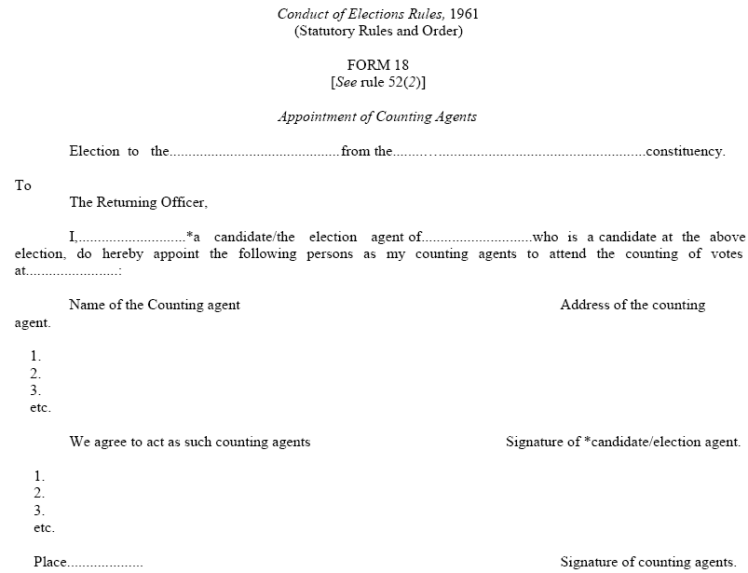
Form 18: Appointment of Counting Agents

Slide 40
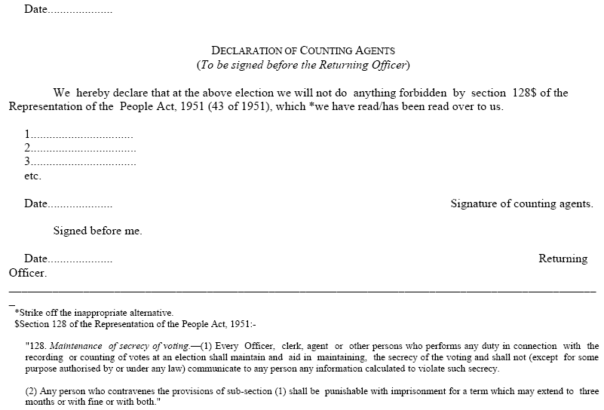
Form 18: Appointment of Counting Agents
32

Slide 41
COUNTING
FROM EVM

Slide 42
Layout
BLACK BOARD
C.S.
C.S.
7
C.A
14
C.A
M.O.
M.O.
C.S.
C.S.
6
C.A
13
C.A
M.O.
M.O.
C.S.
C.S.
5
C.A
C.S.: Counting Supervisor
C.A.: Counting Assistant
M.O.: Micro Observer
12
C.A
M.O.
M.O.
C.S.
C.S.
COUNTING AGENTS OF CANDIDATES
COUNTING AGENTS OF CANDIDATES
4
C.A
11
C.A
M.O.
M.O.
C.S.
C.S.
3
C.A
10
C.A
M.O.
M.O.
C.S.
C.S.
2
C.A
9
C.A
M.O.
M.O.
C.S.
ARO
RO
OBS
C.S.
1
C.A
8
C.A
M.O.
CLERKS TO ASSIST RO
M.O.

Slide 43
Counting Table
Wire - Mesh
Counting Supervisor
COUNTING TABLE
No. 1
Counting Agents
Counting Assistant
Micro Observer

Slide 44
Computer Table
COMPUTER TABLE
Additional Counting Agent
Data Entry Staff
Micro Observer

Slide 45
Duties of staff on Counting Table
On every Counting table, there shall be one Counting Supervisor, one Counting Assistant & Micro-observer.
Distribution officer shall issue sealed carrying cases containing Control Unit/s to each table.
Before opening the sealed carrying case, ensure that:
Carrying case has Form 17C, MPC and PRO declarations are tied to it from outside.
Seals of carrying case are intact. Report to RO/ARO, in case seals are not intact.
Ensure that the Control Unit Number on Address tag and Form 17C are the same.
Remove the Address Tags from carrying case and take out CU and place it on counting table.
Also take out the copy of 17C kept along with CU.

Slide 46
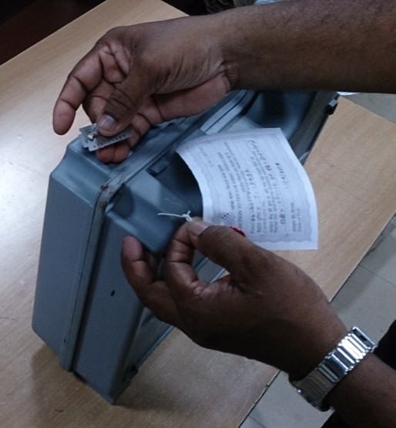
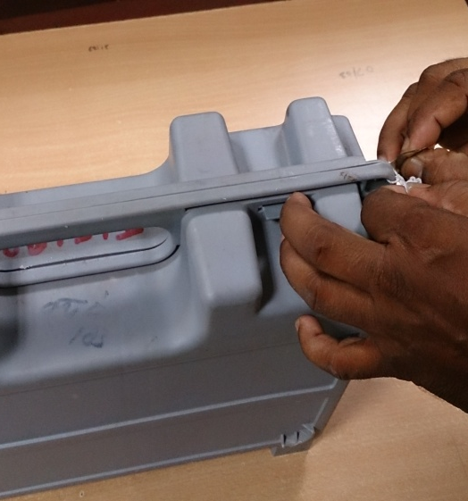
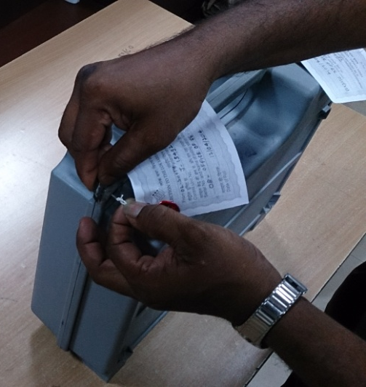
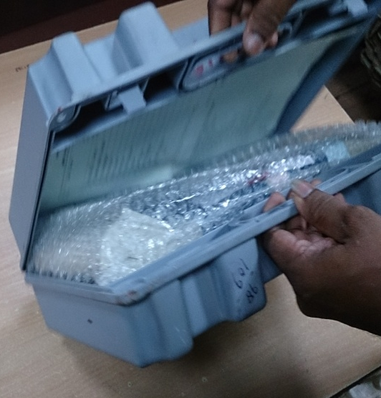
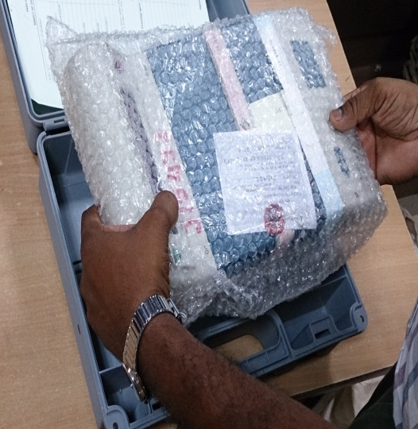
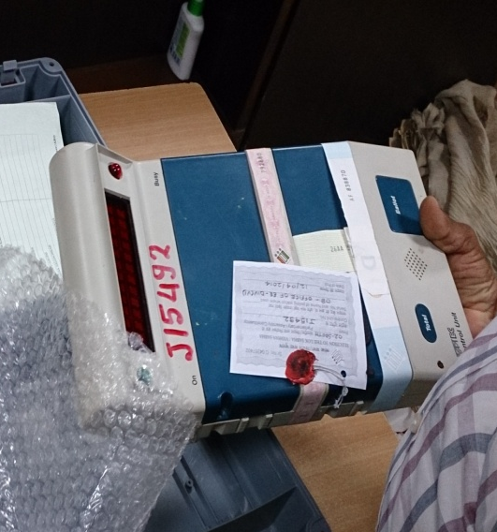
Unsealing EVM from Carrying Case

Slide 47
Counting of votes recorded in EVMs
EVMs to be distributed sequentially, i.e. PS no. 1 to Table 1 and so on.
Nodal officer to ensure.
Keep account of such distribution with you
Only CU required for Counting .
BU to be brought into hall only if inspection required.
Along with CU, sealed cover containing Form 17C (Account of Votes) to be brought to counting table.
Remove the seals from carrying case, take out CU. Place on table for inspection of seals by Candidates/ agents .
If seal is properly intact and there is no tampering, votes will be counted.
Proceed further
…..Decide if clerical errors or actually tampered with. If tampered with, keep aside and inform ECI immediately
When taken out of carrying case, check:
That it is the same CU supplied to the PS
Seal on Cand set Section is intact.
Outer Strip Seal in Result Section.
CHECK that green paper seal is intact and its S. No. tally with paper seal account prepared by PrO in Form 17C : Part I: Item 9. ……
Check S No of Pink paper seal affixed on CU .
Special Tag‘ in Result Section.
37

Slide 48
Counting of votes recorded in EVMs
Switch ‘On’ the CU
Press the ‘Result-I’ button.
Total no. of votes for each candidate will be displayed for that PS. Lift the unit and show it to all agents so that they can note down votes polled by candidates.
Counting Assistant to note result in Part –II – Result of Counting of Form 17C.
If required, press again to show result to candidates/agents so that they are satisfied.
After result noted in Form 17 C-part II, close cover of result section and Switch “OFF” CU.

Slide 49
Counting of votes recorded in EVMs
Counting Supervisor to tally Result noted in part II of Form 17C and that noted down in Item 5: Part I: Form 17C
After completing form, counting supervisor to sign it
Request candidates’/agents’ present at table to also sign .
Counting Supervisor should then hand over duly completed 17C to RO.
RO to countersign in part-II of 17C after satisfying himself.
Thereafter 17C should be sent to the Officer compiling final result in Form 20.
On basis of individual Form 17C, RO to get prepared a round wise statement in the prescribed format. RO and Observer to sign it after necessary checks.
Announce the votes polled against each candidate round-wise after having it written on a black board so everyone can see. A copy of round wise result to be kept in Obs .folder and one copy to each candidate.
Observer to do parallel counting of 2 PSs, randomly selected, with the help of Addl. Counting staff to get satisfied that votes tally with Form 17C

Slide 50
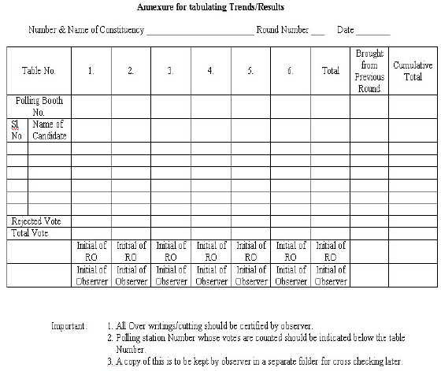
Counting of votes recorded in EVMs
Round wise statement proforma

Slide 51
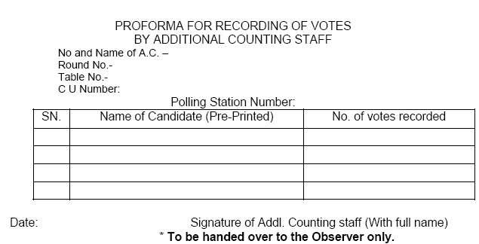
Counting of votes recorded in EVMs
Proforma for recording of Votes by Additional Counting Staff

Slide 52
Counting of votes recorded in EVMs
Officer compiling result in Result Sheet in Form 20 will do so strictly as per entries in Part II of Form 17 C.
He will note down no. of tendered votes polled, if any, in Form 20. Take note that these are not be counted.
For AC, Final Result Sheet, You need to prepare only Part I of Form 20 where you mention no. of postal votes received by each candidate. In LS election Part II also to be filled up.
After all details have entered in Form 20, strike the grand total credited to each candidate, grand total of postal and votes polled at PS
Carefully check entire Form 20 if all entries have been made for every PS and it is not incomplete
Grand total should be struck accurately as discrepancy in the form will affect the result of election and declaration of result. This will invite severe disciplinary action

Slide 53
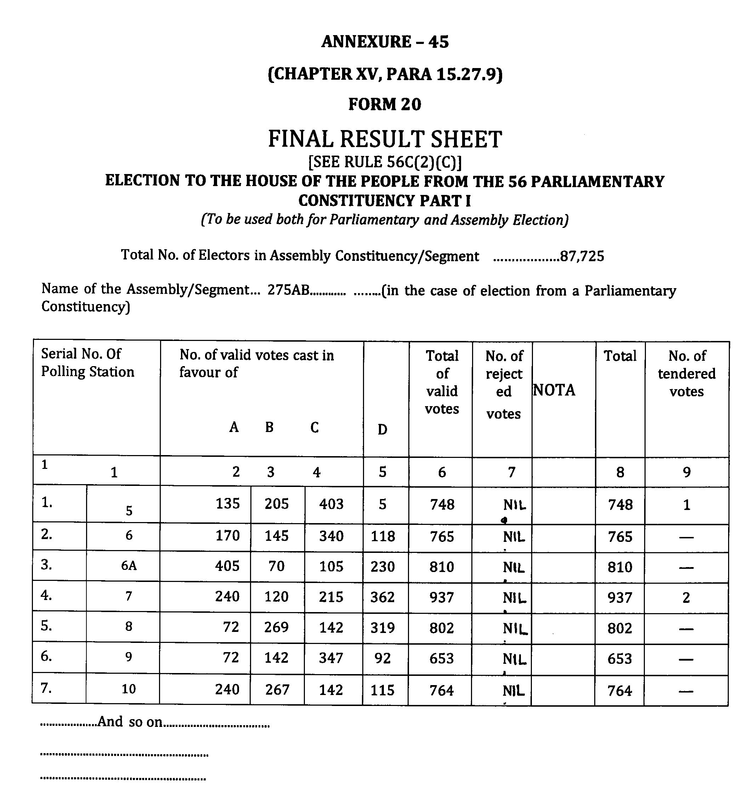
43

Slide 54
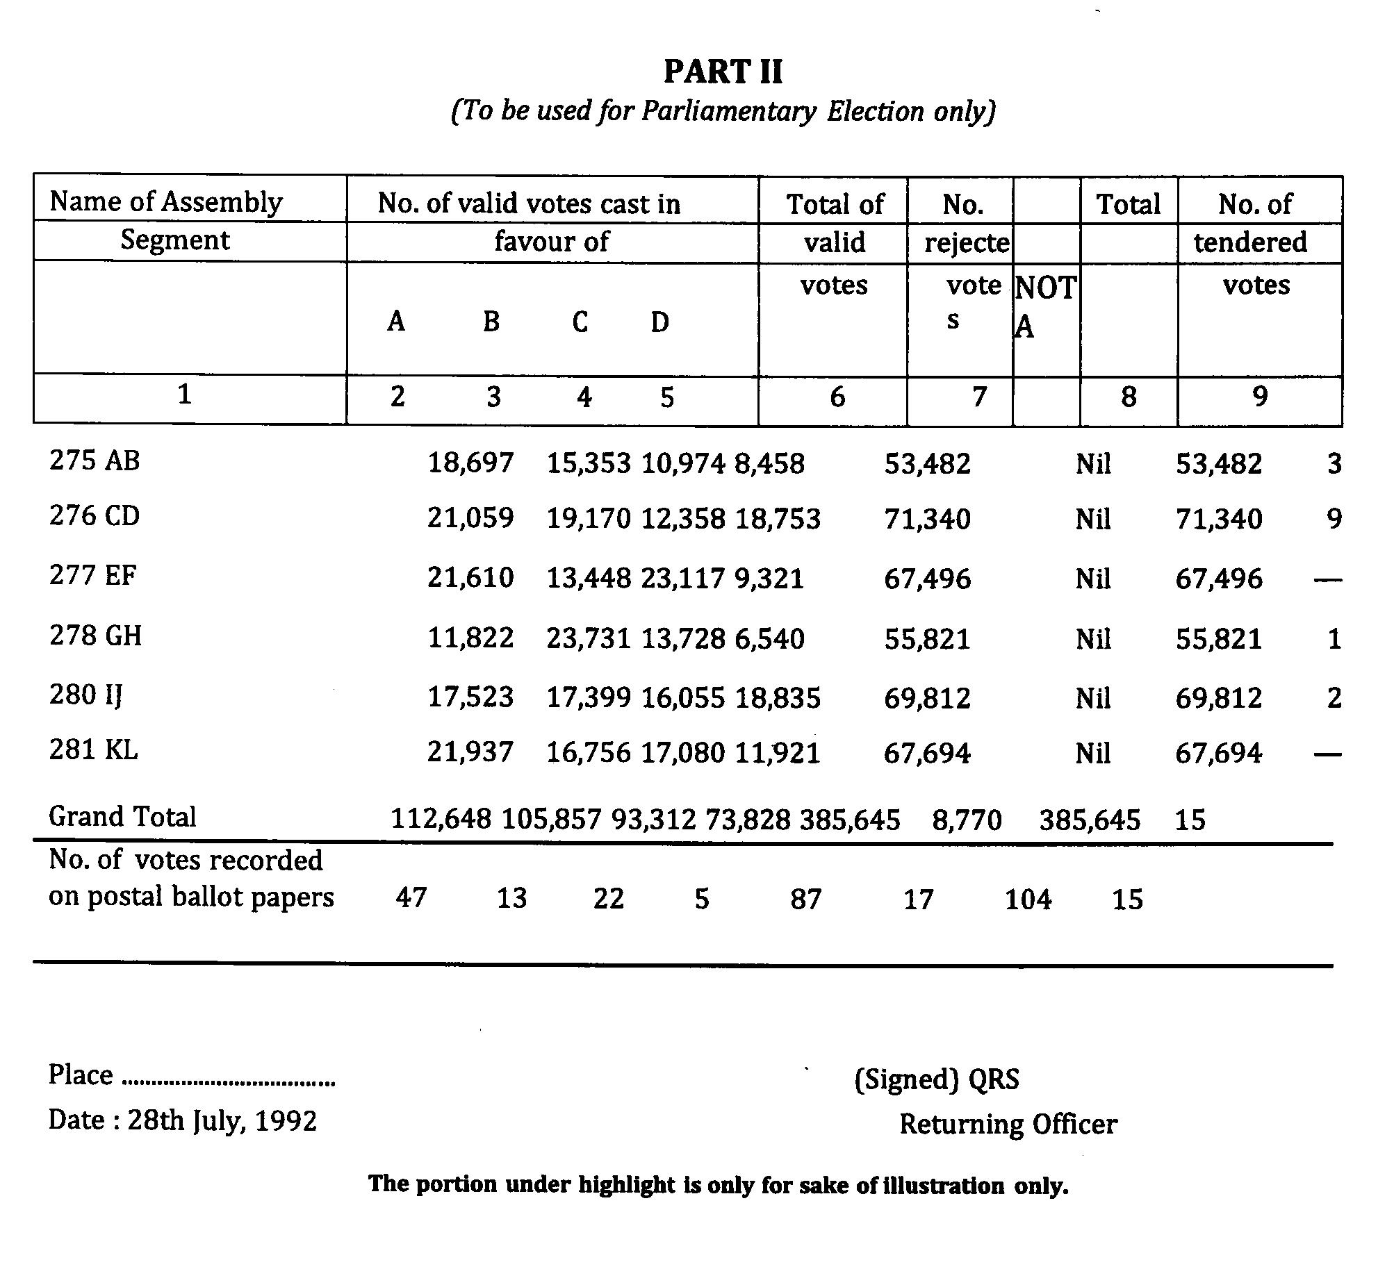
44

Slide 55
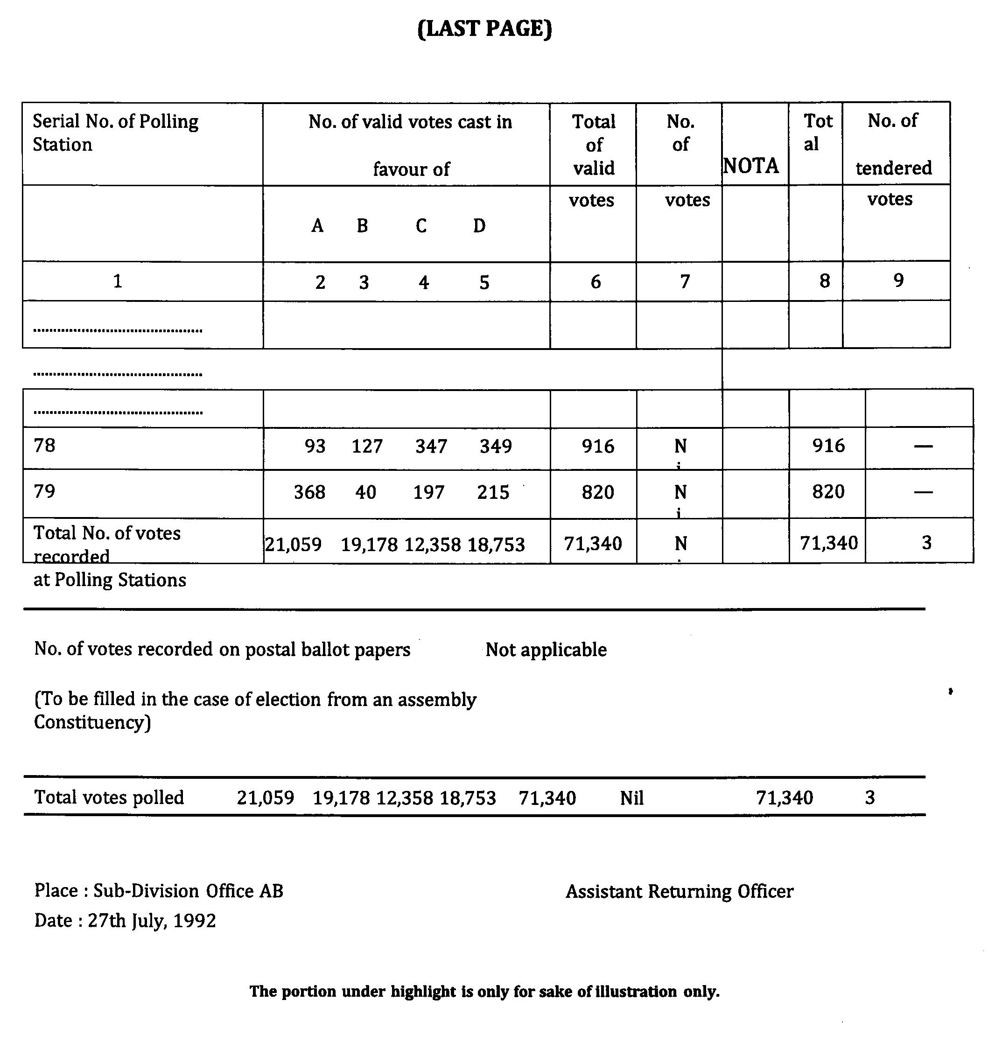
45

Slide 56
Counting of votes recorded in EVMs
After all rounds are completed and final result sheet in FORM-20 is ready, RO SHOULD NOT immediately sign it.
Before announcing , pause for 2 min during which candidate/agent can ask for recount for PB or for all rounds for some round/s.
Ascertain how long he will take to make an application for recount in writing
If time requested is reasonable, announce exact hour and minute till which you will be waiting

Slide 57
Counting of votes recorded in EVMs
If time requested is reasonable, announce exact hour and minute till which you will be waiting
Consider the grounds urged in application and decide if valid in whole or part. Reject entirely if found unreasonable/frivolous
Reason for accepting or rejecting the application should be recorded in detail
After careful recount, make changes if any in Form 20 and announce the same. Complete and sign Form 20
After observer’s clearance is obtained, announce the result

Slide 58
Inspection/Checking of Control Unit
Inspect both Pink Paper Seal and Green Paper Seals. Both these seals MUST be intact.
Immediately report to RO/ARO even if there slightest doubt that these seals are tampered with.
Any doubts raised by Election agents as regards to seals must be addressed to RO/ARO
Ensure that Candidates/Election agents verify the unique ID of Pink paper seal on the Control Unit.
Ensure that Candidates/Election agents also verify the unique ID of Strip [ABCD] Seal on the Control Unit.
Verify the unique ID number of Green paper seal with Form 17C and show to the Candidates/Election agents. `

Slide 59
Steps for opening Seals
Remove/break open the outer Strip [ABCD] Seal taking care of securing its unique ID number.
This will also break open the protruding portion of Green Paper Seal near the pre-gummed portion of strip seal.
Take care to retain the portion of Green paper seal showing its unique ID as far as possible.
Break open the seal on outer cover of result section secured to the Address tag and open the outer cover.
The inner cover of result section sealed with special tag will now be visible.
Notes:
T

Slide 60
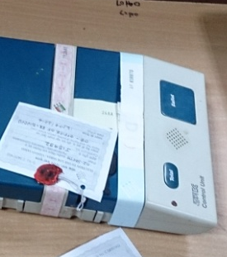
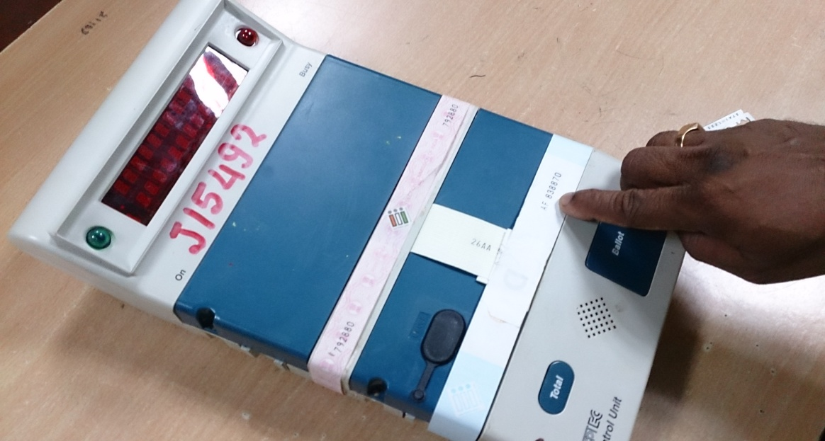
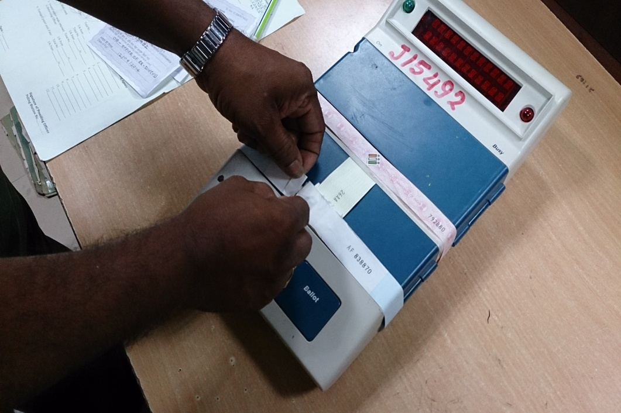
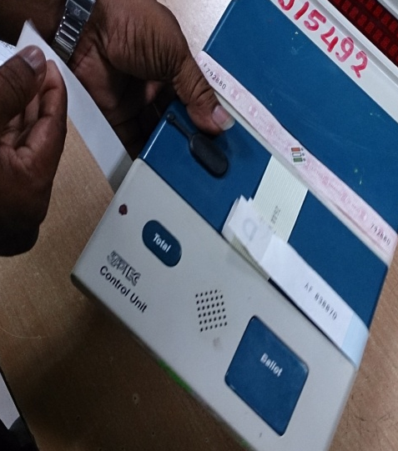
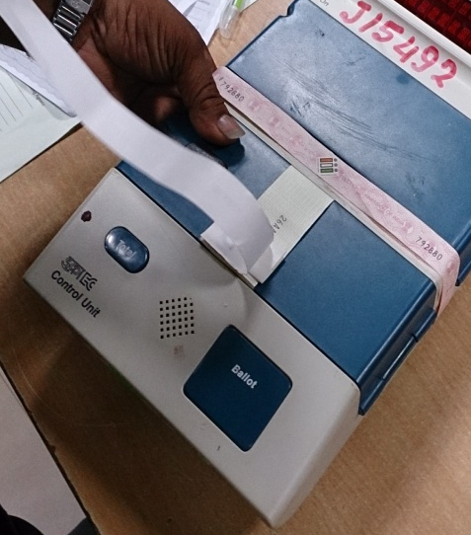
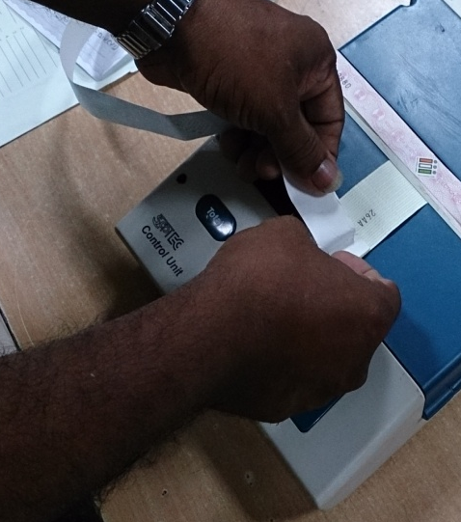
Unsealing EVM

Slide 61
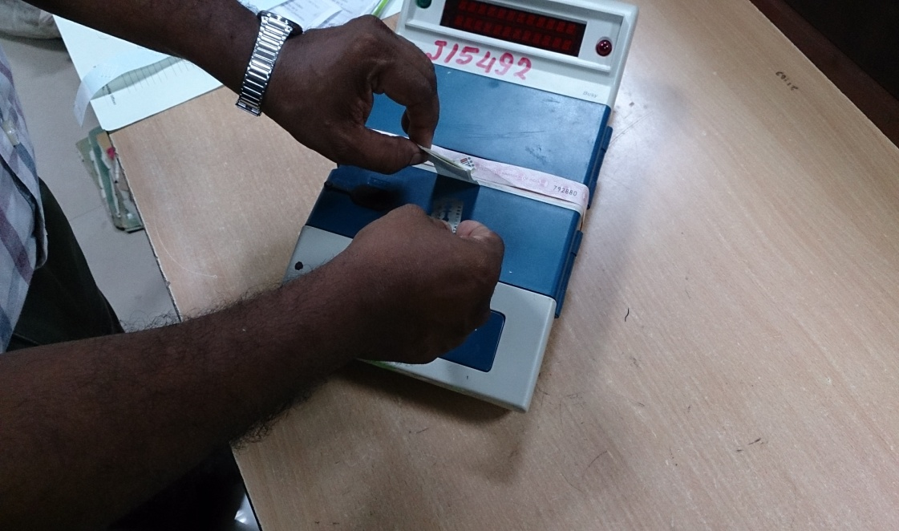
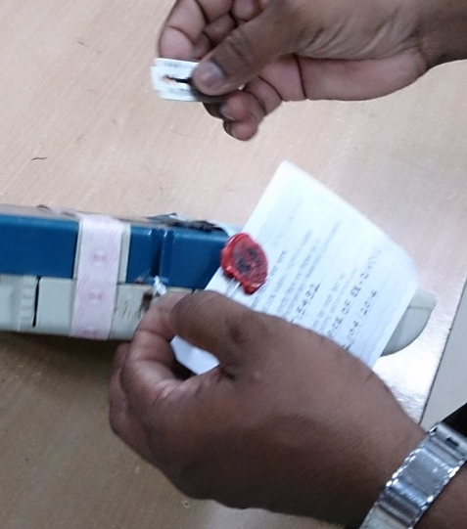
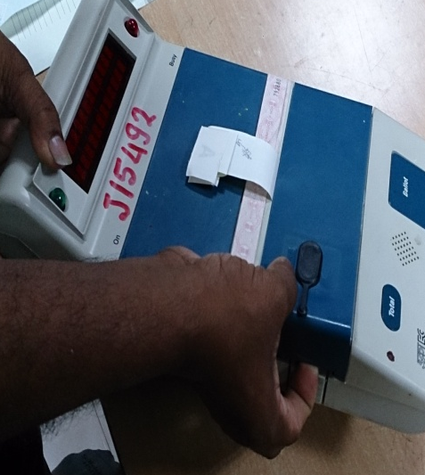
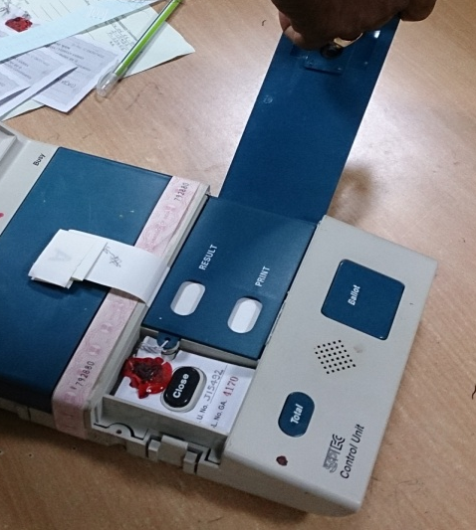
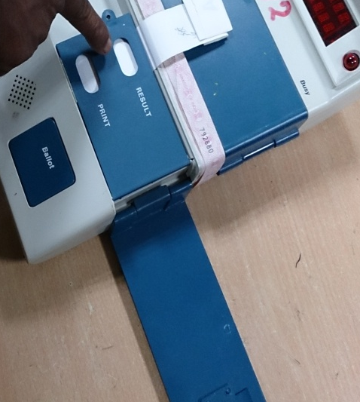
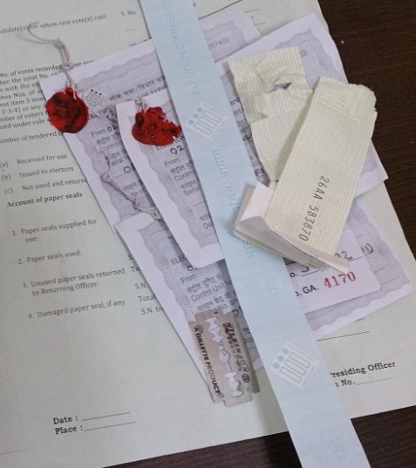
Unsealing EVM

Slide 62
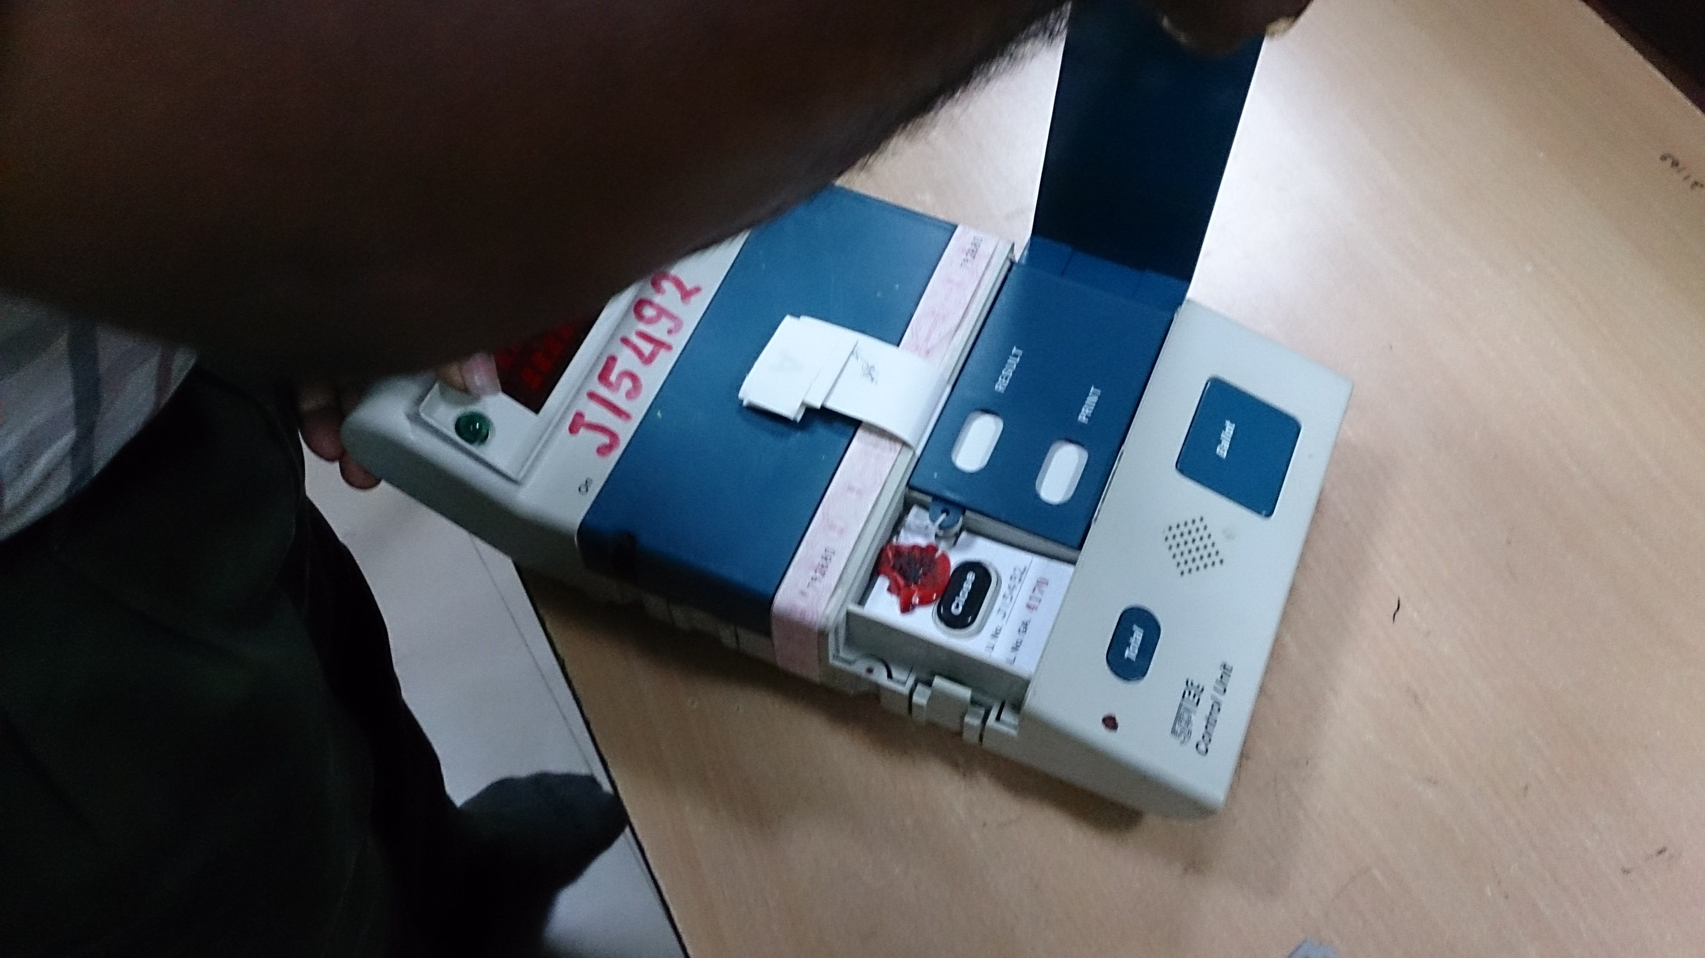
Ready EVM

Slide 63
Steps for opening Seals
Only when it is ensured that this special tag seal is intact, proceed further.
Report immediately to RO/ARO in case of any doubts of any of these seals.
Allow the candidates/election agents to compare the serial number of the Special Tag.
The EVM now is ready for proceeding to the next step of result.

Slide 64
Ascertaining the Result
Switch ON the Control Unit by lifting the power switch provided in the rear compartment ON position.
Care must be taken to enable the Candidates/Election Agents to view the display section of the CU at all times.
Follow the display sequence on the Control Unit.
Pierce the Green paper seal over the Result button provided below the upper aperture.
Press the Result Button.
Follow the display sequence on the CU.

Slide 65
Filling Part – II of 17C
Counting Supervisor will note down, carefully, the above result as displayed sequentially candidate-wise in ‘Part-II – Result of Counting’ of Form 17C.
Calculate the Total votes in CU from Col. 3 of this table and compare the same with Item No. 6 in Part-I of 17C.
Check whether these two figures tally or there is any discrepancy between them.
Accordingly write remark in the space provided and complete the Form in all respects.
Counting supervisor will have to sign this form.

Slide 66
Filling Part – II of 17C
Note that Part II of Form 17C has to be prepared in duplicate using carbon paper.
And both these copies should be got signed from the candidates/their agents present.
One copy of this form will be handed over to RO/ARO for computing round wise tally of votes.
The other copy will be handed over to official designated for the purpose, who will prepare xerox copies of the same and give the same back to counting supervisor.
These Xerox copies are to be distributed amongst the counting agents present at counting table.

Slide 67
Filling Part – II of 17C
The original second copy of every counting round will be retained by the Counting Supervisor till end of counting.
At the end of counting, the Counting Supervisor will keep all these copies in an envelope superscribed “Duplicate copy of result of counting in Form 17C-Part-II”
Counting Supervisor will personally hand over this envelope to RO/ARO.
Counting Staff shall not leave the hall till the results are declared without prior permission of RO/ARO.
Notes:
al

Slide 68
Repeating the result sequence
If required, repeat the result sequence to enable the Candidates/Election agents to note down the results.
After the result has been noted, close the outer cover of the Result Section.
AND SWITCH OFF THE CONTROL UNIT.
Retain every seal opened by you. Keep it in an envelope and hand over the same of RO/ARO.
Keep the CU in Carrying case and hand over the same to the Officer designated for the purpose.

Slide 69
ADDITIONAL TABLE

Slide 70
Additional Table
This table will have 2 Counting Staffs who would assist the Observer to cross check correctness of counting.
After completion of every round, the Observer will randomly select two EVM’s counted in that round.
These EVM’s will be brought on this table and provided to the Additional Counting Staff .
The result of the poll will be checked by these staff from the selected EVM’s by pressing Result Button.
This Candidate-wise result of votes will be entered in the Proforma provided.
This report shall be handed over to OBSERVER ONLY.

Slide 71
SPECIAL
CASES

Slide 72
Special Cases
REPORT TO RO/ARO IMMEDIATELY IN CASE OF:
Malfunctioning of CU during counting of votes.
CLOSE button of CU was not pressed by the Presiding Officer at the end of poll.
Any Doubts related to seals, counting process, etc. raised by Candidates/their Agents.

Slide 73
ANNOUNCEMENT

Slide 74
Announcements
Once RO receives filled in Form 17C in Part II of every round, the same shall be countersigned by RO and shall be forwarded for compiling the final result sheet.
The polling station wise votes polled by each candidate shall than be written on the display board and also shall be announced over PA system.

Slide 75
COUNTING
FROM VVPAT

Slide 76
Counting from VVPAT
After the entries made in the result sheet of election are announced, any candidate, or in his absence, his election agent or any of his counting agents may apply in writing to the Returning Officer to count the printed paper slips of VVPAT unit in respect of any polling station or all polling stations.
Once such application is made, the Returning Officer shall pass a speaking order on whether the counting of paper slips shall be done or not.

Slide 77
Counting from VVPAT
While deciding the matter the RO shall consider the following:
Whether the total number of votes polled in that polling station are more or less than the margin of votes between winning candidate and candidate making the application
Whether there was any complaint about VVPAT not printing the paper slips or complaints under rule 49MA by any voter, in that polling station during the poll
Whether EVM met with any defect and was replaced at that polling station during poll

Slide 78
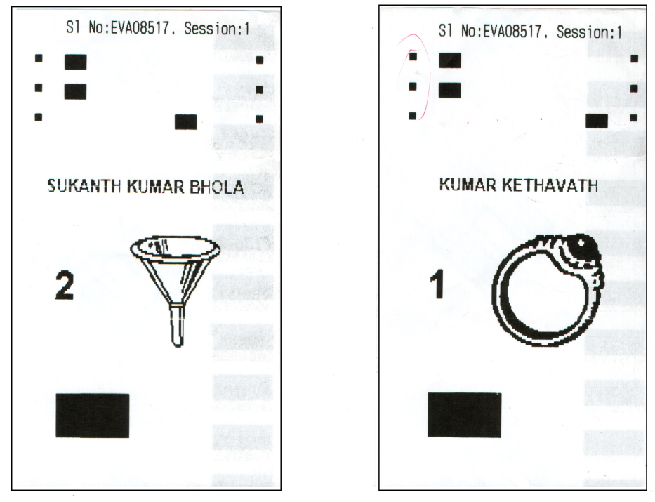
BALLOT SLIPS FROM VVPAT

Slide 79
Counting from VVPAT
If the RO decides to allow counting of VVPAT paper slips of single or all polling stations; such decision shall be recorded in writing and shall contain the reasons therefore.
Procedures for counting of ballot slips from VVPAT shall than be followed at the VVPAT Counting Booth.

Slide 80
VVPAT Counting Booth
The VCB table shall carry an transparent container which can accommodate nearly 1400 printed ballot slips to keep the paper slips taken out from the drop box of the VVPAT.
There shall also be an pigeon hole framework having number of pigeon holes equal to No. of candidates + 2.
The additional pigeon holes are kept for keeping the self-test slips of the VVPAT and Ballot slips of NOTA respectively.
The symbol of each contesting candidate as per the Ballot Paper are affixed on the wall of the pigeonhole allotted to the particular candidates.

Slide 81
VVPAT Counting Booth
The VVPAT unit(s) of the respective polling station(s) shall be brought to the VCB one by one.
In case a VVPAT unit was replaced during poll at that polling station, all the VVPAT units used at that polling station shall be brought to the VCB.
Counting team to check the VVPAT address tag and confirm that the VVPAT pertains to the same Polling station.
Allow the candidates/election agents to compare the serial number of these Address Tag.
Unseal the Ballot slip compartment of VVPAT by removing both the address tags.

Slide 82
VVPAT Counting Booth
Remove all the Printed Ballot Slips from the drop box of VVPAT and keep them in the container with lid.
Counting Supervisor to ensure that no VVPAT paper slips are left inside the VVPAT drop box.
Show the empty drop box to the counting agents.
In case a VVPAT unit was replaced, it may so happen that an uncut fully or partially VVPAT paper slip is hanging and has not got cut and dropped in the drop box and still connected to the paper roll.
Such uncut VVPAT paper slip should not be torn and should not be counted because the vote is not recorded electronically in the CU unless the VVPAT paper slip is cut.

Slide 83
VVPAT Counting Booth
In the drop box of the VVPAT will also have VVPAT slips of self-test report.
These are easily identified, as they do not have either the name or the symbol of any candidate.
These self-test report slips are to be preserved along with the VVPAT paper slips as part of the record but they are not to be counted.

Slide 84
Counting of Ballot Slips
The ballot paper slips shall be segregated one by one and put in the pigeon holes of the respective candidates after showing each slip to the Counting Agents.
The paper slips bearing self-tests report shall also be segregated and put in a separate pigeonhole provided for the purpose.
Bundles of 25 Ballot slips of respective candidates will then be prepared for counting purpose.
VVPAT Paper Slips shall then be counted by the counting staff.
Result of the VVPAT paper slips count shall be prepared in the format as per Annexure-VII & attached to Part-II of Form 17-C.

Slide 85
Counting of Ballot Slips
The result of the count of VVPAT paper slips shall be announced loudly in the counting hall and shown to the counting agents
If there is discrepancy between the count of votes displayed on the control unit and the count of printed-paper slips in respect of any Polling Station, the result sheet will be amended as per the printed-paper slips count.

Slide 86
Counting of Ballot Slips
After completion of counting of VVPAT paper slips, the bundles of all the VVPAT Paper Slips shall be kept back in the Drop Box of the respective VVPAT and door of the Drop Box shall be sealed using address tags.
The candidate(s)/their agents may also be allowed to affix their signature with party abbreviation on the Address Tags

Slide 87
POLLING STATIONS USING MORE THAN ONE VVPAT

Slide 88
PS using more than one VVPAT
In case counting of votes of VVPAT paper slips in respect of those PS where more than one VVPAT were used.
VVPAT paper slips of each VVPAT will be counted separately, one by one.
Result of each VVPAT will be entered separately in annexure attached to Form 17C.
Thereafter, a Final Result sheet shall be prepared by combining all results of that particular polling station and the same shall also to be attached to Form 17C.

Slide 89
SEQUENTIAL COUNTING OF FIVE VVPATS

Slide 90
Sequential counting of Five VVPATs
Mandatory verification of VVPAT paper slips of randomly selected 05 (five) polling stations shall be conducted after the completion of the last round of counting of votes recorded in the EVM’s as under:
The Ballot slips from these VVPATs shall be counted sequentially one after the other.
The Returning Officer shall announce the result of such counting.

Slide 91
Sequential counting of Five VVPATs
The Verification of VVPAT paper slips of randomly selected 05 (five) polling stations for each Assembly Constituency/Segment shall be taken up after the completion of the last round of counting of votes recorded in the EVMs and VVPAT paper slips count due to non-display of result from the Control Unit(s) or under Rule 56(D) of the Conduct of Elections Rules 1961 or whatsoever the reason.
The random selection of 05(five) shall be done by Draw of lots by the Returning Officer concerned, in the presence of candidates/their agents and the General Observer appointed by the Commission for that Constituency.

Slide 92
Sequential counting of Five VVPATs
3. The draw of lots must be conducted immediately after the completion of the last round of counting of votes mentioned, in the designated Counting Hall for the particular Assembly Constituency/Assembly Segment.
4. A written intimation shall be given by the Returning Officer to the candidates/ their election agents well in advance.

Slide 93
Sequential counting of Five VVPATs
5. The following procedure shall be followed for conduct of draw of lots:
White colour paper cards of postcard size for conducting the draw of lots.
Total number of such paper cards should be equal to total number of polling stations in the Assembly Constituency. The Polling station(s) whose VVPAT paper slips have been counted due to non-display of result from Control Unit(s) or under Rule 56(D) of the conduct of Elections Rules, 1961 or whatsoever the reason, shall not be included in the draw of lots for mandatory verification of VVPAT slips count.
The paper cards shall have pre-printed AC/AS number, name and date of polling on the top, and the polling station number in the centre. Each digit of the polling station number shall be at least 1” X 1” (one inch by one inch) size and printed in black.

Slide 94
Sequential counting of Five VVPATs
d) The paper cards to be used for draw of lots should be four folded in such a way that polling station number is not visible.
e) Each paper card shall be shown to the candidates/their agents before folding and dropping in the container.
f) The paper cards shall be kept in the big container and must be shaken before picking up 05 (five) slips by the Returning Officer.

Slide 95
Sequential counting of Five VVPATs
The verification of VVPAT paper slips shall be done in a ‘VVPAT Counting Booth’(VCB), specifically prepared for this purpose inside the Counting Hall.
The booth shall be enclosed in a wire mesh just like a bank cashier’s cabin so that no VVPAT paper slip can be accessed by any unauthorized person.
One of the Counting table in the Counting hall can be converted into VVPAT counting booth and can be used for normal counting of round-wise EVM votes before the count of VVPAT slips as per random selection after the completion of round-wise EVM votes counting.

Slide 96
Sequential counting of Five VVPATs
7. Count of VVPAT paper slips of the randomly selected 05 (five) polling stations shall be conducted sequentially i.e. one after another.
8. The verification count of VVPAT paper slips shall be conducted strictly in accordance with the instructions of the Commission on counting of printed paper slips.
9. The Returning Officer and Assistant Returning Officer, as the case may be, shall personally supervise the counting of VVPAT paper slips at this booth. The General Observer shall ensure close and careful observation of the entire exercise and ensure compliance of the Commission Instructions.

Slide 97
Sequential counting of Five VVPATs
In case of any mismatch between electronic count of the control units and VVPAT slips manual count, recounting of the VVPAT slips of the particular EVM shall be conducted till the recount is tallied either with the EVM count or one of the previous VVPAT slips count.
11. After completing the process as specified in para 10 above, if there is any discrepancy between EVM count and VVPAT paper slips count, as per Rule 56D(4)(b) of the conduct of Elections Rules 1961, the VVPAT paper slips count shall prevail. The result sheet will be amended as per the printed paper slips count.

Slide 98
Sequential counting of Five VVPATs
The above process shall be fully video-graphed.
After completion of the above process, the Returning Officer shall give a certificate in the annexed format (Annexure-A) separately for each polling station to the Chief Electoral Officer concerned. The CEO shall compile the reports for the entire State/UT submit a consolidated summarized report to the Commission within 7 days from the end of counting process.
The Observers appointed by the commission shall also submit their report to the Commission through the Zonal Secretary concerned in the annexed format (Annexure – B)

Slide 99
Annexure - A
Mandatory verification of paper slips of VVPAT of 05 randomly selected Polling Station
(Separate for each polling station - to be sent only to the CEO concerned)
Name of State/UT:……………
No. and Name of Assembly/Parliamentary Constituency :…………………………………
No. and Name of Assembly Segment (in case of PC):……………………………………..
Sl. No. and name of Polling Station:………………………………………………………..
Unique ID of Control Unit:…………………………………………………………………
Unique ID of VVPAT:……………………………………………………………………..
It is certify that mandatory verification of paper slips of VVPAT of randomly selected polling station mentioned above has been conducted as per the instructions of the Commission.
Name of Candidate | No. of Votes Cast |  | Discrepancy if any
 | As per EVM | As per Paper Slips
1.
2.
3.
…
NOTA
Total Votes

Slide 100
Annexure - A
(Present during the mandatory verification of VVPAT Slips count)
Sr. No. | Name of Candidate / Counting Agent | Mention Candidate / Counting Agent | Name of the Party | Signature
Signature of Asst. Returning Officer
Signature of Returning Officer
Signature of ECI Observer

Slide 101
Annexure B Report on mandatory verification of paper slips of VVPAT of 05 (Five) randomly selected Polling Stations
Annexure - B
Name of State:_______________________
No. and Name of Assembly/Parliamentary Constituency:_______________________
No. and Name of Assembly Segment(in case of PC):___________________________
Sr. No. and Name of Polling Stations.:
1.________________________
2.________________________
3.________________________
4.________________________
5.________________________
It is certify that the entire process of mandatory verification of counting of paper slips of VVPAT of randomly selected 05 Polling Stations has been conducted under my close and direct oversight with strict compliance of the Commission’s instructions.
Signature
(Name of ECI Observer)
Observer Code:

Slide 102
MICRO OBSERVER

Slide 103
Role of Micro Observer
Each counting table shall have one micro observer.
The MO shall be responsible for the purity of counting process on his/her respective table.
Since every step in counting is crucial, the role of MO becomes very important as to ensure that the counting supervisor & counting agent perform their duty correctly.
Micro Observer has to watch the proceedings on the table, being the representative of the observer.
MO will note down the details of votes exhibited by the EVMs being counted in each round in that Table.

Slide 104
Role of Micro Observer
MO would be provided with a pre-printed statement on which they would note down the CU No., Round No., Table No., Polling Station Number and thereafter the names of all the contesting candidates as they appear in the ballot paper.
MO shall be filling the vote details of every round of his table on the proforma provided for the purpose.
They will put their signature at the end of the statement and shall hand over the statement to the Observer after each round.

Slide 105
Two Additional Micro Observers
Two additional MOs shall be deployed in each Counting Hall of every Assembly Segment.
MO-1
Keep watch over data entry in the computer placed in the Counting Hall for round-wise compilation of the votes recorded for each candidate.
Should ensure that the entries in the Part II of the Form 17C are correctly entered in this computer by the data entry operator.
MO-2
Assist the Observer and re-check on the printout (of the data entered at MO-1) that all data which has been entered is fully correct and complete and in accordance with the original Part II of Form 17C received from each counting table recorded for each candidate.

Slide 106
RE-COUNTING

Slide 107
Recounting of votes
Since every vote in EVM is a valid vote and no dispute should arise as to its validity.
If Candidates/Agents ask for display of Result of a particular PS; ‘RESULT” button of that CU can pressed to again display the Panels of that control unit.
When the result of an election is going to be decided by difference of postal ballot votes received by the first two candidates, then there shall be mandatory and comprehensive recount of postal ballot papers, even though no candidate ask for it.

Slide 108
DECLARATION OF RESULTS

Slide 109
Declaration of results
Result declaration after:
Completing and Signing Form 20
Obtaining necessary approval from ECI, wherever needed.
Obtaining No Objection from ECI’s Observer
Any request for recount , if received, has been duly disposed of by a speaking order of the RO.
Declare the result by loud announcement
56

Slide 110
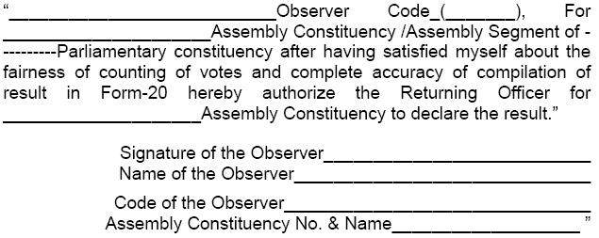
Declaration of result
Observer’s No Objection

Slide 111
Declaration of result
Formal declaration of result should be made by RO in either Form 21C or Form 21D :-
Form 21 C for General Election
Form 21 D for bye election
Name and address of elected candidate to be as per list of contesting candidates [FORM-7A]
Date of declaration is date on which result is declared and not date of dispatch of declaration to appropriate authorities.
Complete and certify return of election in Form 21E.
Forward signed copies of 21E to ECI & CEO of your state
You can supply copy of the 21E to an applicant on payment of Rs. 2/- fee [Rule 93(3)].

Slide 112
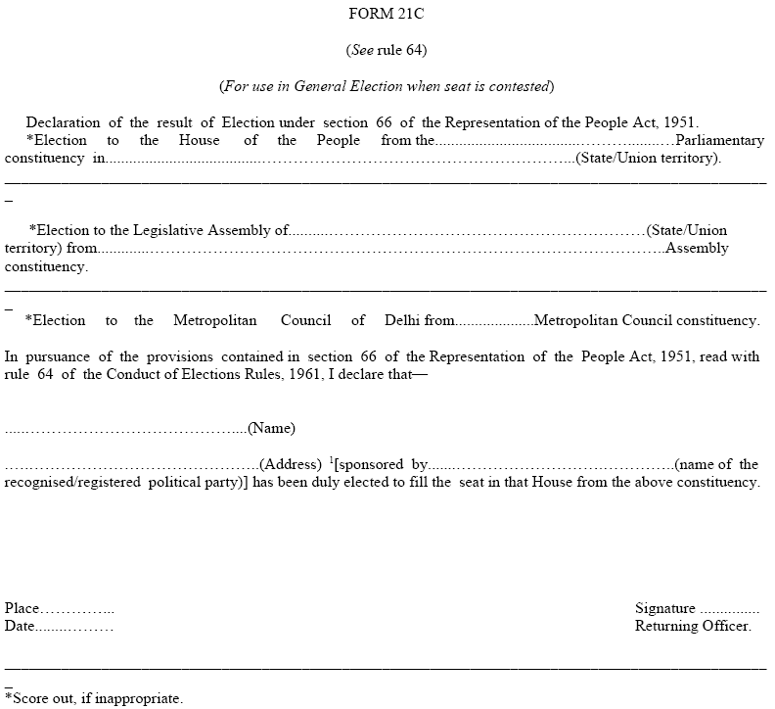
Form 21 C
59

Slide 113
Declaration of result
Send copies of Form 21C to :
ECI
CEO of state
Union Ministry of Law & Justice (Legislative Department)
State Government
Secretary to State Legislative Assembly

Slide 114
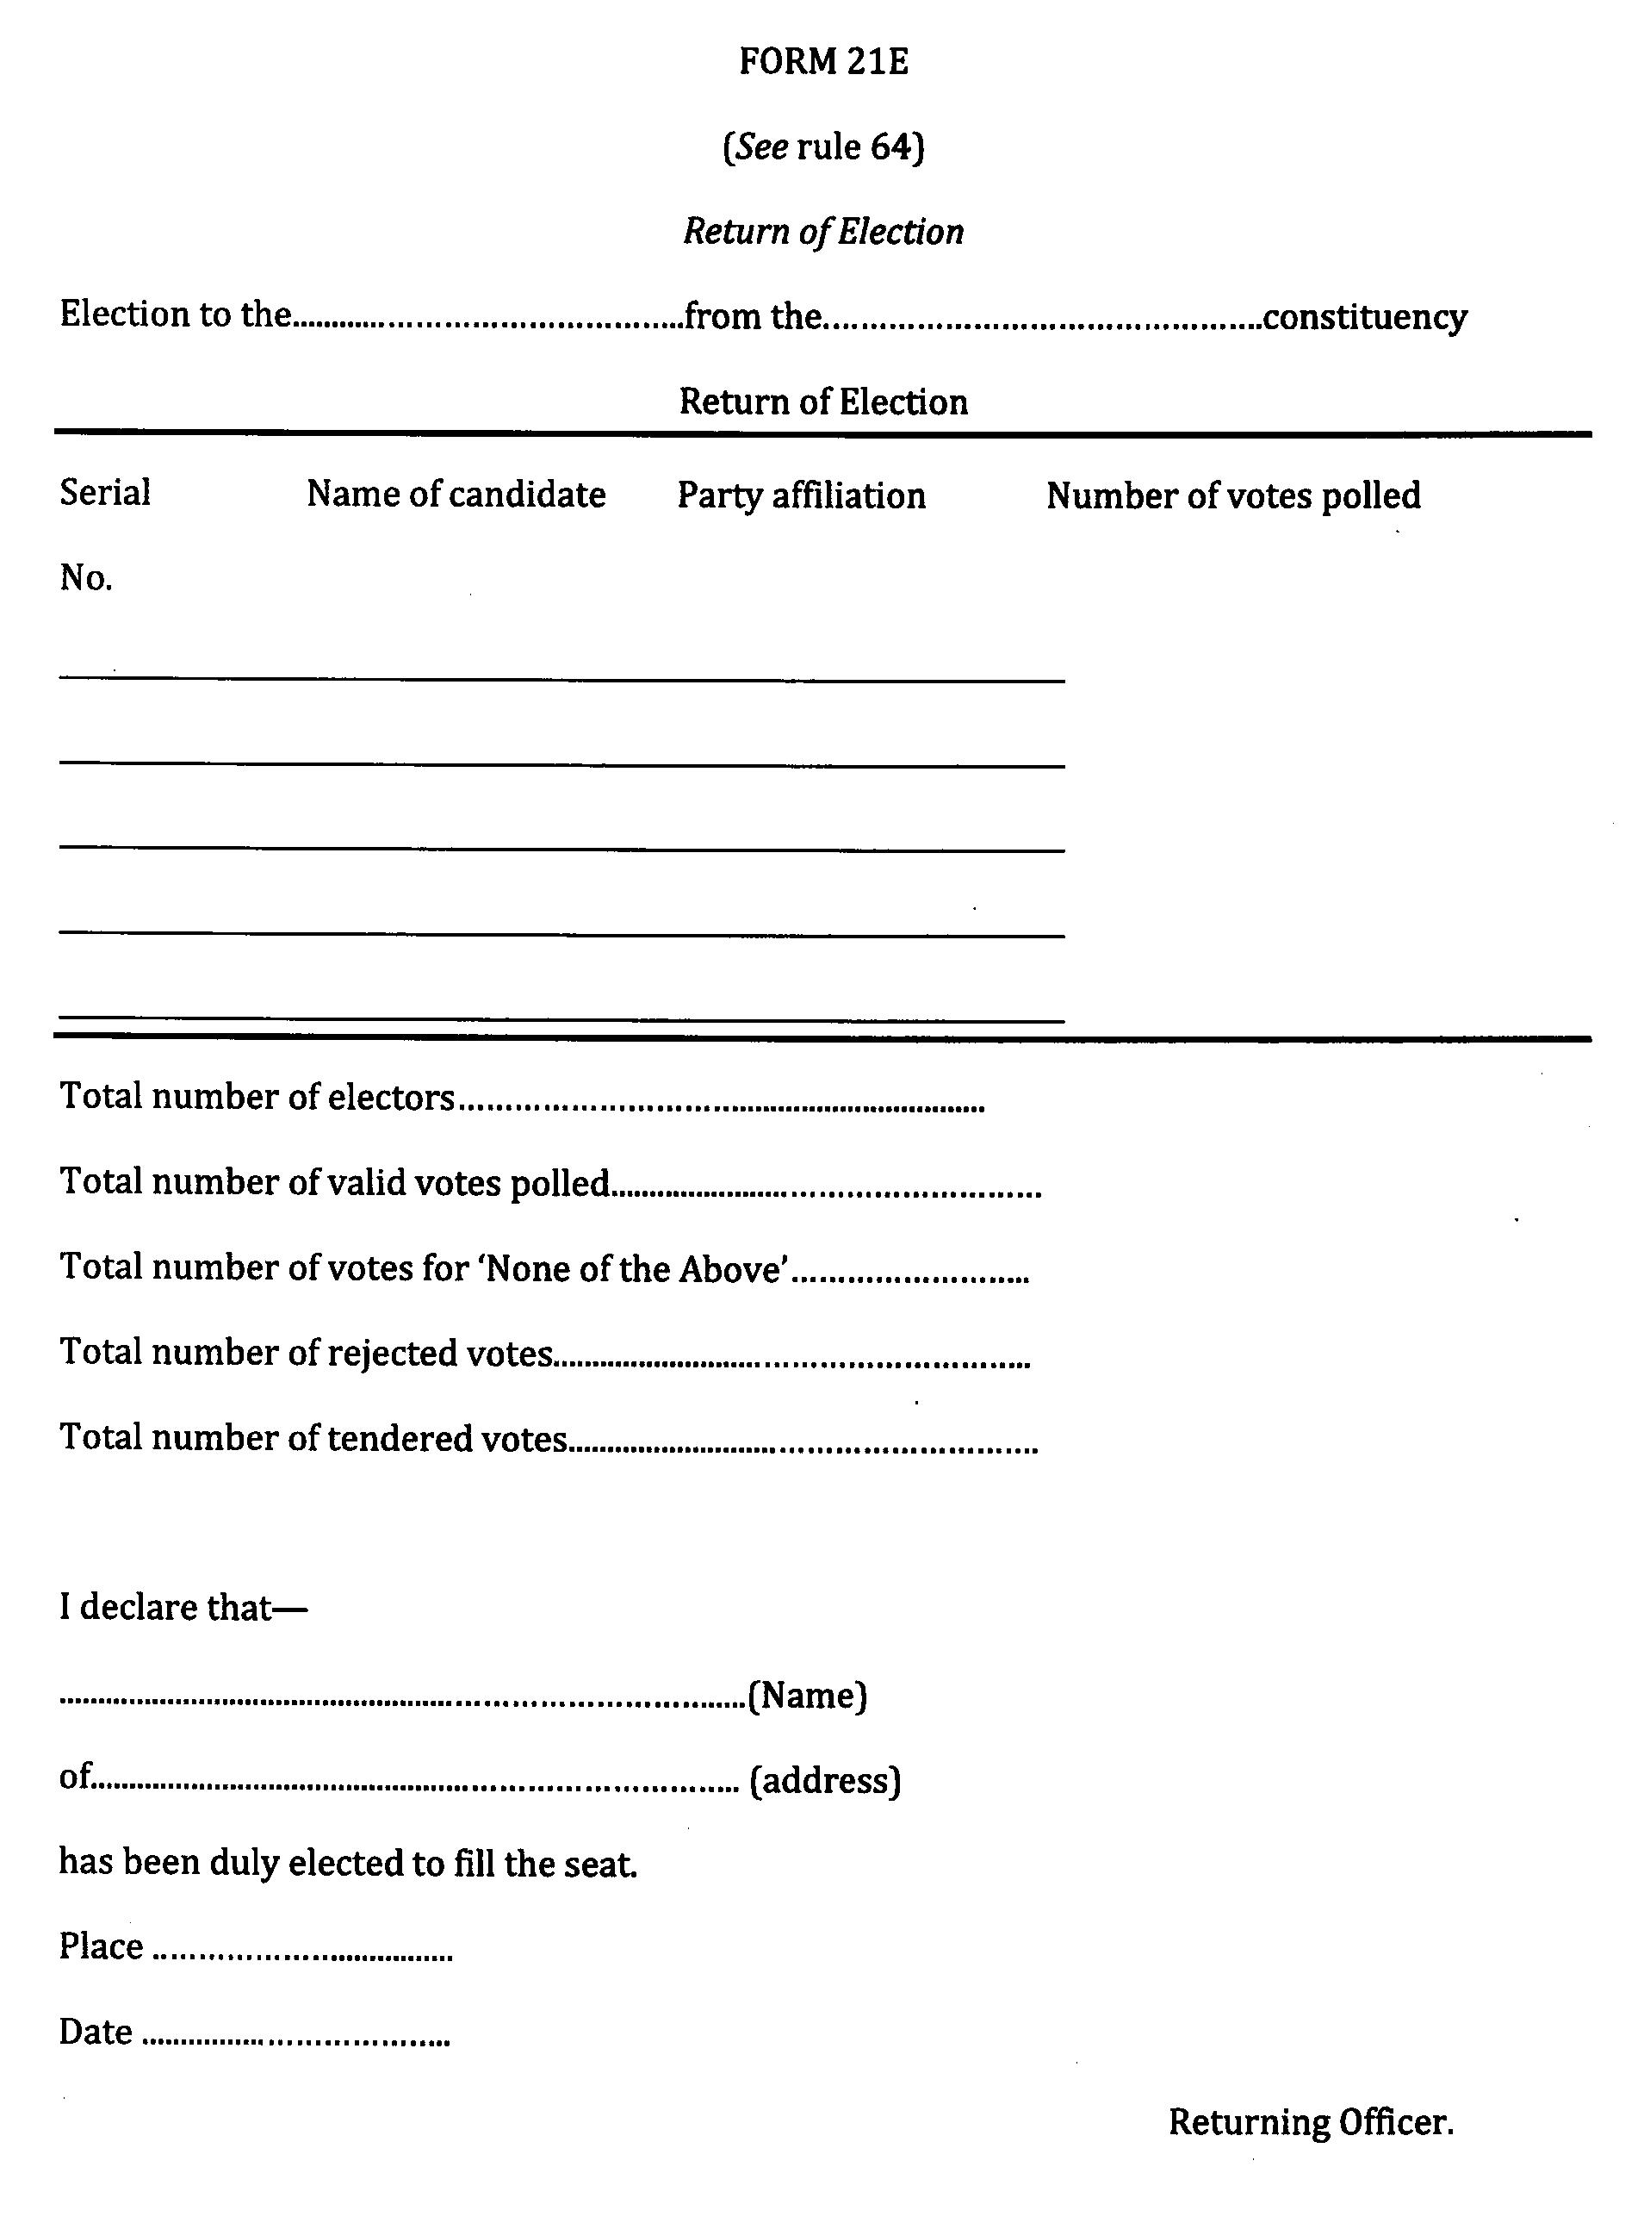

Slide 115
Report result of election to:
ECI by fax/ email (Without any failure)
AIR Station in State HQ
Director, Doordarshan Kendra, New Delhi
Information Officer, PIB, New Delhi
Ministry of Law Govt. of India/ State Govt.
Chief Electoral Officer of State
Secy. Gen. Lok Sabha/ Secretary of State Legislative Assembly
Director of News Services, All India Radio, New Delhi

Slide 116
Declaration of result
As soon as candidate is declared elected, you should grant to such candidate, a certificate of election in Form 22.
Only candidate or in his absence to a person duly authorized by the candidate and who is personally known to the RO, can receive the certificate of election from RO.
Obtain acknowledgement of its receipt duly signed (in any language) by the candidate from the candidate or the person authorized by the candidate.
Only 4 persons can be present at this occasion excluding the candidate or duly authorized person by the candidate for receiving the certificate of election from RO.
Signature has to be attested by RO only before dispatch to the Secretary of state LA/ the Secretary General of the Parliament
Send this acknowledgement by registered Post with AD.

Slide 117
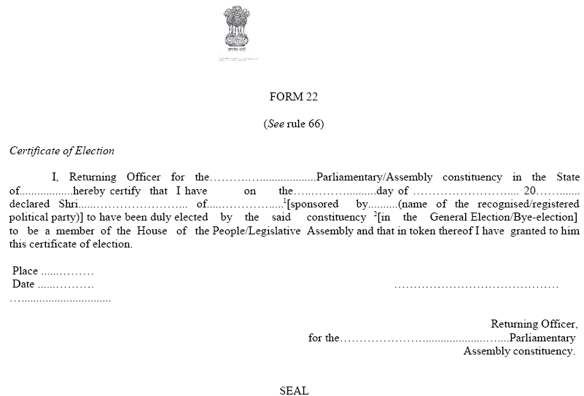
Form 22: Certificate of Election

Slide 118
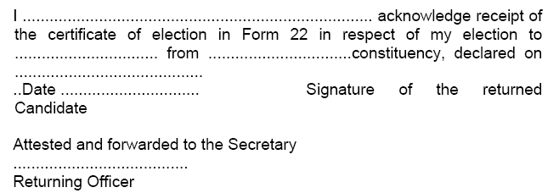
Declaration of result
Acknowledgement from returned candidate

Slide 119
SEALING OF EVM

Slide 120
Sealing of EVMs and other papers
After counting of one round is over, the EVMs have to be re-sealed .
Resealing to follow procedure as given:
Remove battery and re-seal Cand-set Section
Close outer cover of result section and reseal it
Keep CU in carrying case
Reseal Carrying case
Attach address tag containing following details:
Particulars of election
Name of constituency
Particulars of PS where CU used
S. No. of CU
Date of Poll
Date of Counting
Put SECRET SEAL in addition to your own, on all above seals
50

Slide 121
Election Papers that require to be sealed are (Refer Rule 93 (1) of the Conduct of Election Rules 1961):
Packets of registers of Form 17 A including voters’ slips
Packets of unused postal ballot papers with counterfoils attached thereto.
Packets of used PBs- valid or rejected- including the packets in which covers containing PSs received late are kept.
a. Packets of used and unused tendered ballot papers.
b. The packets of unused (surplus) ballot papers meant for display in BU and for use as tendered ballot Papers.
Packets of counterfoils of used PBs.
Packets of marked copies of electoral roll
Packets of declarations by electors and attestation of their signs

Slide 122
Appoint an senior officer to supervise sealing of packets.
These papers to be sealed with Secret Seal of ECI
All to be put in steel trunk
Each steel trunk locked with two locks and each lock be sealed.
EVMs and election papers thus sealed shall be deposited in safe custody of DEO without delay
DEO should ensure that these are deposited in treasury/sub-treasury under double lock, key of one will be kept with DEO himself.
The envelops sealed under R 93(1) shall not be opened and their contents inspected by any person/authority except under the order of a competent court under Secret Seal NOT to be put on locks.

Slide 123
After sealing of EVMs and election papers, RO should draw up proceedings of counting process mentioning, inter alia,-:
* Full particulars of candidates/agents present in counting hall
* Fact that they were asked to affix seals on voting machines and packets of election papers, if they wished.
* Particulars of persons who had affixed such seal and those persons who refused to do so
* Sign the proceedings and obtain signs of the candidates/agents as present and willing to sign. The proceeding should be kept in a sealed cover along with other election papers.
53

Slide 124
After all packets are sealed, Secret Seal should be put in separate packet
Affix seals of candidates/agents if they wish
The secret Seal should be returned IMMEDIATELY after such sealing to ECI
Send through registered insured post
To be returned to Commission within 24 hours after counting is completed.

Slide 125

Strip [ABCD] Seal on CU
BACK

Slide 126
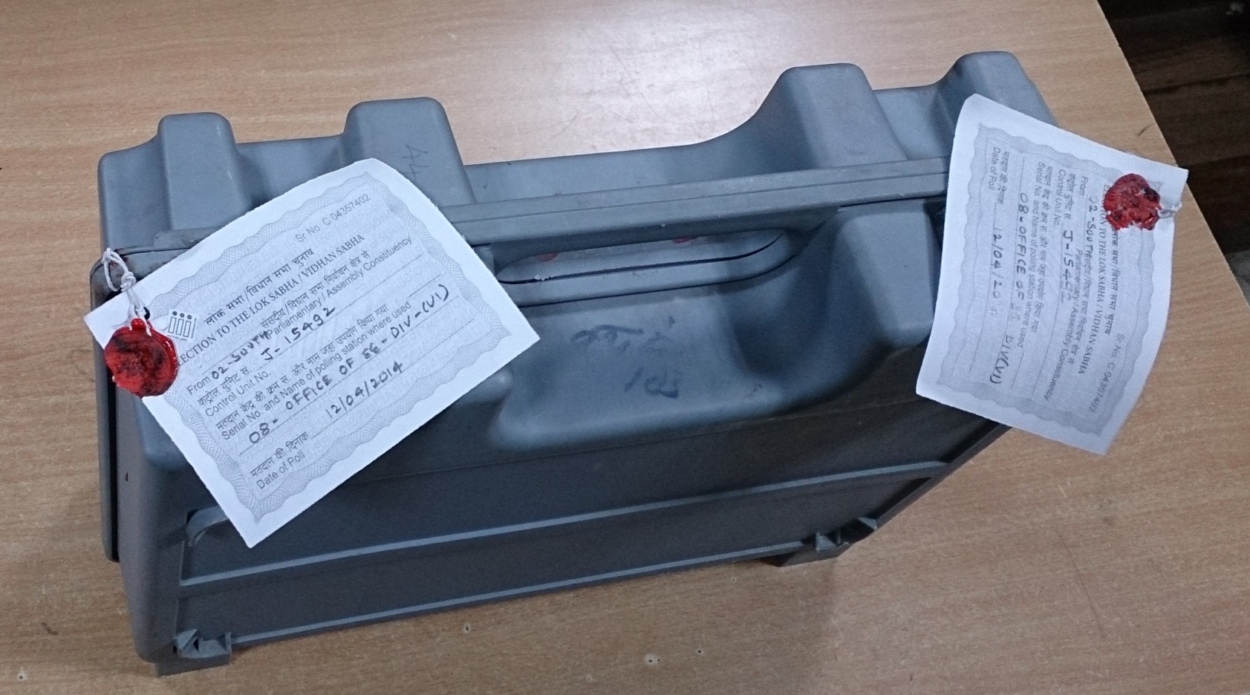
Sealed CU Carrying Case
BACK

Slide 127
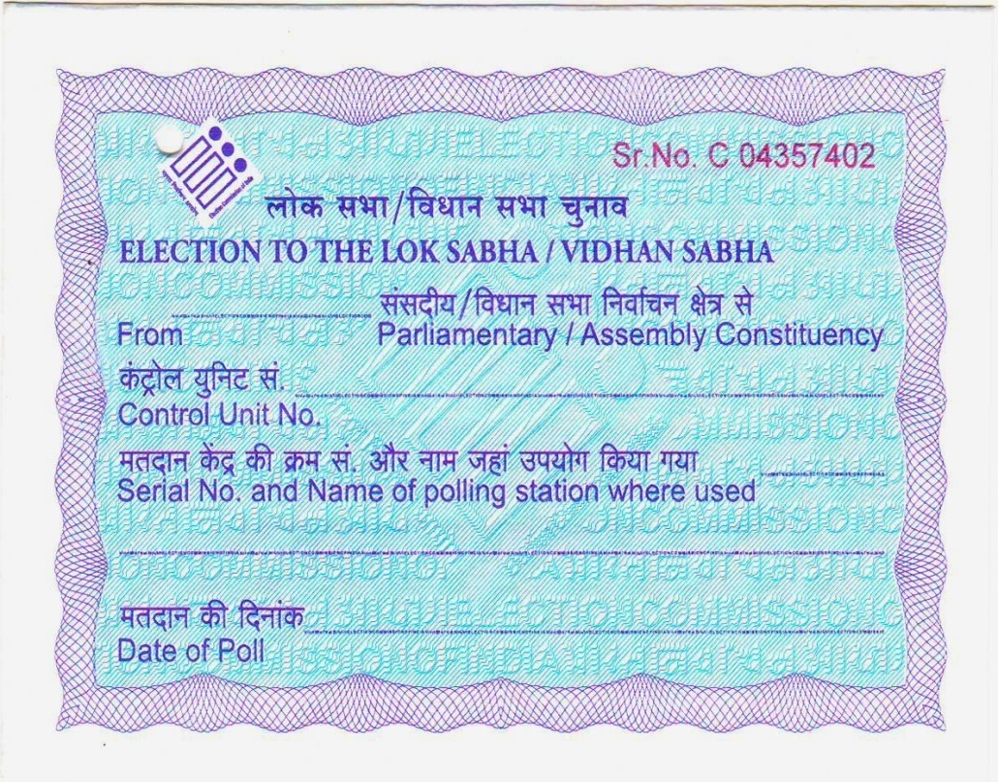
Address Tag
BACK
29
08
29-CURTORIM
B 5 4 3 2 1
08 – Our Lady of Livrament School (West Wing), Arlem
04/02/2017

Slide 128
FORM 17C
BACK
29
FORM 17 – C
[See Rules 49S and 56C(2)]
PART – I – ACCOUNT OF VOTES RECORDED
Election to the House of the People / Legislative Assembly of the State / Union Territory ……………… from................................ Constituency.
Number and Name of Polling Station: ………………….…………………………………………..
Identification Number of Voting Control Unit :.……….…………………………………
Machine used at the Polling Station: Balloting Unit :.………………….……………………….
Printer (if used) : …………………………….……………
Total number of electors assigned to the Polling Station: …………………………………..
Total number of voters as entered in the Register of Voters (Form 17A): …………………………….
Number of voters deciding not to record votes under Rule 49-O: …………………………………….
Number of voters not allowed to vote under Rule 49-M: ……………………………………………..
Test votes recorded under Rule 49MA (d) required to be deducted
Total number of test votes to be deducted: Total No. Sl.No.(s) of elector(s) in Form 17A
…….…….. …………………….………………………………….
Candidate(s) for whom test vote(s) casted: Sl.No. Name of Candidate No. of Votes
………… …………………………..… …….…………….
………… ……………………………… ………………….
Total number of votes recorded as per voting machine:………………………………………………..
08
GOA
29 - CURTORIM
Our Lady of Livrament School (West Wing), Arlem
B 5 4 3 2 1
D 6 7 8 5 2
EVAA 0557
1 1 1 7
9 0 8
0 2
0 1
0
NIL
9 0 5

Slide 129
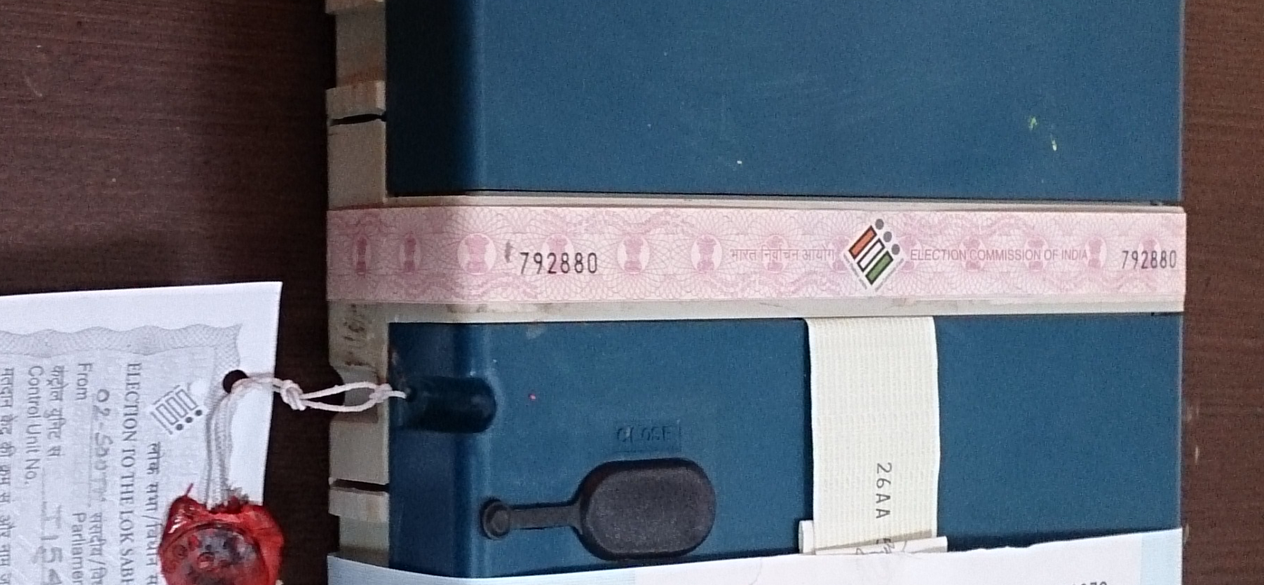
Pink Paper Seal
BACK

Slide 130
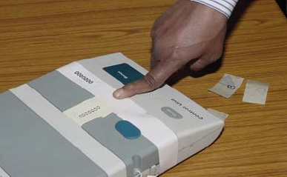


Green Paper Seal
BACK

Slide 131
FORM 17C
BACK
Whether the total number of votes as shown against item No. 6 tallies with the total number of votes as shown against item No. 2 minus number of voters deciding not to record votes as against item No. 3 minus number of voters as against item 4 (i.e. 2-3-4) or any discrepancy noticed ………………………………………………………
Number of voters to whom Tendered Ballot Papers were issued under Rule 49P: ………………………
Number of Tendered Ballot Papers. Sl. No.
Total From To
Received for use: ……………………………………… …………….. ……………… ………………
Issued to electors: .…………………………………… …………….. ……………… ………………
Not used and returned: ……………………………. …………….. ……………… ………………
Account of paper seals Signatures of Polling Agents
1. Paper seals supplied for use: Total No.:……………….… 1. …………………………………………
Sl. Nos. from ……………
2. Paper seals used: Total No.:…………………. 2. ………………………………………….
Sl. No.(s): ………………
3. Unused paper seals returned Total No.:……………….. 3 ……………………………………………
to Returning Officer: Sl. No.(s):………………...
4. Damaged paper seals, if any Total No. ………………… 4 …………………………………………….
Sl. No.(s): ….……………
5…..………………………………………….
Date: ……………………….. Signature of Presiding Officer
Place: ……………………… Polling Station No.: ……………………………
YES, IT TALLIES
01
2 0
0 0 2 1
0 0 4 0
0 1
0 0 2 1
0 0 2 1
1 9
0 0 2 2
0 0 4 0
0 3
1115 - 1117
0 1
1115
02
1116 - 1117
NIL
04/02/2017
29
Arlem
08

Slide 132
PRIOR TO RESULT
BACK

Slide 133
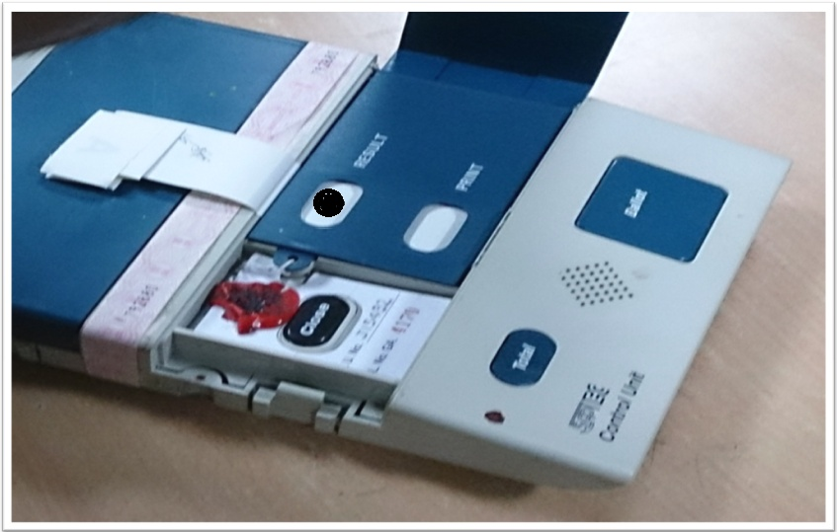
PRIOR TO RESULT
BACK
PIERCE THE GREEN PAPER SEAL THROUGH THIS APERTURE TO PRESS THE RESULT BUTTON

Slide 134
Blackboard/Whiteboard
S. No. | NAME OF CANDIDATE | ROUND 1 | ROUND 2 | ROUND 3 | ROUND 4 | TOTAL
1 | AAAAA
2 | BBBBBB
3 | CCCCCC
4 | DDDDDD
N | NOTA

Slide 135
PROFORMA
BACK
PROFORMA FOR RECORDING OF VOTES BY ADDITIONAL COUNTING STAFF
No. and Name of A.C:- __________________________________________________________
Round No:- ___________________________________________________________________________
Table No:- ____________________________________________________________________________
CU Number: _______________________________ Polling Station Number: ______________
Sr. No. | Name of Candidate (Pre-Printed) | No. of votes recorded
1 | AAAAA
2 | BBBBB
3 | CCCCC
4 | DDDDD
5 | NOTA
Date: | 11/03/2017
*To be handed over to the Observer only. Signature of Addl. Counting staff (with full name)

Slide 136
PROFORMA
BACK
PROFORMA FOR RECORDING OF VOTES BY MICRO OBSERVER
No. and Name of A.C:- __________________________________________________________
Round No:- ___________________________________________________________________________
Table No:- ____________________________________________________________________________
CU Number: _______________________________ Polling Station Number: ______________
Sr. No. | Name of Candidate (Pre-Printed) | No. of votes recorded
1 | AAAAA
2 | BBBBB
3 | CCCCC
4 | DDDDD
5 | NOTA
Date: | 11/03/2017
*To be handed over to the Observer only. Signature of Micro observer (with full name)

Slide 137
PART – II : RESULT OF COUNTING
BACK
PART - II
RESULT OF COUNTING
Sr. No. of candidate | Name of Candidate |  | No. of votes displayed on Control Unit |  | No. of test votes to be deducted as per item 5 of Part I |  | No. of valid votes ( 3-4 )
( 1 ) | ( 2 ) |  | ( 3 ) |  | ( 4 ) |  | ( 5 )
1 | AAAAA
2 | BBBBB
3 | CCCCC
4 | DDDDD
5 | NOTA
TOTAL
Whether the total no. of votes shown above tallies with the total number of votes shown against item 6 of Part I or any descrepancy noticed between the two totals: |  |  |  |  | ____________________________
Place: …………………………
Date: ………………………… |  |  |  | Signature of Counting Supervisor

Slide 138
FORM 17C
BACK
29
FORM 17 – C
[See Rules 49S and 56C(2)]
PART – I – ACCOUNT OF VOTES RECORDED
Election to the House of the People / Legislative Assembly of the State / Union Territory ……………… from ………………… Constituency.
Number and Name of Polling Station: ………………….…………………………………………..
Identification Number of Voting Control Unit :.……….…………………………………
Machine used at the Polling Station: Balloting Unit :.………………….……………………….
Printer (if used) : …………………………….……………
Total number of electors assigned to the Polling Station: ……………………………………………..
Total number of voters as entered in the Register of Voters (Form 17A): …………………………….
Number of voters deciding not to record votes under Rule 49-O: …………………………………….
Number of voters not allowed to vote under Rule 49-M: ……………………………………………..
Test votes recorded under Rule 49MA (d) required to be deducted
Total number of test votes to be deducted: Total No. Sl.No.(s) of elector(s) in Form 17A
…….…….. …………………….………………………………….
Candidate(s) for whom test vote(s) casted: Sl.No. Name of Candidate No. of Votes
………… …………………………..… …….…………….
………… ……………………………… ………………….
Total number of votes recorded as per voting machine:………………………………………..
08
GOA
29 - CURTORIM
Our Lady of Livrament School (West Wing), Arlem
B 5 4 3 2 1
D 6 7 8 5 2
EVAA 0557
1 1 1 7
9 0 8
0 2
0 1
N. A.
9 0 5

Slide 139
Section 128 of ROPA
BACK

Slide 140
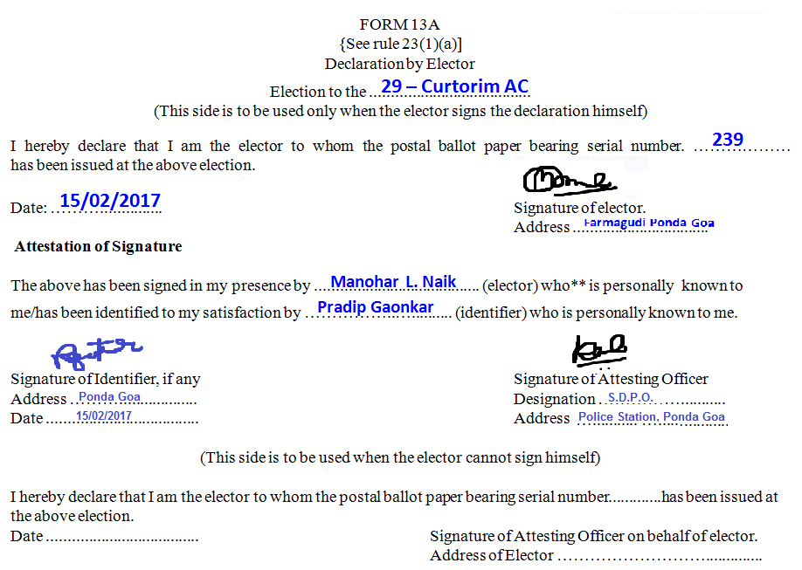
Declaration by Elector in Form 13A

Slide 141
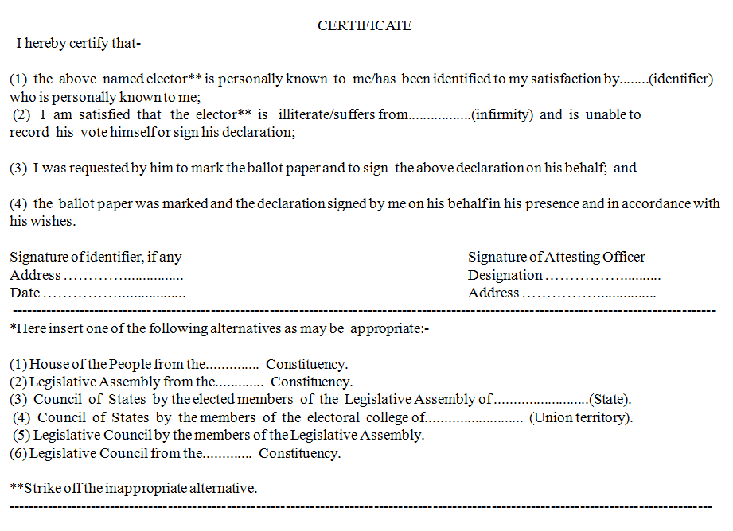
Declaration by Elector in Form 13A
BACK

Slide 142
Postal Ballot in Form 13B
BACK
[FORM 13B]
[ NOT TO BE OPENED BEFORE COUNTING]
Elections to the ……………………………………………….
POSTAL BALLOT PAPER
Serial Number of Ballot Paper: ……………………
COVER A
29 - Curtorim AC
239

Slide 143
Address Cover in Form 13C
BACK
POSTAL BALLOT PAPER
For ………………………………… Constituency
[ NOT TO BE OPENED BEFORE COUNTING]
To
The Returning Officer
……………………………………………………………….
……………………………………………………………….
……………………………………………………………….
……………………………………………………………….
COVER B
[“Every officer under whose care or through whom a postal ballot paper is sent shall ensure its delivery to the addressee without delay---Rule 23(4) of the Conduct of Elections Rules, 1961”]
FORM 13C
29 - Curtorim AC
29 - Curtorim AC
Room No. 316, 3rd Floor
Matanhy Saldanha Adm Complex
Margao Goa

Slide 144
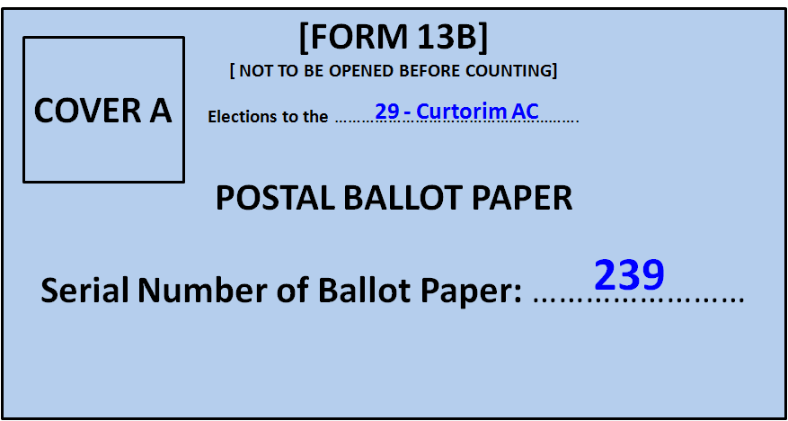
Serial No. on Declaration and Small Envelope
BACK

Slide 145
Declaration by Elector in Form 13A
BACK

Slide 146
Postal Ballots
BACK
Scrutiny of Declaration
Declaration not found
Declaration found
Not Signed
Not Attested
Unauthorized Attestation
Sr. No. on smaller cover not
matching with that on the
declaration.
Defective / Mutilated
PB is outside smaller envelope
PB not returned in same cover A
Reject the PB making suitable endorsement on the bigger cover.

Slide 147
Valid Postal Ballots
BACK
There is no particular mark prescribed by law for recording the vote on postal ballot.
Any mark is valid; if it is clear and beyond reasonable doubt that it has been given in favour of single candidate.
A mark made anywhere in the space allotted to a candidate will be taken as a valid vote in favour of the candidate concerned.
If the mark has been made more than once to clarify choice in favour of single candidate, the PB is valid

Slide 148
Invalid Postal Ballots
BACK
It bears mark apart from vote or writing by which voter can be identified.
If vote is not at all recorded.
If vote is given in favour of more than one candidate.
Mark placed in such a manner that it is doubtful to which candidate vote has been given.
If it is a spurious Ballot Paper.
The Ballot Paper is damaged/mutilated that its doubtful if PB is genuine
Not returned in cover sent along with it to elector by the RO

Slide 149
Form 20
BACK
FORM 20
[ SEE RULE 56(7) ]
FINAL RESULT SHEET
Election to the GOA LEGISLATIVE ASSEMBLY from the 29 – CURTORIM ASSEMLY CONSTITUENCY
PART I
NAME OF ASSEMBLY CONSTITUENCY: 29 – CURTORIM . TOTAL NUMBER OF ELECTORS IN AC: 28077 .
Serial No. of Polling Station | No. of valid votes cast in favour of |  |  |  |  | Total No. of valid votes | No. of rejected votes | NOTA | Total | No. of Tendered Votes
1
2
3
.
.
38
Total votes recorded at PS
No. of votes recorded on postal ballot papers
Grand Total
Place: ______________ ==========================
Date : ______________ Returning Officer: 29 – Curtorim AC

Slide 150
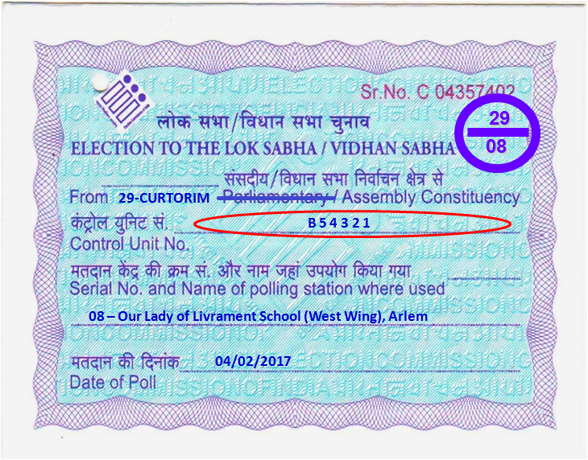
FORM 17C
BACK
29
FORM 17 – C
[See Rules 49S and 56C(2)]
PART – I – ACCOUNT OF VOTES RECORDED
Election to the House of the People / Legislative Assembly of the State / Union Territory ……………… from................................ Constituency.
Number and Name of Polling Station: ………………….…………………………………………..
Identification Number of Voting Control Unit :.……….…………………………………
Machine used at the Polling Station: Balloting Unit :.………………….……………………….
Printer (if used) : …………………………….……………
Total number of electors assigned to the Polling Station: …………………………………..
Total number of voters as entered in the Register of Voters (Form 17A): …………………………….
Number of voters deciding not to record votes under Rule 49-O: …………………………………….
Number of voters not allowed to vote under Rule 49-M: ……………………………………………..
Test votes recorded under Rule 49MA (d) required to be deducted
Total number of test votes to be deducted: Total No. Sl.No.(s) of elector(s) in Form 17A
…….…….. …………………….………………………………….
Candidate(s) for whom test vote(s) casted: Sl.No. Name of Candidate No. of Votes
………… …………………………..… …….…………….
………… ……………………………… ………………….
Total number of votes recorded as per voting machine:………………………………………………..
08
GOA
29 - CURTORIM
Our Lady of Livrament School (West Wing), Arlem
B 5 4 3 2 1
D 6 7 8 5 2
EVAA 0557
1 1 1 7
9 0 8
0 2
0 1
0
NIL
9 0 5

Slide 151
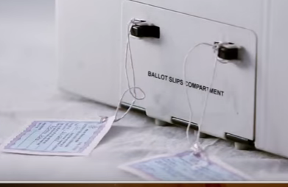
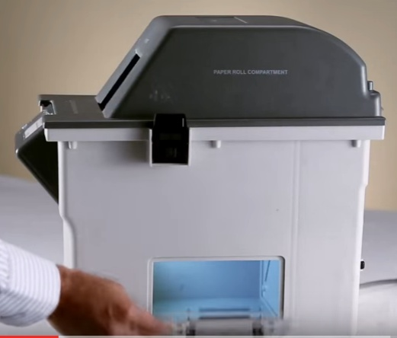
Unsealing VVPAT
BACK

Slide 152
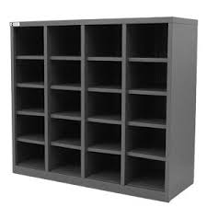
Piegeon Holes
BACK

Slide 153
Malfunctioning of EVM
If a particular Control Unit used at a Polling Station does not display the results, such CU will be kept inside its carrying case and is to be kept in custody of RO; while continuing with counting of other EVM’s.
Result from such Control Unit(s) will not be retrieved using Auxiliary Display Unit or Printer.
After completion of counting of votes from all the Control Units, the printed paper slips of the respective VVPAT shall be taken up for counting as per the counting procedure prescribed by the Commission.
Thereafter, counting of printed paper slips of VVPAT(s) under Rule 56D of Conduct of Election Rules, 1961 shall be taken up.

Slide 154
Malfunctioning of EVM
Procedure in case of discrepancy in the date and time of start and end of poll:
1.In case of above, the difference will be compared with the date and time noted by Presiding Officer in the mock poll certificate.
2.If the date and time difference at the time of mock poll does not match with the date and time difference of start and end of poll at the time of counting, the EVM will be kept aside and the matter to be referred to the RO/ARO for decision.
3. On the other hand if it matches, the discrepancy will be explained to the candidates and their representatives and the votes polled in the EVMs will be counted in the usual manner.

Slide 155
Malfunctioning of EVM
BACK
After completion of counting, all the Control Units whether result has been retrieved from it or not should be kept back inside their respective carrying cases.
The carrying cases should then be sealed by Returning Officer and Observer should put their signatures on the seal.
Candidates and their election agents should also be allowed to put their signature on the seal. The Control Unit should be then kept in the strong room (s).

Slide 156
Close button not pressed
If close button of the CU was not pressed by the Presiding Officer, the message on CU will be “INVALID” when Result button is pressed.
Such CU will be kept inside its carrying case and is to be kept in custody of RO; while continuing with counting of other EVM’s.
Only when counting of all the EVM’s is over, the RO and Observer to check the margin of votes between the first and the second candidate and compare the same with the votes in this EVM.
The Returning Officer/Counting Supervisor shall press the “Total” button of the Control Unit to see whether the total votes polled in that machine and that mentioned in Form - 17 C are the same.

Slide 157
Close button not pressed
BACK
Only if the votes in CU and 17 C are tallying:
The RO/CS shall press the “Close” button of the Control Unit (s) followed by the “RESULT” button to get the results.
Proceedings of the such activity has to be drafted explaining the facts to the candidates/counting agents and their signatures taken thereof.
If the votes in CU and 17 C does not tally:
The matter should be referred by RO to the Commission for its decision and action may be taken as per the direction of the Commission.
After completion of counting, all the CU should be kept back inside their respective carrying cases & sealed with seals of RO, Observer, Candidates and their election agents.

Slide 158
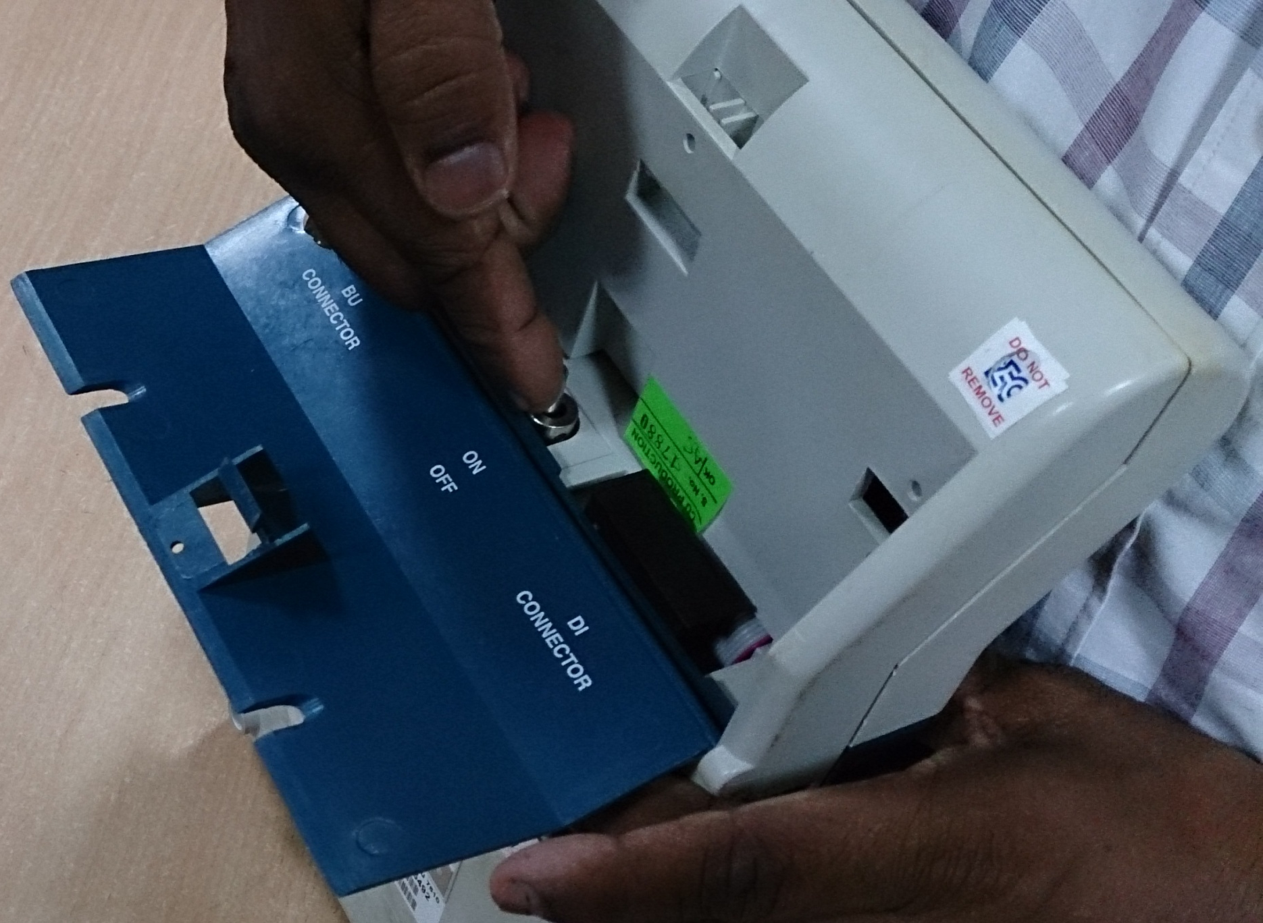

Slide 159


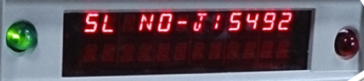
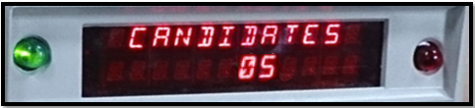
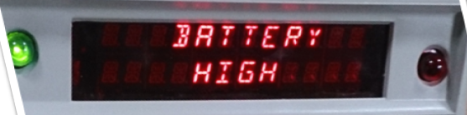
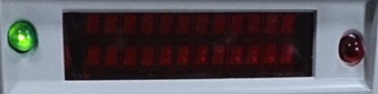
BACK

Slide 160






Slide 161






Slide 162



BACK
CANDIDATE | VOTES
1 | 204
2 | 349
3 | 149
4 | 164
5 | 39
TOTAL | 905

