Slide 1
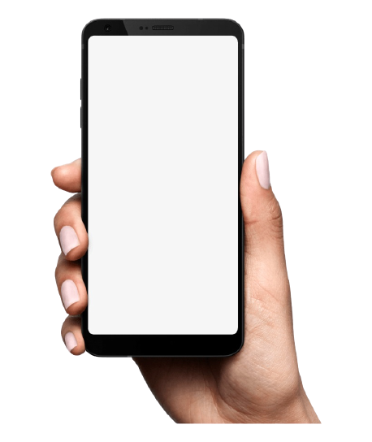
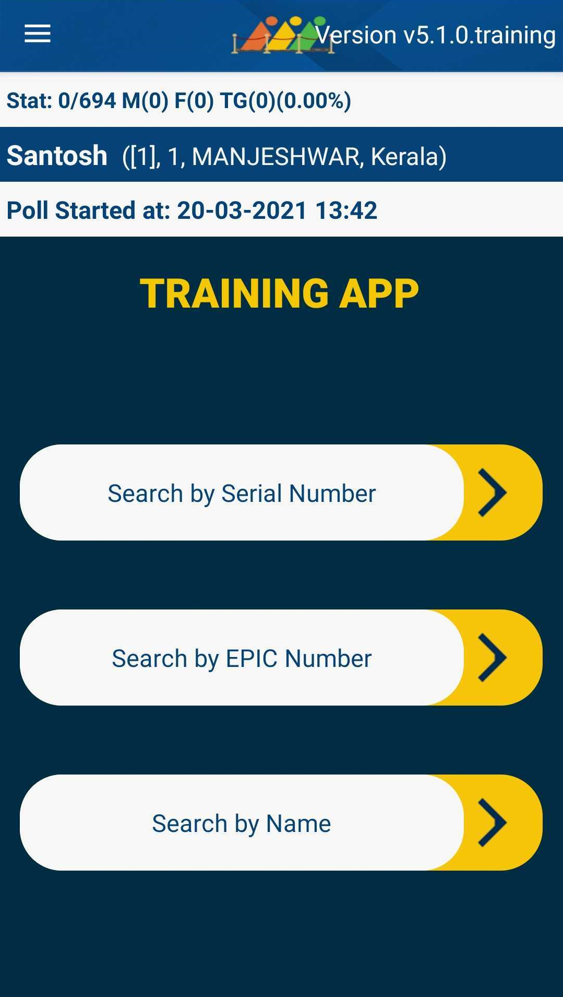

BOOTH APP
App reduces the queue, helps in faster polling and allows error-free recording of poll turnout without manual intervention

Slide 2
Why it is known for ?
“It facilitates in faster identification of voter Serial number of part from the digital marked copy of the electors. This reduces the queue, helps in faster polling and allows error-free recording of poll turnout without manual intervention.”

Slide 3
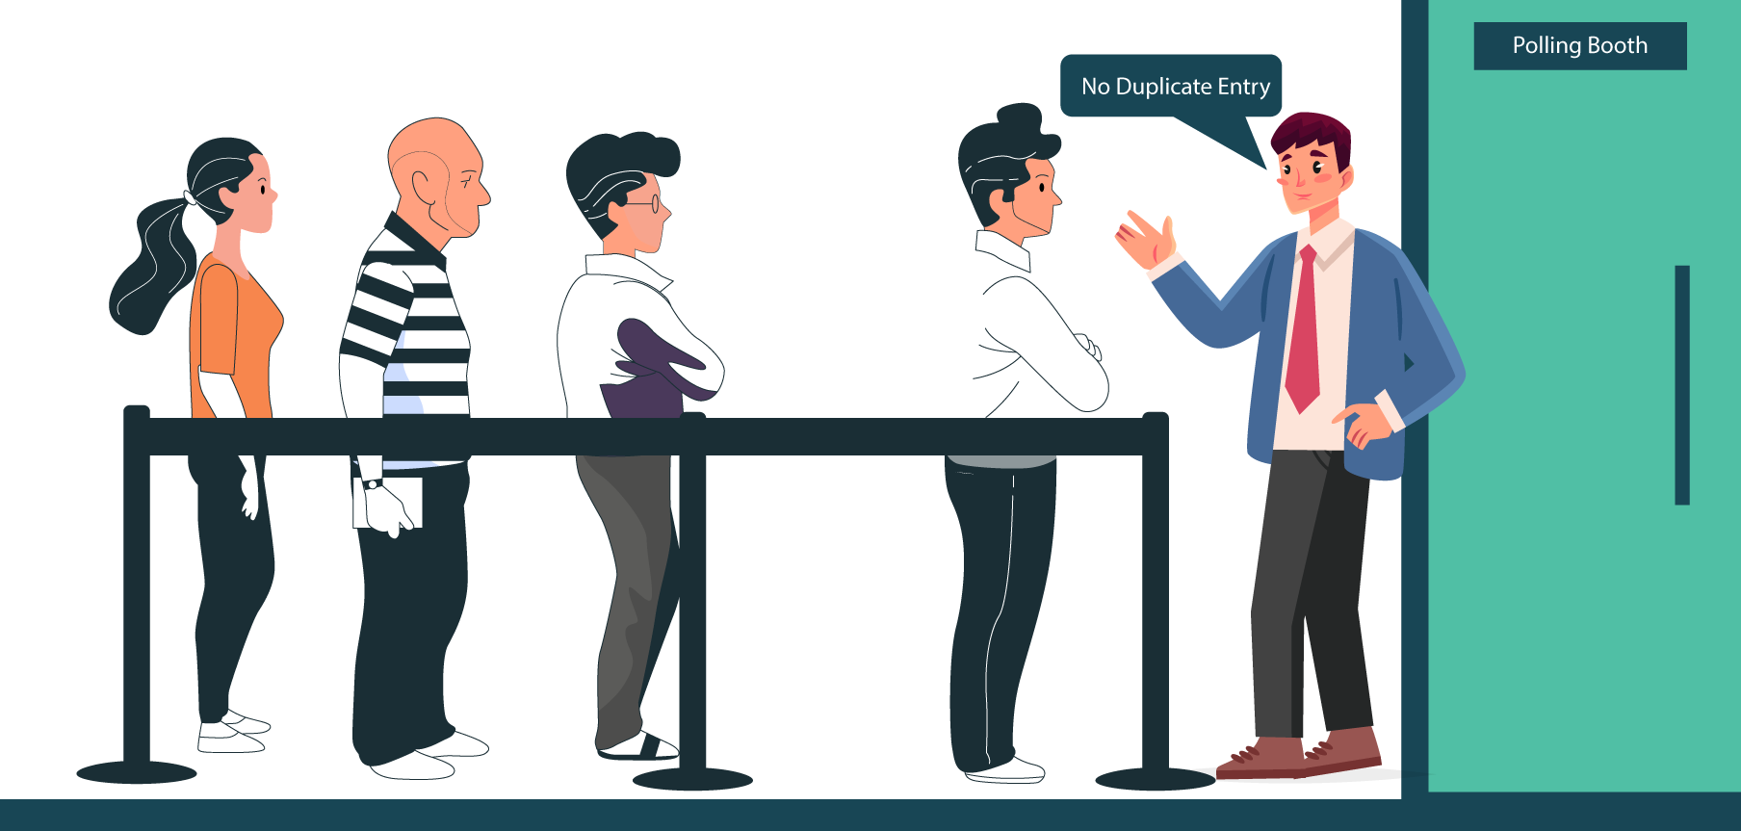
My USP No. 1
No Duplicate Entries
The App helps in reducing the chances of bogus voting or duplication of votes

Slide 4
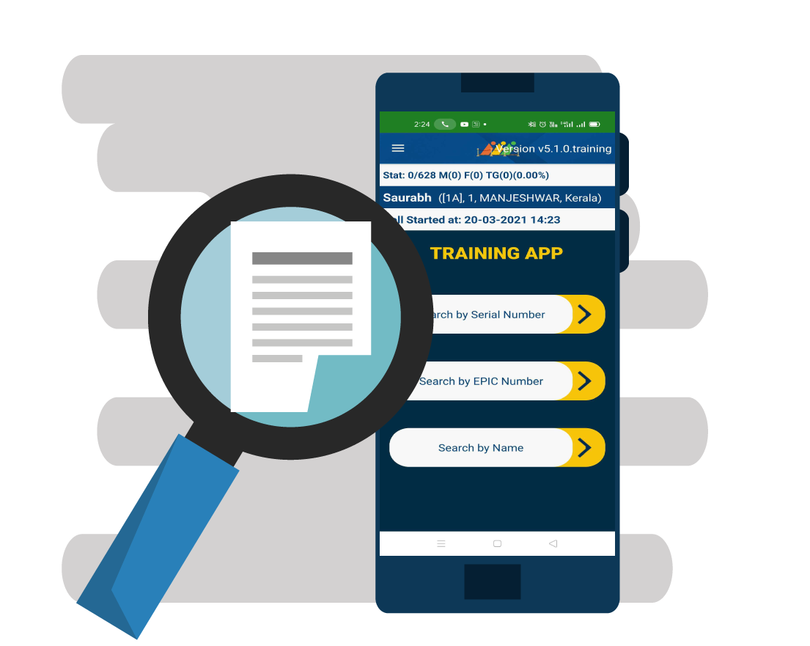
My USP No. 2
Fast Electoral Search
By the simple entry of the serial number, the voter is identified thereby reducing wait time considerably.

Slide 5

My USP No. 3
Automated Poll Turnout
By using robust technologies like that used in UPI / BHIM, the turnout information is automated by using Long-code SMS on the background in case internet is not available on polling booth on poll day.

Slide 6
Important Note
The Booth App implementation will be in addition to the normal polling process.
The original polling process will continue as per the existing norms.

Slide 7
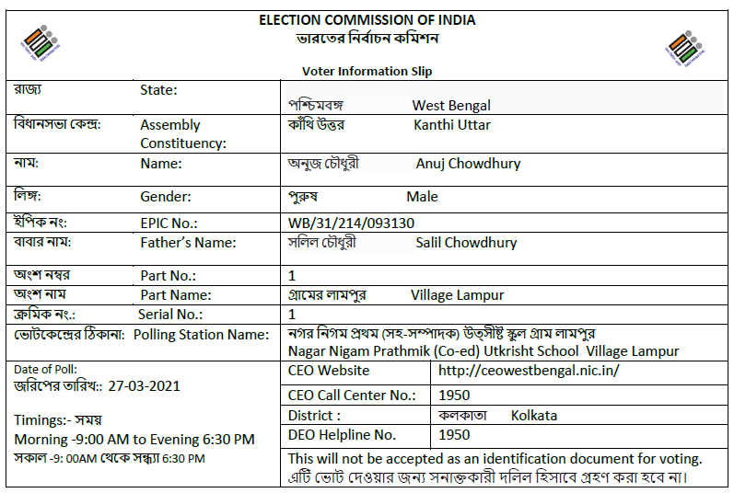
Prerequisites
Voter Slips
Voter Slips should be downloaded from ERONET State VM
Ensure 100% distribution of Voter Slips to electors.
Publicity of carrying voter slip during the poll.

Slide 8
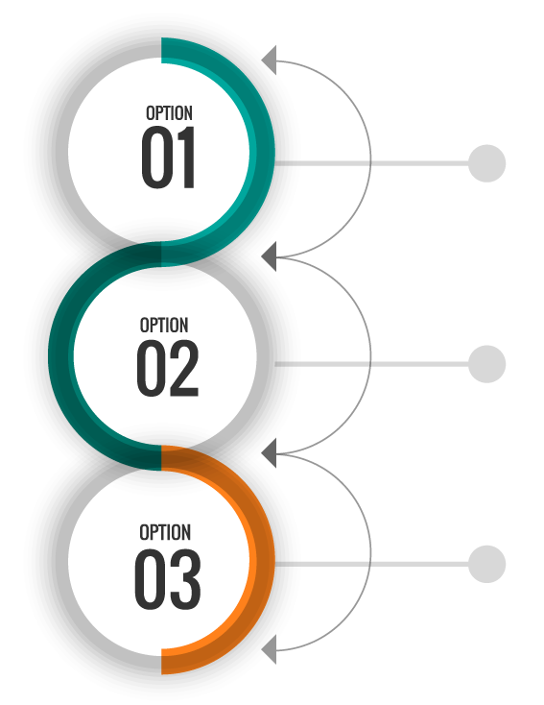

How a voter can be identified ?
Serial Number
EPIC Number
Search by Name

Slide 9
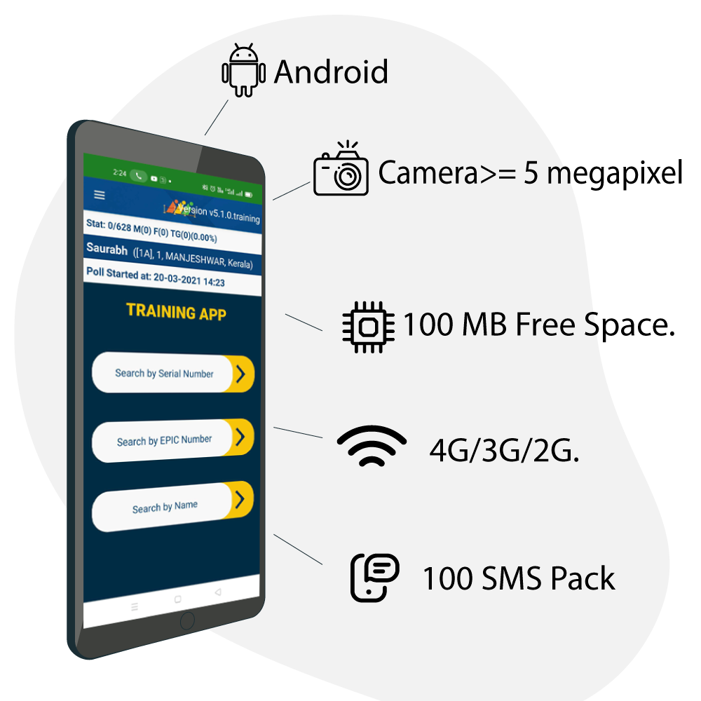
Prerequisites
“The Booth App installed on the PO will automatically validate the compatibility of the mobile phones. “

Slide 10
Prerequisites for RO
Polling Party Account Management
Create account in Encore (https://encore.eci.gov.in ) for Booth App by entering Name & Mobile number. After third randomization against the assigned polling station.
More than one user can be added based on requirement, but at a time only one user can do the transaction at polling party.
Training and Handholding
Full end to end training & process flow to each Polling Party officer (PO-1/ PO-2)

Slide 11
Prerequisites for RO
Poll Day Monitoring
Ensure 100% scan and/or data entry through app.
Involve SLMT / DLMT’s for hands on training and troubleshooting.

Slide 12


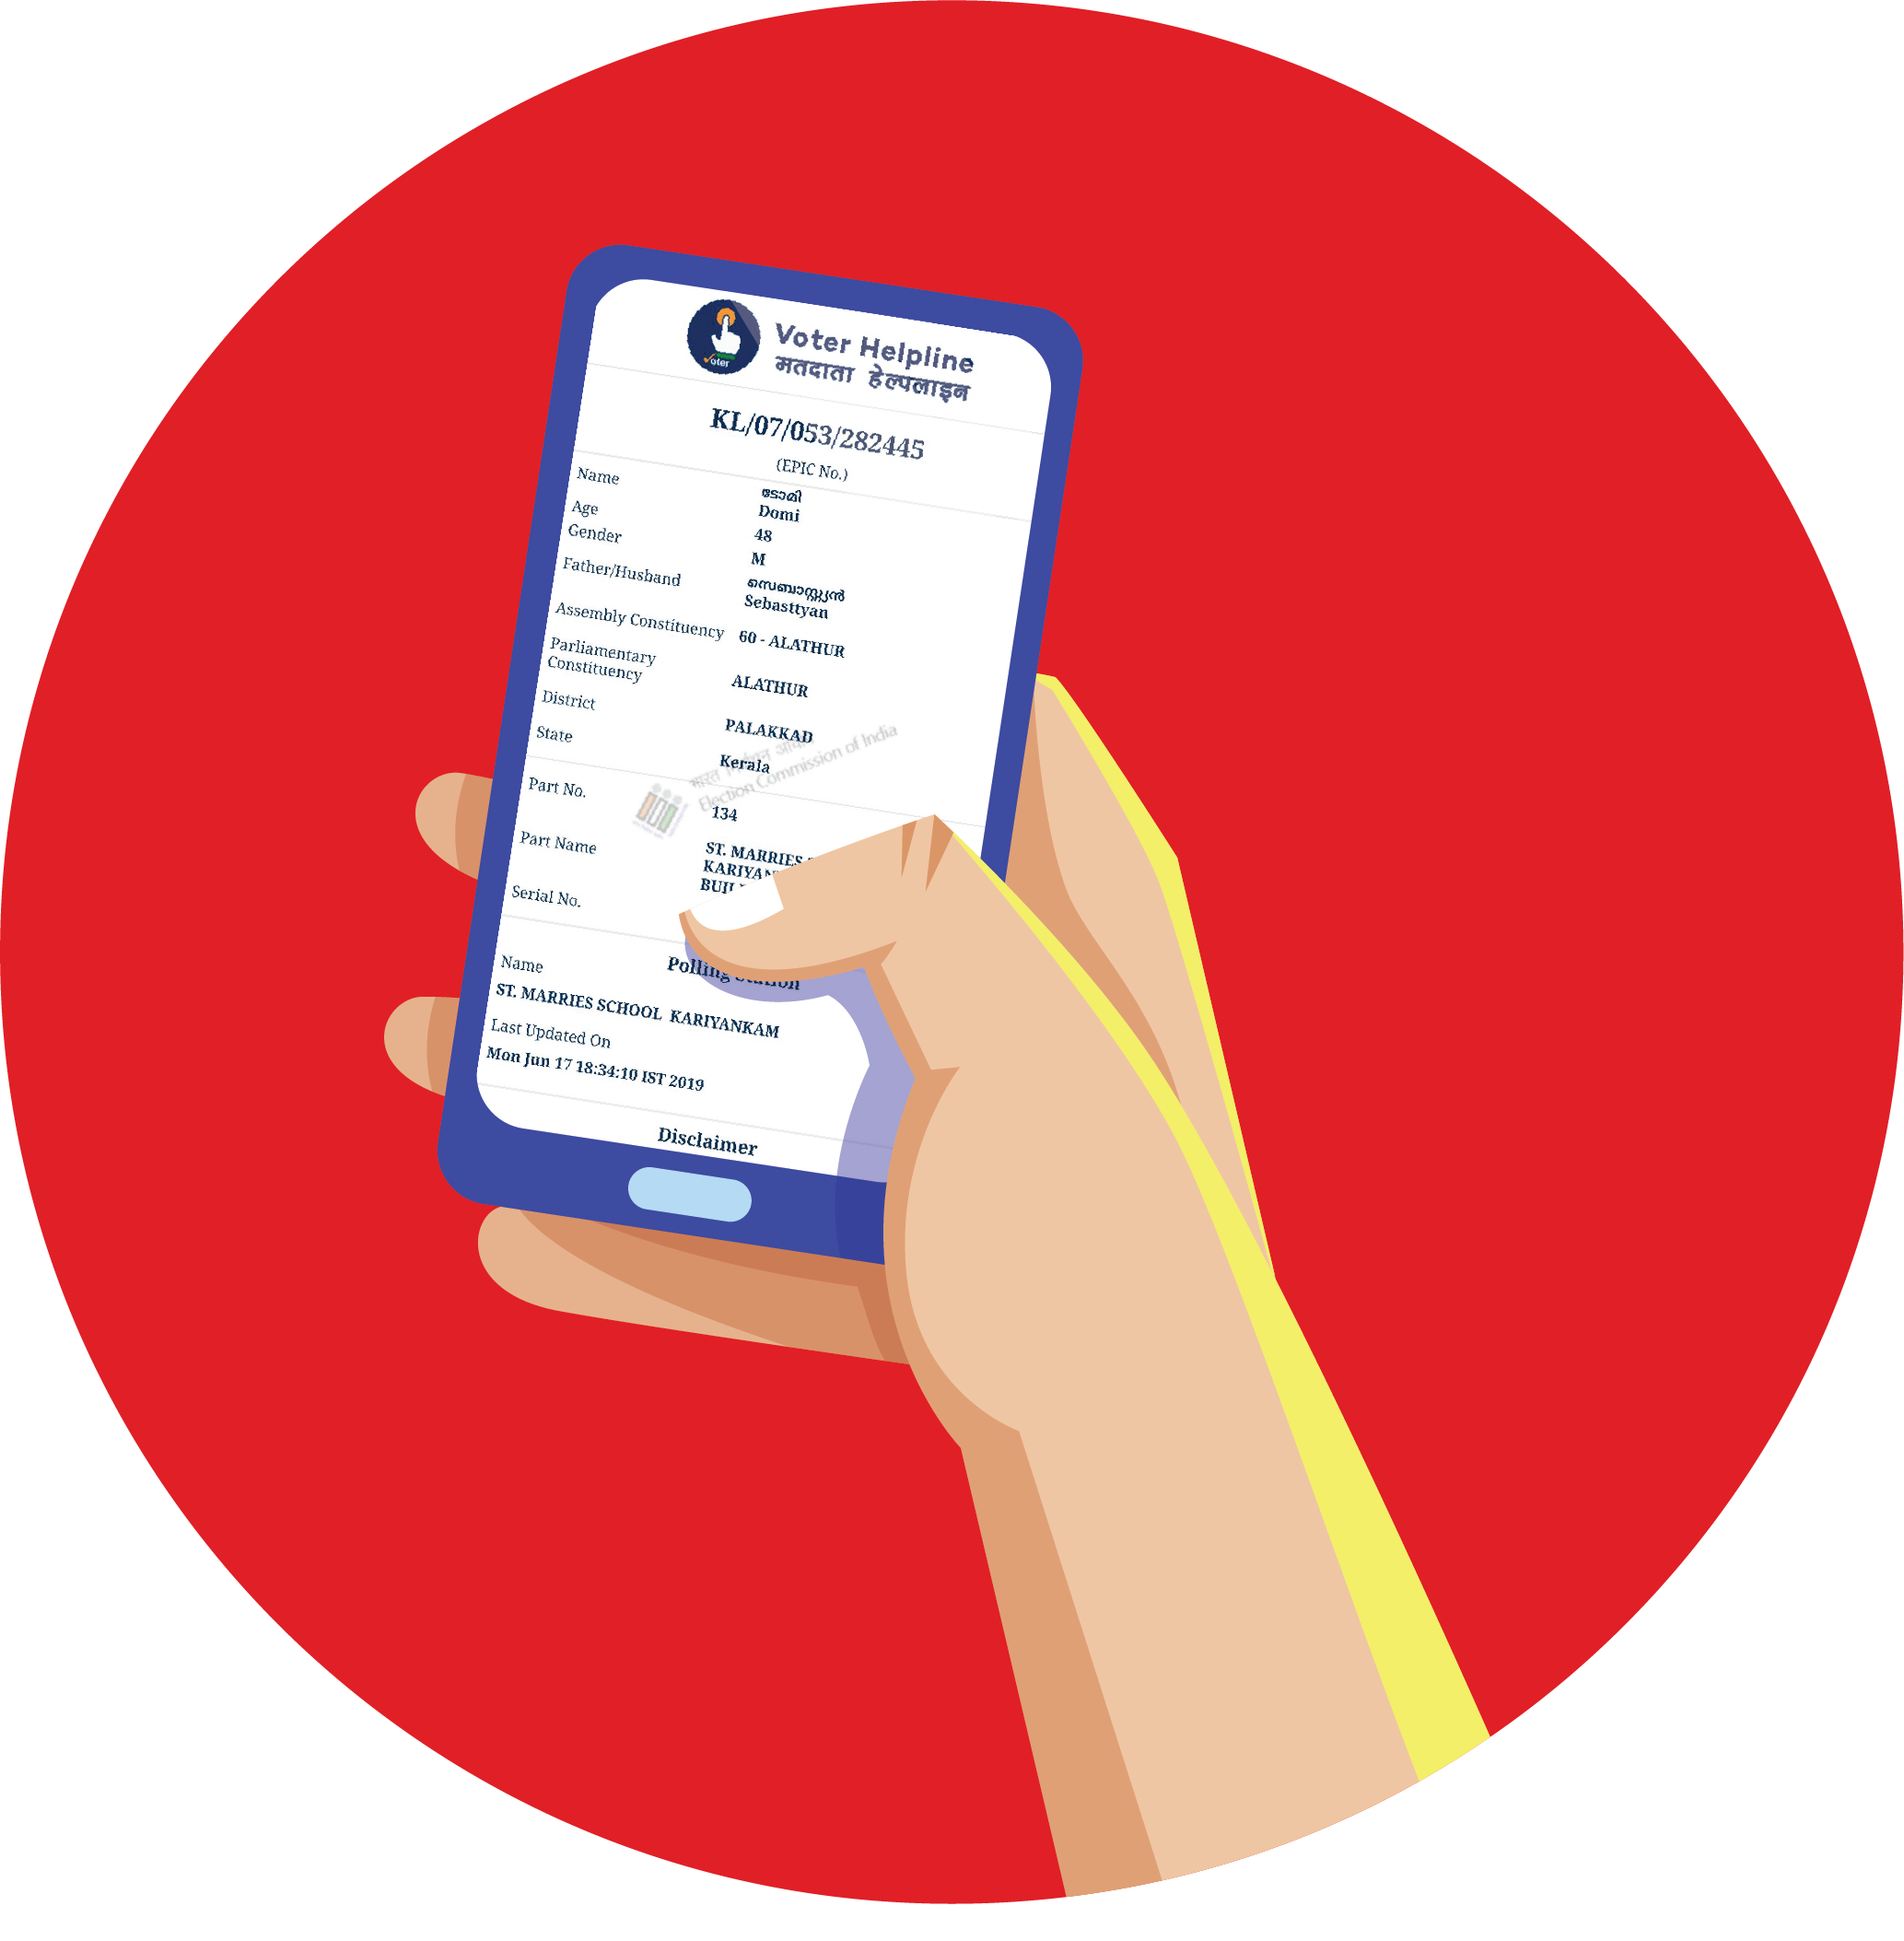

Step 1
Presentation of Voter Slip
1122
Voter Slip
with
Serial Number
PO-1/PO-2

Slide 13
Step 2
Polling officials should search the elector through serial number in part/Name/Epic Number
Verify the voter details through Booth App.

Slide 14
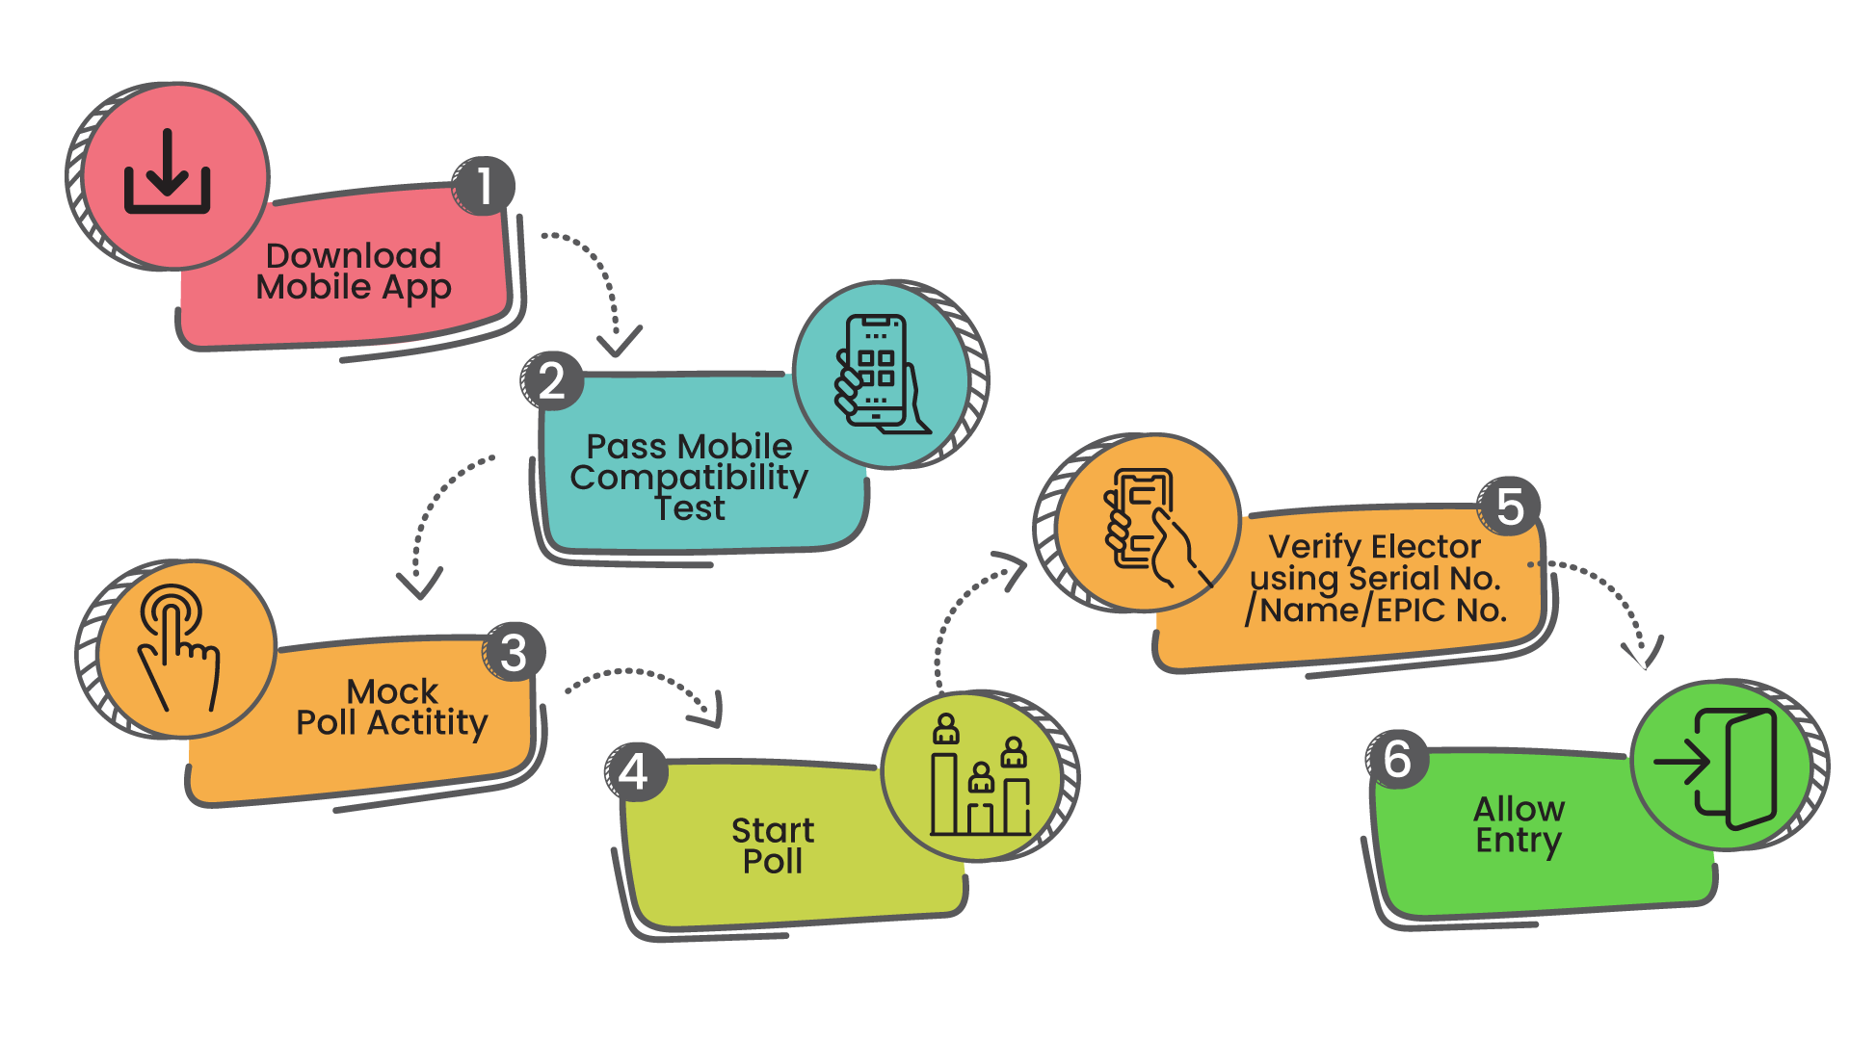
Responsibilities of Polling Officer

Slide 15
RO’s Responsibilities in ENCORE
Account creation (PO-1)
Alternate number can be registered (as PO-2) in case if the primary doesn’t work.
Pre-poll and Poll day Monitoring through dashboard

Slide 16
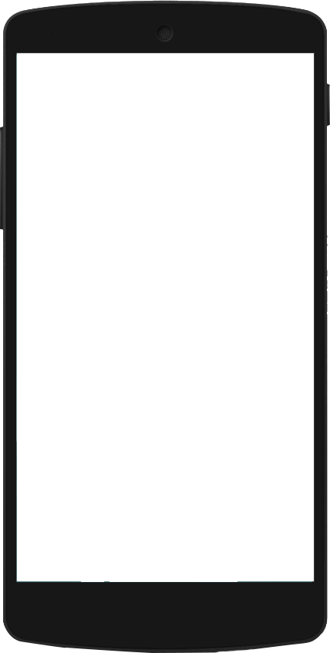
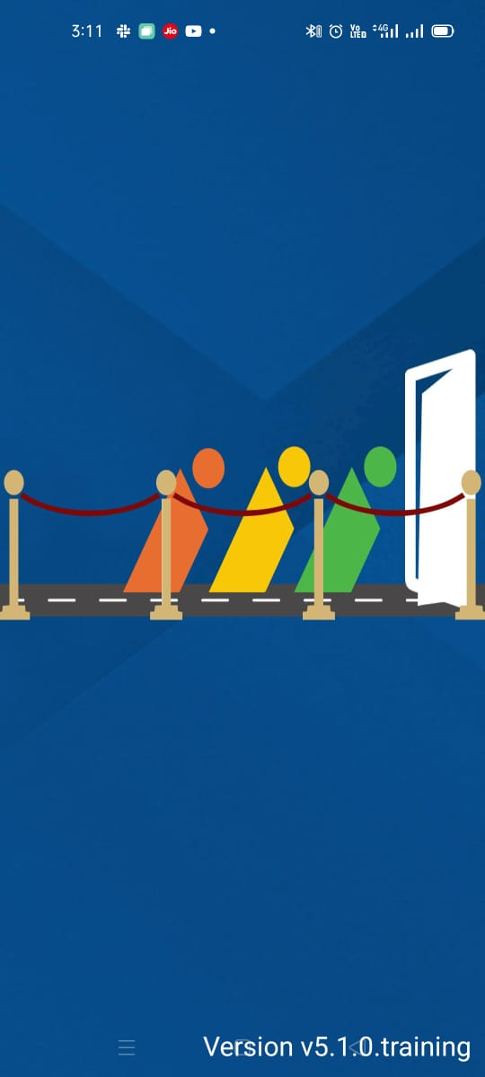
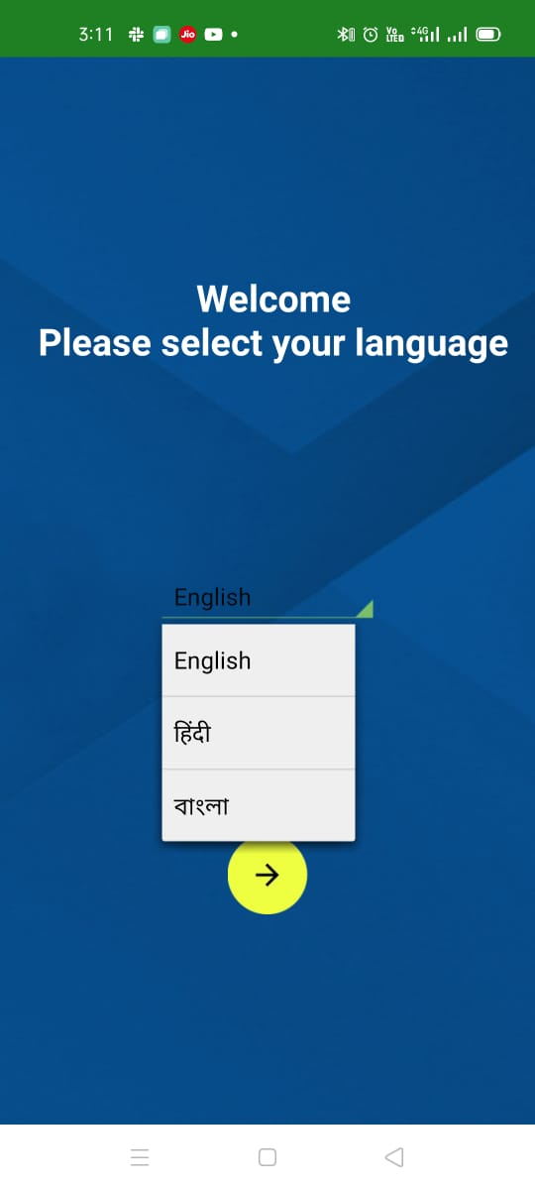
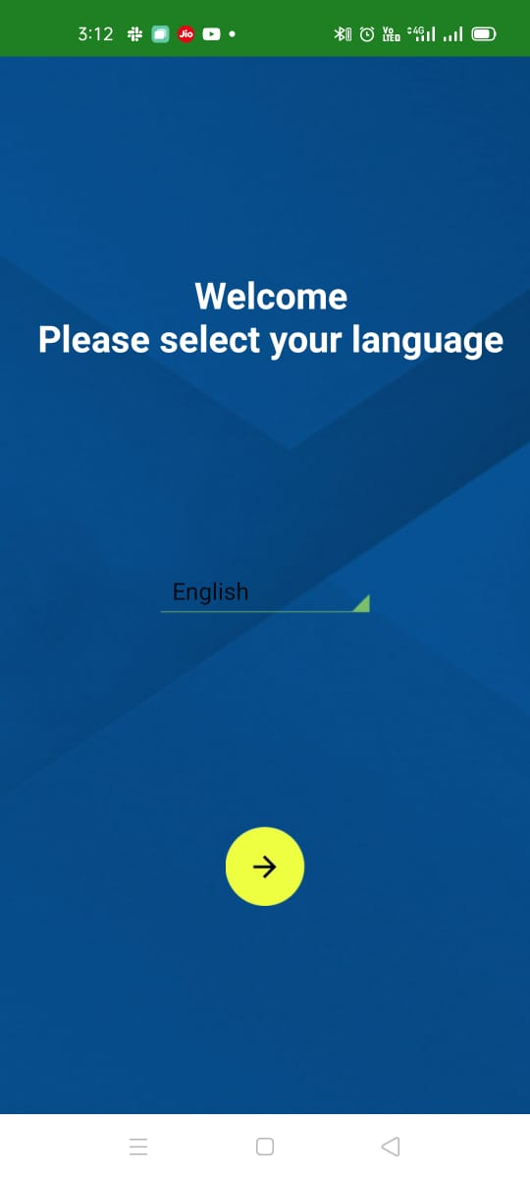
Choose Language

Slide 17
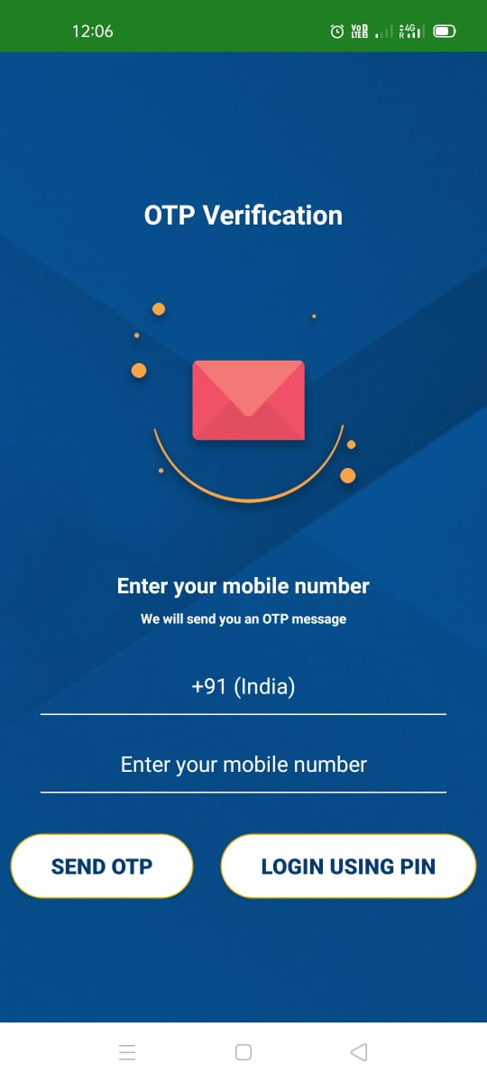
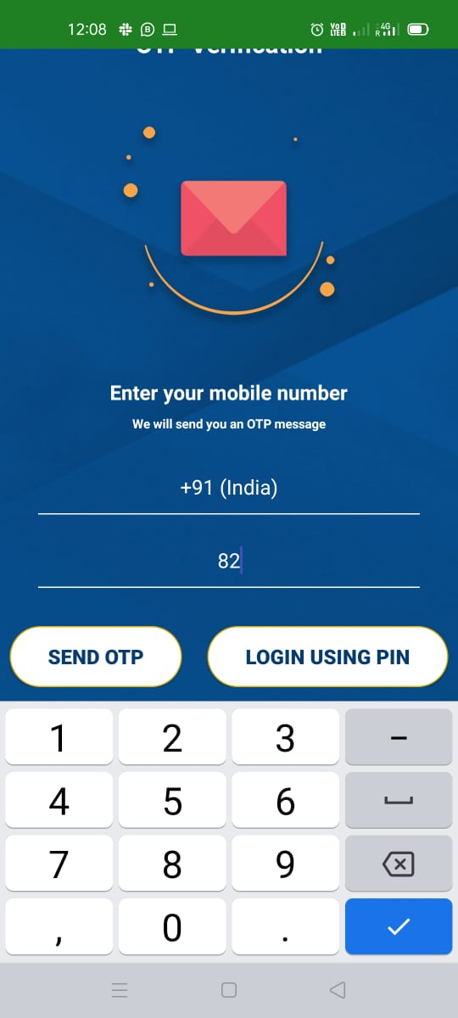
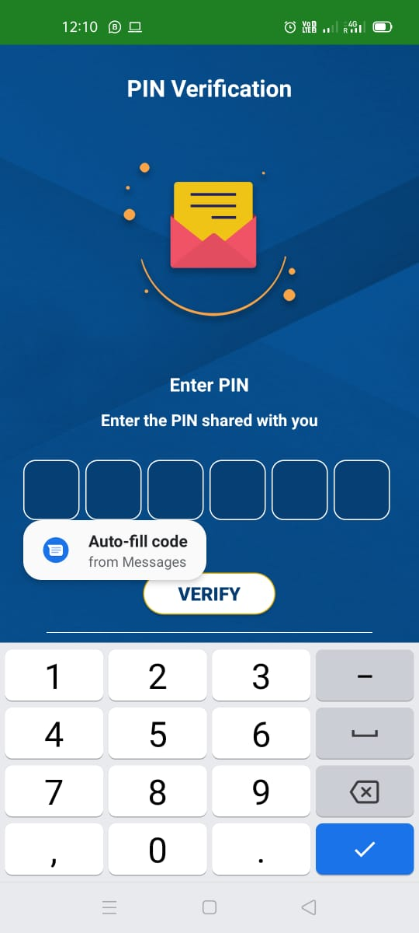
How to Login?

Slide 18
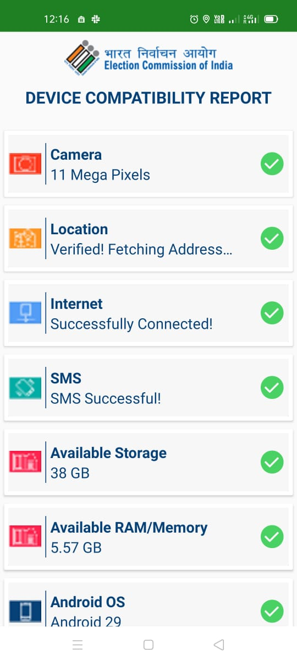
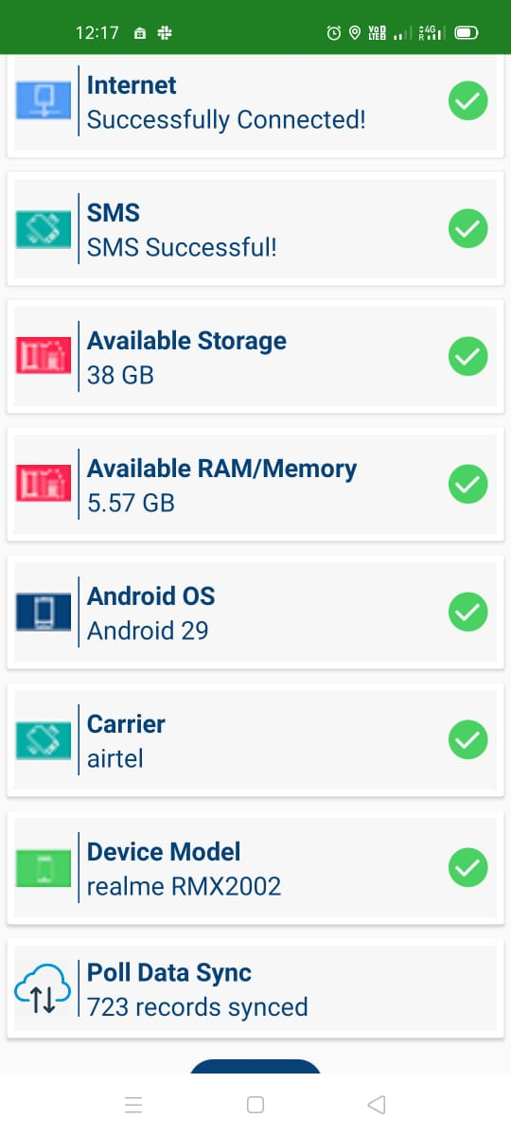
Compatibility Check

Slide 19
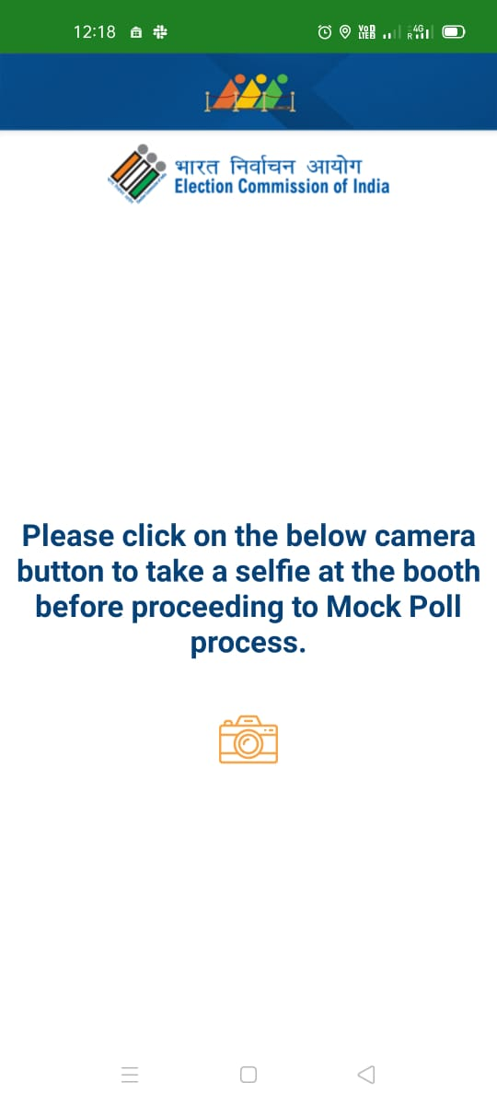
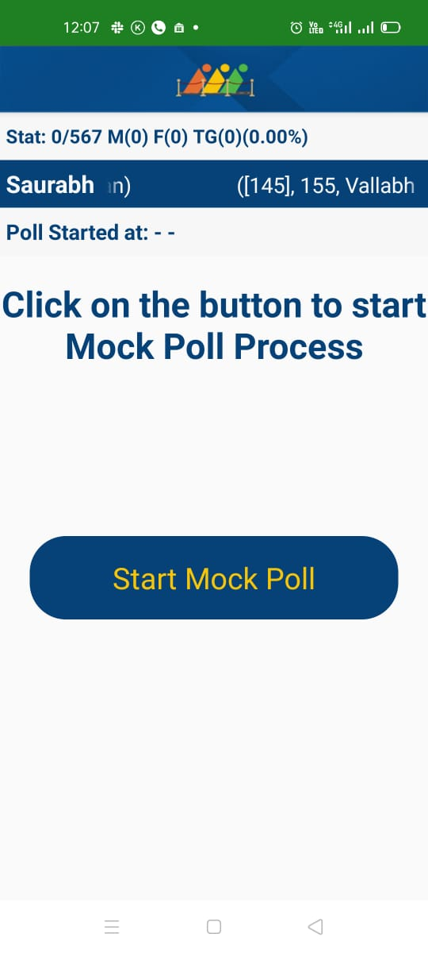
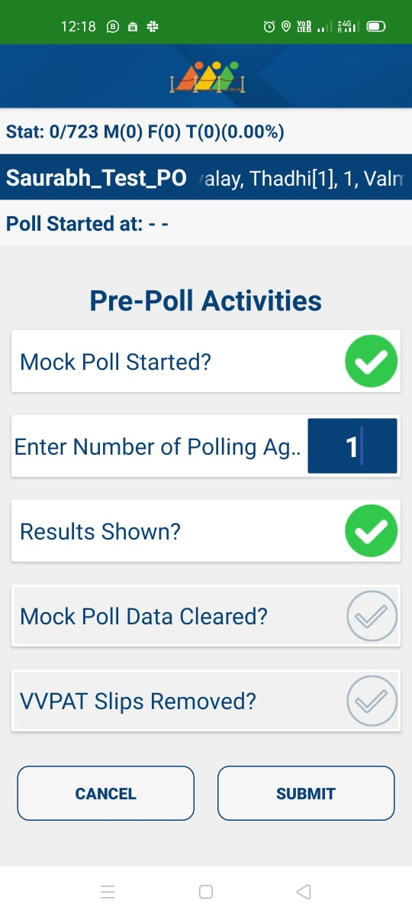
Pre-Poll Activity

Slide 20
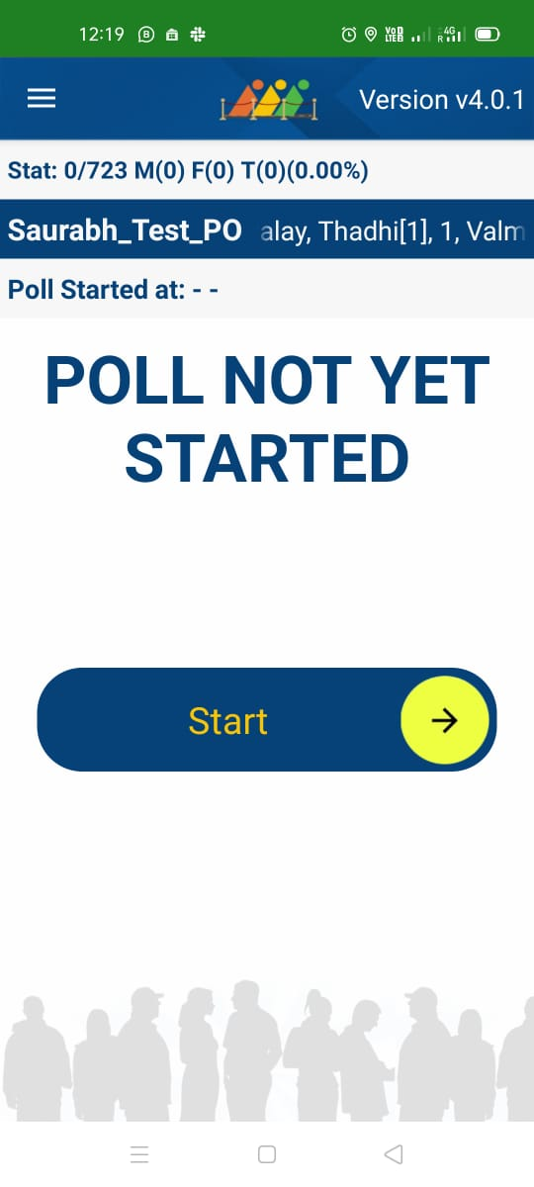
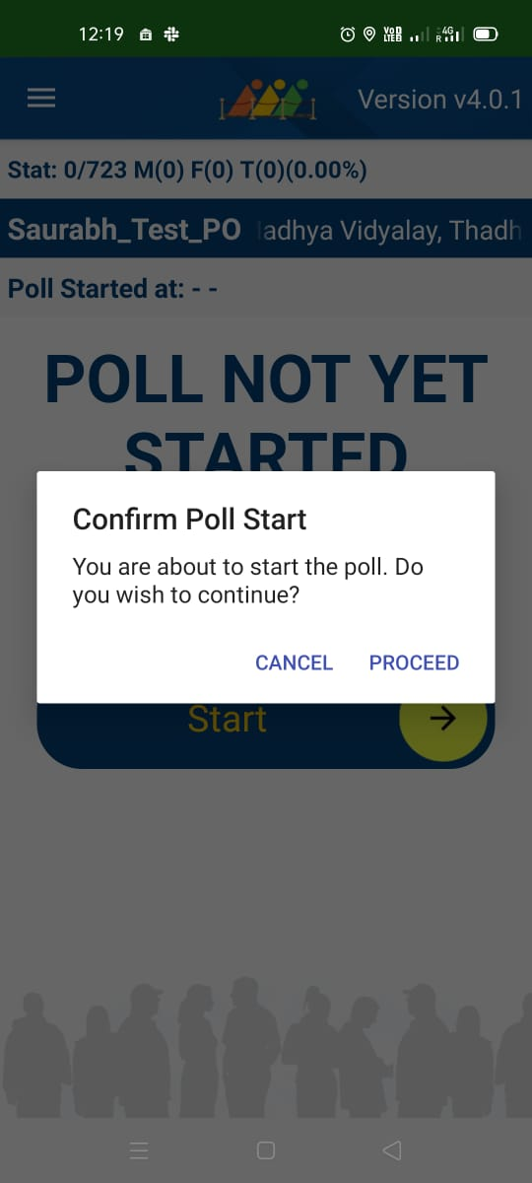
Start Poll And Confirmation

Slide 21
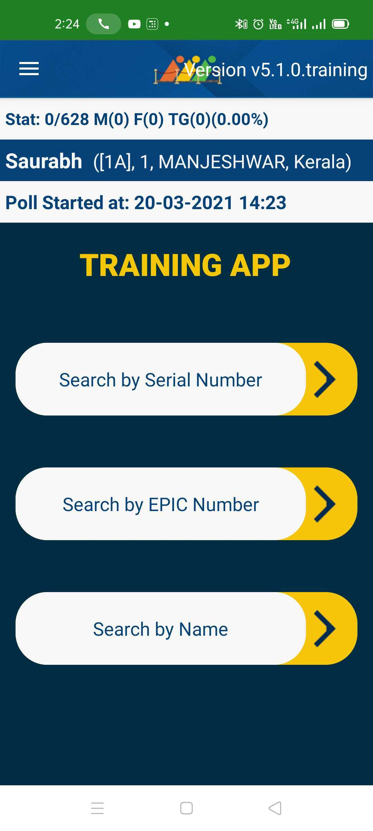
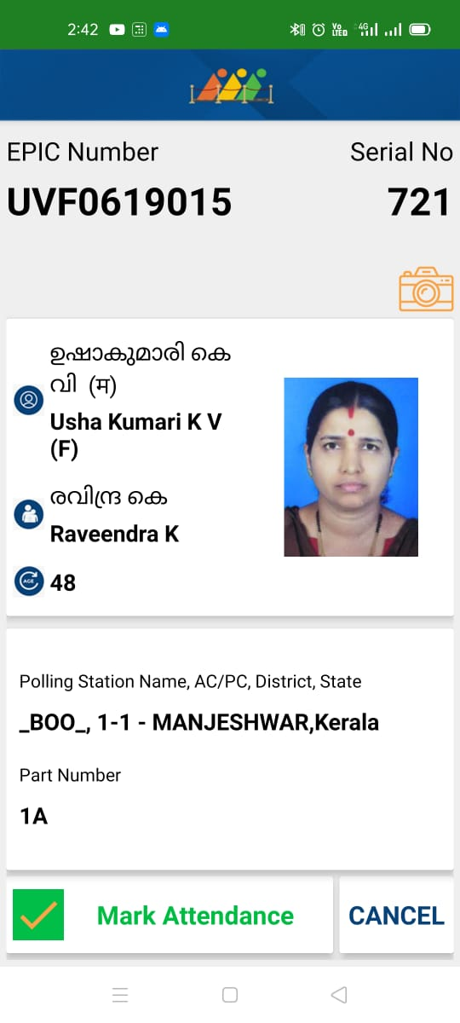
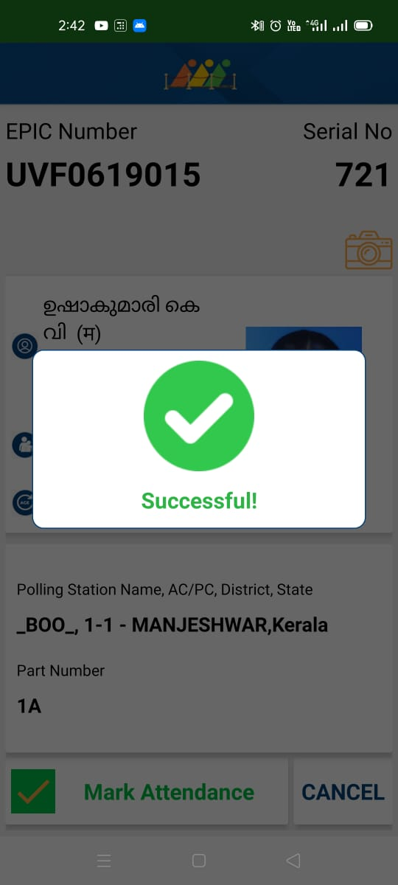
Verify Voter By Quick search

Slide 22
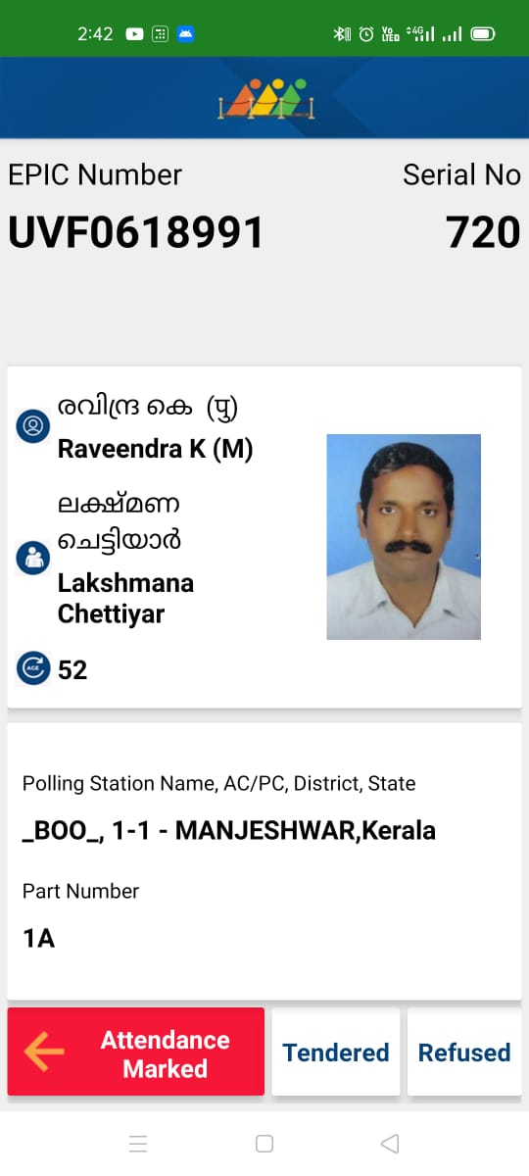
Attendance Marked Already

Slide 23
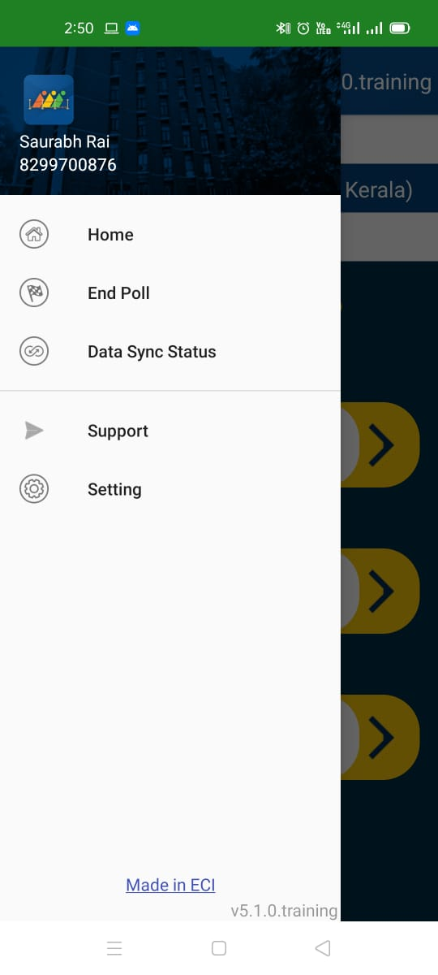
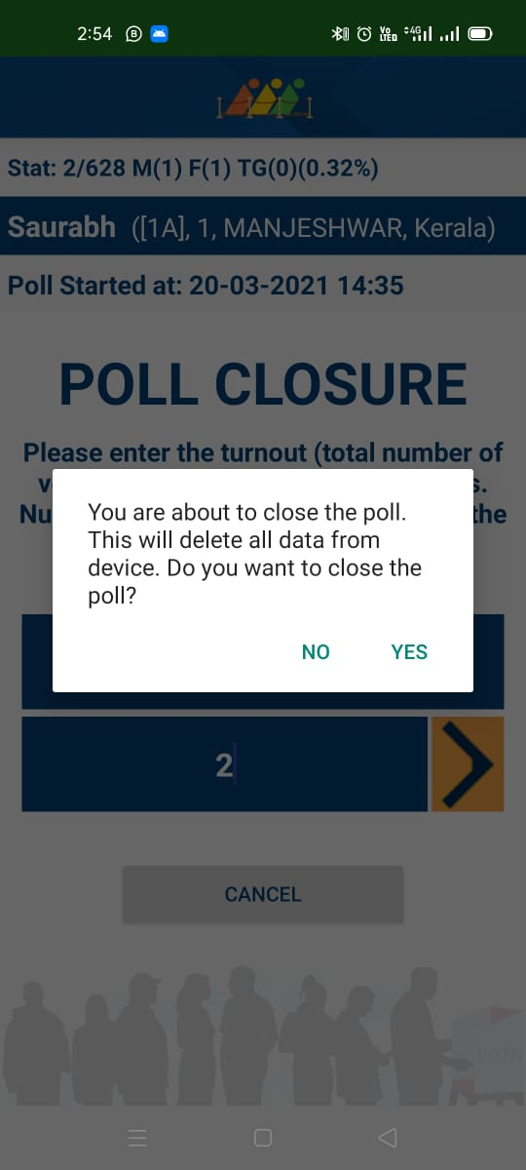
End of Poll

Slide 24
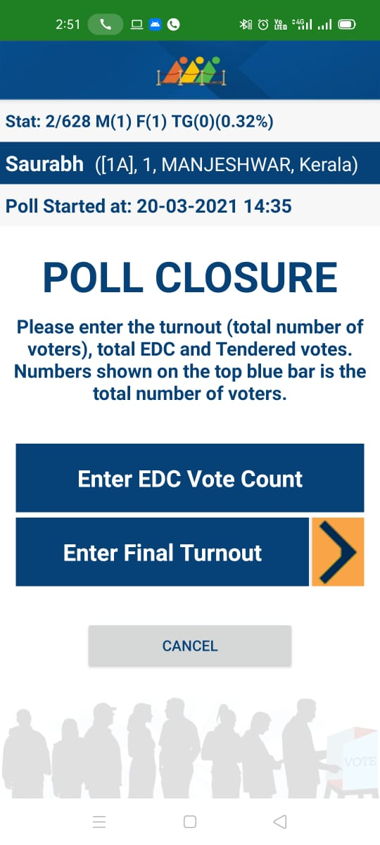
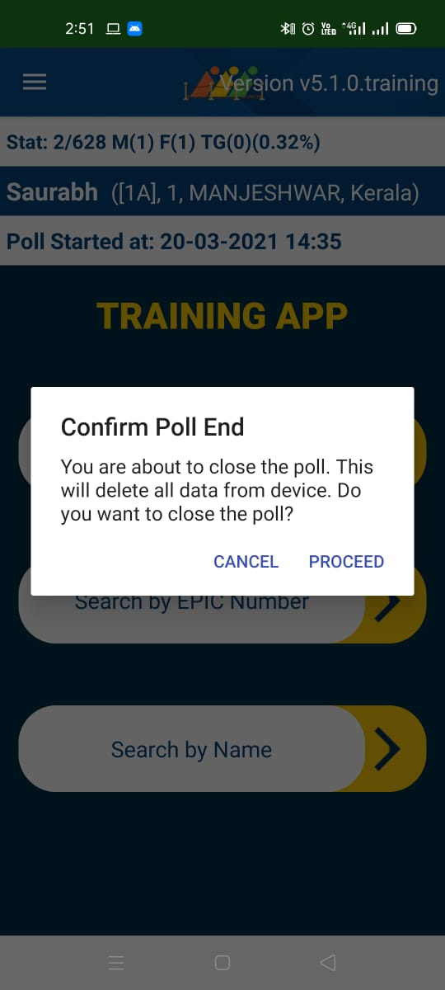
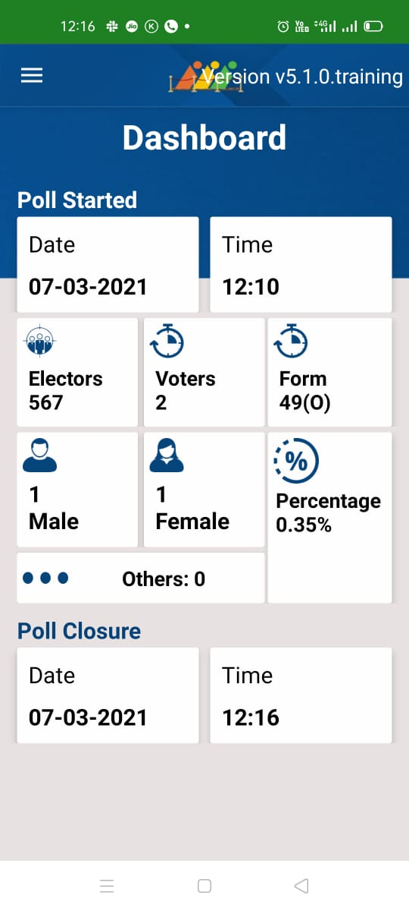
End Poll & Dashboard

Slide 25
Use of 49(O)
49 (O) : Valid voter decides not to cast his vote and decides to record this fact

Slide 26
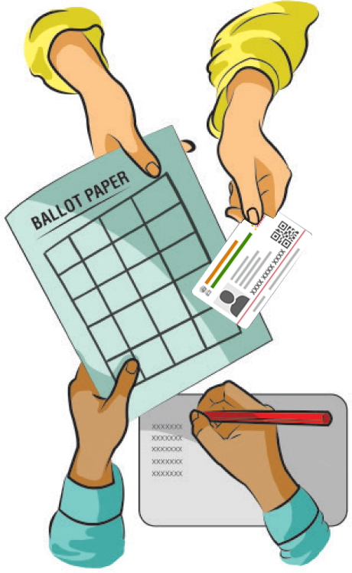
Tendered Vote
“In case someone has already voted in his/her name, voter can approach the presiding officer and flag the issue. After answering PRO’s question and his/her identity. The voter will be allowed to cast a tendered vote.”

Slide 27
WHY WOULD IT SUCCEED ?

Slide 28


It can work with or without internet
The good news is Booth app works good with internet but even can work without internet. The data is sent through long code sms technology.

Slide 29

If Phone got Damaged
The application is available on multiple devices of polling parties as a fall back arrangement.

Slide 30

If Battery dies out
Using offline technology improves the battery life.
All other applications will be forcefully closed down.
External battery and power supply can be aided.
10,000 mAH commercial power bank can keep the phone working for 12 hours.

Slide 31
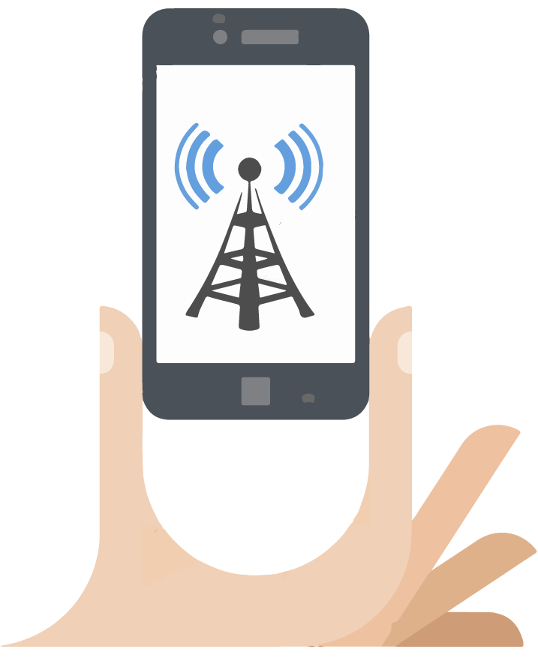
Absolute Network Problem
Booth App work in complete offline mode also.
Polling from the app can continue and the data gets uploaded on its return to reception.

Slide 32
In Case of Shadow Area
The Serial Number in the voter slip contain complete data including voter photograph which can be read without the use of server connection.
1122

Slide 33
Auxiliary Polling Station ?
Photo Voter Slips from State VM (Printing Tool)
Elector data for each polling station

Slide 34

Pitfalls that spoil the story...

Slide 35


Perfect Condition...
Handset using Booth app should have registered ENCORE mobile number in primary sim slot of the same mobile as PO1 / PO2.

Slide 36

Reasons for error...
1
“Handset using Booth app may not have registered mobile number in ENCORE”

Slide 37
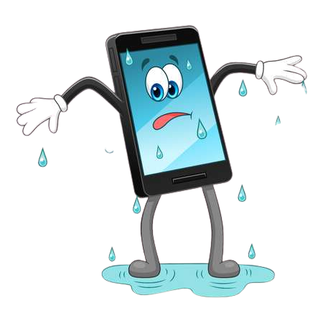
Reasons for error...
2
“Handset using Booth app may not have registered mobile number in the same mobile phone.”

Slide 38

Reasons for error...
3
“Handset using Booth app may not have registered ENCORE mobile number in the primary sim slot.”

Slide 39
THANKS

