Slide 1
Administrative SoP on EVM-VVPAT
By
Madhusudan Gupta, Secretary, ECI
(8810689142)
O.P. Sahani, Under Secretary, ECI

Slide 2
1. What is EVM?
(Ballot Unit + Control Unit + VVPAT)

Slide 3
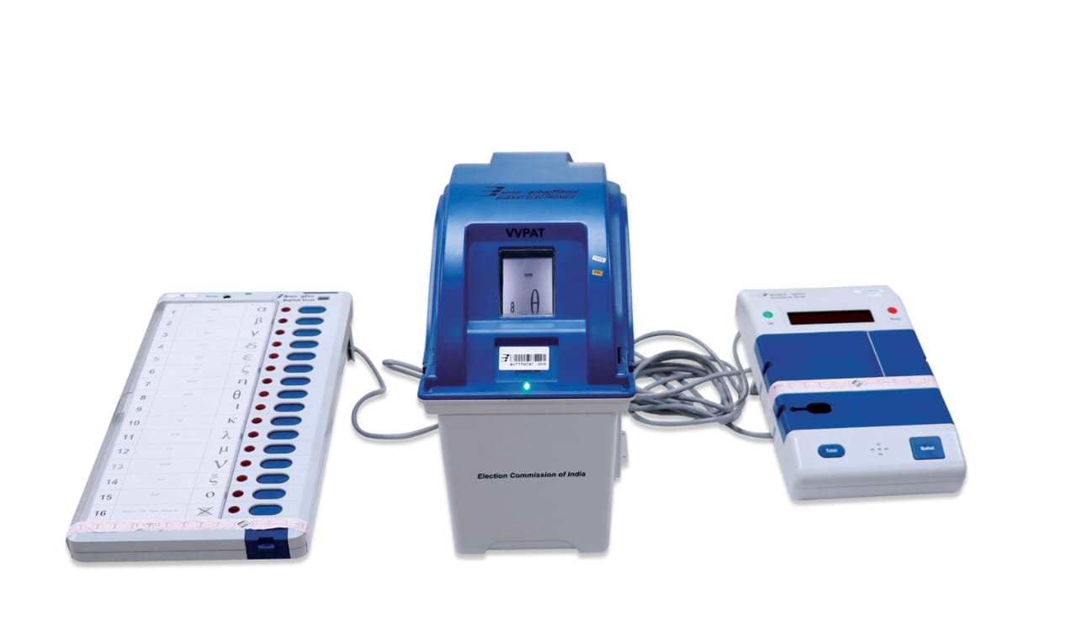
EVM (Ballot Unit + Control Unit + VVPAT)
EVM consists of Ballot Unit, Control Unit and VVPAT
Polling Officer presses the Ballot Button of Control Unit which enable the voter to cast his vote using Ballot Unit
When a voter presses a button against the candidate of his choice in Ballot Unit, red light glow against candidate of his choice in Ballot Unit.
A paper slip showing the serial no, name and the symbol of the candidate of his choice is generated and visible for about 7 seconds through transparent window of VVPAT
Ballot Unit
VVPAT
Control Unit

Slide 4
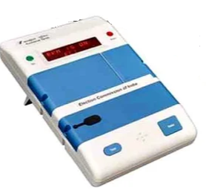
Control Unit
CONTROL UNIT- enables the Ballot Unit to accept vote from the voter and stores the vote cast
.

Slide 5
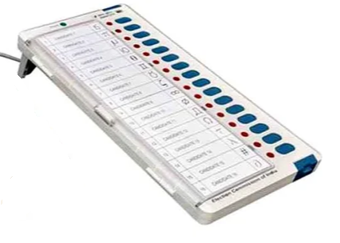
Ballot Unit
BALLOT UNIT- the voter can franchise his/her vote by pressing a button against the candidate of his/her choice

Slide 6
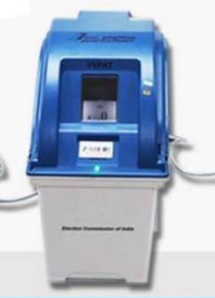
VVPAT
VVPAT- allows the voters to verify that their votes are cast as intended.

Slide 7
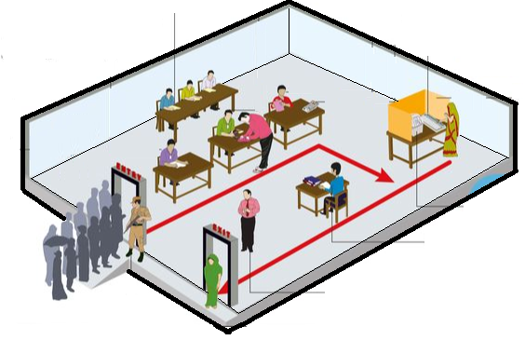
POLLING STATION LAYOUT
Polling Agents
Voting Compartment
Polling Officers
BU & VVPAT
Presiding Officer with CU
Voter

Slide 8
Sub-topics
1. Storage
2. First Level Checking
3. Randomizations
4. Commissioning/Preparation
5. Dispersal Day
6. Poll Day
7. Example of Critical Mistakes

Slide 9
1. Storage (1/9)
A. Non-election Period: After Election Petition till start of FLC
B. Election Period: FLC to Election Petition Period
C. Petition Period: After Counting of Votes to confirmation of Election Petition Period

Slide 10
1. Storage (2/9)
Non-election Period:
Storage Place: Treasury/District HQs/Tehsil HQs
Physical Aspects of WH:
Only 1 entry/exist point
Double lock system
Installation of Main Switch outside WH/Strong Room
No other material to be stored
Custody of keys:
All keys of Lock-1 with DEO and all keys of Lock-2 with Dy.DEO (District HQs)
All keys of Lock-1 with SDM and all keys of Lock-2 with Tehsildar (Outside District HQs)
Deposition of keys in Treasury
Handling of keys to be a part of CTC (Certificate of Transfer Charge)

Slide 11
1. Storage (3/9)
Non-election Period:
Security:
1/2 Section Armed Security
CCTV/Fire Alarm
Fire extinguisher both inside and outside
Inspection by DEO:
Monthly
Quarterly (April, July, October & January)

Slide 12
1. Storage (4/9)
B. Election Period (Strong Room):
FLC to 1st Randomization
After 1st Randomization to dispersal
Poll Day to before Counting Day
Counting Day

Slide 13
1. Storage (5/9)
B. Election Period:
FLC to 1st Randomization
Custody of DEO
Strong Room with Double Lock System
All keys of Lock-1 with DEO and all keys of Lock-2 with Dy.DEO
1 Section Armed Security
CCTV
Open for taking out Awareness/Training units (10%) and after 1st Randomization in presence of political parties (National & State Recognised) under videography

Slide 14
1. Storage (6/9)
B. Election Period:
ii. After 1st Randomization to dispersal
Custody of RO
Double Lock System
All keys of Lock-1 with RO and all keys of Lock-2 with ARO
1 Section Armed Security
CCTV
Open only after 2nd Randomization for commissioning/preparation and on dispersal day in presence of candidates/ their agents under videography

Slide 15
1. Storage (7/9)
B. Election Period:
iii. Poll Day to before Counting Day
Custody of RO
Double Lock System
All keys of Lock-1 with RO and all keys of Lock-2 with ARO
CCTV
1 Platoon Armed Security (2 tier Security)
No one allow to enter inner tier
Daily visit of RO/ARO/DEO/SP
Candidates/their agents are allowed to watch security

Slide 16
1. Storage (8/9)
B. Election Period:
Counting Day
1 Platoon Armed Security
3 tier Security on Counting Day: Inner- CPAF, Middle-SAP, Outer-DAP
CCTV
Opening/Closing of Strong Room in presence of candidates/ their agents under videography

Slide 17
1. Storage (9/9)
C. Petition Period:
Custody of DEO
1 Platoon Security
CCTV

Slide 18
2. First Level Checking (1/4)
Schedule of FLC and intimation to political parties
Arrangements for FLC
Work to be done during FLC
Supervision of FLC
Marking of FLC Status on EVM Management System (EMS)

Slide 19
2. First Level Checking (2/4)
Schedule of FLC and intimation to political parties
CEO/DEO to prepare schedule
Intimation of political parties at the district HQs with intimation to State HQs
Arrangements for FLC
Spacious, well-lit, dust-free hall
FLC area to be barricaded and sanitized by police
Entry of hall through Door Frame Metal Detector
Entry on production of ID Card issued by DEO
Webcasting of FLC process
Arrangement of manpower

Slide 20
2. First Level Checking (3/4)
Work to be done during FLC
FLC only by authorised engineers of BEL/ECIL
FLC Process
Cleaning of machine
Visual Inspection
Full functionality checks: 1 vote to each candidate for EVM, 6 votes to each candidate button for VVPAT. In 1% testing by connecting 4 BUs.
Conduct of Mock Poll: Randomly Selected (5% EVMs and VVPATs)- 1200 votes in 1%, 1000 votes in 2% and 500 votes in 2% and verification
Opening of plastic cabinet of EVM and sealing of CU Cabinet with Pink Paper Seal
Supervision of FLC
Under close supervision of DEO
FLC Supervisor appointed by DEO
CEO/DEO to monitor through web cast

Slide 21
2. First Level Checking (4/4)
Disposal of VVPAT slips generated during FLC on daily basis
Marking on FLC Status on EMS
DEO to provide 2 mobiles
FLC OK to be scanned by election official
FLC Rejected to be scanned by BEL/ECIL engineer

Slide 22
3. Randomizations
Randomizations in EMS only
First Randomization
After FLC at DEO Level
In presence of political parties
To allocate AC-wise
Second Randomization
Before commissioning/preparation at RO Level
In presence of candidates/their agents
To allocate PS-wise

Slide 23
4. Commissioning/Preparation
In presence of candidates/their representatives
Under videography
Work Done
VVPAT: Symbol Loading/Power Pack/Paper Roll/Sealing of Paper Roll Compartment
Ballot Unit: Ballot Paper/Thumb-wheel setting/Masking/Sealing with Pink Paper Seal and Address Tags
Control Unit: Candidate Setting/sealing of Candidate Set and Power Pack Sections with Address Tags
1 vote to each candidate button
1000 votes in randomly selected 5% EVMs and VVPATs and verification
Replacement of particular BU, CU and VVPAT in case of non-functional
Disposal of VVPAT slips generated during commissioning on daily basis
Pasting of ‘Reserve’ stickers on reserve units

Slide 24
5. Dispersal Day
In presence of candidates/their representatives
Checking of seals, buttons, switch, ballot etc to ensure correctness and pertaining to particular PS
Not to test VVPAT
Replacement of particular BU, CU and VVPAT in case of non-functional

Slide 25
6. Poll Day (1/2)
Start of Mock Poll before 90 minutes
Atleast 50 votes and 1 vote to each candidate/NOTA
Sealing of CU and VVPAT after mock poll
Pressing of CLOSE BUTTON after completion of Poll
Sealing of BU/CU/VVPAT in respective carrying case
Replacement Protocol
Respective Unit during Mock Poll
Entire Set (BU+CU+VVPAT) in case of Non-functional of BU or CU and VVPAT only in case of Non-functional of VVPAT
Handling of critical situations- no beep sound, no paper cutting, 49MA etc.

Slide 26
6. Poll Day (2/2)
EVM management on Poll Day
Category A: Polled Units (with PO)
Category B: Polled Defective Units (with PO)
Category C: Un-polled Defective Units (with SO)
Category D: Reserved Units (with SO)
Strong Room: Category A and Category B (Collected at Collection Centre)
Repair Room: Category C (Collected at separate Collection Centre)
Separate Strong Room: Category D (Collected at separate Collection Centre)
All movement to be GPS tracked
Proper security with all category of units

Slide 27
7. Examples of Critical Mistakes (1/3)
First Level Checking of EVMs and VVPATs
Non-Updation of FLC-OK or FLC-Reject status in EMS through Mobile-App on day to day basis.
FLC of VVPATs without using Dummy Ballot Paper on BU.
Non-Uploading of 16 candidates (including NOTA) Dummy Symbols in the 1% VVPATs used for testing with 4-BUs having 64 dummy symbols (including NOTA)
Irregularity on use of Dummy Symbols
Commissioning of EVMs and VVPATs
Non-checking of candidate symbols uploaded in VVPAT during commissioning.
In case of M3 EVMs, M3 VVPATs and all BUs must be connected at the time of commissioning of the EVMs otherwise EVM will not accept a VVPAT or BU at a later stage.

Slide 28
7. Examples of Critical Mistakes (2/3)
Transportation of VVPATs
Lock paper roll when transporting the VVPAT from one place to another
Dispersal
Do not switch on the VVPAT in broad daylight at the time of dispersal as the VVPAT may go into error mode.
Mock-Poll on Poll Day
Not pressing the CLOSE button of CU after mock-poll.
Not matching the mock-poll result of the CU with the VVPAT Paper Slips.
Not removing the mock-poll paper slips from VVPAT
Non-deletion of mock-poll data from the Control Unit.
When setting up the EVMs and VVPATs in the polling station, the VVPAT should be positioned so as to avoid direct light from falling on it.
Do not position the VVPAT near an open window or directly under a bulb or halogen lamp.

Slide 29
7. Examples of Critical Mistakes (3/3)
During Poll
Conducting mock poll, in case of replacement of VVPAT only as Mock poll is not required to be conducted in case of only VVPAT being replaced.
In case of non-functioning of CU or BU replacing only CU or BU. In such case both BU and CU alongwith VVPAT shall be replaced.
Non-pressing of CLOSE Button after completion of Poll.
Damaging any seal of BU/CU/VVPAT.
General
Do not repeatedly switch ON and OFF the VVPAT as it will deplete the battery as well as paper roll.
Switch OFF the CU when connecting or disconnecting the EVMs/VVPATs and do not pull the cable for disconnecting.
In case of M3 VVPAT, there is no VSDU and VVPAT status will be displayed on the CU Display Panel.

Slide 30

Counting Arrangements & Instructions
For
Counting on July 2021

Slide 31
Arrangement for counting of votes

Slide 32
Arrangements at Counting Hall
Spacious halls for social distancing
Adequate lighting with Generator backup
Separate entry and exit
7 Counting Tables in each Counting Hall (or as approved by the Commission)
VCB in only 1 Counting Hall (RO present) per AC/AS
Barricades using transparent material/wire-mesh
Videography/cctv of counting process in general
Large whiteboard having pre-written candidates name/round numbers.

Slide 33
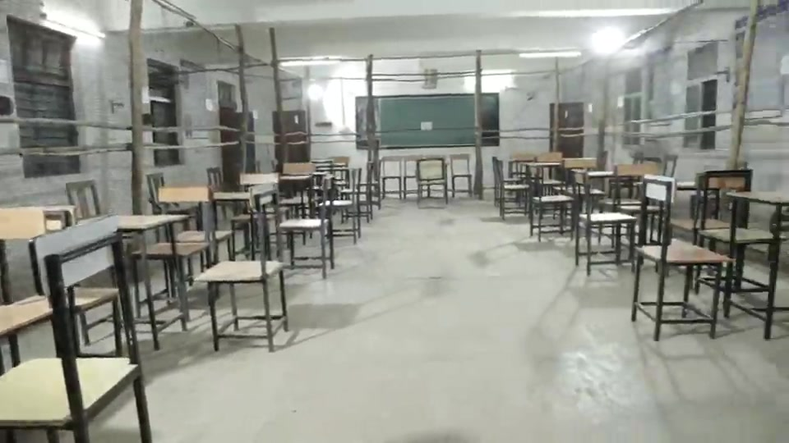
To ensure infrastructure and security arrangements at counting centres
Three tier cordoning security
Outer cordon: by Local police
Middle cordon: at the gate of counting premises by SAP
Inner cordon: at door of Counting Hall by CAPF
Smooth flow of EVMs/VVPATs from strong room to counting hall with CCTV coverage with no blind spots and without crisscrossing paths with another strong room/counting hall.
Opening of strong room in presence of candidates/their agents, RO and Observer under videography

Slide 34
Media Centre
SETTING UP MEDIA CENTRE
Separate Room for Media Centre
Appoint one senior officer from the Public Relation Department for Media Centre
Allow media persons in small batches and for short duration only to visit Counting Hall
Prohibition of mobile phone and other communication equipment by media person in Counting Hall.
Allow mobile phones or Communication equipments from Media Centre

Slide 35
Counting of Postal Ballot (PB)

Slide 36
General
Provide account of PB to contesting candidates on daily basis
Provide latest account of PB to Observer on previous day of counting
Provide latest account of PB to Observer on counting day also
Take PB count first at 8.00 AM
Not more than 500 PBs in one Table
An ARO for each Table.
Candidates are allowed to depute counting agents for each PB Table
Where victory margin is less than the number of rejected PB as invalid, all the rejected PB shall be mandatorily re-verified by RO and Observer before declaration of result under videography

Slide 37
Counting of votes from EVMs

Slide 38
General
At 8.30 AM start counting of votes from EVMs
Examination of seals of CU and Form 17 C to ensure CU was actually used at that particular polling station and shown to candidates/counting agents
Note down result displayed on CU in Part-II of FORM-17C carefully and ensure signing by Counting Agents and Counting Supervisors
Photocopy of round-wise tabulation signed by RO and Observer provides to candidates/their agents
RO shall be responsible for any inaccuracy/discrepancy in Form 20.
EVM counting go on irrespective of the stage of Postal Ballot counting.
Once EVM counting is completed, VVPAT slips counting start as per prescribed procedure

Slide 39
Challenges in EVM Counts
Serial number of seals mentioned in Form 17C does not match Unique ID of CU mentioned in Form 17C does not match Seal of the CU or its carrying case is damaged/broken Use of multiple sets of EVMs and VVPATs in a particular PS
Low Power or No Power in the CU thereby non retrieval of polled data No display or Partial display (segment issue) in CU
Non-closure of CLOSE button by PO on poll day
Non-compliance of mock poll procedure cases Total votes polled in CU do not match with total polled votes entered in Form-17C

Slide 40
Encore Counting Application

Slide 41
Infra Requirement
Dedicated Computer, Printer, Scanner
Redundant IT system for each RO.
Dedicated 8MBPS leased line for counting centre with fixed IP address for each computer.
Backup 8MBPS leased line with Internet connectivity from diff. service provider.
Generator Power Backup
Online UPS with sufficient backup and surge protection
Disabling all USB ports and drives except Printers
Installation of Updated antivirus with current definition
Microsoft Office licensed version and patched up
DIO to be responsible for network architecture and operations

Slide 42
Process- A day before counting day
Step 1
Round Set up
Step 2
Account set up
Step 3
Table Assignment
Rounds = Total Polling Stations/ Total Tables setup in counting centre
Create additional RO- Computer Assistant for data entry of votes
Activate account and set password and PIN
Assign tables to users for data entry of EVM votes

Slide 43
Process- On counting day
Step 1
Table wise EVM Votes entry for each Round
Step 2
Round Declaration
Step 3
Postal Ballot Votes entry
Step 4
Results Declaration
Table 1
Table 2
.
.
.
.
.
.
Table N
Round 1
Round 2
.
.
.
.
.
.
Round N
Enter Postal Ballot Votes
& Finalise
Finalise EVM votes and Postal Votes entry & Declare Results after verification of complete data

Slide 44
Counting of VVPAT Slips

Slide 45
ARRANGEMENTS FOR COUNTING OF VVPAT PAPER SLIPS
One of the Counting Tables inside the Counting Hall (RO Hall) shall be earmarked by the Returning Officer as VVPAT Counting Booth (VCB) for Counting of VVPAT Paper Slips.
Dimension of VCB: 6ft x 6ft x 8ft
VCB shall be enclosed in a wire-mesh just like a Bank Cashier Cabin, so that no VVPAT paper slip can be accessed by any un authorised person.
Installation of CCTV at ceiling

Slide 46
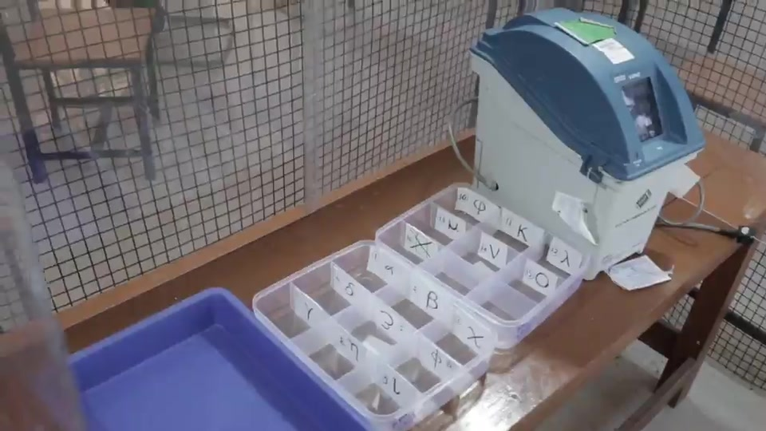
VVPAT COUNTING BOOTH (VCB)
PIGEON HOLE
CONTAINER

Slide 47
SEQUENCE OF VVPAT PAPER SLIPS COUNTING
Counting of VVPAT slips of polling station (s) due to non-display of result on CU.
Counting of VVPAT slips of polling station (s) due to non-compliance of mock poll. Note: For Assembly Constituency-in such case, VVPAT slips count is NOT required, if winning margin is more than the total votes in that particular polling station(s)
Counting of VVPAT slips under Rule 56D of the Conduct of Elections Rules 1961
Mandatory verification of VVAPT slips of randomly selected 05 polling stations per AC/each AS of PC.
NOTE:
Count the VVPAT slips one by one not simultaneously
In case more than 1 VVPAT used in a PS, both will come in VCB, but counting of slips shall be done one by one.

Slide 48
APPLICATION FOR VVPAT PAPER SLIPS COUNTING
After announcement of result sheet entries, any candidate, their election agent or their counting agents may apply in writing (Under Rule 56 of the Conduct of Elections Rules 1961) to the RO to count the printed VVPAT paper slips in any or all polling stations. If such application is made, the RO shall pass a speaking order on whether the VVPAT paper slips should be counted. If the RO decides to allow the counting of the VVPAT paper slips of any or all polling stations, such decision of the RO must be recorded in writing along with the reasons thereof. The RO shall give due consideration to the following:
1. Whether the total number of votes polled in that polling station is greater or lesser than the margin of votes between winning candidate and candidate making the application
2. Whether EVM had a problem and was replaced at that polling station during poll
3. Whether there was any complaint about VVPAT not printing or complaints by any voter under Rule 49MA in that polling station during the poll.

Slide 49
MANDATORY VERIFICATION OF VVPAT PAPER SLIPS
Mandatory verification of VVPAT paper slips of randomly selected 05 (five) polling station shall be conducted in all General and Bye Elections to the House of the People and State Legislative Assemblies, in addition to the provisions of Rule 56D of the Conduct of Elections Rules, 1961, after the completion of the last round of counting of votes recorded in the EVMs, as under:
In case of General and Bye elections to State Legislative Assemblies, verification of VVPAT paper slips of randomly selected 05 (five) polling stations per Assembly Constituency.
In case of General and Bye elections to the House of the People, verification of VVPAT paper slips of randomly selected 05 (five) polling stations of each Assembly Segment of the Parliamentary Constituency concerned.

Slide 50
RANDOM SELECTION OF PS FOR PAPER COUNTS…….
Written intimation regarding draw of lots by RO to Candidates/Election agents well in advance
Draw of lots must be conducted after completion of CU counts
Procedure for the conduct of draw of lots:
White colour paper cards of postcard shall be used for conducting the draw of lots
Total number of such paper cards should be equal to total number of polling stations in the AC/AS
The paper cards shall have pre-printed AC/AS number, AC/AS name and date of poll on the top, and the polling station number in the centre. Each digit of the polling station number shall be atleast 1”x1” (1 inch by 1 inch) size and printed in black.
The paper cards to be used for draw of lots should be four folded in such a way that polling station number is not visible.
Each paper cards shall be shown to the candidates/their agents before folding and dropping in the container.
The paper cards shall be shown in the big container and must be shaken before picking up 01 (one) slip by the Returning Officer.

Slide 51
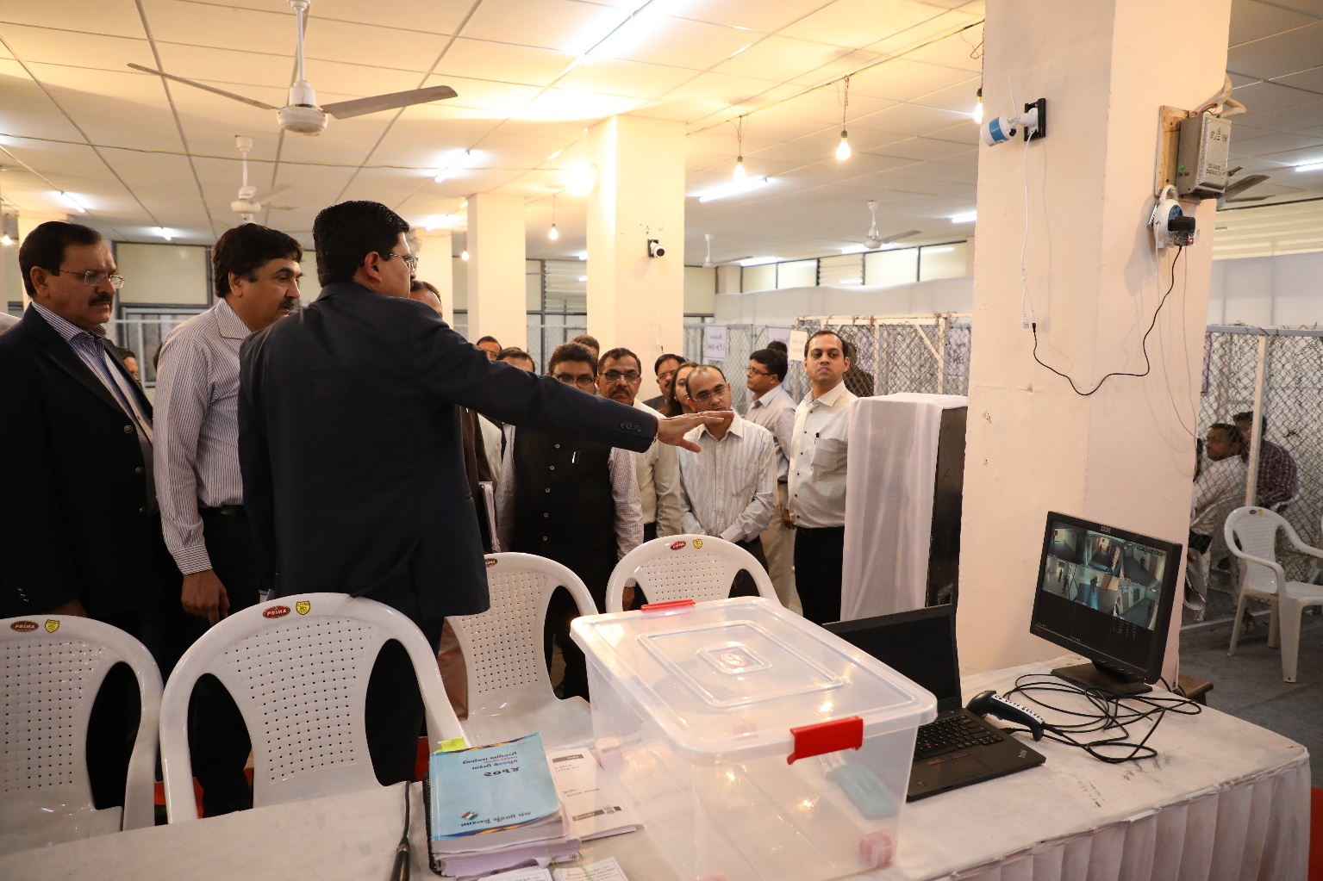
RANDOM SELECTION OF PS FOR PAPER COUNTS

Slide 52
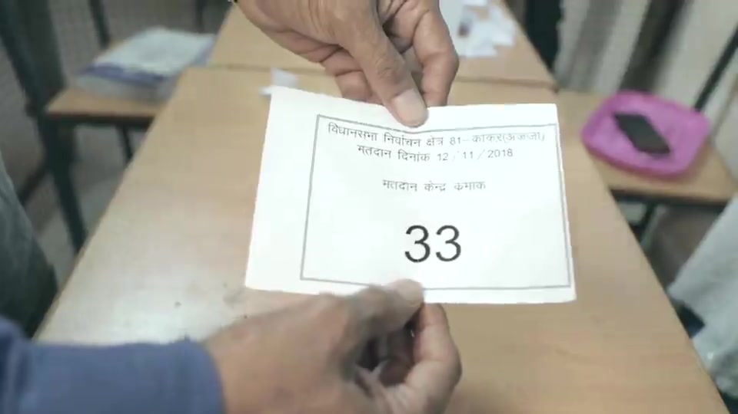
RANDOM SELECTION OF PS FOR PAPER COUNTS

Slide 53
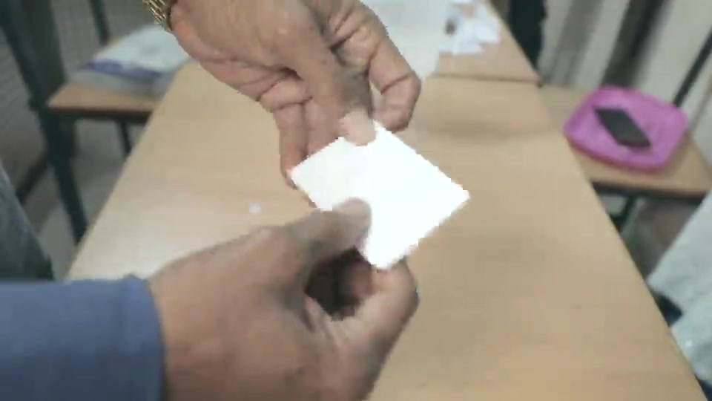
RANDOM SELECTION OF PS FOR PAPER COUNTS

Slide 54
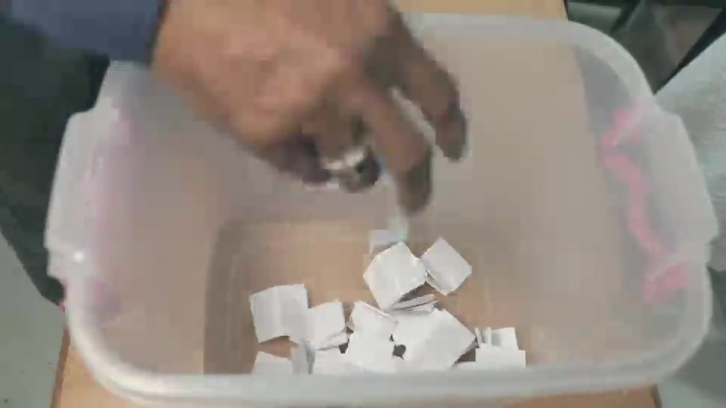
RANDOM SELECTION OF PS FOR PAPER COUNTS

Slide 55
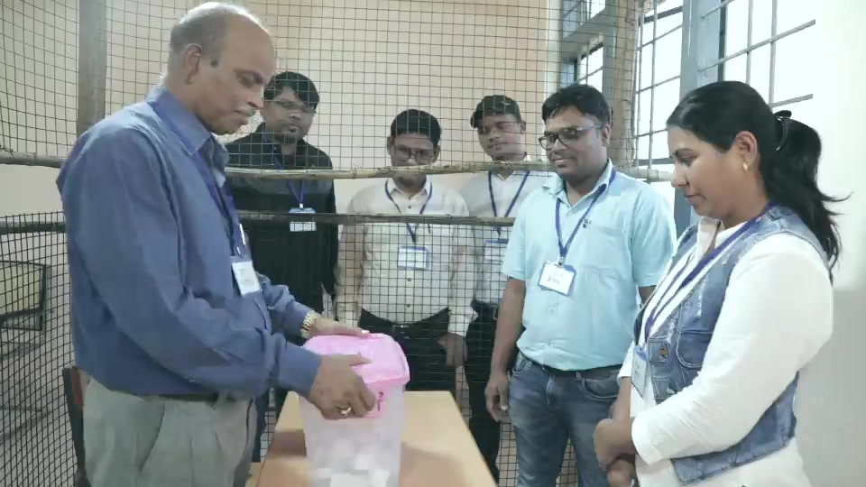
RANDOM SELECTION OF PS FOR PAPER COUNTS

Slide 56
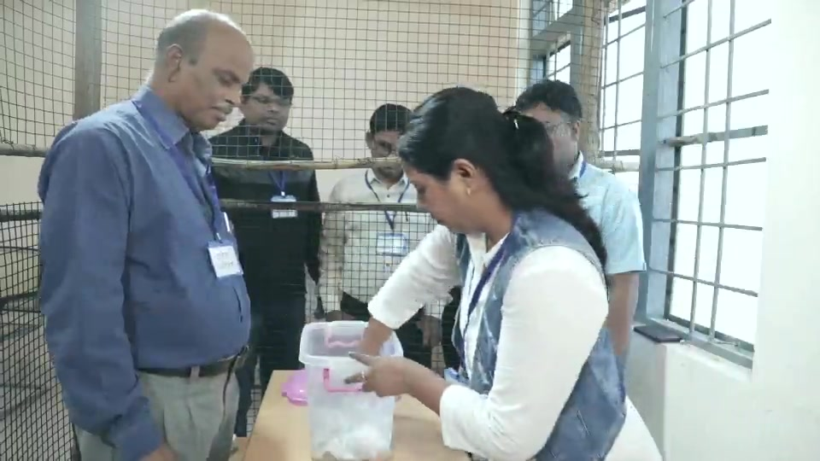
RANDOM SELECTION OF PS FOR PAPER COUNTS

Slide 57
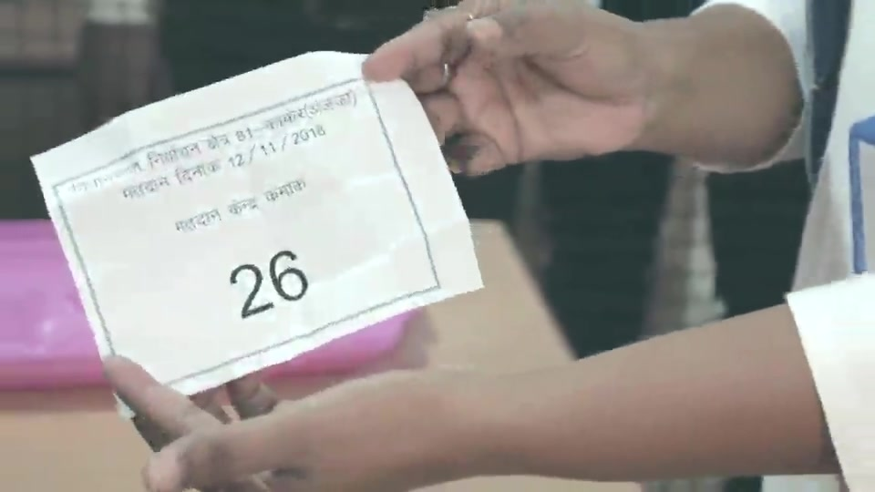
RANDOM SELECTION OF PS FOR PAPER COUNTS

Slide 58
Thank You

